Slide 1
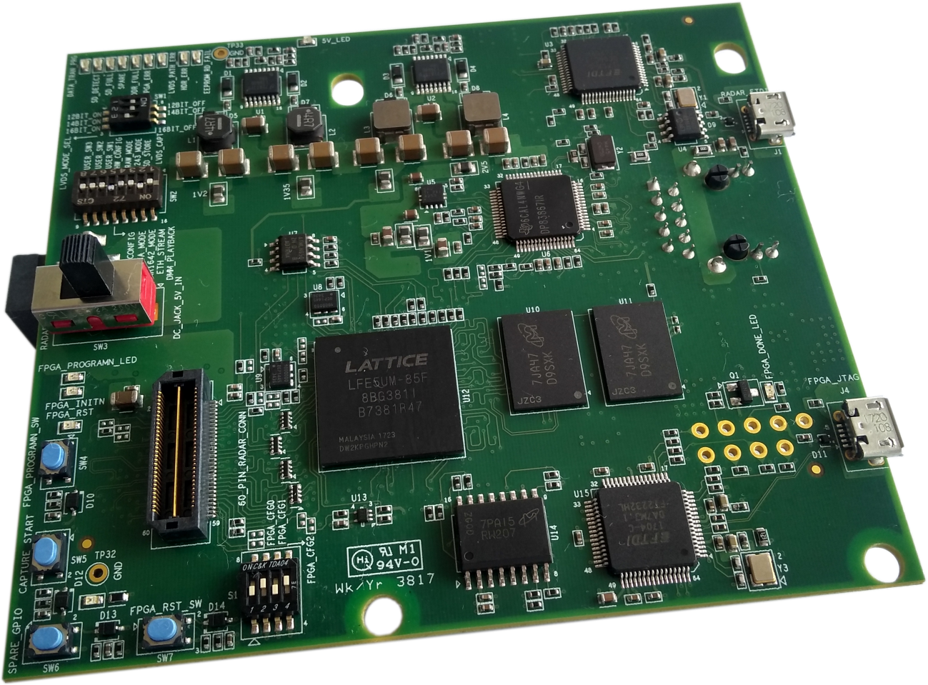
DCA1000 Quick start guide
Getting started with raw ADC data from the xWR mmwave sensor EVMs

Slide 2
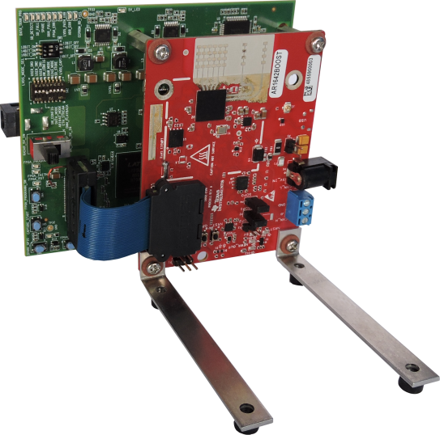
Hardware connection: DCA1000 with xWR mmwave sensor EVMs
The DCA1000 board is interfaced with the xWR mmwave sensor EVMs as below.
Spacers available in the DCA1000 kit to assemble the two boards together.
L brackets available in the xWR EVM kit to enable vertical mounting of the sensor
60 pin samtec cable to electrical connection between the two boards.

Slide 3
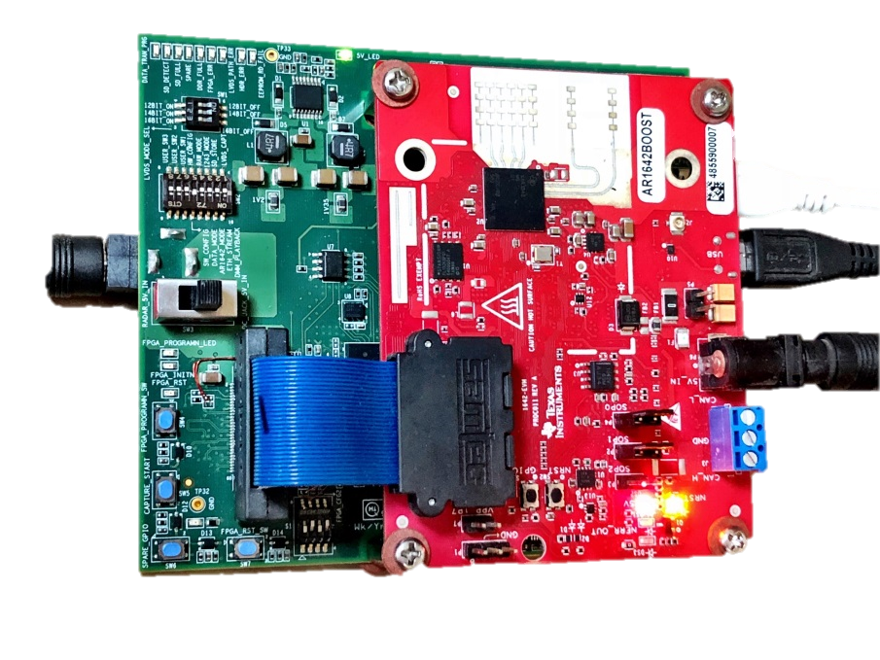
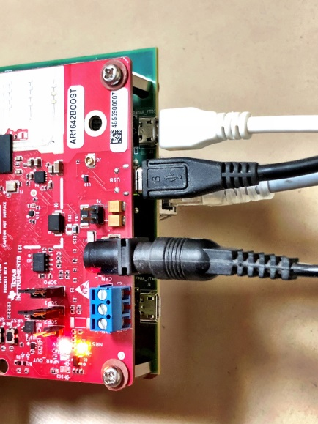
Data and supply Cable connections
2. The DCA1000 and the xWR EVM are powered with 5 V, 2.5 A supplies. Micro USB cable an Ethernet cables are connected for PC interface.
SW3 switch set to “DC_JACK5V_IN”
Micro USB to J1 on DCA1000 for FTDI interface.
Micro USB to J8 on xWR EVM for XDS110 interface
Ethernet RJ45 cable to J6 on DCA1000
5V supply (2.1 mm jack) to DCA1000
5V supply (2.1 mm jack) to xWR EVM
Mount jumpers on the SOP0 and SOP1 pins (P4 and P2)
Note: It is recommended that the xWR EVM is powered up with only SOP0 jumper (P4) placed and then the SOP1 jumper (P2) is placed followed by a toggle of nRST using SW2 onboard switch.

Slide 4
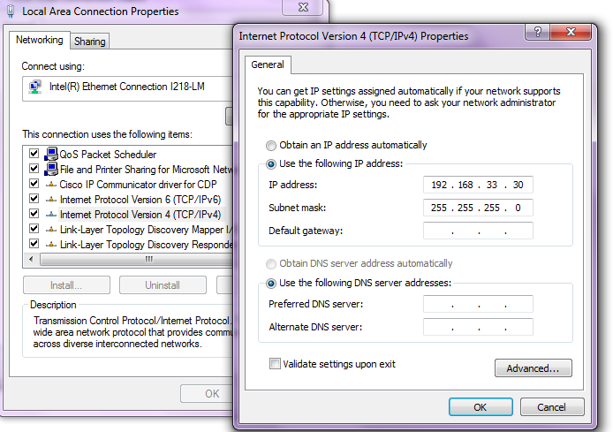
Configure static IP address on the PC
3. In the PC local area network properties select the static IP address as shown below.

Slide 5
SW download
3. Download and install the “mmwave studio” tool from the following link:
http://www.ti.com/tool/MMWAVE-STUDIO

Slide 6
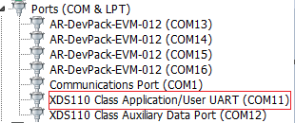
Software Installation
Once the EVMs are powered and connected to the PC Install FTDI drivers available in the from the mmWaveStudio installer package.
Install Matlab Runtime Engine from .https://in.mathworks.com/supportfiles/downloads/R2015a/deployment_files/R2015aSP1/installers/win32/MCR_R2015aSP1_win32_installer.exe
Device manager should show the COM ports as shown in the figure.
RS232 COM power is the one which is shown as XDS110 Class Application/User UART.
Note: If the XDS110 ports do not show up install the EMUPACK from http://processors.wiki.ti.com/index.php/XDS_Emulation_Software_Package

Slide 7
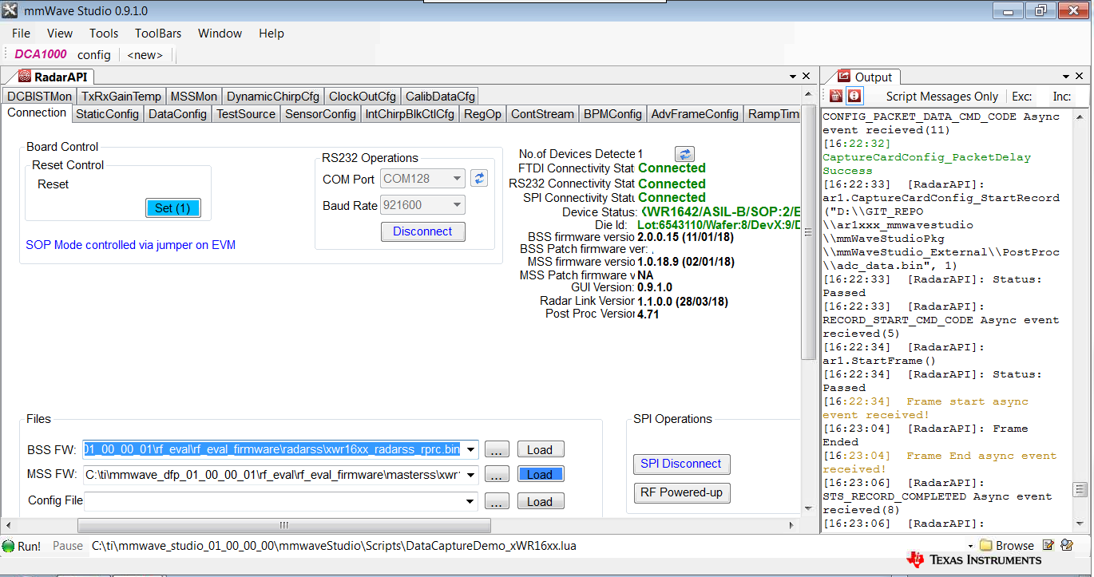
Steps to follow to capture ADC data and post process it
4. Issue board reset and connect RS232 COM port.
Select the “DataCapturedemo_xWR.lua” file from the \mmwaveStudio\Scripts\ folder by clicking on the browse button, then click on run button.

Slide 8
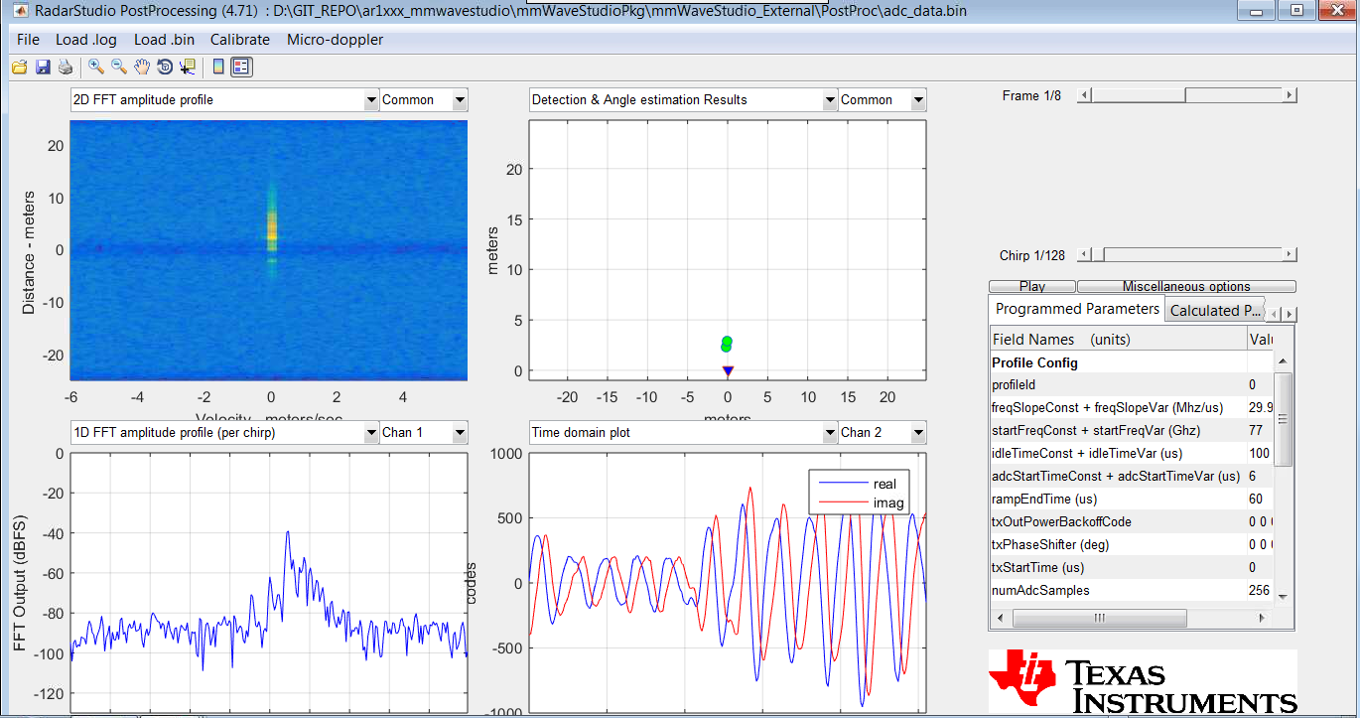
Visualization of the captured raw ADC data
Data is captured by the captured card for a sample profile and frame and the capture data is processed and displayed

