Slide 1
PRU Workshop Lab
George Mock
August 2015

Slide 2
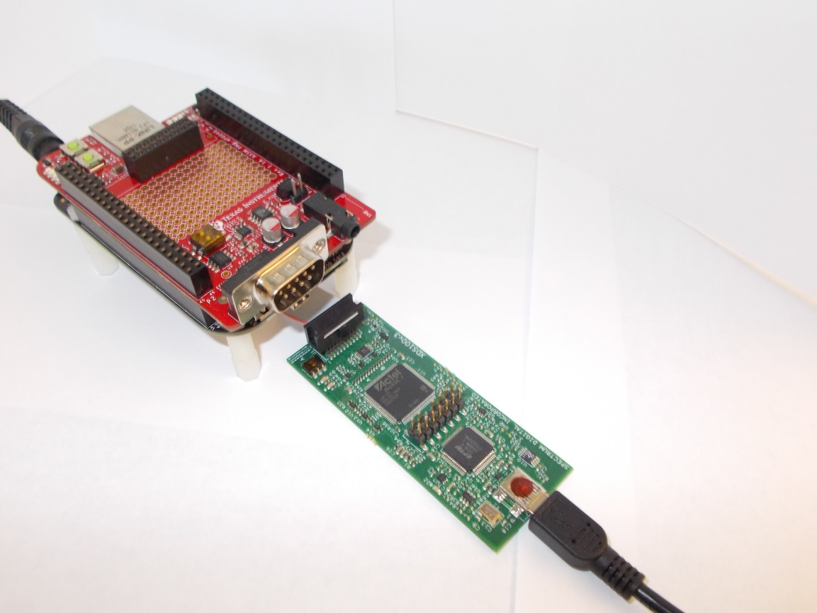
Hardware - BeagleBone Black
BeagleBone Black (BBB)
AM335x device
2 PRU’s embedded in AM335x
Add JTAG header to P2 on back
Optional standoffs
Debug Probe
XDS100 or XDS200
Screen shots show XDS100v3
PRU Cape
Add-on board for learning about PRU
BBB only info is marked
BBB Only

Slide 3
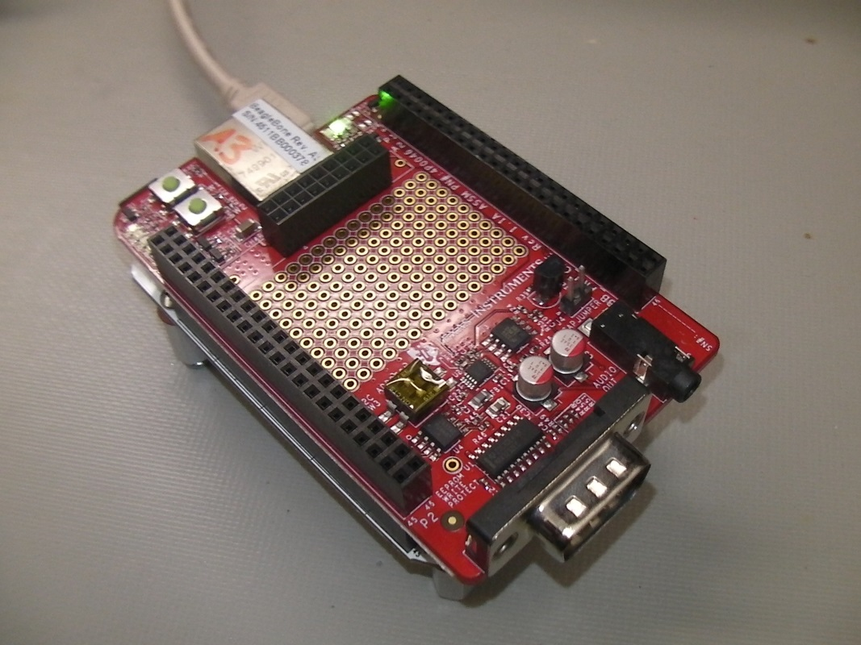
Hardware - BeagleBone White
BeagleBone White (BBW)
AM335x device
2 PRU’s embedded in AM335x
More expensive than BBB
Debug Probe
XDS100v2 built-in
PRU Cape
Add-on board for learning about PRU
BBW only info is marked
BBW Only

Slide 4
Lab Conventions
Lab steps are in black and numbered for easier reference
…
…
Descriptive text is written in blue

Slide 5
Install Software
CCS version 6.1
Install PRU C compiler
Select View→CCS App Center
To right of Code Composer Studio Add-ons, click on See more >
Select PRU Compiler
Version 2.1.0 or later
Click on Install Software
In the upper left corner. Scroll up if needed.

Slide 6
Workaround: Avoid Linux on BBW
BBW Only
Prevent Linux from running
Eject micro SD card before power up
OK for Linux to run on BBB

Slide 7
BBB - Create Blink LED Project
BBB Only
From CCS Edit perspective
Go to File→New→CCS Project
Set Target to BeagleBone_Black
Set Connection to your debug probe
Select PRU tab
Enter project name
This workshop uses pru_blink_led
Leave Project templates and examples at default
Empty Project (with main.c)
Click Finish
CCS creates the project

Slide 8
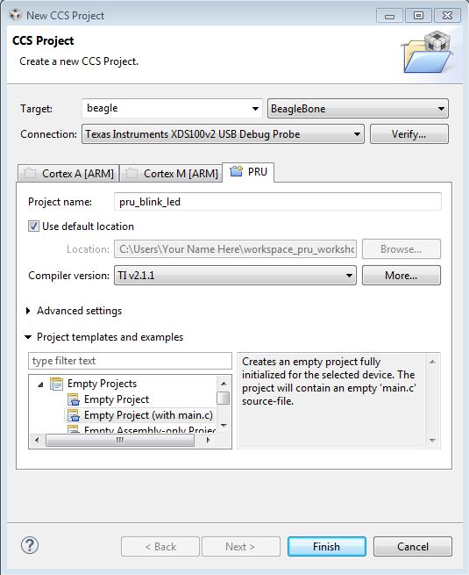
BBW - Create Blink LED Project
BBW Only
From CCS Edit perspective
Go to File→New→CCS Project
Set Target to BeagleBone
Set Connection to XDS100v2 USB
Select PRU tab
Enter project name
This workshop uses pru_blink_led
Leave Project templates and examples at default
Empty Project (with main.c)
Click Finish
CCS creates the project

Slide 9
Replace all code in main.c with these lines
#include <stdint.h> // for uint32_t
volatile register uint32_t __R30;
int main(void)
{
uint32_t gpo;
while (1)
{
gpo = __R30;
gpo ^= 0xF;
__R30 = gpo;
// 10 to the 8th == half-second delay
__delay_cycles(100000000);
}
}

Slide 10
Build
Save changes to main.c with control-S
Click build icon
Correct any errors found

Slide 11
Debug Configuration Described
It is tricky to access a deeply embedded CPU on a complicated SOC
When you start a debug session, CCS automatically creates a Debug Configuration
Contains detailed info about how to start up the debugger part of CCS
Accessing the PRU requires adding a special script to the Debug Configuration

Slide 12
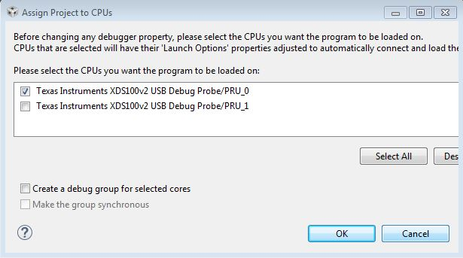
Create Initial Debug Configuration
Right click the project name and choose Properties
In left pane highlight Debug
CCS asks which PRU core to load. Check PRU_0. Clear PRU_1.
Click OK
Click OK again
Adding the script is next

Slide 13
Add PRU Startup Script to Project
More initialization needs to happen when debugger launches
Some on Debug Access Port (DAP), some on PRU
Cannot perform with GEL
GEL script can only be associated with one CPU
Can control from a Debug Server Scripting (DSS) script
Can perform operations on all CPU’s
Download example DSS script
http://processors.wiki.ti.com/index.php/Debug_Configuration_Initialization_Scripts
File named bbb_pru_startup.js
If Project Explorer view is not present, select View→Project Explorer
Paste bbb_pru_startup.js into pru_blink_led project next to main.c
CCS Project Explorer view works just like Windows Explorer

Slide 14
Add Startup Script to Debug Configuration
Click down arrow next to Debug icon and select Debug Configurations
In left pane, expand Code Composer Studio entry
Highlight the pru_blink_led configuration
Next to Initialization Script click Workspace
Open tree for pru_blink_led and select bbb_pru_startup.js
Click OK
Click Apply
Compare with screen shot in next slide
Click Close
This DSS script runs every time debugger is launched

Slide 15
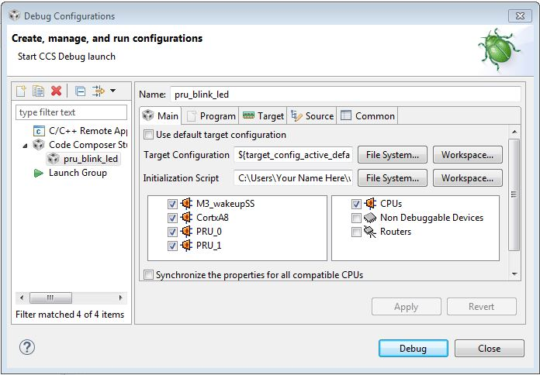
Debug Configuration

Slide 16
Execute the Code
Click Debug icon
Click Resume Execution icon
See the LED’s blink!
Click Suspend to halt execution
Ignore any error message about: invalid register index 8
Known issue which will be fixed

Slide 17
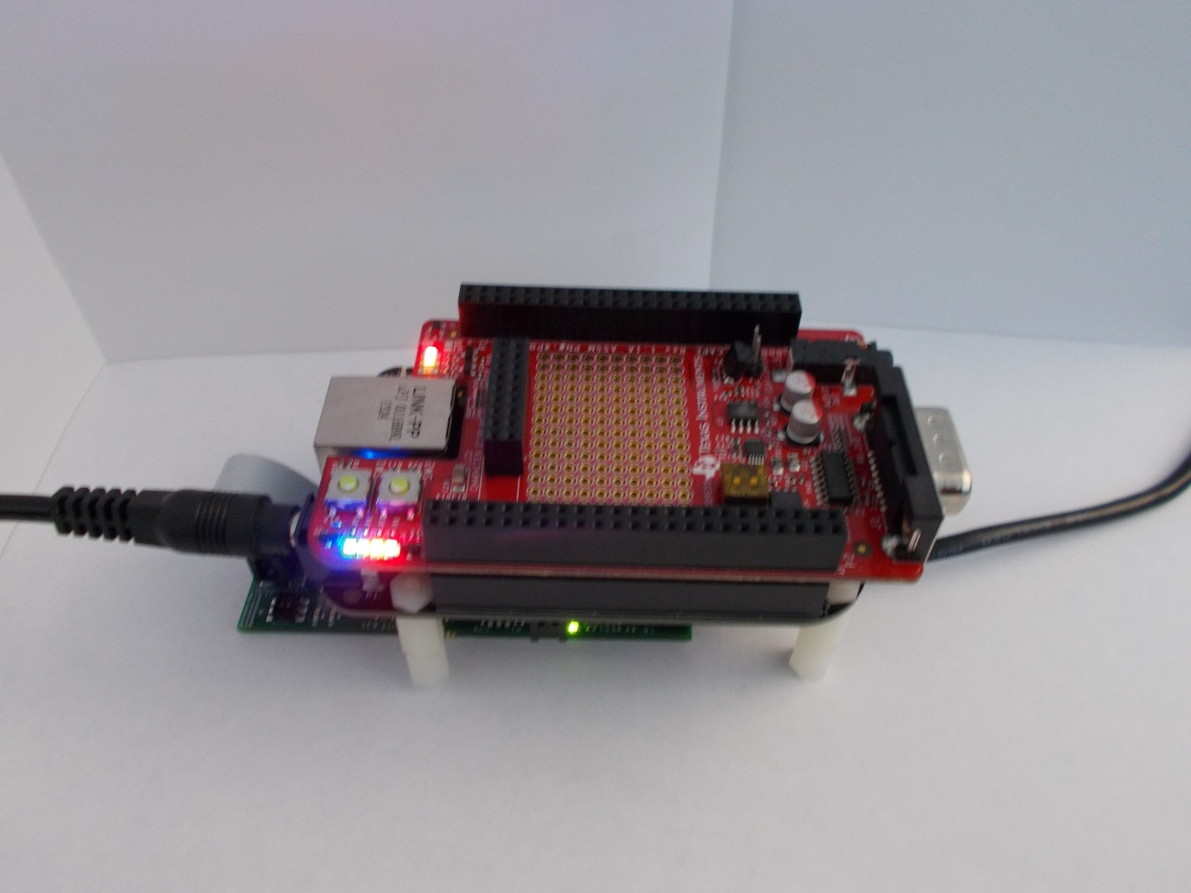
Blinking LED

Slide 18
Backup Slides

Slide 19
Startup Script Explained
CCS launches the target configuration right before running the script
The script performs these steps
Connects to the Debug Access Port (DAP)
Configures pins on the PRU
Enables the Industrial Communication Subsystem (ICSS) clock
Resets ICSS
bbb_pru_startup.js is a text file
Can view with any text editor
After the script runs, CCS automatically connects to the PRU, loads the program, and runs to the start of main

Slide 20
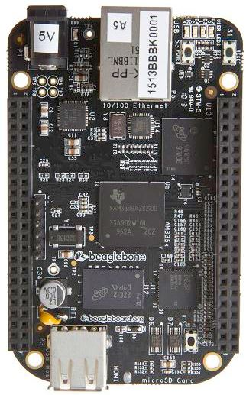
BBB Power Up Sequence
BBB Only
When power is applied, Linux starts running on ARM Cortex-A8
OK for this workshop
If you ever need to disable Linux …
Plug in power
Allow Linux to boot normally. See heartbeat flash on LED’s.
Turn off by holding power button for 8 seconds
While holding down boot button, press power button
Difficult to do with PRU cape installed

