Slide 1

Code Composer Studio v6
Fundamentals Workshop for MSP432
Lab Handbook

Slide 2
Outline
Lab Requirements and Setup
Lab 1: Getting Started: Blink LED Example
Lab 2: Basic Debug Concepts: Blink LED Example
Lab 3: Optimizer Assistant: Out of Box Experience Demo Example
Lab 4: Real-time Access: Out of Box Experience Demo Example
Lab 5: SWO Trace: Out of Box Experience Demo Example

Slide 4
Lab Requirements and setup
Notes:
4

Slide 5
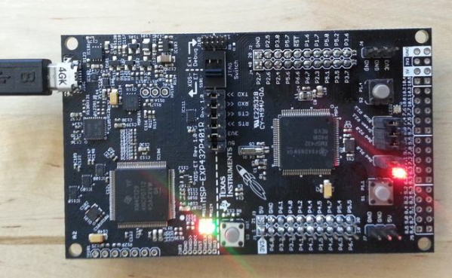
  LAB Requirements and Setup
Software:
  Code Composer Studio v6.1.3 or greater
    With all MSP components installed
  MSPWare 3.30 or greater
Hardware:
  MSP432P401R LaunchPad
USB JTAG Connection

Slide 6
LAB Material Notes
It is assumed the main workshop directory is located in C:\ccsv6_workshop\msp432\workspace
The lab material will make references to these directory
If the lab material is located in a different location, please update the path to reflect your environment
If an existing workspace folder already exists in this location, please use a different folder (ex. “workspace2”)

Slide 7




LAB Conventions
Before starting, it is important to review some lab conventions that will ease your work…
Lab steps are in black and numbered for easier reference
  …
  …
Explanations, notes, warnings are written in blue
  Warnings are shown with
  Information is marked with
  Tips and answers are marked with
  Questions are marked with
Notes:
7

Slide 9
Lab 1: Getting Started:
Blink LED Example
10 minutes
Notes:
9

Slide 10
LAB 1: Exercise Summary
Key Objectives
  Import and build the Blink LED example program
  Start a debug session and load/flash the program to the target
  Run the program
Tools and Concepts Covered
  Eclipse Concepts (Workspace, Workbench, Perspectives, Views, Projects)
  Resource Explorer
  Importing/Building/Running an example project/program
Notes:
10

Slide 11

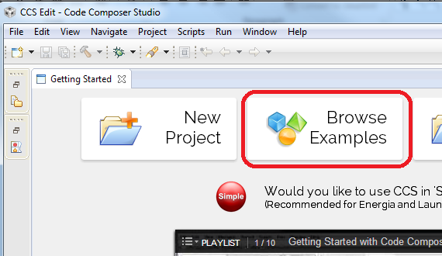
Launch CCS and Open Resource Explorer
Double click on the Code Composer Studio desktop icon
Specify C:\ccsv6_workshop\msp432\workspace as the workspace location
Select Browse Examples in the Getting Started page

Slide 12
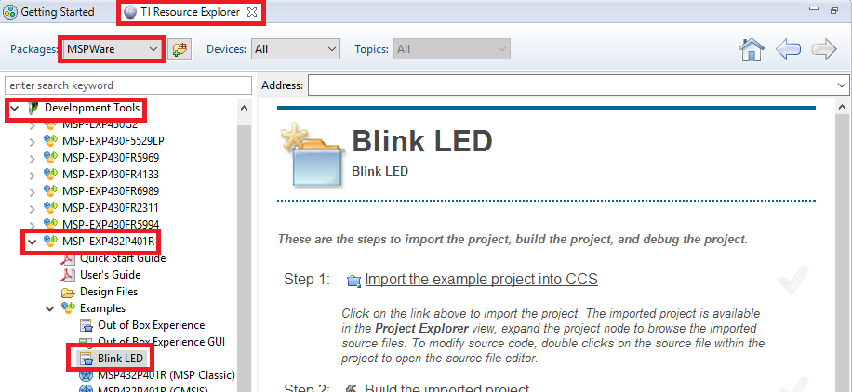
Resource Explorer: Examples
Displays all example projects discovered by the Resource Explorer
Step by step instructions on how to build/run the examples
Select the Blink LED example under MSPWare -> Development Tools -> MSP-EXP432P401R –> Examples -> Blink LED

Slide 13
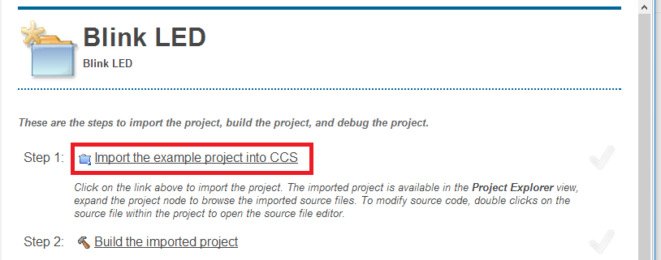
Step 1: Import Blink LED Project
Follow Step 1 and import the Blink LED project into the CCS Workspace by clicking on the Import the example project into CCS link

Slide 14

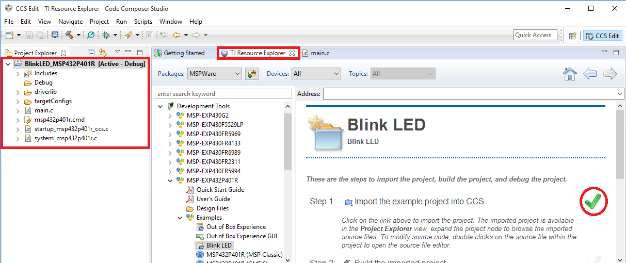
Step 1: Import Blink LED Project
The project will appear in the Project Explorer if the import is successful, the main.c source file will be opened in the editor, and a green checkmark will appear next to the link to indicate success

Slide 15
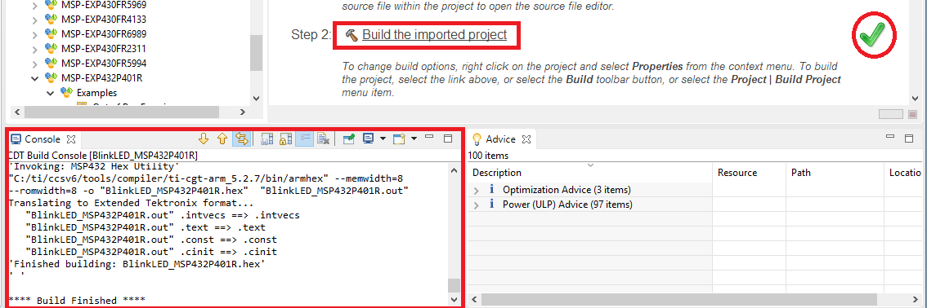
Step 2: Build Blink LED Project
Follow Step 2 and build the Hello Example project by clicking on the Build the imported project link
The build Console view will appear along the bottom with build messages as the project builds
If the build is successful, a green checkmark will appear next to the link to indicate success

Slide 16
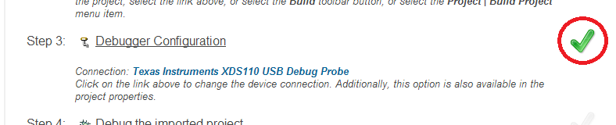
Step 3: Specify Debugger Configuration
Note that a green checkmark exists for Step 3 since the Connection type is already defined
  The emulator connection is already specified in the project properties and a target configuration was generated on project import (Step 1)

Slide 17
Step 4: Debug Blink LED Project
Follow Step 4 and debug the project by clicking on the Debug the imported project link
Several actions are done automatically
  Prompt to save source files
  Build the project (incrementally)
  Start the debugger (CCS will switch to the CCS Debug perspective)
  Connect CCS to the target
  Load (flash) the program on the
  target
  Run to main
Don’t want it to do all of the above at once? You can configure it to skip some steps (Debugger Options)

Slide 18
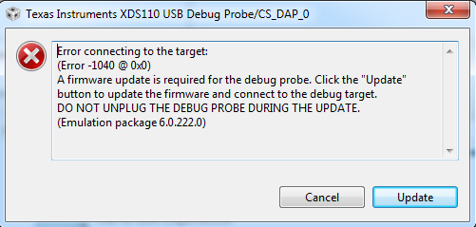
Debug Probe Firmware Update
Depending on the LaunchPad version and the version of the Emulator Pack installed with CCS, a dialog box with the follow message may appear:
If this message is encountered, please click on the the Update button in the dialog box, to update the firmware
  This update is only required once (until the TI Emulation Package is updated within CCS)

Slide 19
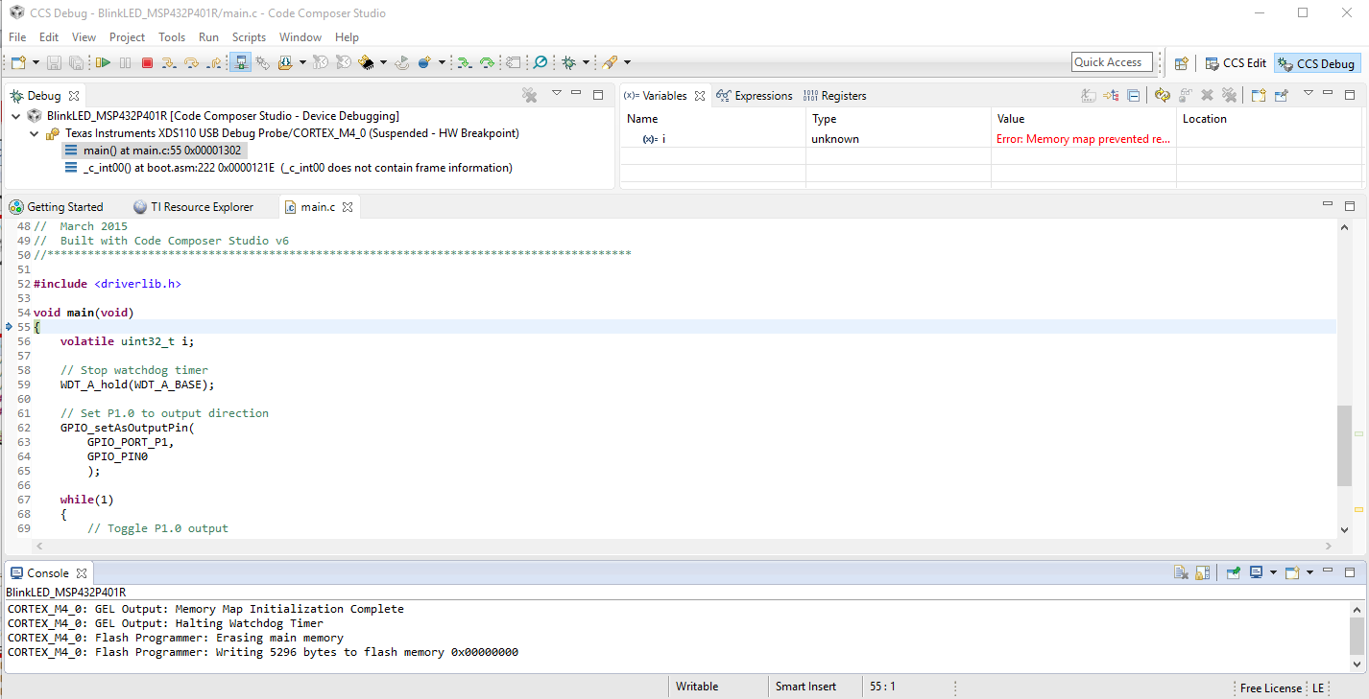
Debug Session for Blink LED Project
Target execution toolbar
Switched to CCS Debug perspective
Debug view for project being debugger
Program counter at main
Debug messages in the Console view
Notes:
19

Slide 20

  Run Blink LED Program
Press the Resume button (in the target execution toolbar) to run the program
  Program will run and blink LED1
Leave the target running for the next lab
Notes:
20

Slide 21
LAB1: Summary
In this lab we completed the following:
  Imported the Blink LED project from MSPWare via the Resource Explorer
  Built and ran the Blink LED example
Notes:
21

Slide 23
Lab 2: basic debug:
Blink LED Example
20 minutes
Notes:
23

Slide 24
LAB 2: Exercise Summary
Key Objectives
  Modify/Debug the Blink LED example
  Basic Profiling
Tools and Concepts Covered
  Basic Debug Concepts
  Breakpoints/Watchpoints
  Event Counters
  Local History
Notes:
24

Slide 25
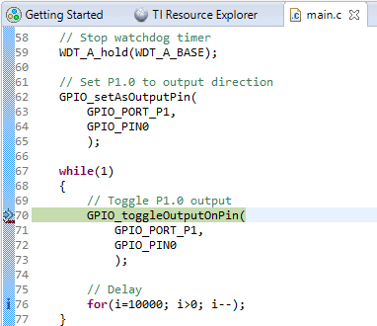
Debugging: Using Breakpoints
Set a breakpoint on line 70 of main.c by double-clicking in the editor margin
  This will place a hardware breakpoint at line 70 and the target will halt there shortly afterwards
  The default behavior is to use a software breakpoint unless the program address is in a memory region known to the debugger as read-only memory (as in this case) by the debugger memory map
Press the Resume button to run the program again
  Note that the target will be halted at the breakpoint again after toggling the LED
Notes:
25

Slide 26
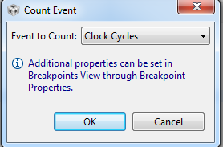
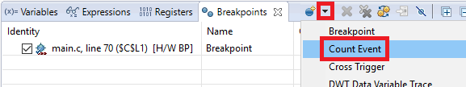
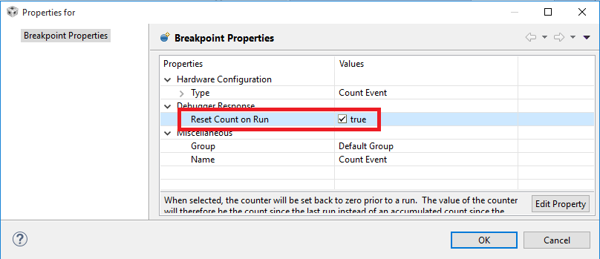
Debugging: Counting Events
Open the Breakpoints view via View -> Breakpoints
Set an event counter to count cycles
Right-click on the event counter in the Breakpoints view and select Breakpoint Properties in the context menu
Enable the Reset Count on Run
option in the properties dialog
Press OK

Slide 27
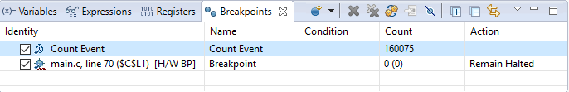
Debugging: Counting Events
Run the target again
  The target will halt at the breakpoint and the event counter will display the number of cycles executed since the last time the target was halted: ~160000 cycles
Notes:
27

Slide 28
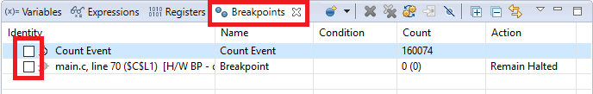
Modify LED Blink Rate
The blink rate of the LED can be modified by changing the delay value in the loop
Modify line 76 in main.c
  From: for (i = 10000; i > 0; i--);
  To: for (i = 20000; i > 0; i--);
Save main.c (File -> Save or Save button )
In the Breakpoints view, disable the breakpoint and event counter by unchecking the checkboxes for them
Notes:
28

Slide 29
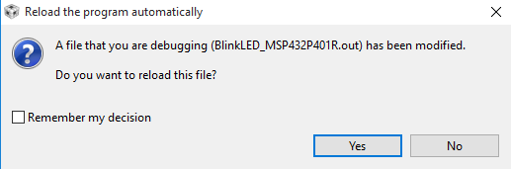
Rebuild, Reload and Run the Program
Rebuild the program (Project -> Build Project or Build button )
A dialog will appear, notifying that the loaded executable has been modified and requesting to reload the file. Select Yes
Press the Resume button to run the program
  The LED on the Launchpad should now be blinking at a slower rate since the number of loops was increased between LED toggles
  If it is not blinking, remember to disable (not delete) the breakpoints set in the previous session!
Notes:
29

Slide 30
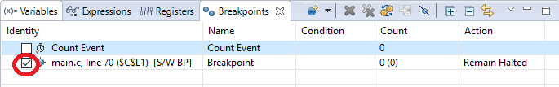
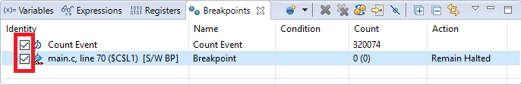
Re-enable Breakpoint and Counter
Enable just the breakpoint in the Breakpoints view and wait for the program to halt
  Program will be halted at line 70
Enable the event counter in the Breakpoints view and run the target again
  Note how the event counter now displays a value of ~320000 (roughly double of value as before since we reduced the loop count by half)
Notes:
30

Slide 31
Clean Up
Remove all entries from the Breakpoints view
Terminate the Debug Session
  This will terminate the debug session and switch to the CCS Edit perspective

Slide 32
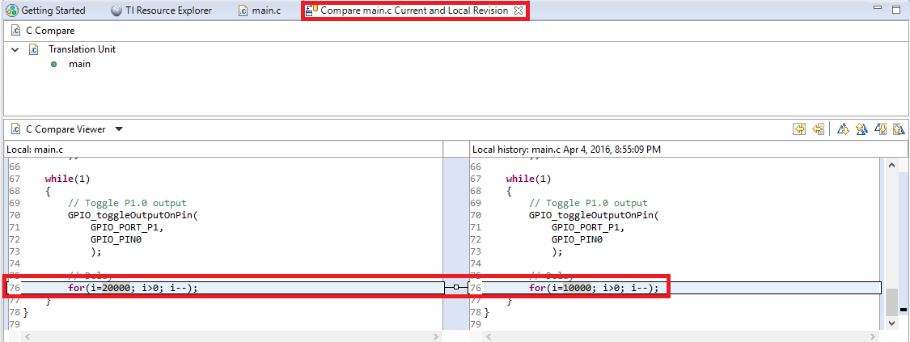
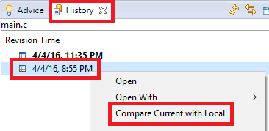
Restore From Local History
Right-click anywhere inside the main.c source file open in the Editor and select Team -> Show Local History
  This will open the History view for the file and display a list of times for when changes were made to it
Right-click on the bottom entry in the History view and select Compare Current with Local to show the differences between that version and the current version of the file
  This will open a “diff” tool in the editor that highlights all the changes between the two versions
Notes:
32

Slide 33
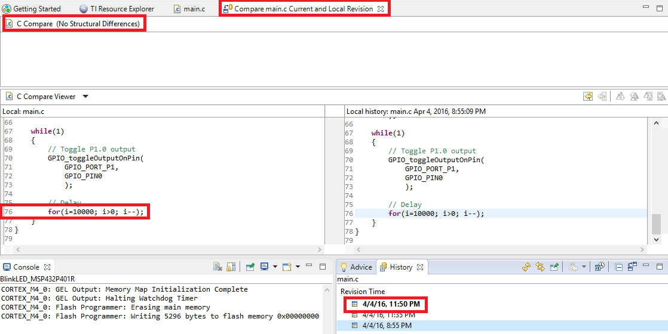
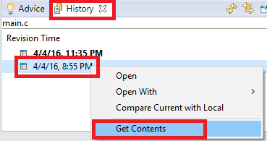
Restore From Local History
Right-click on the bottom entry in the History view and select Get Contents to restore that version of the file
  Note that a new entry appears in the History view which indicates the latest (current) version and shows the same content as the bottom version
  The original version of
  the file has been restored
Notes:
33

Slide 34
Rebuild, Reload and Run the Program
Close the History view and the “diff” tool in the editor
Make sure you are in the CCS Edit perspective and project BlinkLED_MSP432P401R is active (in focus)
Click the Debug button to rebuild the project and reload the code
Press the Resume button to run the program for a few seconds
Press the Suspend button to halt the program
Notes:
34

Slide 35
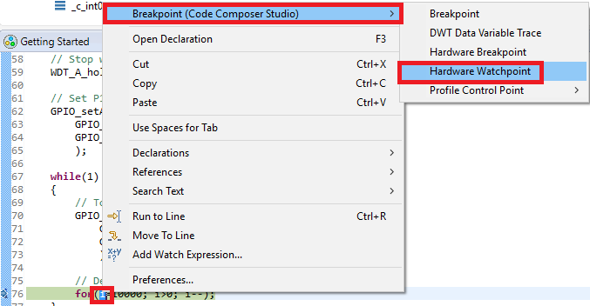

Debugging: Using Watchpoints
A Watchpoint is a type of breakpoint that monitors activity at a memory address
In this step we will set a watchpoint to halt the CPU when variable i reaches a certain value
Highlight i on line 76, right-click and select Breakpoint -> Hardware Watchpoint in the context menu
Notes:
35

Slide 36
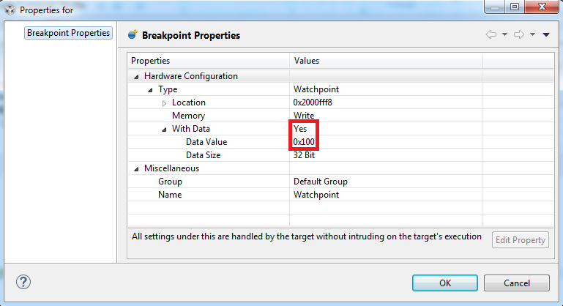
Debugging: Watchpoints
Right-click on the watchpoint in the Breakpoints view and select Breakpoint Properties in the context menu
Modify the properties to match the settings in the screenshot below
Hit OK to apply changes
Notes:
36

Slide 37
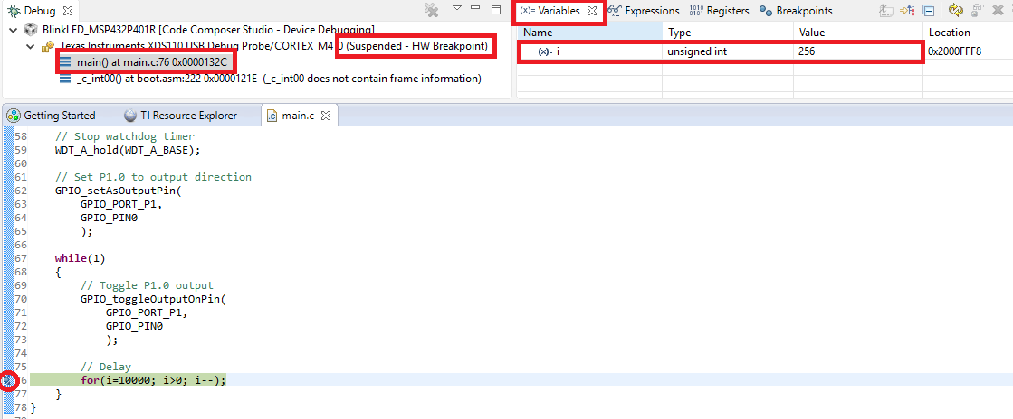
Debugging: Using Watchpoints
Run the target again and wait until the target is halted
  The program will be halted at line 76
Check the value of i in the Variables view
  Note that i has the value of 256 (0x100 hex)
Run the target again and note how it again halts the value of i is 256
Remove the watchpoint using the Remove All Breakpoints button in the Breakpoints view
Notes:
37

Slide 38
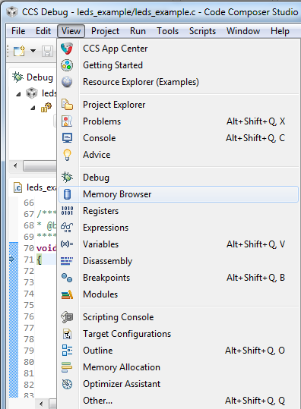
More Debugging (Review)
Investigate other debugging views
(Open via View menu)
  Memory Browser
  Registers
  Modules
  Disassembly (see next slide)
Notes:
38

Slide 39

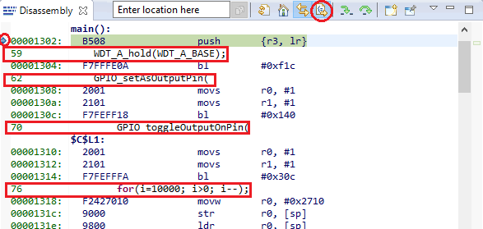
View: Disassembly
Press the Restart button to restart the program
  Program should be at main
Open the disassembly view by going to View -> Disassembly
  You can see the current location of the PC (small blue arrow) and any breakpoints (small blue circles)
Toggle the Show Source button
  Note the toggling of interleaved
  source with the disassembly
Notes:
39

Slide 40
Clean Up
Remove all breakpoints from the Breakpoints view (if any)
Terminate the Debug Session

Slide 41
LAB 2: Summary
In this lab we completed the following:
  Covered the basics of Debugging
  Learned how to use breakpoints and watchpoints
  Learned how to count events (cycles)
  Became familiar with the Local History feature
  Became familiar with the Disassembly view
Notes:
41

Slide 43
Lab 3:
Optimizer Assistant: blink LED example
20 minutes
Notes:
43

Slide 44
LAB 3: Exercise Summary
Key Objectives
  Get familiar with the Optimizer Assistant
Tools and Concepts Covered
  Optimizer Assistant
  Memory Allocation view
  Project Properties
Notes:
44

Slide 45
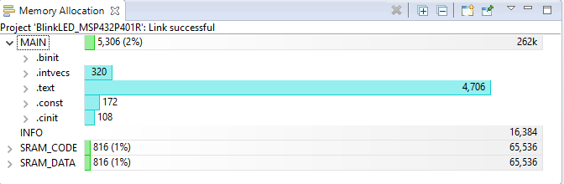
View: Memory Allocation
Open the Memory Allocation view via View -> Memory Allocation
  The Memory Allocation view is a detailed graphical display of the memory allocation of the program
  Note the total allocation size in MAIN (5,306 in this example), the .text section under MAIN (4,706) and how only 2% of Flash (5,306 of 262k) is being used
Numbers may vary slightly in your environment
Notes:
45

Slide 46
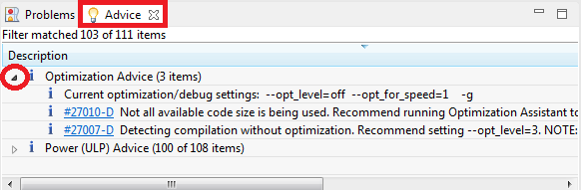
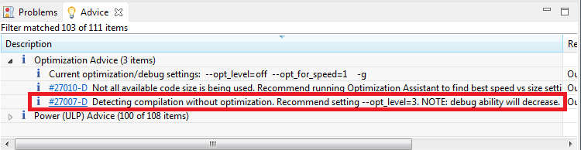
View: Advice
Go to the Advice view in the lower right corner and expand the Optimization Advice node
  The Advice view provides advice on how to better
  optimize the code for size/performance/power
  If the Optimization Advice is missing, the project
  may have to be rebuilt to have the advice reappear (right-click on the project and select Rebuild Project in the context menu)
Note the third advice, on how optimization is disabled and level 3 optimization is recommended
46

Slide 47
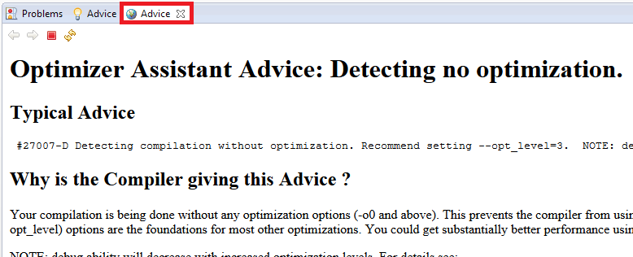

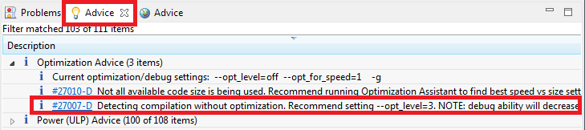
Optimization Advice: Optimization Level
Click on the hyper-link #27007-D to open more information on the advice (a new Advice tab will open)
  Go back to the original Advice tab and
  double-click on the entire third advice
  itself (not on just the hyperlink) to open
  the project optimization settings
    If the original Advice view is blank, go to the Project Explorer and set the BlinkLED_MSP432P401R project to the Active project (select/click on the project to put it in focus)
47

Slide 48
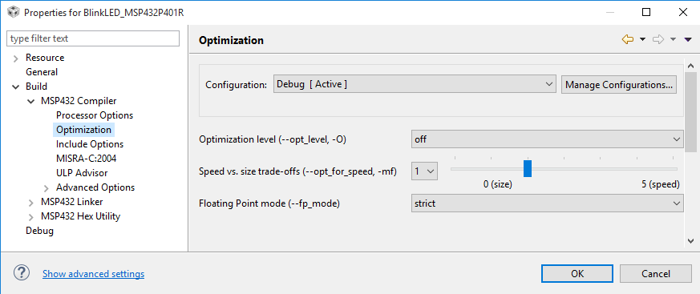
Project Properties: Optimization
The Project Properties dialog will be opened to the compiler optimization settings
  Options such as compiler/linker settings, pre/post build steps, and project dependencies can be set from this dialog
  The dialog can also be opened by right-clicking on a project in the Project
  Explorer view and selecting Properties
Device and high level settings
Compiler Options
Linker Options

Slide 49
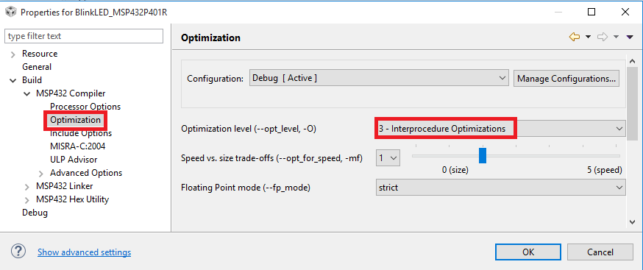
Project Properties: Optimization
Change the Optimization level to 3
Press OK to apply the changes and exit the dialog

Slide 50
Debug vs Optimization Tradeoff
The higher the level of optimization (speed/size/power), the greater the negative impact in debug visibility/experience
Trade-off between the ease of debugging and the effectiveness of compiler optimization
Best trade-off point depends on user preference… but usually the lowest level of optimization which meets your system constraints
  Use the lowest optimization setting if debug visibility is the highest priority (debugging difficult bugs in application behavior)
Some impact on the debug experience for highly optimized code:
  Source-line setting is erratic (code has been removed/rearranged)
  Unable to set source-line breakpoints (code has been removed/rearranged)
  Unable to view certain variables (variables optimized out)
http://processors.wiki.ti.com/index.php/Debug_versus_Optimization_Tradeoff

Slide 51
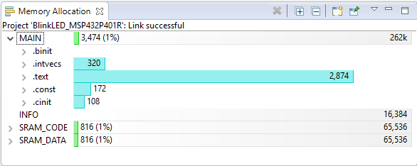
View: Memory Allocation
Build the project
The Memory Allocation view should refresh when the build is complete
Note the total allocation size for MAIN and the .text section
  Code size has decreased since code optimization was enabled
    MAIN drops from 5,306 to 3,474
    .text drops from 4,706 to 2,834
Numbers may vary slightly in your environment
Notes:
51

Slide 52
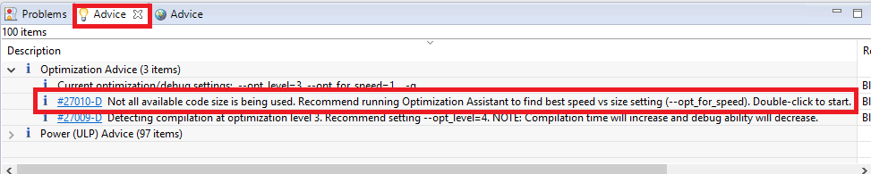
Optimizer Assistant: Speed vs. Size
Go to the Advice view in the lower right corner
Note the second advice, regarding Optimizer Assistant
52

Slide 53
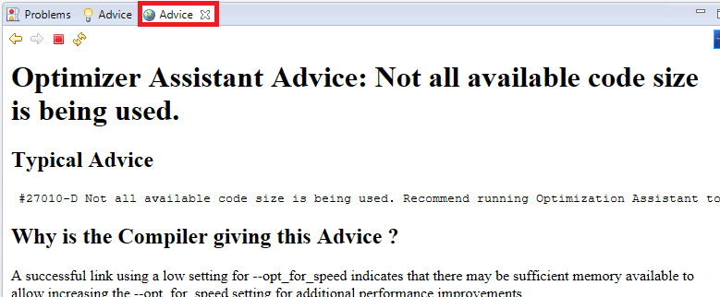

Optimizer Assistant: Speed vs. Size
Click on the hyper-link #27010-D to open more information on the advice (a new Advice tab will open)
  Go back to the original Advice tab and
  double-click on the entire third advice
  itself (not on just the hyperlink) to open
  the project optimization settings
    If the original Advice view is blank, go to the Project Explorer and set the BlinkLED_MSP432P401R project to the Active project (select/click on the project to put it in focus)
53

Slide 54
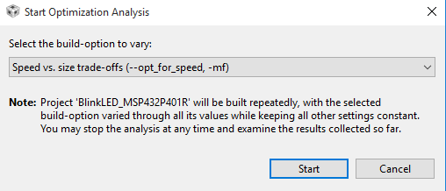
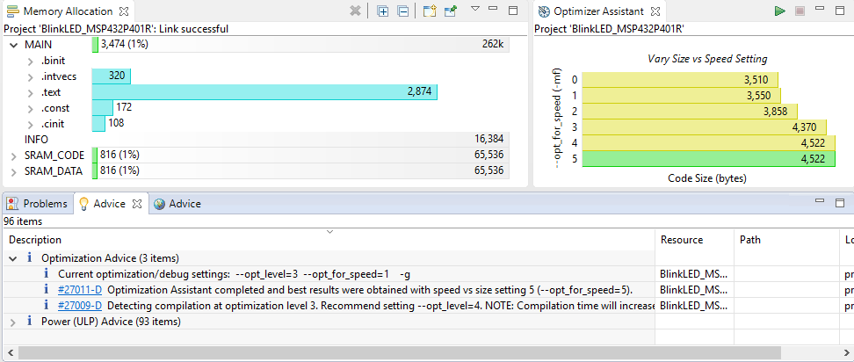
Optimizer Assistant: Speed vs. Size
Press the Start button to run the analysis
  The project will be built multiple times – once for each
  available setting for the --opt_for_speed option
  Results of the analysis will be displayed in a bar
  graph in the Optimizer Assistant view
The recommended setting to –opt_for_speed is highlighted in green (setting 5)
Note that the advice also changed (#27011-D)
54

Slide 55
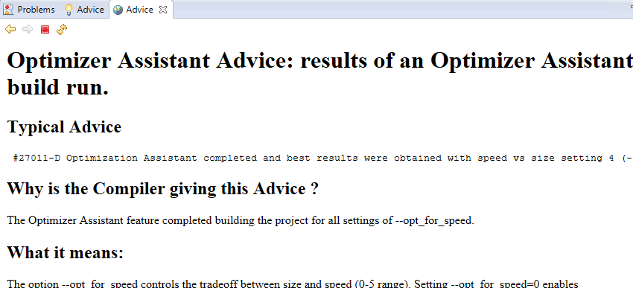
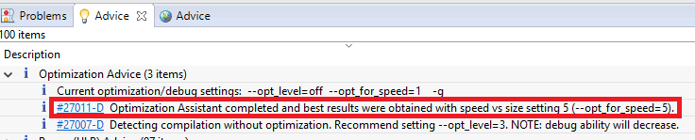
Optimizer Assistant: Speed vs. Size
Click on the hyper-link #27011-D to open more information on the advice (a new Advice tab will open)
  Go back to the original Advice tab and
  double-click on the entire second advice
  itself (not on just the hyperlink) to open
  the optimization build properties
55

Slide 56
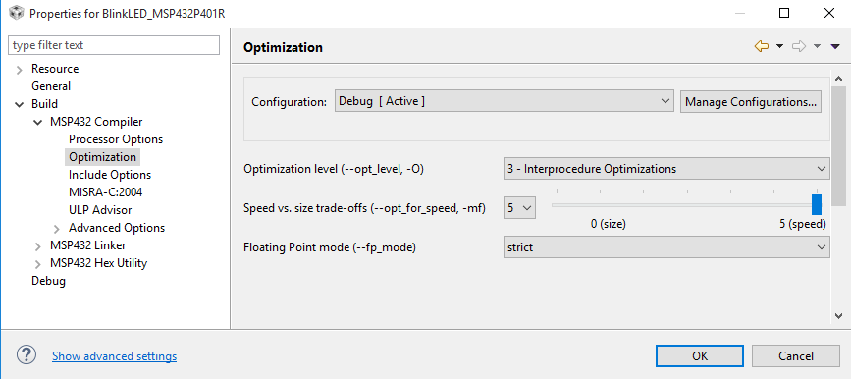
Project Properties: Optimization
Move the Speed vs. size trade-offs slider to 5
Press OK to apply the changes and exit the dialog

Slide 57
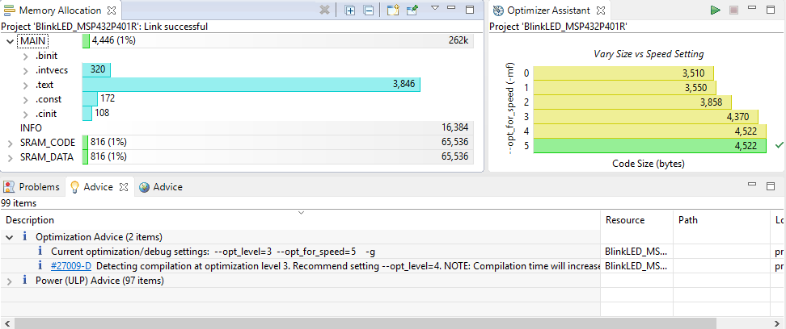
Optimizer Assistant: Speed vs. Size
Rebuild the project
  Note the updates in the various views
Code size increased a bit since the project was compiled favoring speed

Slide 58
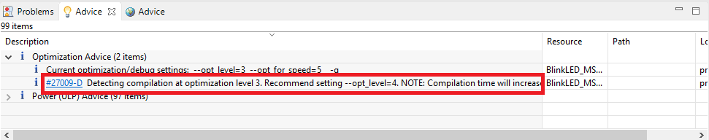
Optimization Advice
[OPTIONAL]: Analyze and resolve #27009-D

Slide 59
Clean Up
Close the Memory Allocation and Optimizer Assistant views

Slide 61
Lab 4:
REALTIME Memory ACCESS:
OUT OF BOX EXPERIENCE DEMO
20 minutes
Notes:
61

Slide 62
LAB 3: Exercise Summary
Key Objectives
  Demonstrate how to access/modify memory in real time when processor is running
Tools and Concepts Covered
  Real-time access to memory
  Continuous refresh in views
Notes:
62

Slide 63
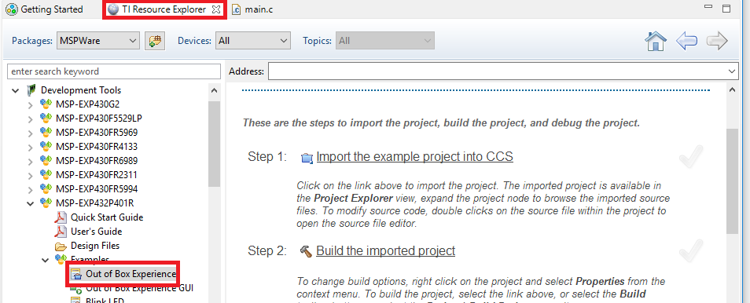
Resource Explorer: Examples
The Out of Box Experience example is available from Resource Explorer in tutorial format
Select the Out of Box Experience example under MSPWare -> Development Tools -> MSP-EXP432P401R –> Examples

Slide 64
Out of Box Experience
Follow tutorial steps 1 – 4 to import, build and debug the Out of Box Experience example project
  Note that step 3 is already marked as completed since the project itself has information on the debug connection for the LaunchPad
Press the Resume button to run the program

Slide 65
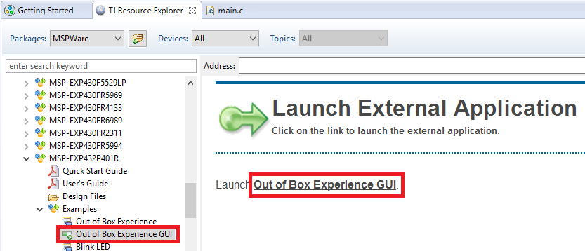
Out of Box Experience GUI Application
Go back to the Resource Explorer and select the Out of Box Experience GUI under MSPWare -> Development Tools -> MSP-EXP432P401R –> Examples and select the Out of Box Experience GUI link to launch the external GUI application
  This will launch a separate GUI application in a new window (takes a few seconds)

Slide 66
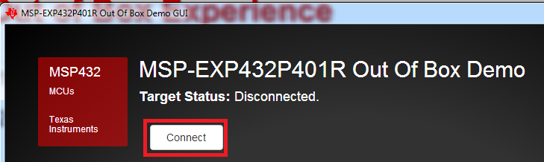
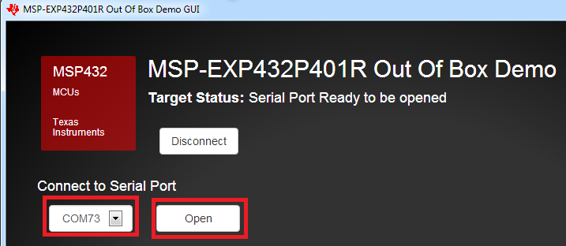
Out of Box Experience
Press the Connect button in the external GUI Application (this may take a few moments)
Specify the serial port that is associated with the LaunchPad and select Open to open a serial connection to the LaunchPad
  The GUI should be able to detect the correct serial port and provide it as the default option

Slide 67

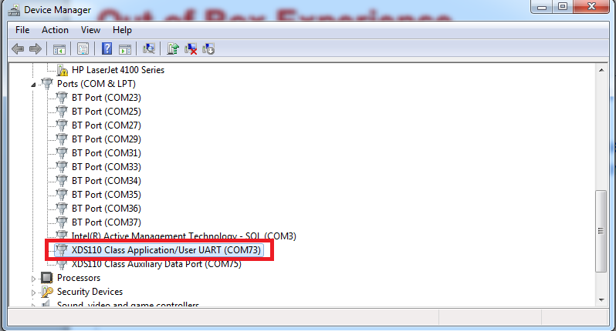
Troubleshooting: Wrong Serial Port
If the GUI is unable to establish a serial connection, or the demo does not work as expected, a different serial port may need to be selected
  Check your host OS to see a list of serial ports being used and look for the one being used by the LaunchPad debug connection (XDS110) for a serial/UART port
  Example (Windows Device Manager):

Slide 68
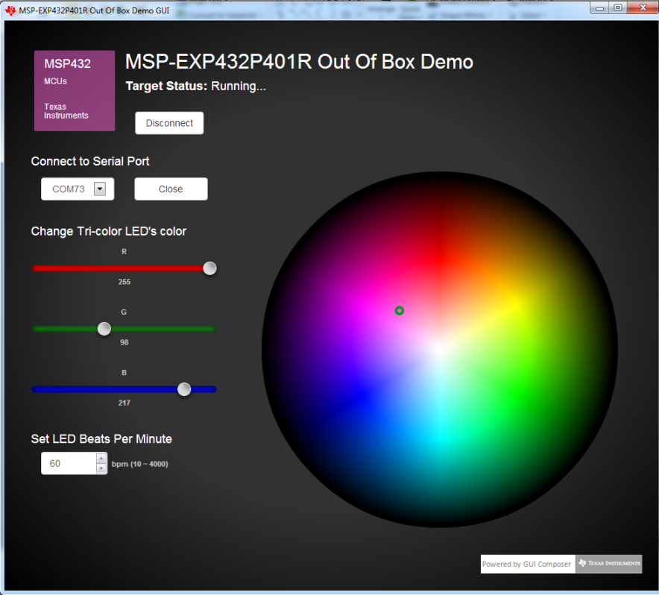

Out of Box Experience
Experiment with the GUI interface to change the color and blink rate of LED2

Slide 69



GUI Composer: See & Control
The standalone external GUI application was created with a tool provided by CCS called GUI Composer
Create GUI applications with GUI Composer that provide:
  Visibility into what is happening in the target application
  The ability to control target variables

Slide 70
When to use GUI Composer
While debugging
  Create simple displays that allow you to quickly see target status in a meaningful way
Standalone applications
  Create GUI applications that allow you to see and control your application outside of the CCS environment
  Great for demonstrations
Want to learn more about GUI Composer?
  http://processors.wiki.ti.com/index.php/Category:GUI_Composer

Slide 71


Add Watch Expressions
Select and right-click on the variable interval on line 56 of main.c and select Add Watch Expression… to add it to the Expressions view

Slide 72


Add Watch Expressions
Add the variable oldTick to the Expressions view by clicking on Add new expression and start typing in oldTick
  Select the oldTick option drop-down list of choices that appears
Add the additional following variables to the Expressions view (either using the method in Step 1 or Step 2):
  newTick
  count
  sysTickCount
  taps
  currentColor

Slide 73


Viewing Memory
Right-click on interval in the Expressions view and select View Memory
  The Memory Browser will open to the address of
  interval

Slide 74

Continuous Refresh
Enable Continuous Refresh in both the Expressions view and Memory Browser view
  This will enable constant periodic refresh the views vs the default behavior to refresh on target halt

Slide 75

Viewing Memory
Experiment with buttons S1 and S2 on the LaunchPad
  S1 can be tapped repeatedly at a constant rate to set the blink frequency of LED2
  S2 cycles LED2 through four different color settings: RED, GREEN, BLUE, and a random RGB color. Each color setting retains its own blink frequency.
Notice how various values in the Expressions view and the Memory view will change depending on which button was pressed (and the tap rate for S1)
  Each press of S2 will change the value (0 – 3) of currentColor

Slide 76
Clean Up
Press the Close and Disconnect buttons (in that order) in the external GUI
Close the external GUI
Halt the running target in CCS
Remove all variables from the Expressions view
Shut down the debug session in CCS

Slide 77
LAB 4: Summary
In this lab we completed the following:
  Real-time memory accesses with CCS
  How to enable Continuous Refresh in a view
  Used a standalone application created by GUI Composer
Notes:
77

Slide 79
Lab 5: SWO Trace
OUT OF BOX EXPERIENCE DEMO
20 minutes
Notes:
79

Slide 80
LAB 5: Exercise Summary
Key Objectives
  Get familiar with the capabilities of SWO Trace
Tools and Concepts Covered
  Target Configurations
  Data Visualization views
  SWO Trace Use Cases
    Statistical Function Profiling
    Data Variable Tracing
    Interrupt Profiling
Notes:
80

Slide 81

Target Configuration Editor
Double-click on the MSP432P401R.ccxml file in the OutOfBox_MSP432P401R project to open the file in the editor
Select the Advanced tab at the bottom of the editor
Select the top node Texas Instruments XDS110 USB Debug Probe in the left panel
Select SWD Mode – Aux COM port is target TDO pin under the Connection Properties for JTAG / SWD / cJTAG Mode
Press the Save
button to save the
changes

Slide 82

Restart Debug Session and Load/Run the Program
Make sure you are in the CCS Edit perspective and project OutOfBox_MSP432P401R is active (in focus)
Click the Debug button to restart the debugger and reload the code
  CCS should be in the CCS Debug perspective and the program should be halted at main
Notes:
82

Slide 83



Statistical Function Profiling Setup
Open the Trace Configuration dialog via Tools -> Hardware Trace Analyzer -> Statistical Function Profiling
Leave the default options and select Start
  The Trace Viewer and Statistical Function
  Profiling views
  will be opened
Note the default Sampling Interval of 1084 cycles

Slide 84


Statistical Function Profiling Setup
Press the Resume button to run the program
Halt the program after the LED has blinked about 10 times
Note the contents in the Trace Viewer and Statistical Function
Profiling views

Slide 85
Statistical Function Profiling View
Displays a list of functions that were called along with the following information for each function
  Number of times called
  Which file the function is from
  The percentage that function was called
Auto Fit Columns
Filter
Find/Search

Slide 86
Trace Viewer View
Displays the raw trace data that was used by the Statistical Function Profiling view
Note the interval between the ticks is ~1084
Save Data to file
Start/Stop Data Collection

Slide 87


Data Variable Tracing Setup
Click the Reset button to reset the target
Open the Trace Configuration dialog via Tools -> Hardware Trace Analyzer -> Data Variable Tracing
A dialog will appear with a notification that the existing analysis must be closed to run a new analysis. Choose the option to Close Statistical Function Profiling (CORTEX_M4_0)
Enter &taps for the Variable Address
and select Start
The taps variable counts # of times button S1 was pressed since the last reset

Slide 88

Data Variable Tracing
Press the Resume button to run the program
Press button S1 about 5 times
Halt the program
Observe the graph in the Data Trace view
Zoom out the graph as much as possible using the Zoom Out button or pressing the CTRL and - keys
Zoom in/out
This graph shows how the taps variable was incremented when S1 was pressed

Slide 89
Interrupt Profiling Setup
Click the Reset button to reset the target
Open the Trace Configuration dialog via Tools -> Hardware Trace Analyzer -> Interrupt Profiling
A dialog will appear with a notification that the existing analysis must be closed to run a new analysis. Choose the option to Close Data Variable Tracing (CORTEX_M4_0)
Leave the default options in the Configuration dialog and select Start
  The Trace Viewer, Interrupt Analyzer Graph, and Interrupt Analyzer Summary views will be opened

Slide 90

Interrupt Profiling
Press the Resume button to run the program
Halt the program after the LED has blinked a few times
Observe the graph in the Interrupt Analyzer Graph view
Zoom out the graph as much as possible using the Zoom Out button or pressing the CTRL and - keys
Note how SYSTICK is the main interrupt displayed since no buttons were pressed and this interrupt occurred at a consistent interval

Slide 91


Measurement Markers
Right-click and select Insert Measurement Mark in the
context menu
Drag the X1 marker to the first “tick” and click the left mouse
button to set it
  The marker will automatically “snap” to the closest tick when set
Repeat the above steps to place a second marker (X2) to the
second “tick”
Note the delta between the two ticks (X2 – X1)
Remove the measurement markers by
right-clicking inside the view and selecting
Remove All Measurement Marks in the
context menu

Slide 92

Measurement Markers
Region Zoom is a feature that will zoom in a specified region by selecting the immediate region around it
  To use the “region zoom” feature:
    Hold the ALT key and the left mouse button
    As you drag the cursor it shows you the zoom region
    Let go of the left mouse button and it will zoom into that region
Use the “region zoom” feature to zoom around the first “tick”
  Repeat the step until a GREEN bar appears (may take several times)
Use measurement markers to find the delta between the entry and exit point of the interrupt

Slide 93

Trace Viewer View
Displays the raw trace data that was used by the Interrupt Analyzer views
Shows additional details such as the logged time for entry and exit

Slide 94

Interrupt Analyzer Summary View
Displays a list of interrupts that were profiled along with the following information for each interrupt
  Number of times the interrupt occurred
  Inclusive and Exclusive cycle counts (min/max/average/total)

Slide 95

Interrupt Profiling
Reset and Resume the target
Press buttons S1 and S2 quickly and randomly for a few seconds
Halt the program
Observe the graph in the Interrupt Analyzer Graph view
  Don’t forget to zoom the graph out as much as possible!
Note the difference with this graph due to the additional interrupts triggered with the button toggles

Slide 96
Clean Up
Shut down the debug session

Slide 97
LAB 5: Summary
In this lab we completed the following:
  Became familiar with the Target Configuration Editor
  Became familiar with Data Visualization views
  Used SWO Trace for:
    Statistical Function Profiling
    Data Variable Tracing
    Interrupt Profiling
Notes:
97

Slide 98
Thank You!

