Slide 1

CCSv6 Fundamentals Workshop for CC3200
Lab Handbook

Slide 2
Outline
Lab Requirements and Setup
Lab 1: Hello Example (TI-RTOS)
Lab 2: blinky Example (CC32XX SDK)
Lab 3: timer Example (CC32XX SDK)
Lab 4: Stairstep JTAG Stopmode Example (TI-RTOS)

Slide 3
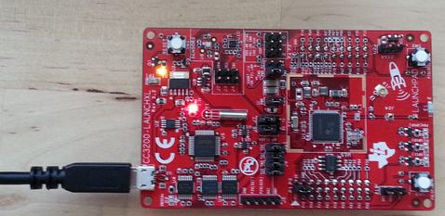
LAB Requirements
Software:
  Code Composer Studio v6
    With all Wireless Connectivity components installed
    CC3200 Device Support Package (via App Center)
    TI-RTOS for SimpleLink CC3XXX (via App Center)
Standalone compiler version TI ARM 5.1.4
CC32XX SDK
Hardware:
  CC3200 LaunchPad
USB JTAG Connection

Slide 4
LAB Material Notes
It is assumed the main workshop directory is located in C:\ccsv6_workshop\cc3200\workspace
It is assumed that that CC32XX SDK is installed in C:\ti\CC3200SDK
It is assumed that that TI ARM compiler v5.1.4 is installed in C:\ti\cgt\arm_5.1.4
The lab material will make references to these directory
If the lab material is located in a different location, please update the path to reflect your environment

Slide 5




LAB Conventions
Before starting, it is important to review some lab conventions that will ease your work…
Lab steps are in black and numbered for easier reference
  …
  …
Explanations, notes, warnings are written in blue
  Warnings are shown with
  Information is marked with
  Tips and answers are marked with
  Questions are marked with
Notes:
5

Slide 6
Lab 1: Hello world
(TI-RTOS)
15 minutes
Notes:
6

Slide 7
LAB 1: Exercise Summary
Key Objectives
  Import and build a simple Hello World TI-RTOS example program
  Start a debug session and load/flash the program to the target
  Run the program
Tools and Concepts Covered
  Workspaces
  Resource Explorer
  Building example projects
  Debugging example project
  Project Properties
  Changing compiler versions
Notes:
7

Slide 8

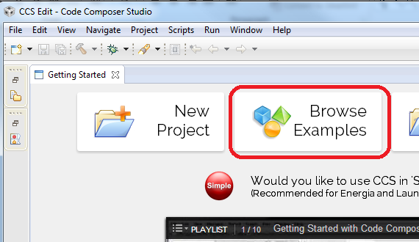
Launch CCS and Open Resource Explorer
Double click on the Code Composer Studio desktop icon
Specify C:\ccsv6_workshop\cc3200\workspace as the workspace location
Select Browse Examples in the Getting Started page

Slide 9
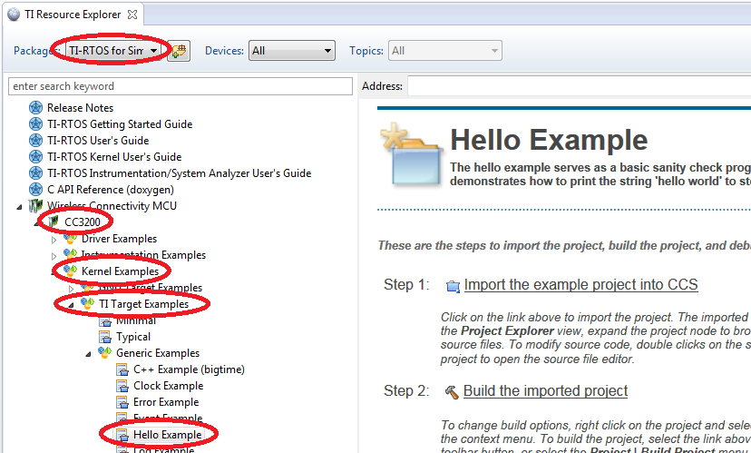
Resource Explorer: Examples
Displays all example projects discovered by the Resource Explorer
Step by step instructions on how to build/run the examples
Select the Hello example under TI-RTOS for SimpleLink Wireless MCUs -> Wireless Connectivity MCU -> CC3200 –> Kernel Examples -> TI Target Examples -> Generic Examples

Slide 10
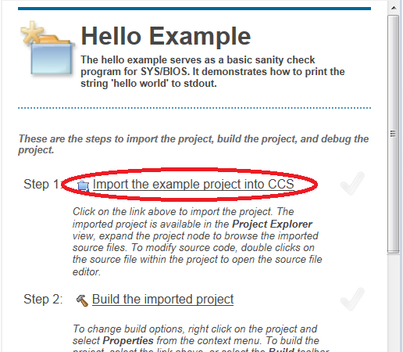
Step 1: Import Hello Example Project
Follow Step 1 and import
the Hello project into the
CCS Workspace by clicking
on the Import the example
project into CCS link

Slide 11

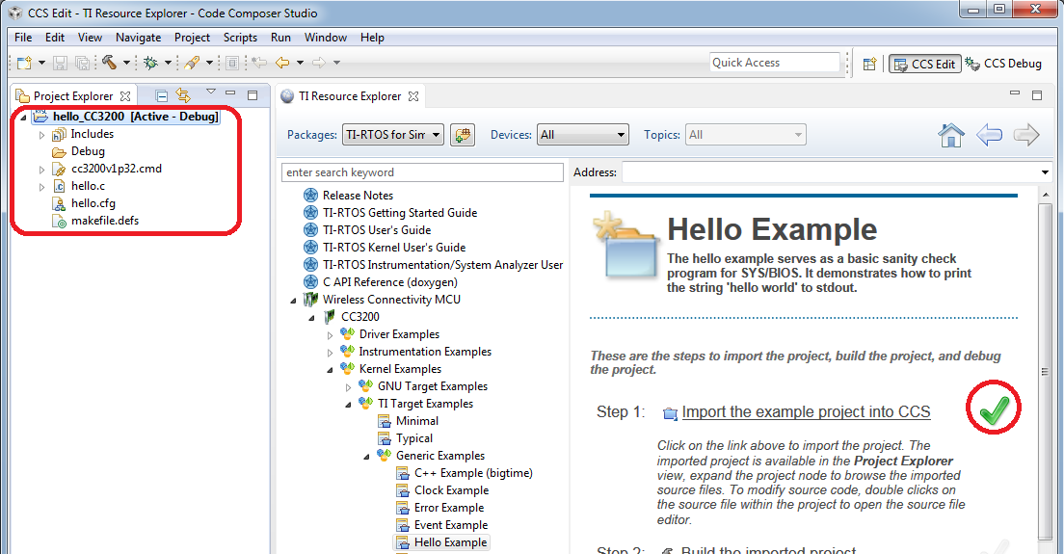
Step 1: Import Hello Example Project
The project will appear in the Project Explorer if the import is successful and a green checkmark will appear next to the link to indicate success

Slide 12
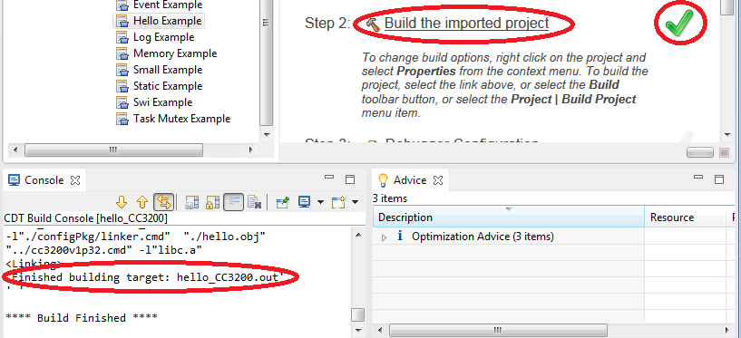
Step 2: Build Hello Example Project
Follow Step 2 and build the Hello Example project by clicking on the Build the imported project link
The build Console view will appear along the bottom with build messages as the project builds
If the build is successful, a green checkmark will appear next to the link to indicate success
Note that if this is the first time building with this compiler, the run-time library will need to be built. This can take some time. But once the library is built once, it will not need to be rebuilt again for this compiler installation

Slide 13
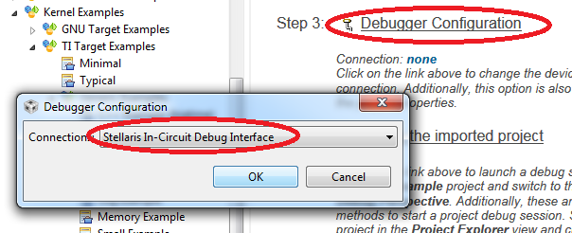
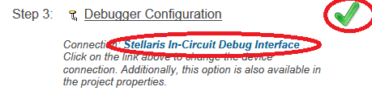
Step 3: Specify Debugger Configuration
Follow Step 3 and specify the Debug Connection by clicking on the Debugger Configuration link and selecting Stellaris In-Circuit Debug Interface for the Connection in the pop-up dialog
A green checkmark will appear
when this step is complete

Slide 14
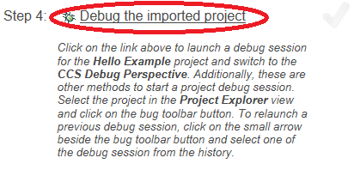
Step 4: Debug Hello Example Project
Follow Step 4 and debug the project by clicking on the Debug the imported project link
Several actions are done automatically
  Prompt to save source files
  Build the project (incrementally)
  Start the debugger (CCS will switch to the CCS Debug perspective)
  Connect CCS to the target
  Load (flash) the program on the
  target
  Run to main
Don’t want it to do all of the above
at once? You can configure it to skip
some steps (Debugger Options)

Slide 15
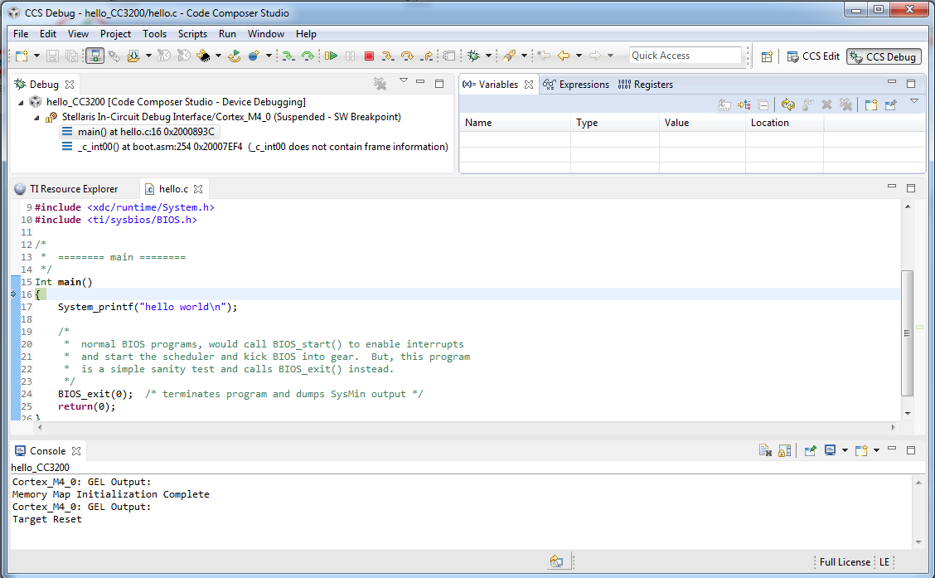
Debug Session for Hello Example Project
Switched to CCS Debug perspective
Debug view for project being debugger
Program counter at main
Notes:
15

Slide 16
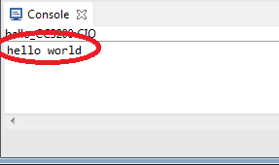
  Run Hello Example Program
Press the Resume button to run the program
  Program will run to termination and “hello world” will appear in the C/IO Console at the bottom
Press the Terminate button to terminate the debugger
  This will terminate the debug session and switch back to the CCS Edit perspective
Notes:
16

Slide 17
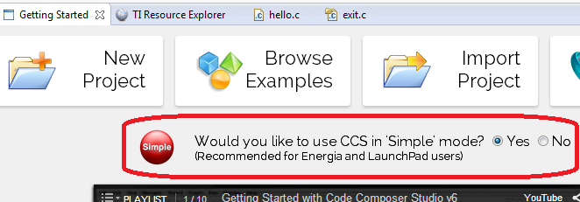

Switch to Simple Mode
Select the option to enable Simple Mode in the Getting Started page (View -> Getting Started)
This will switch the perspective to the CCS Simple perspective
17

Slide 18
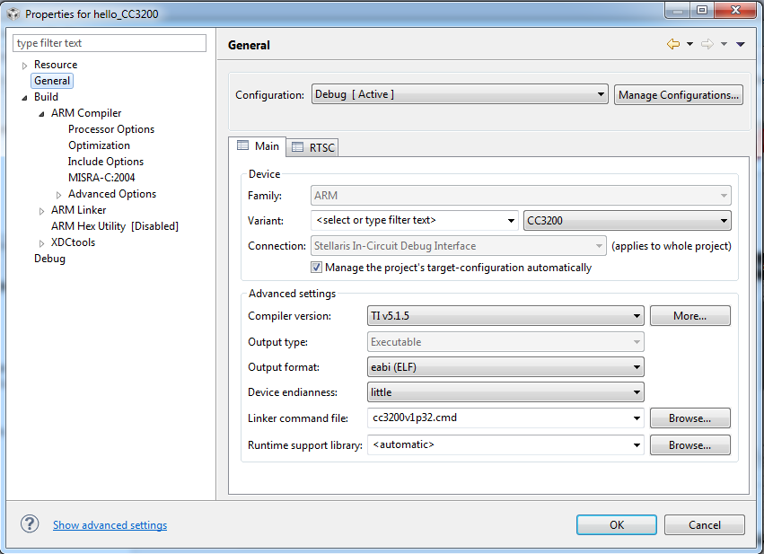
Project Properties
Right click on the project and select Properties
Device and high level settings
Compiler Options
Linker Options

Slide 19
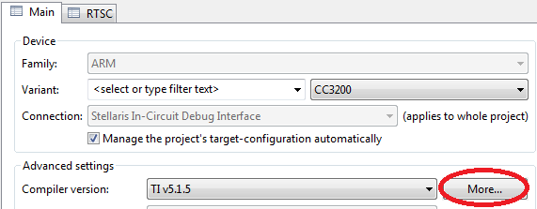
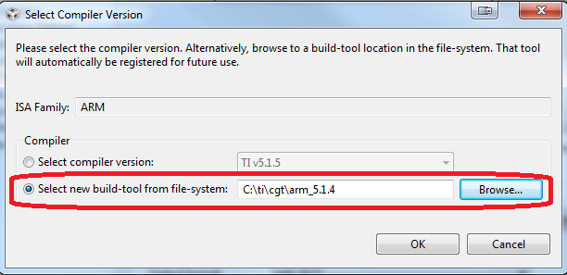
Using a Separate Standalone Compiler
Select the More… button next to the Compiler version
Use the option to Select new build-tool from file-system and browse to the standalone installation of the TI ARM 5.1.4 compiler
Press OK with finished

Slide 20
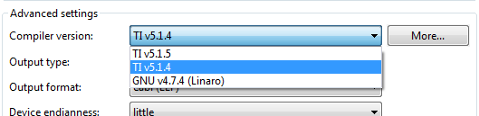
Using a Separate Standalone Compiler
Note that the compiler version for the project is now TI ARM v5.1.4 and the drop-down list of compilers available for the project now include it
The location of this standalone compiler installation is now “known” to CCS and will be available for all CCS projects

Slide 21
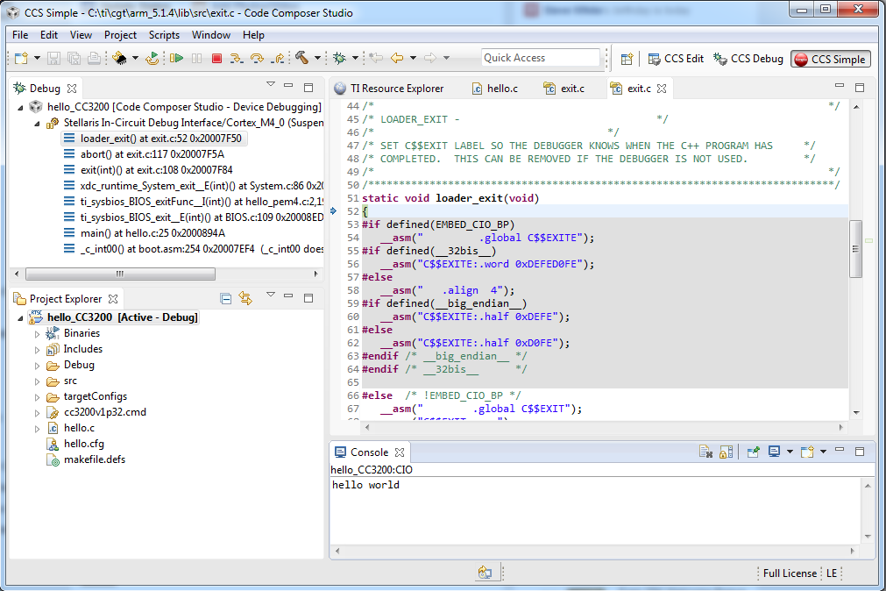
Using a Separate Standalone Compiler
Use the Debug button to build, load and run the program to verify that it still works
Note that since this is a different compiler installation, the run-time library may need to be first compiled as described earlier in slide 12.
Note that there is no perspective switch in Simple Mode

Slide 22
Simple Mode
Terminate the Debug Session
Disable Simple Mode in the Getting Started page (View -> Getting Started)
  The rest of the workshop will not use Simple Mode but instead use the default CCS Edit and CCS Debug perspectives

Slide 23
LAB 1: Summary
After completing this lab you should now be familiar with:
  Using the Resource Explorer to import, build and debug TI-RTOS examples
  Became familiar with Simple Mode
  How to configure CCS to use a standalone compiler installation
Notes:
23

Slide 24
Lab 2: BLINKY EXAMPLE
30 minutes
Notes:
24

Slide 25
LAB 2: Exercise Summary
Key Objectives
  Import the blinky project from the SDK
  Modify source code in the blinky project
  Create and add a Target Configuration file to the project
  Debug the blinky project
  Profiling
Tools and Concepts Covered
  Project Import Wizard
  Basic Source Editing
  Target Configurations
  Basic Debug
  Watchpoints
  Event Counters
Notes:
25

Slide 26
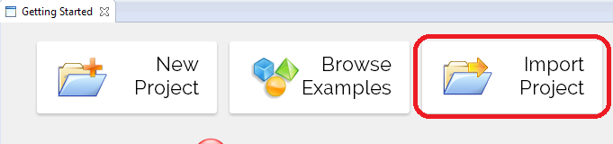
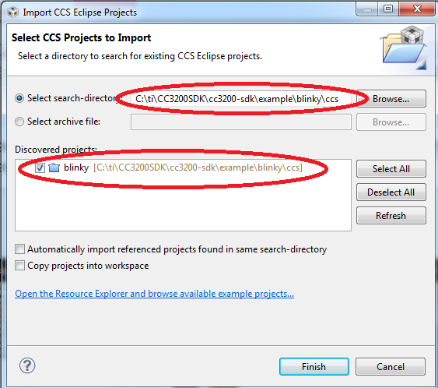
Import blinky Project
Select Browse Examples in the Getting Started page
Import the blinky example project located in: C:\ti\CC3200SDK\cc3200-sdk\example\blinky\ccs

Slide 27
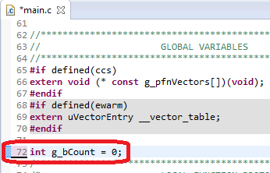
Modify blinky Project
Open main.c in the editor by double-clicking it in the Project Explorer
Insert the following line after line 70:
  int g_bCount = 0;

Slide 28
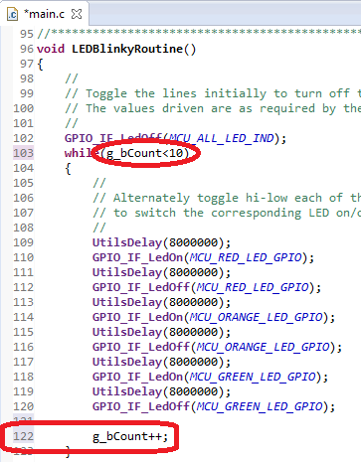
Modify blinky Project
In the LEDBlinkyRoutine:
  Modify the while loop as such:
    while(g_bCount<10)
  Add the following line at the end of the function:
    g_bCount++;
Press the Save button to save the changes in the file

Slide 29
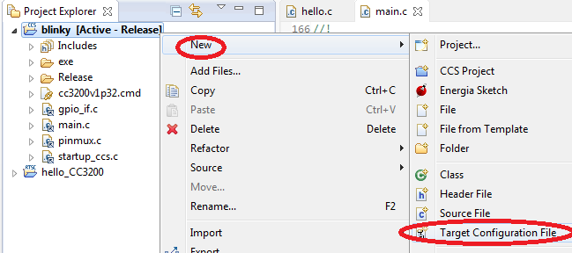
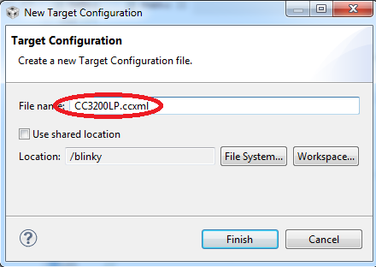
Create and Add Target Configuration
Right-click on the blinky project and select New -> Target Configuration File in the context menu
Select CC3200LP.ccxml as the File Name
Select Finish

Slide 30
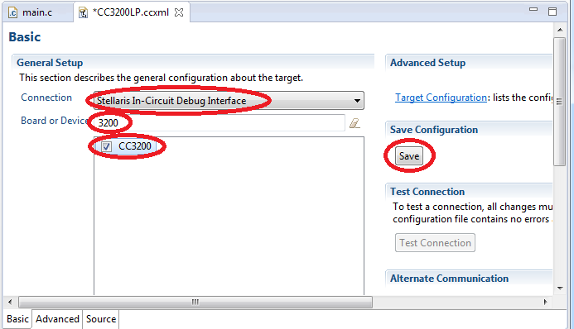
Create and Add Target Configuration
Set the following:
  Connection: Stellaris In-Circuit Debug Interface
  Board or Device: CC3200
Press Save to save the target configuration

Slide 31
Build and Debug blinky Project
Press the Debug button – make sure the blinky project is selected first!
  Program should be loaded to target and CCS should be halted at main()
Press the Run button to run the program
  LEDs D7 (red), D6 (yellow), D5 (green) will blink in that order, cycling through 10 times
[OPTIONAL]: Press the Suspend button to halt execution (if you do not wish to wait for the LEDs to cycle 10 times)
Press the Restart button to restart the program and set the program counter at the beginning of main

Slide 32
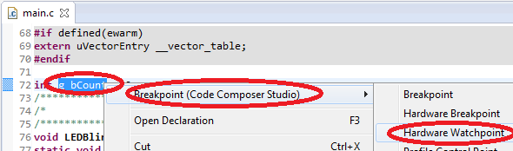

Debugging: Using Watchpoints
A Watchpoint is a type of breakpoint that monitors activity on a memory address
In this step we will set a watchpoint to halt the CPU when g_bCount reaches ‘3’ (3 cycles of LED blinks)
In main.c (via the editor): Highlight g_bCount right-click and select Breakpoint -> Hardware Watchpoint in the context menu
Notes:
32

Slide 33
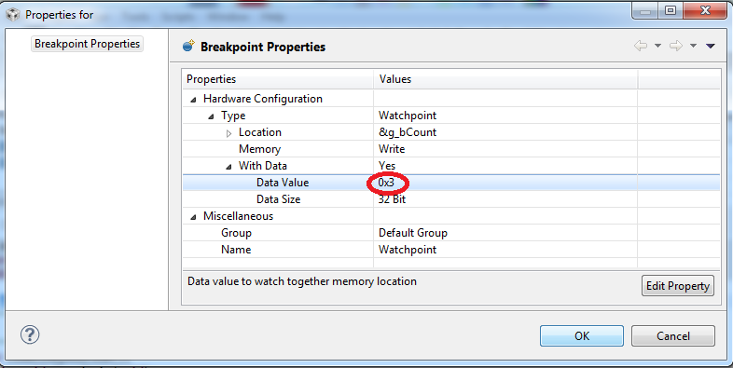
Debugging: Watchpoints
Right-click on the watchpoint in the Breakpoints view and select Breakpoint Properties in the context menu
Modify the properties to match the settings in the screenshot below
Hit OK to apply the changes
Notes:
33

Slide 34
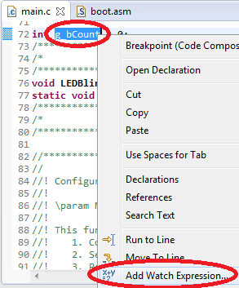
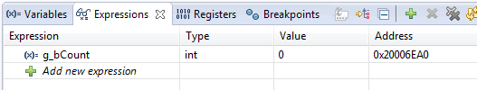

Debugging: Using Watchpoints
In main.c (via the editor): Highlight g_bCount, right-click and select Add to Watch Expression… in the context menu
Run the target again. Execution will halt when g_bCount reaches 3
Remove the watchpoint using the Remove All Breakpoints button
Notes:
34

Slide 35
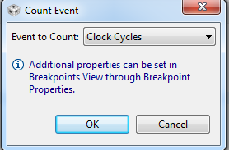

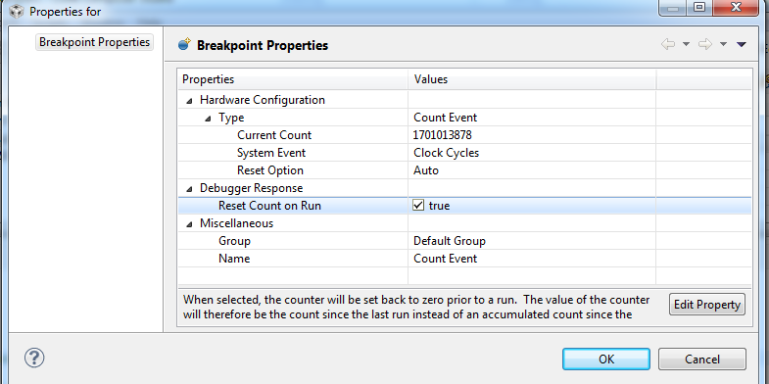
Debugging: Counting Events
Set event counters from the Breakpoints view
Set a event counter to count cycles
Right-click on the event counter in the Breakpoints view and select Breakpoint Properties in the context menu
Enable the Reset
Count on Run
option in the
properties dialog
Press OK

Slide 36
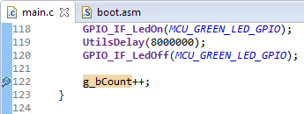
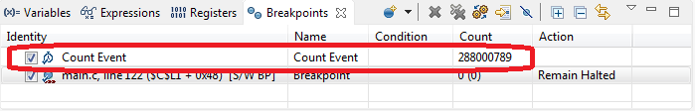
Debugging: Counting Events
Set a breakpoint on line 122 of main.c by double-clicking in the editor margin
Run the target again a few times
  Note that the event counter will show a count of ~288M – the cycles between each LED toggle
Remove the event counter and breakpoint using the Remove All Breakpoints button
Notes:
36

Slide 37
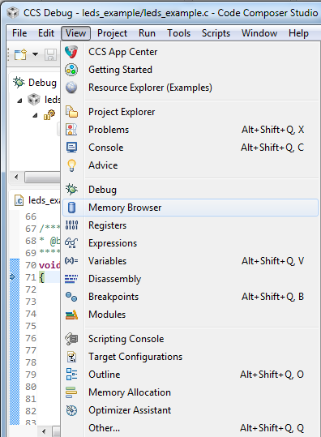
More Debugging (Review)
Investigate other debugging views
(Open via View menu)
  Memory Browser
  Registers
  Modules
  Disassembly (see next slide)
Notes:
37

Slide 38

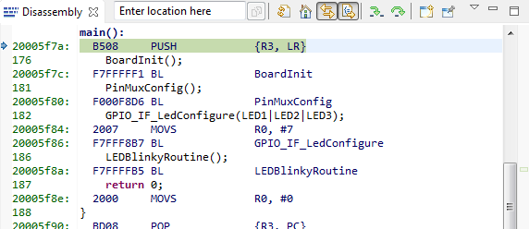
View: Disassembly
Press the Restart button to restart the program
  Program should be at main
Open the Disassembly view by going to View -> Disassembly
  You can see the current location of the PC (small blue arrow) and any breakpoints (small blue circles)
Toggle the Show Source button
  Note the toggling of interleaved source with the disassembly
Notes:
38

Slide 39
Clean Up
Remove all breakpoints from the Breakpoints view (if any)
Terminate the Debug Session

Slide 40
LAB 2: Summary
After completing this lab you should now be familiar with:
  Importing existing projects into the workspace
  Opening and editing source code
  Became familiar with target configurations
  How to use watchpoints
  How to count events (cycles)
  Became familiar with the Disassembly view
Notes:
40

Slide 41
Lab 3: TIMER EXAMPLE
15 minutes
Notes:
41

Slide 42
LAB 3: Exercise Summary
Key Objectives
  Demonstrate how to access/modify memory in real time when processor is running
Tools and Concepts Covered
  Linking an existing Target Configuration file to a project
  Real-time access to memory
  Continuous refresh in views
Notes:
42

Slide 43
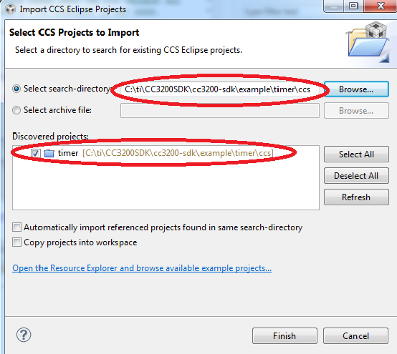
Import timer Project
Select Import Project in the Getting Started page
Import the blinky example project located in: C:\ti\CC3200SDK\cc3200-sdk\example\timer\ccs

Slide 44
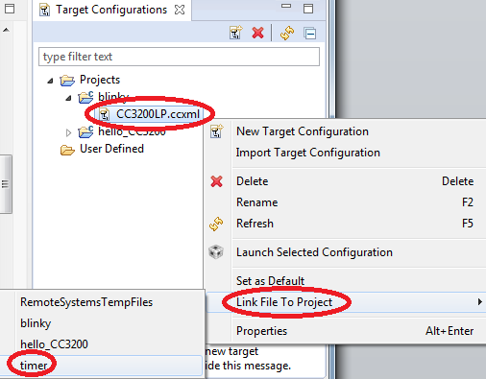
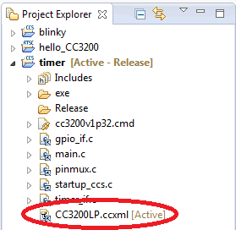
Link Target Configuration
Open the Target Configurations view via View -> Target Configurations
Right-click on the CC3200LP.ccxml file underneath Projects -> blinky and select Link File To Project -> timer
  File will be linked to the
  timer project

Slide 45
Build and Debug timer Project
Press the Debug button – make sure the timer project is selected first!
  Program should be loaded to target and CCS should be halted at main()

Slide 46
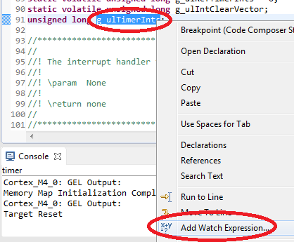
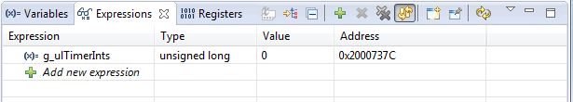
Add Watch Expressions
Select and right-click on g_ulTimerInts on line 91 of main.c and select Add Watch Expression… to add it to the Expressions view

Slide 47
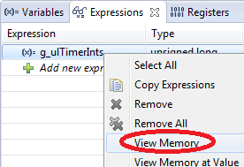
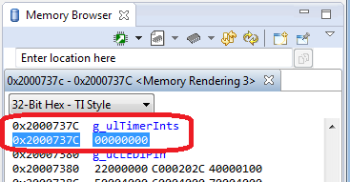
Viewing Memory
Right-click on g_ulTimerInts in the Expressions view and select View Memory
  The Memory Browser will open to the location of
  g_ulTimerInts

Slide 48
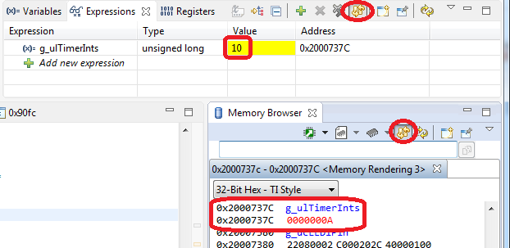
Continuous Refresh
Run the target
Enable Continuous Refresh in both the Expressions view and Memory Browser view
See the values of both variables update while the target is running
Halt the target

Slide 49
Clean Up
Remove all breakpoints from the Breakpoints view (if any)
Terminate the Debug Session

Slide 50
LAB 3: Summary
After completing this lab you should now be familiar with:
  Linking an existing Target Configuration file to a project
  Real-time memory accesses with CCS
  How to enable Continuous Refresh in a view
Notes:
50

Slide 51
Lab 4: TI-RTOS STAIRSTEP JTAG STOPMODE EXAMPLE
30 minutes
Notes:
51

Slide 52
LAB 4: Exercise Summary
Objectives
  Get familiar with using ROV (RTOS Object View) to inspect state of the scheduler, threads and objects in the system
  Get familiar with using RTOS Analyzer to view RTA data (execution graph, task/CPU load etc)
Tools and Concepts Covered
  RTOS Object Viewer (ROV)
  RTOS Analyzer
Notes:
52

Slide 53
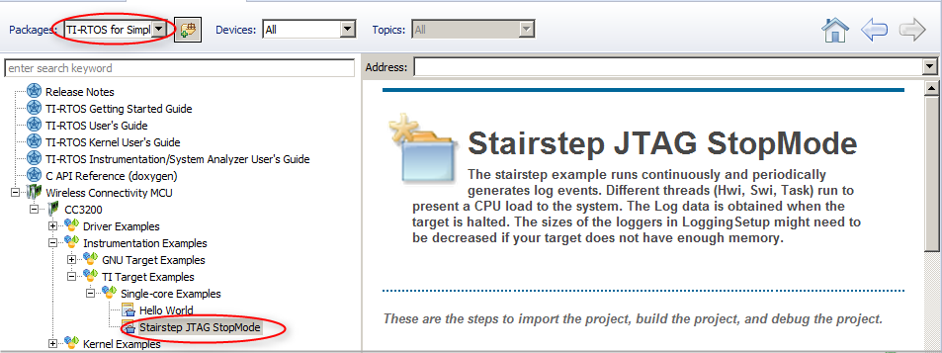
Import an Example with Resource Explorer
Go to CCS menu View -> Resource Explorer (Examples)
Select TI-RTOS for SimpleLink Wireless MCUs in the Packages filter box
Expand Wireless Connectivity MCU -> CC3200 -> Instrumentation Examples -> TI Target Examples -> Single-core Examples, and select Stairstep JTAG StopMode

Slide 54
Import, Build and load the example
Click Step 1 link in the right pane to “Import the example project into CCS”
  The project will appear in the Project Explorer view if the import is successful and a green checkmark will appear next to the link in the right pane
Click Step 2 link in the right pane to “Build the imported project”
The Console view will appear along the bottom with build messages as the project builds. If the build is successful, a green check mark will appear in the link in the right pane
Click Step 3 link in the right pane to set up “Debugger Configuration”. Select Stellaris In-Circuit Debug Interface
Click Step 4 link in the right pane to “Debug the imported project”

Slide 55
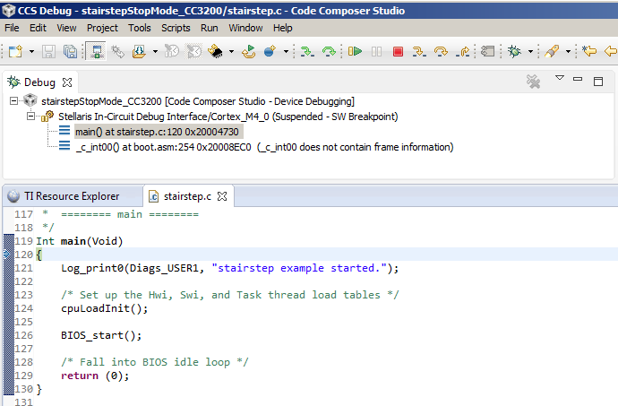
Debug session
The program should be loaded and halted at main()

Slide 56
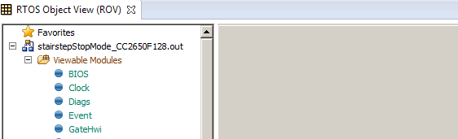
Open the RTOS Object View (ROV)
ROV can be used to inspect state of the scheduler, threads and objects in the system
Go to menu Tools -> RTOS Object View (ROV) to open ROV
In RTOS Object View, expand stairstepStopMode_CC3200.out

Slide 57
Use ROV
Click on “Task” to see details of tasks in the system
Answer the following for each task:
  What are the priorities and current states/mode?
  What is the size of stack and stack peak? (Hint: some info is in Detailed tab)
Click the Resume button to run the program
Let it run for 5 seconds, then click the Suspend button to halt
Answer the following for each task again:
  What are the current states/mode?
  What is the stack peak?

Slide 58
Use ROV
Click on “HeapMem” to see details about the system heap
Answer the following: (Hint: need to go to Detailed tab for some info)
  What is the total size of heap, and free size?
  What is the starting address of the heap?
Click on the Terminate button in the Debug View
More information on ROV is available at:
http://rtsc.eclipse.org/docs-tip/RTSC_Object_Viewer

Slide 59
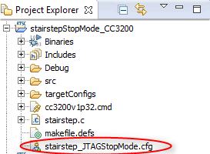
Launch XGCONF
In the Project Explorer view, expand the stairstepStopMode_CC3200 project and double-click on stairstep_JTAGStopMode.cfg to open it in the XGCONF graphical editor
This will open 3 views:
  The Editor view in the middle
  The Outline view on the right
  The Available Products view at the bottom left

Slide 60
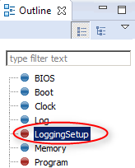
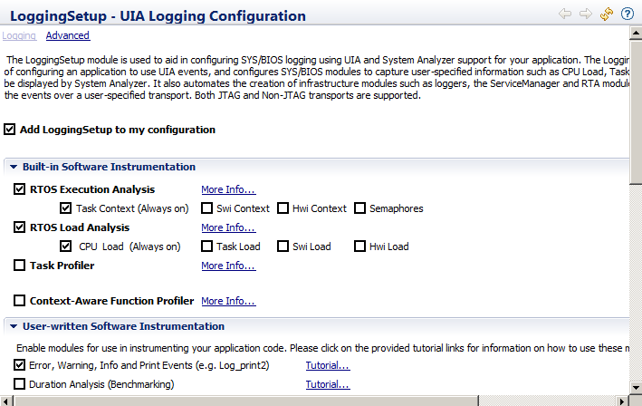
RTA Logging
In the Outline view, click on LoggingSetup
Note that LoggingSetup is enabled in the configuration.
The LoggingSetup module is used to configure SYS/BIOS
logging of info such as CPU/Task Load and Execution so it
can be displayed by System Analyzer

Slide 61
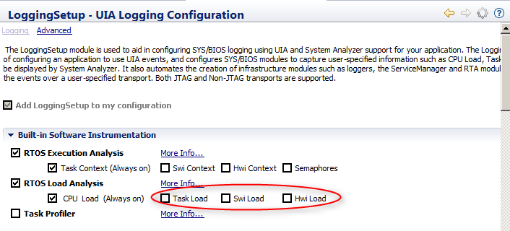
RTA Logging
In the Editor view, under Built-in Software Instrumentation,
uncheck Task Load, Swi Load and Hwi Load
  Due to smaller RAM in these devices, we are limiting the load logging to CPU Load to avoid much data loss
Save the .cfg file

Slide 62
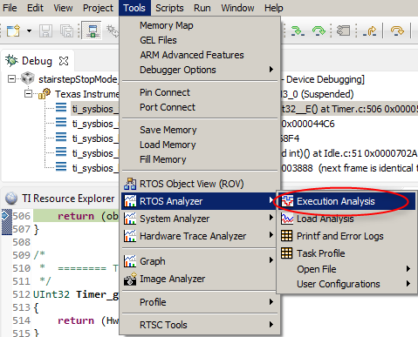
Launch RTOS Analyzer
Click the Debug button to build, load the code and run to main()
Go to menu Tools->RTOS Analyzer->Execution Analysis

Slide 63

Analysis Configuration
In the Analysis Configuration dialog, the Analysis Feature “Execution Graph” should already be enabled
(Additional analysis features can be optionally selected here)
Enable “CPU Load”
Click Start
The Live Session, Execution
Graph and CPU Load Graph
views will open

Slide 64

Run the code
Click the Resume button to run
Let it run for ~5-10 seconds, then click the Suspend button to halt
Repeat this Run/Suspend process 3-4 times

Slide 65

Execution Graph
Go to the Execution Graph view and expand the OS node in the Execution graph

Slide 66

Use Zoom in the Execution Graph
Use the zoom buttons on the Execution Graph toolbar to zoom in/out
Zoom out a few times until you see many instances of taskLoad
Then zoom into one instance of taskLoad using either:
  Zoom in and moving the time axis so you can see the task OR
  Using the region zoom feature:
    Hold the Alt key and the left mouse button
    As you drag the cursor it shows you the zoom region
    Let go of the mouse button and it will zoom into that region

Slide 67

Use Measurement Marks to measure Time
Right click and select “Insert Measurement Mark”. Drag it to the start of taskLoad and click the left mouse button
Right click and select “Insert Measurement Mark”. Drag it to the end of the same taskLoad and click the left mouse button
The time spent in task1Fxn is shown at the top of the view:
X2 – X1 = 7us
To remove the measurement marks, right-click inside the view and select “Remove All Measurement Marks”
Measurement
marks

Slide 68



Use RTOS Analyzer
Go to CPU Load:Graph view
Zoom out a few times (The Load graph should look like a stairstep)
The Load Analysis views can be opened
as Graphs, Summary logs or Detailed logs
The Summary views numerically show
the min, max and average load values
When finished with analysis, click the Terminate button

Slide 69
LAB 4: Exercise Summary
After completing the labs you should be familiar with:
  Using ROV (RTOS Object View) to inspect state of the scheduler, threads and objects in the system.
  Using RTOS Analyzer to view RTA data (execution graph, task/CPU load).
Additional References:
  TI-RTOS Users Guide: http://www.ti.com/lit/spruhd4
  System Analyzer Users Guide: http://www.ti.com/lit/spruh43
  SYSBIOS Wiki: http://processors.wiki.ti.com/index.php?title=Category:SYSBIOS

