Slide 1

Code Composer Studio v6
Fundamentals Workshop for CC2560

Slide 2
Agenda
CCSv6 Overview
Getting Started with CC2650
Basic Debugging
Real-Time Memory Access
RTOS Object View (ROV)
Multi-Target Debug

Slide 4
CCSv6 Overview
Notes:
4

Slide 5
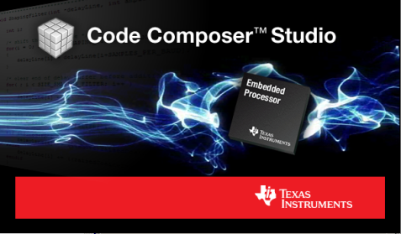
Code Composer Studio
What is Code Composer Studio?
  Integrated development environment for TI’s embedded processors supporting all Microcontrollers and Processors in a single environment
  A suite of tools including a debugger, compiler, editor…
Based on the Eclipse open source software framework
  Eclipse is widely used by many development environments
  Offers a rich set of code development tools
  TI contributes changes directly to the open source community
  Extended by TI to support device capabilities
Integrate additional tools & functionality
  OS application development tools (TI-RTOS, Linux, Android…)
  Code analysis, source control…

Slide 6
Where does CCS fit in the Ecosystem?
There is a diverse ecosystem of software and tools supporting TI embedded processors (especially ARM based devices)
CCS is a software development environment that is available for all of our embedded processor families
A selection of free CCS options allow users to get started without having to invest a significant amount of money
Support from partner tools is essential to TI success
  Some of our partners provide products that offer a differentiated feature set or a feature set tailored to specific market segments
  Customers are free to choose the product that best meets their needs or individual preferences
  TI will make selected features available in partner environments (XDS debug probe support, Grace, ULP Advisor are examples)

Slide 7
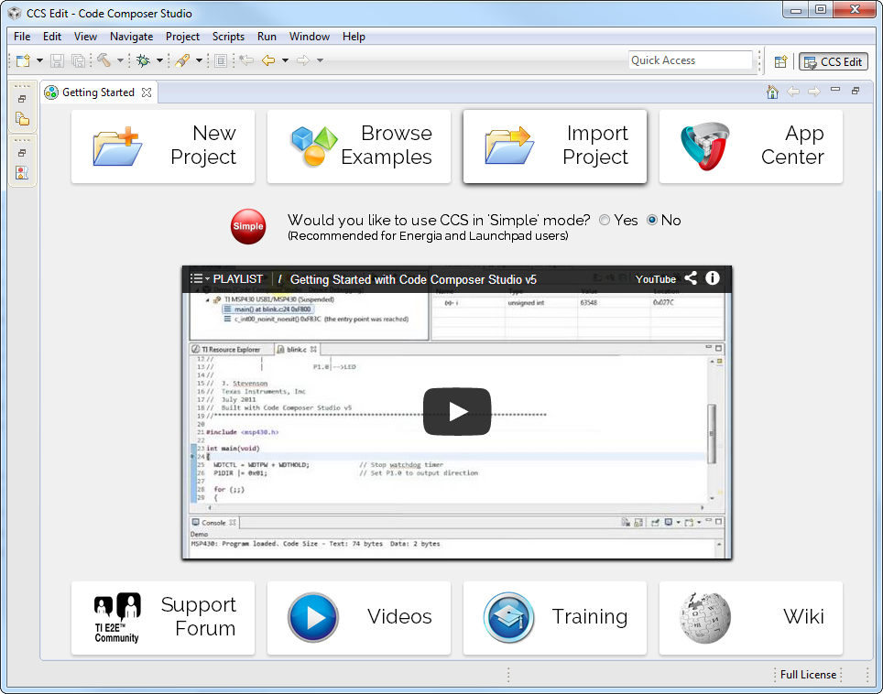
Getting Started View
Initial screen visible when Code Composer Studio is launched
Provides fast access to common tasks
  Create a new project
  Use a example
  Open the App Center…
Embedded Getting Started Video walks users through the basics of using CCS
Links to support, videos and training material

Slide 8
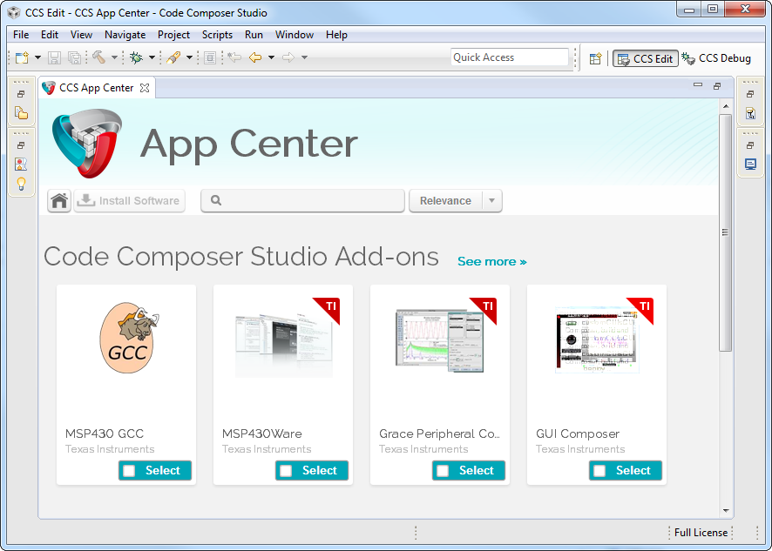
CCS App Center
Access to additional products
  “Wares”
  SDKs
  New features
Keep products up to date from within CCS
Further reduce CCS download size
Great way to promote features

Slide 9
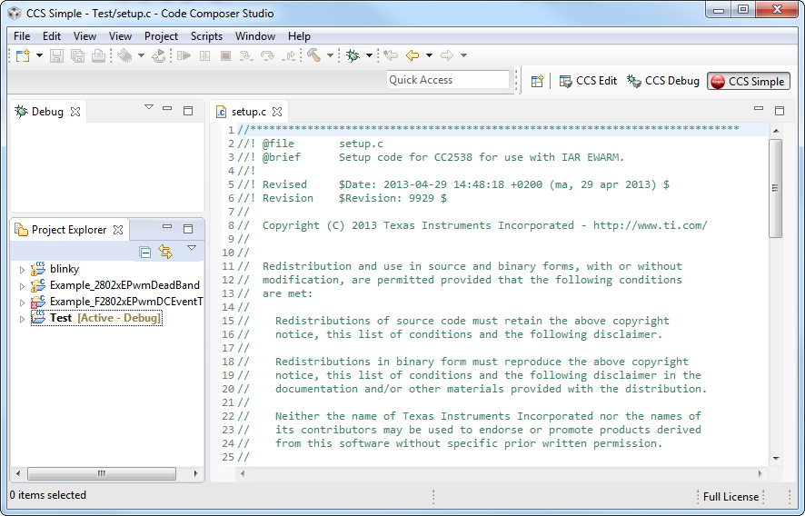
“Simple” Mode
Enabling “Simple” mode reduces the environment to just essential functionality
Makes it easier for new users, especially LaunchPad type customers to start using the CCS environment

Slide 10
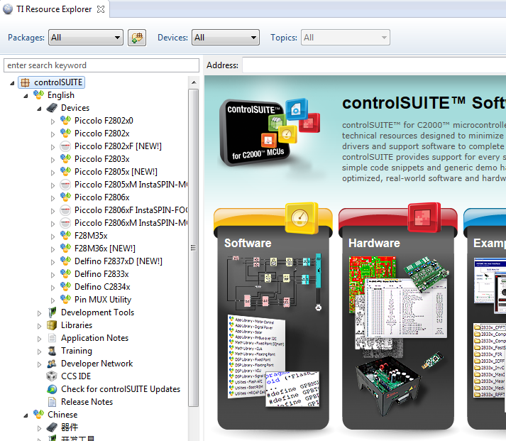
Resource Explorer
Easily access a broad selection of packages such as controlSUITE, MSP430ware, TivaWare, TI-RTOS…
Guides you step by step through using examples
Provides links to documentation, videos and other collateral

Slide 11
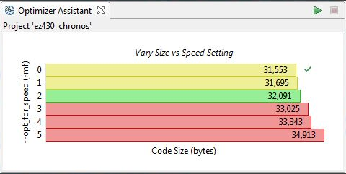
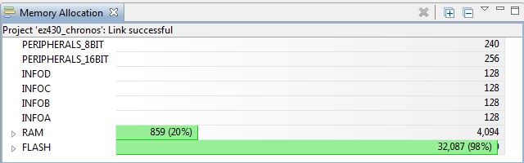
Optimizer Assistant
Provides advice on how to get the best performance for available code size
Graphical display of memory usage
CCS APPS

Slide 12
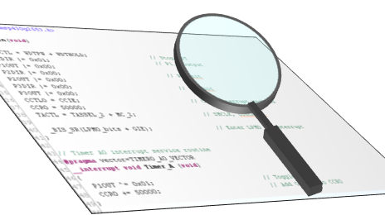
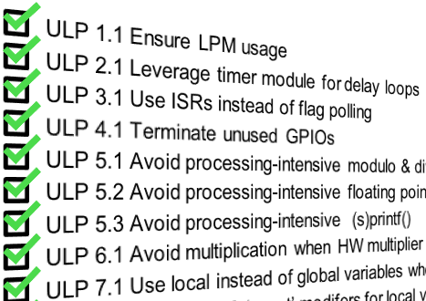
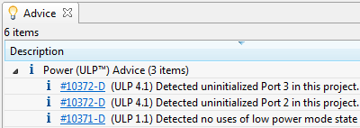
ULP (Ultra Low Power) Advisor
Turning MCU developers into Ultra-Low-Power experts
ULP Advisor analyzes all C code line by line.
Checks against a thorough Ultra-Low-Power checklist.
Highlights areas of improvement within code.
Can benefit any application
Checks all code within a project at build time
Enabled by default
Parses code line-by-line
List of 15 Ultra-Low-Power best practices
Compilation of ULP tips & tricks from the well-known to the more obscure
Combines decades of Ultra-Low-power development experience
Identify key areas for improvement
Listed in the “Advice” view
Includes a link to more information
www.ti.com/ulpadvisor

Slide 13
Code Composer Studio Licenses
Free options:
  90 day evaluation
  MSP430: 16KB Code Size Limited with the optimizing TI compiler
  MSP430: unlimited code size with GCC
  When using XDS100 JTAG emulators
  Tied to development kits with onboard emulation (not for MSP430)
Purchase professional tools:
  Starting at $495
  Node Locked License (tied to a PC)
  Floating Licenses available (shared licenses)
  www.ti.com/ccstudio

Slide 14

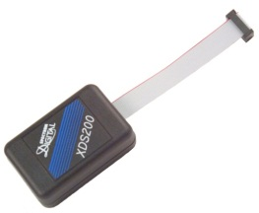
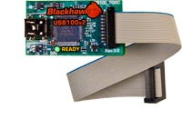
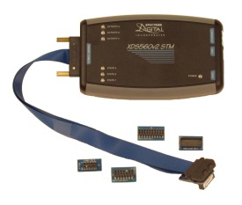
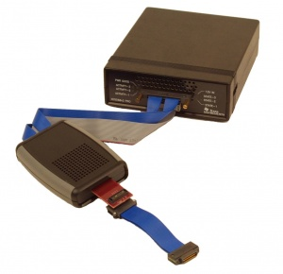
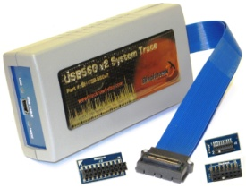
XDS Debug Probes
  Entry level JTAG emulator
  USB interface
  3 models based on JTAG headers (14pin TI, 20pin TI, 20/10pin ARM)
  $79
  Excellent balance of performance and cost
  USB interface (Ethernet version available)
  20pin TI, 14pin TI, 20pin ARM and 10pin ARM connectors
  $295
XDS100v3 – Entry Level
XDS200 – Mid Range
  USB or USB + Ethernet interfaces
  Includes multiple JTAG adapters (14pin TI, 20pin TI, 20pin ARM, 60pin MIPI, some include 60pin TI)
  System Trace
  $995 - $1495
  Trace Receiver & XDS560v2 JTAG emulator
  USB + Ethernet interfaces
  MIPI60 and 60pin TI adapters
  DSP, ARM & System Trace to pins
  $3495
XDS560v2 – High Performance
Pro Trace

Slide 15
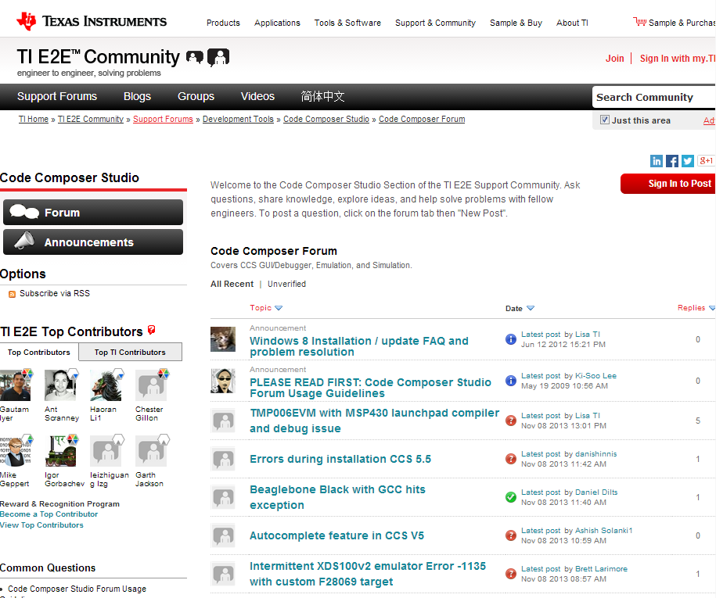
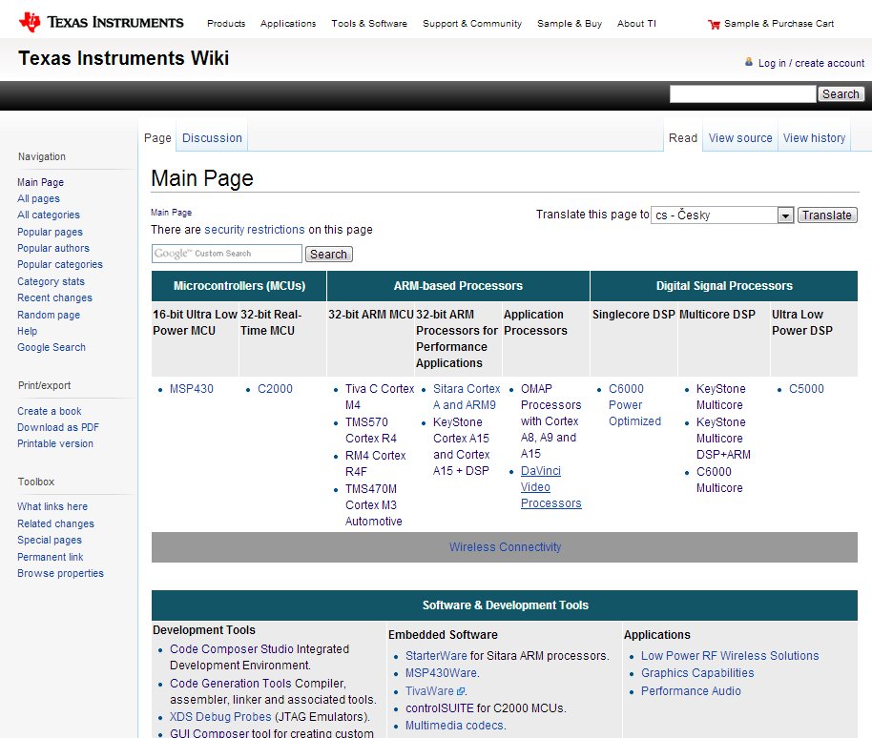
Extensive Support
E2E Community
Wiki
Videos, Blogs, Forums
Global customer support
Search for answers
http://e2e.ti.com
Technical articles
Training
Design ideas
http://processors.wiki.ti.com

Slide 16
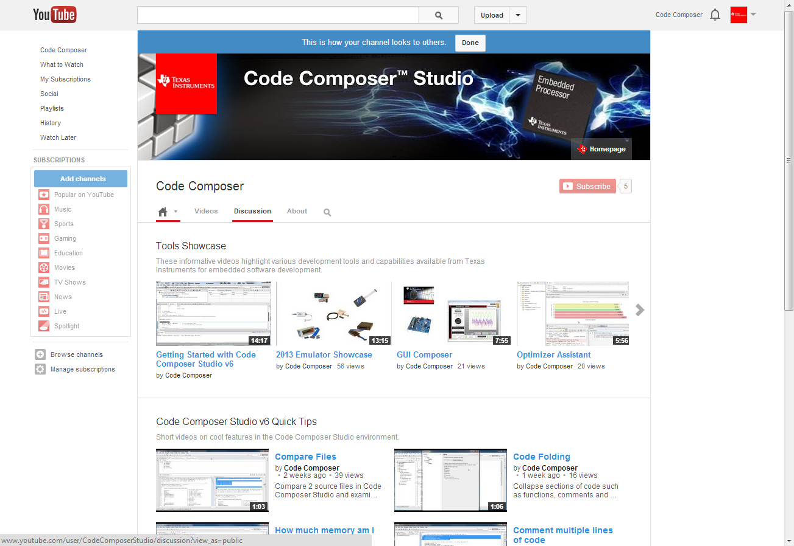
YouTube Channel

Slide 18
GETTING STARTED WITH CCSv6 AND CC2650
Notes:
18

Slide 19
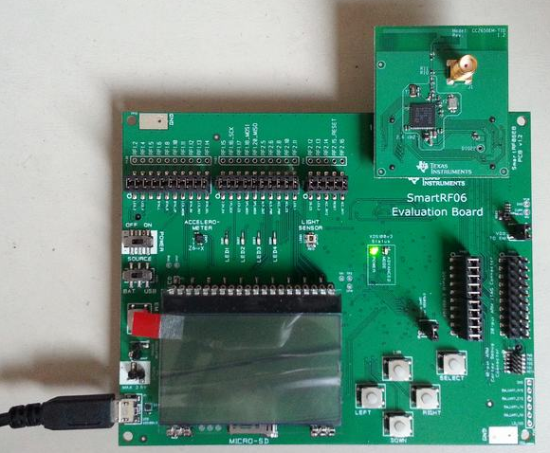
  CC2650EM-7ID + SmartRF06EB Setup
Software:
  Code Composer Studio v6.1.0 or greater
    With all Wireless Connectivity components installed
  TI-RTOS for SimpleLink Wireless MCUs
  PER Test package
Hardware:
  CC2650EM-7ID with SmartRF06EB
    Device rev PG 2.2+
    Lab 4 requires two such targets!
Power Switch
USB JTAG Connection

Slide 21
Lab Setup
Refer to the Lab Requirements and Setup section in your Lab Handbook for more details
Notes:
21

Slide 23
Getting Started:
LCD SmartRF06EB Example
Notes:
23

Slide 24
Getting Started: Exercise Summary
Key Objectives
  Import and build the LCD SmartRF06EB example program
  Start a debug session and load/flash the program to the target
  Run the program
Tools and Concepts Covered
  Workspace
  Resource Explorer
  Building example projects
  Running example projects
Notes:
24

Slide 25
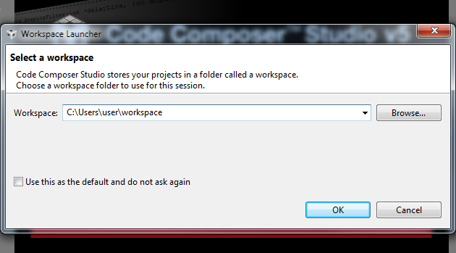
Workspace
Launching CCS for first time requires you to select a workspace folder
  Defaults to your user folder
Notes:
25

Slide 26

Eclipse Concept: Workspaces
Main working folder for CCS
Contains information to manage all the projects defined to it
  The default location of any new projects created
User preferences, custom perspectives, cached data for plug-ins, etc all stored in the workspace
Multiple workspaces can be maintained
  Only one can be active within each CCS instance
  The same workspace cannot be shared by multiple running instances of CCS
  It is not recommended to share workspaces amongst users
Notes:
26

Slide 27
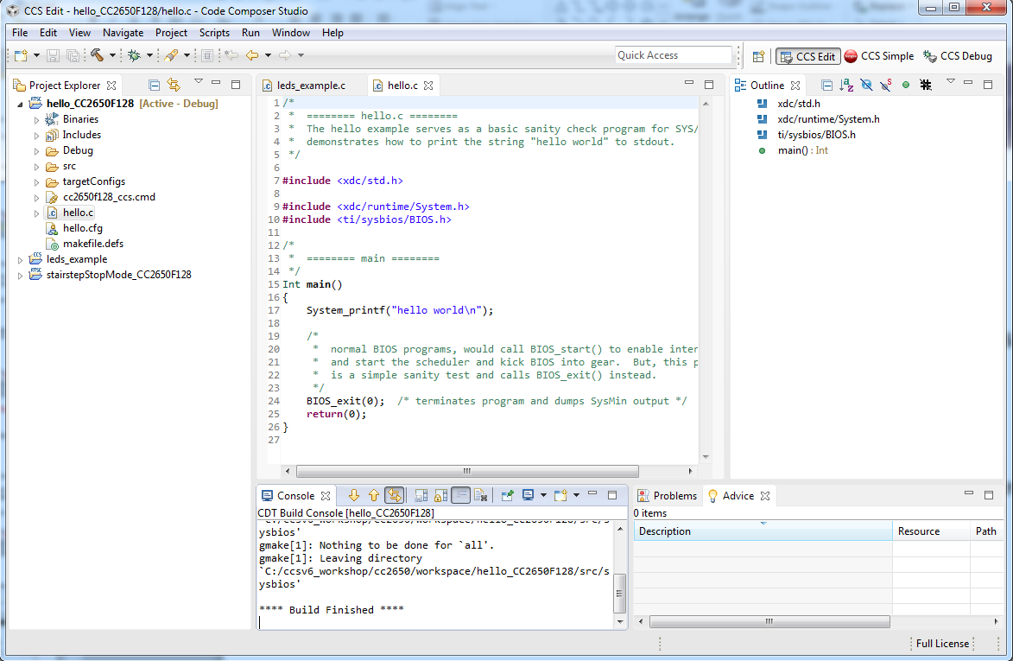
Eclipse Concept: Workbench
Workbench refers to the main CCS GUI window
The Workbench contains all the various views and resources used for development and debug

Slide 28
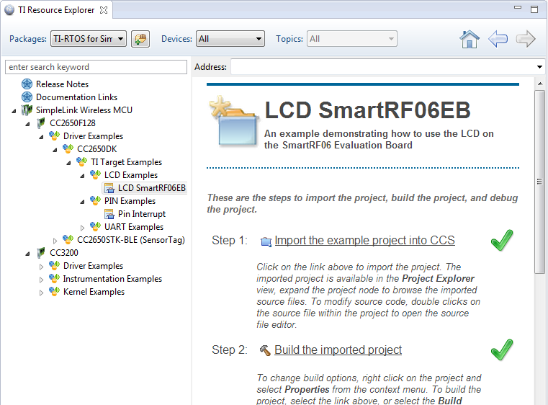
View: Resource Explorer
Easily access a broad selection of software packages including:
  controlSUITE
  MSP430ware
  TivaWare
  TI-RTOS
Guides you step by step through using examples
Browse resources:
  Documentation
  Videos

Slide 29
Eclipse Concept: Projects
Projects are typically a collection of files and folders
Files/folders can be added or linked to the project
  Adding file/folder to project
    Copies the file into your project folder
      Any file physically in the project folder is considered part of the project
  Linking file/folder to project
    Makes a reference to the file in your project (file stays in original location)
Projects are either open or closed
  Closed Projects:
    Still defined to the workspace, but it cannot be modified by the Workbench
    Closed projects require less memory and are not scanned during routine activity
Projects that are not part of the workspace must be imported into the active workspace before they can be used
http://processors.wiki.ti.com/index.php/Projects_and_Build_Handbook_for_CCS#Projects_Overview
Notes:
29

Slide 30
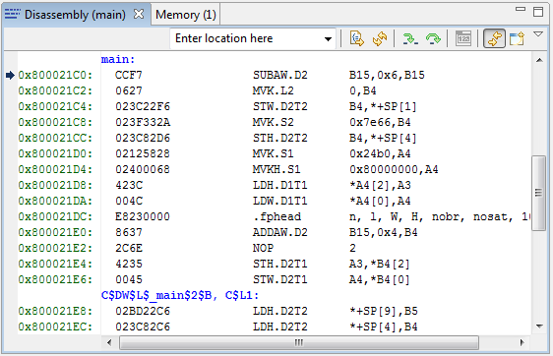
Eclipse Concept: Views
Views are windows within the main Workbench window that provide visual representation of some specific information
  Most views can be accessed in the menu View
  Can be identified by the organization in tabs
Active tab (in focus)
Inactive tab
(out of focus)

Slide 31
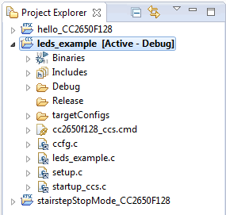
View: Project Explorer
Displays all projects defined in the active workspace
The view is a loose representation of the file system of the project folder
  Linked files are marked with a special link graphic in the icon
Files can be easily referenced and opened from the Project Explorer view

Slide 32
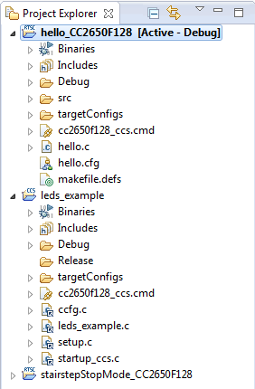
Eclipse Concept: Focus
Focus refers to the highlighted portion of the workbench
  Can be an editor, a view, a project, etc.
This concept is important since several operations inside Eclipse are tied to the element in focus
  Project build errors, console, menu and toolbar options, etc.
hello_CC2650F128 project is in Focus since it has been selected. So pressing the Debug button will build the project and start the debugger for the hello_CC2650F128 project. Note how the project in focus is also highlighted in bold and with the word Active next to it for easy identification

Slide 33
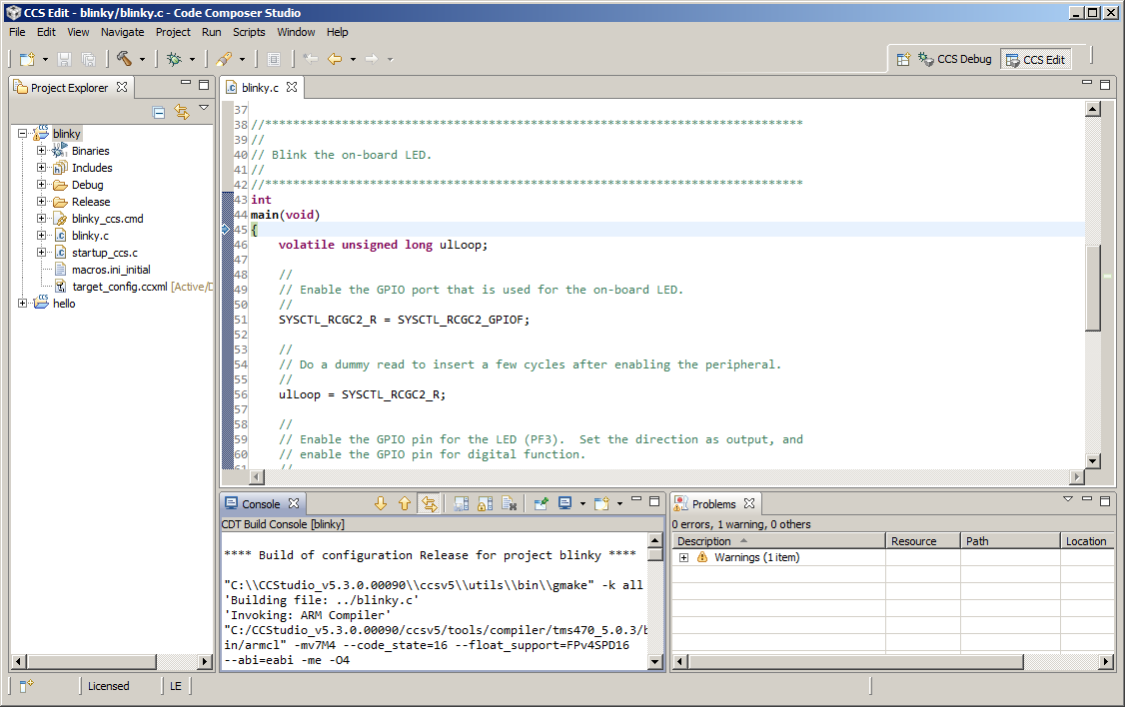
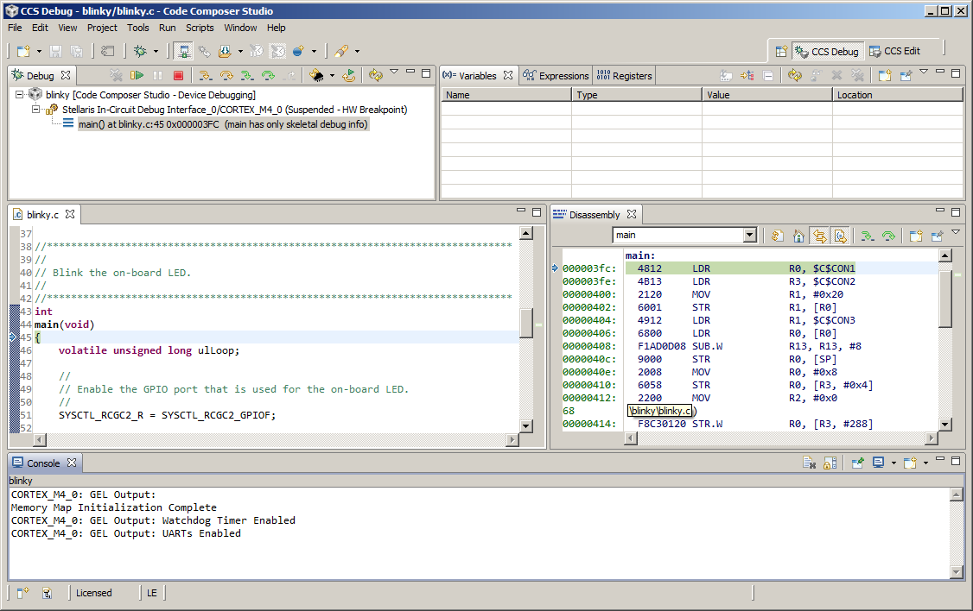
Eclipse Concept: Perspectives
Defines the initial set and layout of views in the Workbench window
Each perspective provides a set of functionality aimed at accomplishing a specific type of task (CCS Edit for project development, CCS Debug for debugging, etc)
  CCS will automatically switch to the CCS Debug perspective when the debugger is started
Can create custom perspectives

Slide 34
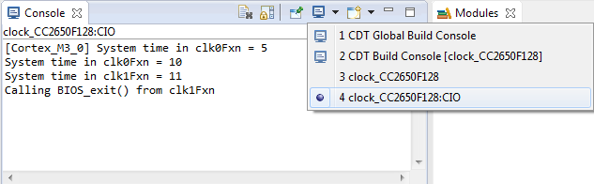
View: Console
Multiple contexts
  Can display build messages or debug messages (including C/IO) depending on which console is selected
  Automatically switches contexts when a new message occurs
    Can use the Pin option to prevent this
You can open multiple Console views
  C/IO output in one and build messages in the other
Notes:
34

Slide 35
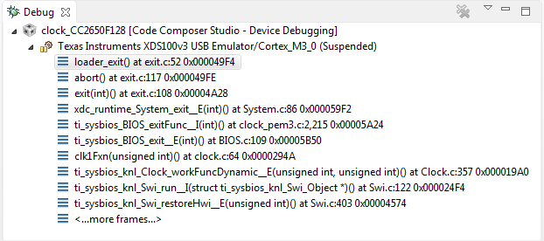
View: Debug
Main debug interface (must be open to control the target)
Debug view displays:
  Target configuration or project
  Call stack
Notes:
35

Slide 36
Lab 1A: Getting Started: LCD SmartRF06EB Example
15 minutes
Refer to the Lab 1A section in your Lab Handbook for instructions
Notes:
36

Slide 38
More basics:
LCD SmartRF06EB Example
Notes:
38

Slide 39
More Basics: Exercise Summary
Key Objectives
  Use the Memory Allocation view to determine code size usage
  Analyze the advice from the Optimizer Assistant in the Advice view
  Enable optimization in the Project Properties
  Get familiar with Simple Mode
Tools and Concepts Covered
  Memory Allocation view
  Optimizer Assistant
  Advice view
  Project Properties
  Simple Mode
Notes:
39

Slide 40
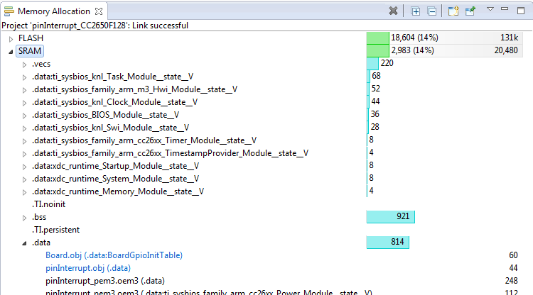
View: Memory Allocation
Graphically displays the memory allocation details of the selected project
  Can provide recommendations for alternative object placements for cases where memory allocation failed
  Created by reading the data from a linker generated xml file
  Shows memory usage of FLASH/RAM
Expand top nodes to show breakdown of each section

Slide 41
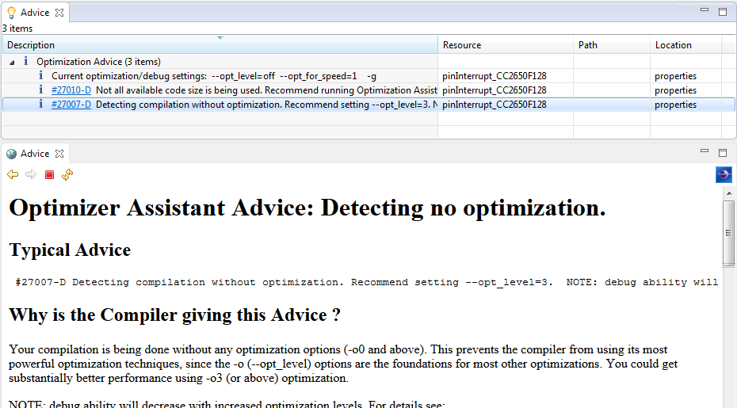
View: Advice
Main dashboard for the Optimizer Assistant suite of tools
  Optimizer Assistant: Generated advice from the compiler to improve application code size and/or performance
    http://processors.wiki.ti.com/index.php/Optimizer_Assistant
  The Advice view displays the generated advice from the Optimizer Assistant
Entries can be selected to provide more details or even apply changes (apply compiler options) when applicable

Slide 42
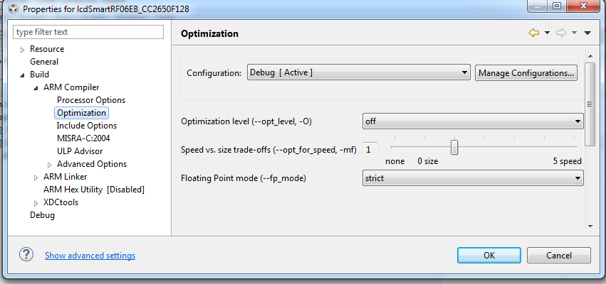
Project Properties
The Project Properties dialog contains all the setting that apply to the project
  Settings such as all compiler/linker options, pre/post build steps, project dependencies, device/connection information, and more can be set from this dialog
  The dialog is accessible by right-clicking on a project in the Project
  Explorer view and selecting Properties
Device and high level settings
Compiler Options
Linker Options

Slide 43
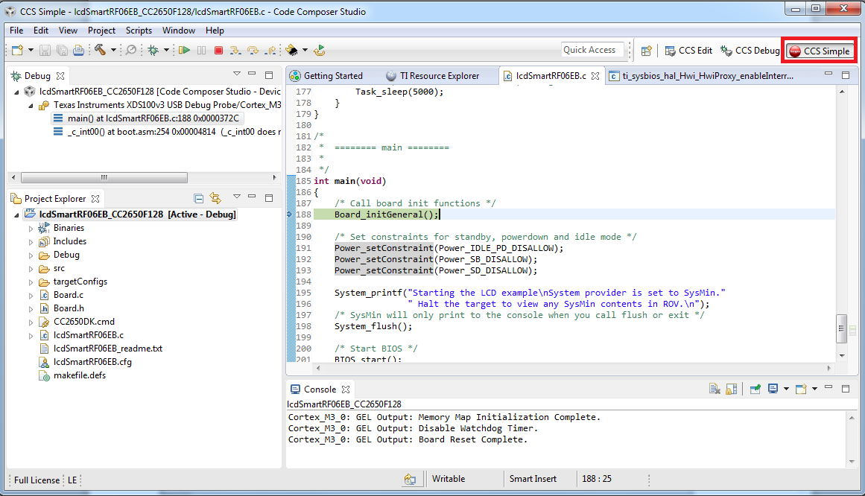
Perspective: CCS Simple
Single perspective that combines just the most common features of the CCS Edit and CCS Debug perspectives
  Simplifies the environment for new users
  Avoid perspective switching when starting a debug session

Slide 44
Lab 1B: More basics:
LCD SmartRF06EB Example
15 minutes
Refer to the Lab 1B section in your Lab Handbook for instructions
Notes:
44

Slide 46
basic debug:
Pin Interrupt Example
Notes:
46

Slide 47
Basic Debug: Exercise Summary
Key Objectives
  Debug the Pin Interrupt example
  Basic Profiling
Tools and Concepts Covered
  Basic Debug
  Breakpoints/Watchpoints
  Event Counters
Notes:
47

Slide 48
Breakpoints Types
Software (SW) Breakpoints
  Implemented as an opcode replacement
    Limited to RAM
  (Generally) no limit to the number of software breakpoints available
  Intrusive
Hardware Breakpoints
  Implemented internally by the hardware (on-chip emulation module)
  Limited number (varies with on-chip emulation module)
  Two types of hardware breakpoints
    Program: Monitor activity at a program address (or addresses)
    Data: Monitor activity at a data address (also known as ‘watchpoints’)
  Non-intrusive
http://processors.wiki.ti.com/index.php/How_Do_Breakpoints_Work#Hardware_vs._Software_Breakpoints
Notes:
48

Slide 49
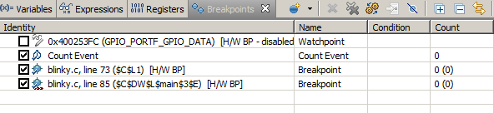
View: Breakpoints
View all available breakpoints
  Watchpoints and HW Event Counters can be also controlled and viewed
Enable/Disable individual breakpoints
Access/modify breakpoint properties
  Set conditions to trigger
  Specify various actions when the breakpoint is triggered
    Refresh All Windows or update a specific view
    File I/O
    Run a GEL expression
Notes:
49

Slide 50
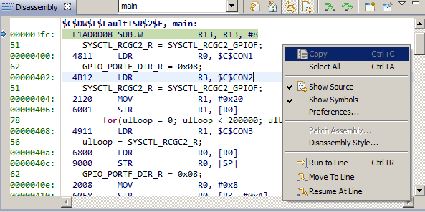
View: Disassembly
View disassembled code, optionally interleaved with C source
Toggling the Show Source button toggles interleaved C source with the disassembly
Type symbol names (such as main) in the address field to view code at that address
Notes:
50

Slide 51
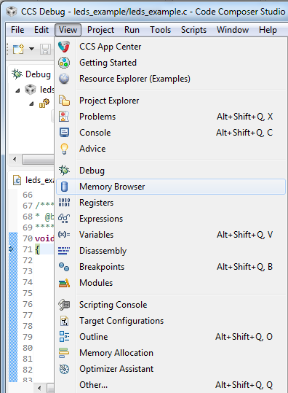
More Debugging
Many other debugging specific views are available from the View menu
  Memory Browser: View the contents of
  memory
  Registers: View register values
  Disassembly: View disassembled code
  Breakpoints: View breakpoints
  Modules: Browse loaded debug symbol
  information
Notes:
51

Slide 52
Debugger Options
Many debugging features can be enabled/disabled from the Debugger Options
During a debug session in the CCS Debug perspective:
  Tools -> Debugger Options
Configure a variety of debug options like [enable/disable]:
  Auto-run to a label (main)
  Auto-connect to a HW target
  Program verification on load
  Reset target on program load or restart
  Halt target on debugger access (disable real-time accesses)
  etc…
Use the Remember My Settings option to have the settings apply for subsequent debug sessions
Notes:
52

Slide 53

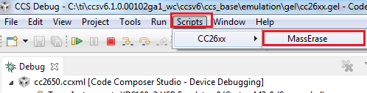
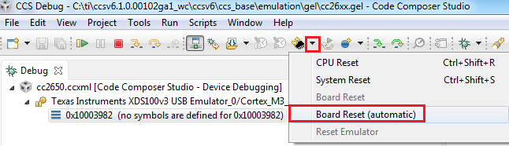
Debugging Tips & Tricks on CC2650
Mass Erase option is available under Scripts -> CC26xx -> MassErase
  Erases the device flash: Issues a board reset before erasing the device flash and disconnecting from the target
Board Reset is recommend to properly reset the device (CPU and System Reset does NOT completely reset the device)
Notes:
53

Slide 54
Lab 2: basic debug:
Pin Interrupt Example
30 minutes
Refer to the Lab 2 section in your Lab Handbook for instructions
Notes:
54

Slide 56
REAL-TIME DEBUG:
LCD SmartRF06EB Example
Notes:
56

Slide 57
Real-Time Debug: Exercise Summary
Key Objectives
  Demonstrate how to access/modify memory in real time when processor is running
Tools and Concepts Covered
  Real-time access to memory
  Continuous refresh in views
Notes:
57

Slide 58
What is Real-Time Debug?
Stop Mode Debug (traditional debugging)
  require the processor to be completely halted to access memory and registers
  stops all threads and prevents interrupts from being handled
Stop Mode can be used as long as system/application does not have real-time constraints, but is very undesirable for real-time applications
Real-time Debug enables programmers to:
  examine and modify contents of memory/register locations while CPU is running and executing code
  halt/debug application while allowing user specified time critical interrupts to be serviced without interference
Real-time debug capabilities vary by device and are supported via different methods
Notes:
58

Slide 59
Real-Time Debug Capabilities on CC26xx
Access to memory while the processor is running
  Supported through the DAP (Debug Access Port)
    DAP is part of the ARM emulation logic and enables the debugger to access memory of the device without requiring the processor to enter the debug state
    CCS will use the DAP under the hood to make real-time memory accesses
  Default behavior of CCS is to always make a real-time access to memory
Notes:
59

Slide 60
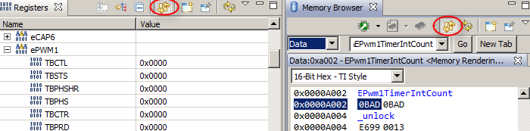
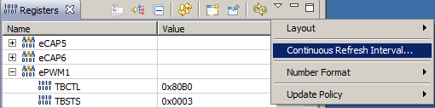
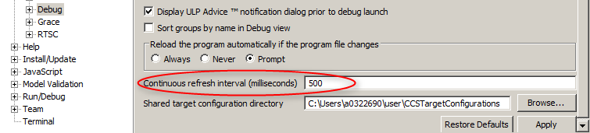
Viewing Real-Time Accesses with CCS
To enable/view real-time access to memory and registers, click on Continuous Refresh in Memory Browser and Registers view in CCS
Continuous Refresh will periodically refresh the debug views
  Default refresh interval is 500 ms
  Default refresh interval is configurable
Notes:
60

Slide 61
Lab 3a: REAL-TIME DEBUG:
LCD SmartRF06EB Example
15 minutes
Refer to the Lab 3A section in your Lab Handbook for instructions
Notes:
61

Slide 63
RTOS Object View (ROV):
LCD SmartRF06EB Example
Notes:
63

Slide 64
ROV: Exercise Summary
Objectives
  Get familiar with using ROV (RTOS Object View) to inspect state of the scheduler, threads and objects in the system
Tools and Concepts Covered
  RTOS Object View (ROV)
Notes:
64

Slide 65
What is TI-RTOS?
One-stop solution for developing applications on TI processors and microcontrollers
Combines real-time kernel with additional middleware components such as TCP/IP and USB stacks, FAT file system, and device drivers
Includes several examples that can be used as starting point
Contains the following components:
  SYS/BIOS, UIA, MSP430Ware, MWare, NDK, TivaWare, etc
More details and download available at
  http://www.ti.com/tool/ti-rtos

Slide 66
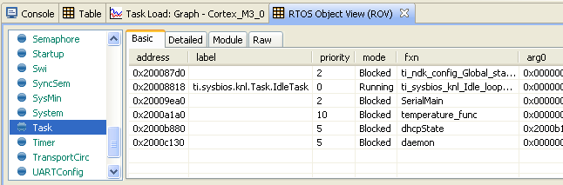
RTOS Object View (ROV)
Provides state information about the modules used by the application
Stop mode debugging tool
Invoked from CCS menu Tools -> RTOS Object View (ROV)

Slide 67
Lab 3b: rov:
LCD SmartRF06EB Example
15 minutes
Refer to the Lab 3B section in your Lab Handbook for instructions
Notes:
67

Slide 69
multi-target deBug:
Per Test Example
Notes:
69

Slide 70
Multi-Target Debug: Exercise Summary
Key Objectives
  Create a single custom target configuration file for two CC2650F128+SmartRF06EB targets
  Learn the basic concepts of:
    Target configurations
    Project-less debugging
    Multi-target debugging
Tools and Concepts Covered
  Target Configurations view
  Advanced Target Configuration Editor
  Starting a project-less debug session
  Working with executables generated from other tool chains
  Specifying debug source search paths
  Multi-target Debug
NOTE: This lab requires two targets (CC2650EM-7ID+SmartRF06EB)
Notes:
70

Slide 71
Target Configuration Files - Basics
Target Configuration files are xml files that define the connection and device (have a file extension *.ccxml)
The Target Configurations view is used to manage and work with target configuration files
Target Configuration Editor is used to create/modify target configuration files
  Basic tab is intended to be used by majority of end users
  Advanced tab is intended to be used for adjusting default properties, initialization scripts or creating target configurations for new boards/devices
Target Configurations can be part of a project or in the user defined default location
  A user defined target configuration can be linked to a project

Slide 72
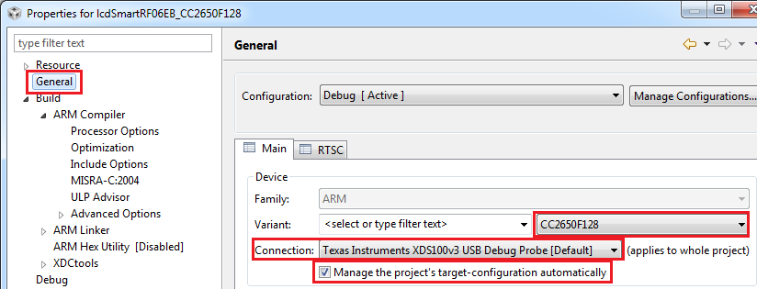
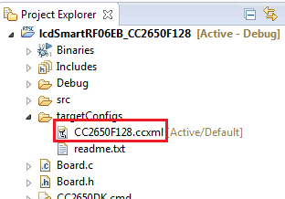
Target Configuration Files - Basics
Target Configurations will be generated and maintained by the project if the following is specified in the project properties:
  Device Variant and Connection type
  The Manage the project’s target-configuration automatically option is enabled
Generated project target configuration files will be created in the targetConfigs subfolder

Slide 73
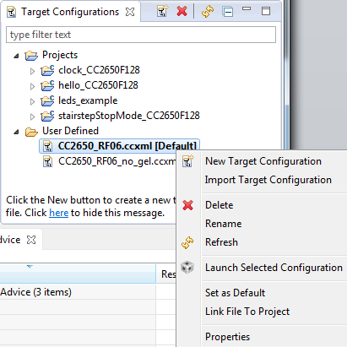
View: Target Configurations
All known target configuration files are easily deleted, copied and opened for inspection (XML files)
Launch a debug session quick (with no project association): right-click on target configuration and select Launch Selected Configuration
Debug will use target configuration
that is identified with [Default] tag in
Target Configurations view if there
is no target configuration file associated
with the active project
  Right-click on a file and select Set as
  Default to make it the default
To associate an existing user defined
file to a project: Right-click on the target
configuration and select Link File To
Project

Slide 74
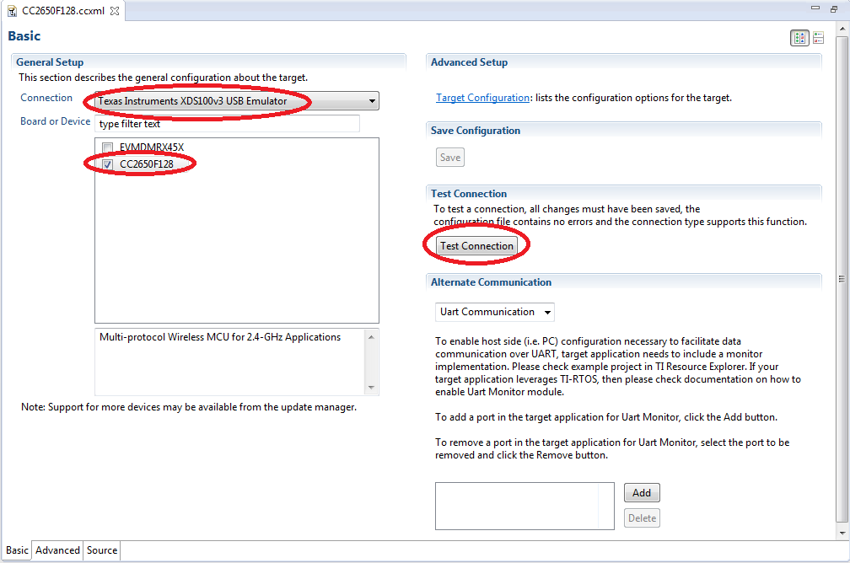
View: Target Configurations Editor
1. Select your Connection (emulation)
3. Save the file
2. Select your device
4. Test/verify your target connection

Slide 75
Target Configurations - Advanced
Use the Advanced setup utility if option for your emulator/target is missing from the Basic setup utility
  Select from a list of available Connections to specify the connection type
  Then select from the list of components (Devices, CPUs, Routers) to add to the connection
Use the Advanced setup to create a single target configuration using two emulators
  Example: A single target configuration file for two separate XDS100v3 connections (each communicating to a separate SmartRF06EB+CC2650F128 target board)
Must have good knowledge of the device to correctly use the Advanced setup utility to build a configuration

Slide 76
Target Configurations - Advanced
Adjust default properties of the target configuration:
  Specify initialization files (GEL startup files)
  Specify IcePick subpath port numbers
  Bypass CPU
  Set JTAG TCLK Frequency
  etc

Slide 77
GEL
‘C’ like scripting language that extends CCS functionality
  Many built-in GEL functions for common debug actions
Interfaces to debuggers expression evaluator
  You can enter expressions in:
    GEL file
    Expressions view
    Conditions on breakpoints
‘Startup’ GEL file:
  Used to automate debugger and target initialization steps when launching the debugger
  Many default files provided with CCS and automatically used in a Target Configuration file
    Will be automatically run if it is part of the Target Configuration file
  Create custom menu items for specific debugger actions
  Advanced users may modify the Startup GEL file to perform additional options if desired
    Most standard users will likely not need to modify the file
http://processors.wiki.ti.com/index.php/GEL

Slide 78
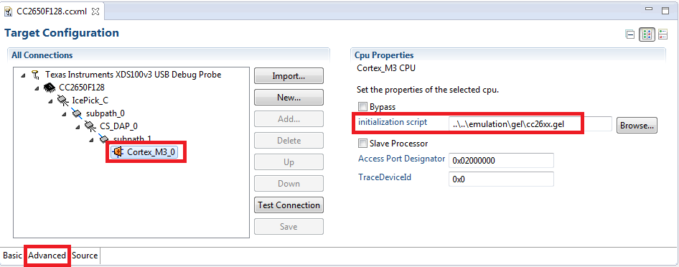
Target Configurations – Advanced – Examples: Startup GEL File
Startup GEL file is specified at the CPU level

Slide 79
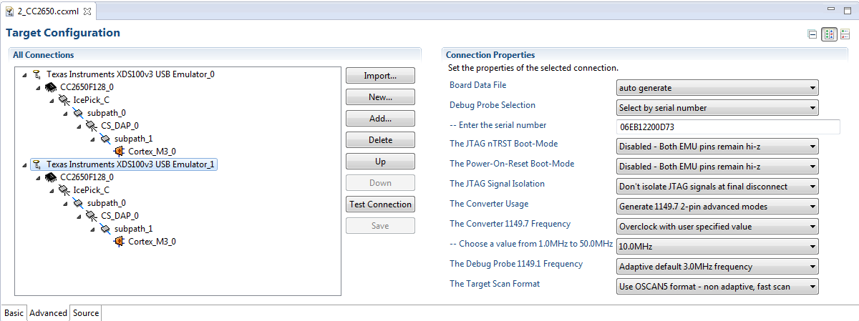
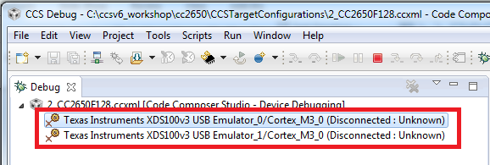
Target Configurations – Advanced
Example: Using 2 XDS100v3 Connections
Single target configuration for two CC2650F128 targets, each with their own XDS100v3 connection to the debugger
Launching a debug session for this configuration will show all debuggable cores from both emulators

Slide 80
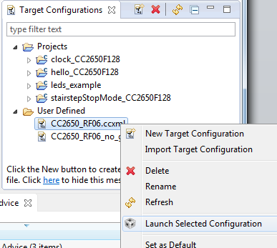
Project-Less Debug Session
This is a debug session where there is no project association
Use project-less debug sessions to debug executables without a CCS project (ex. Projects built outside CCS using standard make or another development environment)
To start a project-less debug session:
  Open the Target Configurations view
  Create a target configuration file if one
  does not already exist
  Right-click on the target configuration
  file and select Launch Selected
  Configuration

Slide 81
Source Debugging Without a Project
For project-less debug sessions, CCS will look for source files using relative path information stored in the debug symbols
  CCS will find the source files if the executable and source files are in the exact same location as when the executable was originally built
If the location of the executable file or source (or both) has changed, CCS may not be able to find the source files
CCS can be instructed where to find the source files one of two ways:
  Tell CCS where the first file is and let CCS find the rest of the files using relative path information in the symbols (recommended method)
  Set Source Lookup Paths for CCS to scan when looking for source files:
    Set for current debug session
    Set for Debug Configuration - apply for every debug session launched by the debug configuration (under the Source options}
    Set at global (workspace) level – apply for any debug session started with this workspace
Notes:
81

Slide 82

Source Debugging Without a Project
If a source file cannot be found during debug, it will be indicated in the editor
Use Locate File… button to browse to the location of the source file
  The debugger can then find other source files in the same location or use relative path information to
  find files relative to the
  current file
  Location is remembered for
  future loads of the same
  program
Notes:
82

Slide 83

More Debugging: Source Lookup Paths
Once the path is known to the debugger, the source file will be
opened in the debugger and other files can be found using relative paths from the first found file
Notes:
83

Slide 84
Multi-Emulator Debug
CCS treats a multi-emulator debug session the same a multi-core debug session
The user can then apply the techniques of debugging a multi-core target to their multi-emulator debug session

Slide 85
Multi-Core Debug
Basics
Embedded Development Tools

Slide 86
Multi-Core Debug Overview
A single debug session may have multiple debuggable cores/CPUs
  A single device that has multiple cores
  A single board that has multiple devices (single or multi core) on the same JTAG scan chain
  Multiple boards, each with their own emulation connection, connected to the same single debug instance
  A combination the above
CCS has the ability to provide debug visibility and control over all debuggable cores from a single debug session called a multi-core debug session
The following material show how to work with a multi-target debug session with 2 SmartRF06RB+CC2650F128 targets

Slide 87

Starting a Debug Session
Project-less Debug Session
  Launch the debugger for a target configuration from the Target Configuration view
  Manually connect / load program to desired CPU
Project Debug Session
  Build the project in context and then launch a debug session for the
  project, connect, and load the application to desired CPUs
    CCS will detect which CPUs match
    the project type and then prompt the
    user asking which CPUs to debug the
    project on (connect, load program)
    The prompt will only appear the first
    time a Debug Configuration is
    launched

Slide 88

Debug View
Debug visibility to all ‘debuggable’ CPUs can be gained through the Debug view
Selecting the stack frame for a particular CPU in the Debug view will give you debug visibility for that particular CPU (set the ‘debug context’ for that CPU)
  Most views in the CCS Debug perspective show data for the debug context
  All debugger commands (run, step, reset, etc) apply to the debug context
  Debugger options (Tools -> Debugger Options) apply to the debug context

Slide 89

Debug Context - Editor
The CCS editor will show the PC location for all CPUs for any shared source files
Solid blue arrow indicates program counter location of the CPU with debug context
“hollow” arrow indicates program counter location of CPU that does not have debug context

Slide 90

Pinning a View to a CPU
You can pin debug session views to the debug context of the currently selected CPU:
  Done using the Pin to Debug Context icon in the view
    The name of the connection and CPU of the debug context will in the view to identify which context the view is “pinned” to
  Change the debug context to another CPU but still have that view still reflect the context of the CPU it is "pinned" to
  Open multiple views of the same kind with each “pinned” to different CPU for quick side-by-side comparison

Slide 91

Use Multiple Workbench Windows
TIP: Open a separate Workbench Windows for a CPU
  Window -> New Window
  All workbench windows reference the same debug server
Window 1 with CPU 1 in context
Window 2 with CPU 2 in context

Slide 92


Grouping CPUs
Combine CPUs into groups to
broadcast debug commands to
multiple CPUs at once
  Synchronous target stepping
  of multiple CPUs can be done
  through a group
Multi-select the CPUs of
interest in the Debug view,
right-click and select Group
core(s) in the context menu
  A Group node will be
  created
Select the Group node in the Debug view to send commands to the group

Slide 93
Grouping CPUs
Group node:
  Control all CPUs in the group by selecting the group node (set debug context to the group)
  Can still control individual CPUs in the group by selecting the specific CPU in the group to get that CPU’s debug context
  Various views may be blank when the group is in context since multiple CPUs will be in context (unless the view is pinned)
Group settings are saved in the Debug Configuration and subsequent launches of the Debug Configuration will remember the group settings

Slide 94
Auto-Grouping CPUs
CCS can also be configured to automatically group CPUs when first prompted to specify which CPUs to load the program on
  Can also specify to make the group a sync group

Slide 95


Hiding CPUs
Hide CPUs that will not be used from
the Debug view
Multi-select the CPUs to hide,
right-click and select Hide core(s)
in the context menu
  Selected CPUs will disappear from
  the Debug view
To Unhide all CPUs, right-click on a
debug context and select Show all
cores in the context menu
Configure CCS to automatically hide
CPUs in the Debug Configurations
options

Slide 96


Breakpoints View
The Breakpoint view will display all breakpoints set for all CPUs by default
Use the Show Breakpoints Supported by Selected Target button to show only breakpoints for the currently selected CPU

Slide 97


Breakpoints View
The Breakpoints view can also display all breakpoints set for all cores and group them by CPU
  This can be enabled by selecting Group By -> Debug Contexts in the options for the Breakpoints view:
This will group breakpoints under their respective cores to easily identify which CPU a breakpoint if set for

Slide 98
Lab 4: multi-target deBug: Per Test Example
45 minutes
Refer to the Lab 4 section in your Lab Handbook for instructions
NOTE: This lab requires two targets (CC2650EM-7ID+SmartRF06EB)
Notes:
98

Slide 100
Questions?

