Slide 1
Code Composer Studio v6
Fundamentals Workshop with Tiva C Connected Launchpad (EK-TM4C1294XL)

Slide 2
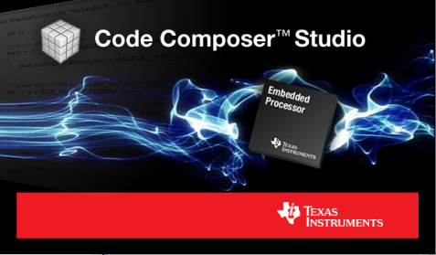
Code Composer Studio
What is Code Composer Studio?
Integrated development environment for TI’s embedded processors supporting all Microcontrollers and Processors in a single environment
A suite of tools including a debugger, compiler, editor…
Based on the Eclipse open source software framework
Eclipse is widely used by many development environments
Offers a rich set of code development tools
TI contributes changes directly to the open source community
Extended by TI to support device capabilities
Integrate additional tools & functionality
OS application development tools (TI-RTOS, Linux, Android…)
Code analysis, source control…

Slide 3
Where does CCS fit in the Ecosystem?
There is a diverse ecosystem of software and tools supporting TI embedded processors (especially ARM based devices)
CCS is a software development environment that is available for all of our embedded processor families
A selection of free CCS options allow users to get started without having to invest a significant amount of money
Support from partner tools is essential to TI success
Some of our partners provide products that offer a differentiated feature set or a feature set tailored to specific market segments
Customers are free to choose the product that best meets their needs or individual preferences

Slide 4
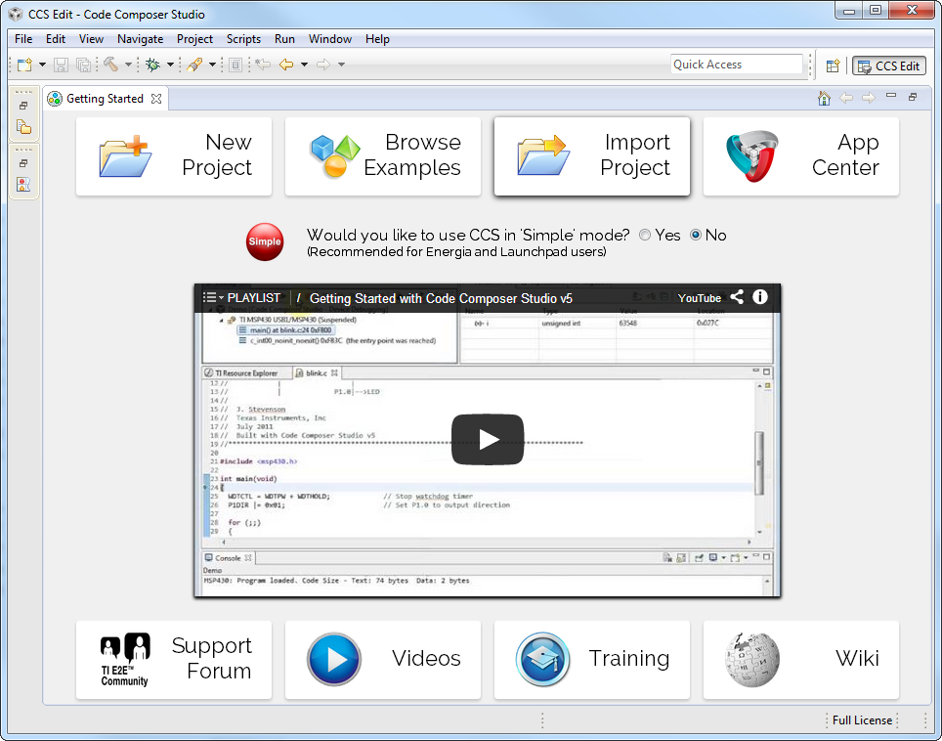
Getting Started View
Initial screen visible when Code Composer Studio is launched
Provides fast access to common tasks
Create a new project
Use a example
Open the App Center…
Embedded Getting Started Video walks users through the basics of using CCS
Links to support, videos and training material

Slide 5
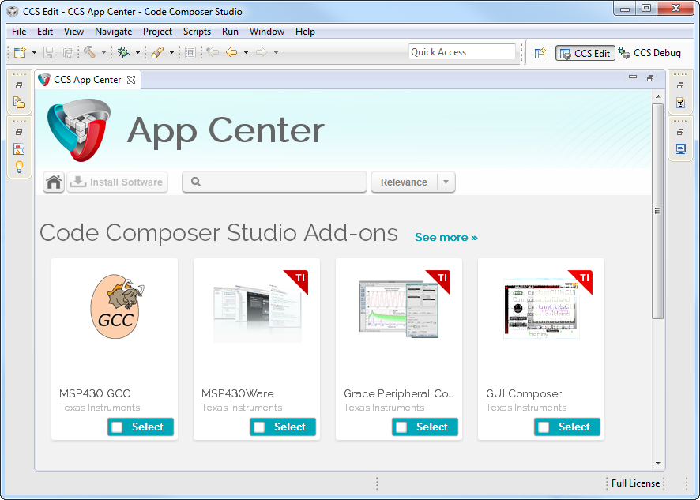
CCS App Center
Access to additional products
“Wares”
SDKs
New features
Keep products up to date from within CCS
Further reduce CCS download size
Great way to promote features

Slide 6
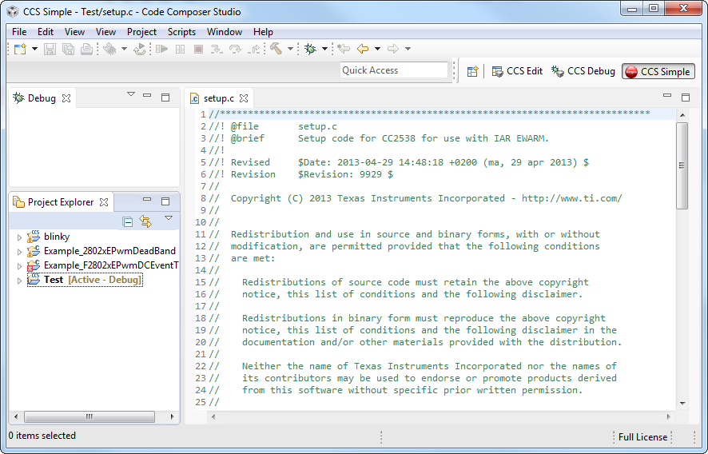
“Simple” Mode
Enabling “Simple” mode reduces the environment to just essential functionality
Makes it easier for new users, especially LaunchPad type customers to start using the CCS environment

Slide 7
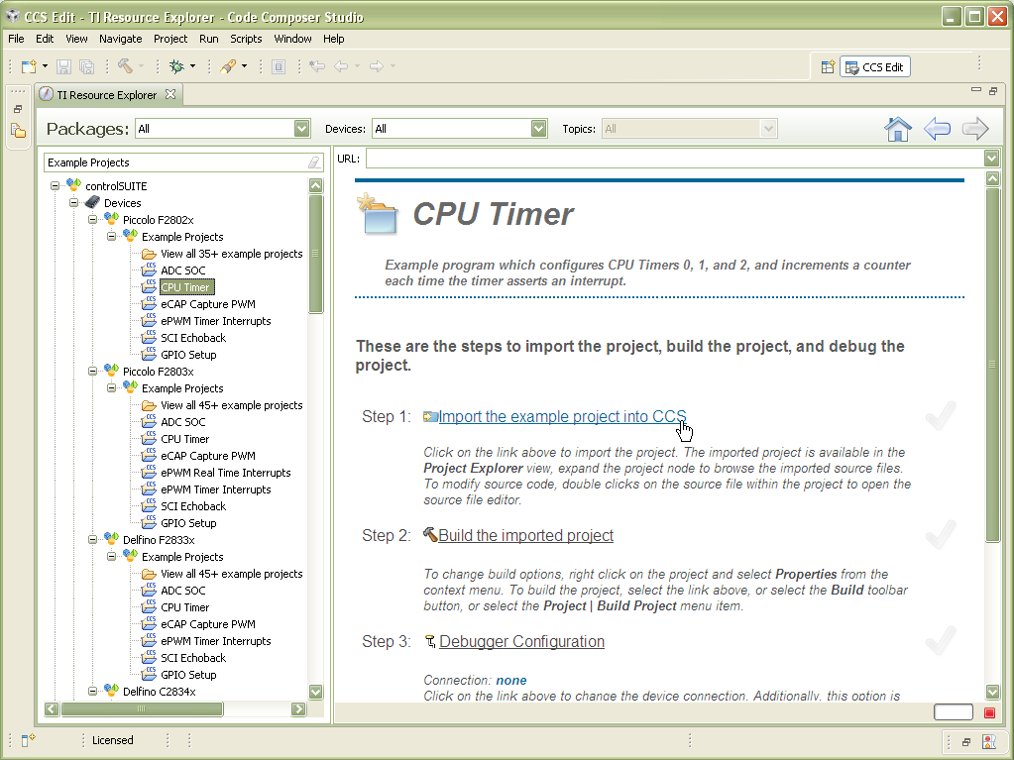
Resource Explorer
Easily access a broad selection of packages such as controlSUITE, MSP430ware, TivaWare, TI-RTOS…
Guides you step by step through using examples
Provides links to documentation, videos and other collateral

Slide 8
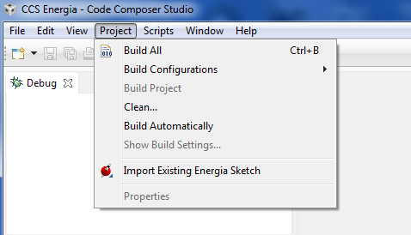
Energia Support in CCSv6
Import existing Energia sketches
Leverage existing work
You can build/edit/debug Energia projects inside CCS
Provide more debugging capabilities
JTAG debug
Register display
See the generated code
Keep it simple
CCS will most likely be customer’s second debugger ever used and their first full software development environment
Recommended to use “Simple” Mode

Slide 9
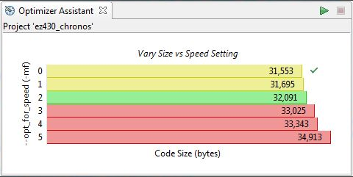
Optimizer Assistant
Provides advice on how to get the best performance for available code size
Graphical display of memory usage
CCS APPS

Slide 10
Code Composer Studio Licenses
Free options:
90 day evaluation
MSP430: 16KB Code Size Limited with the optimizing TI compiler
MSP430: unlimited code size with GCC
When using XDS100 JTAG emulators
Tied to development kits with onboard emulation (not for MSP430)
Purchase professional tools:
Starting at $495
Node Locked License (tied to a PC)
Floating Licenses available (shared licenses)
www.ti.com/ccstudio

Slide 11
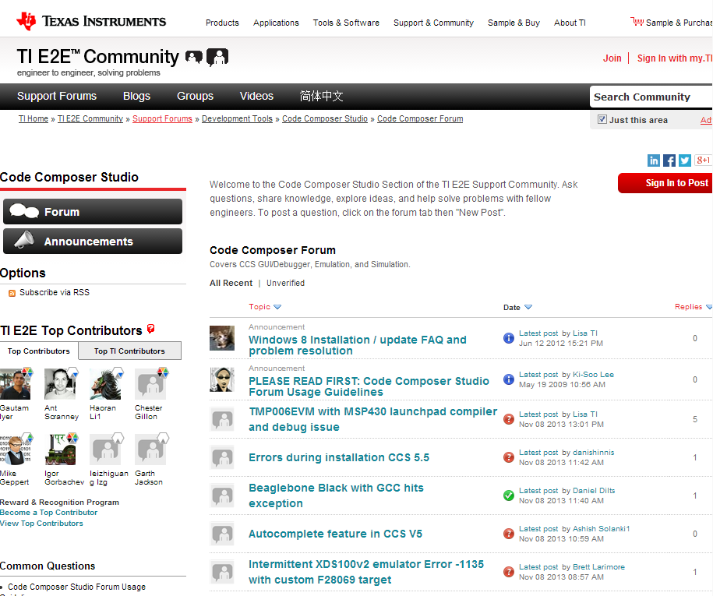
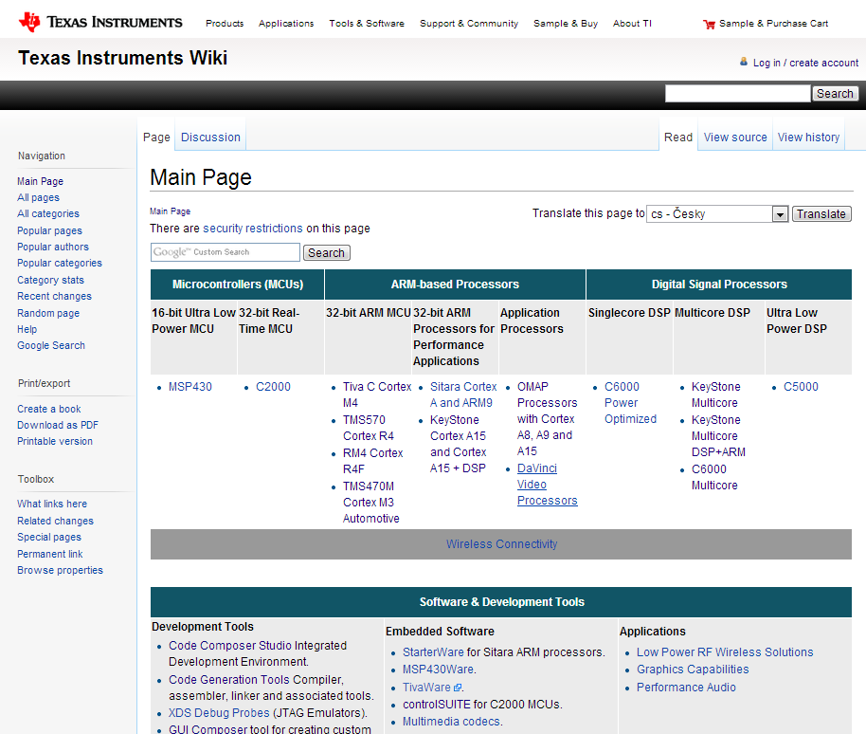
Extensive Support
E2E Community
Wiki
Videos, Blogs, Forums
Global customer support
Search for answers
http://e2e.ti.com
Technical articles
Training
Design ideas
http://processors.wiki.ti.com
Notes:
Wiki:
Same infrastructure as Wikipedia.
Wealth of technical articles
E2E Community:
Conversation oriented. You can post a question and get answers within a community. We have experts monitoring posts and answering questions.

Slide 12
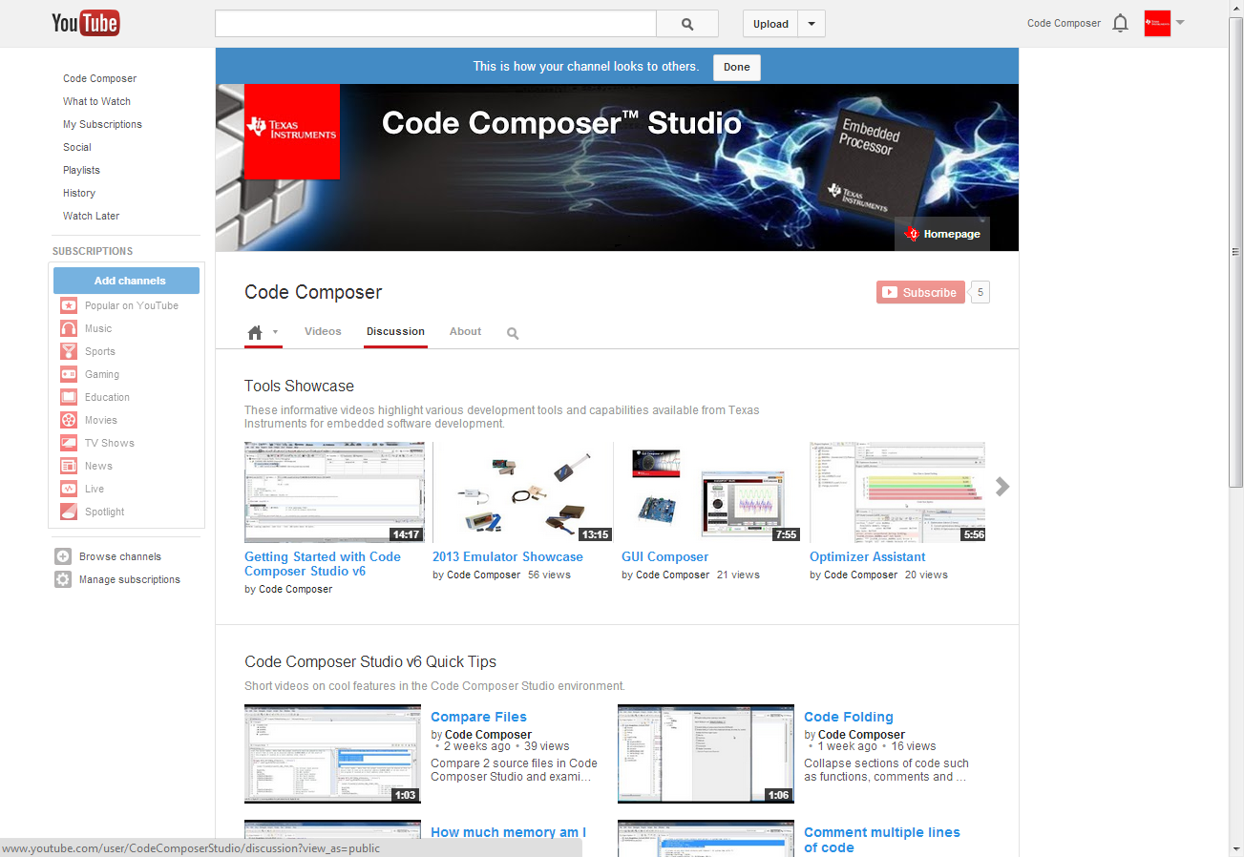
YouTube Channel

Slide 13
Getting Started with CCSV6 and TIVA C CONnected LAUNCHPAD
Notes:
13

Slide 14
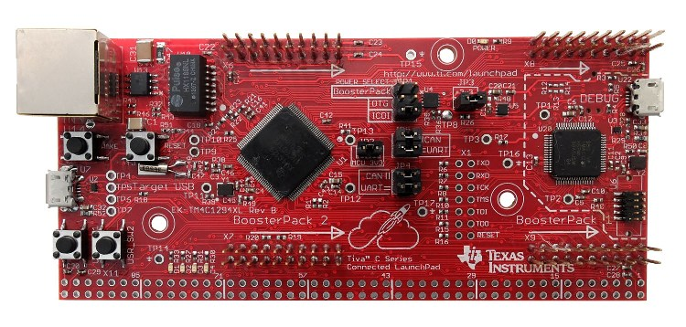
What is Tiva C Connected Launchpad?
Low-cost evaluation platform for ARM Cortex M4-based microcontrollers
Complete development environment that features all of the hardware and software necessary to develop applications
Uses TM4C1294NCPDT microcontroller
On-board In-Circuit debug interface (ICDI)
Website for more details: http://www.ti.com/tool/ek-tm4c1294xl

Slide 15
What is TivaWare?
Extensive suite of software designed to simplify and speed up development of Tiva C Series-based MCU applications
Includes Peripheral Driver library, Graphics Library, USB Library and code examples
Can be downloaded free at: http://www.ti.com/tool/sw-tm4c

Slide 16
BlinkY Example: Basic project debugging
Notes:
16

Slide 17
Blinky Example: Exercise Summary
Key Objectives
Import and build a simple program to blink the on-board LED
Start a debug session and load/flash the program to the Launchpad
Run the program to blink LED
Tools and Concepts Covered
Workspaces
Welcome screen / Resource Explorer
Project concepts
Basics of working with views
Debug launch
Debug control
Profiling Clock Cycles
Local History
Build Properties
Updating compiler tools
Changing compiler versions
Notes:
17

Slide 18
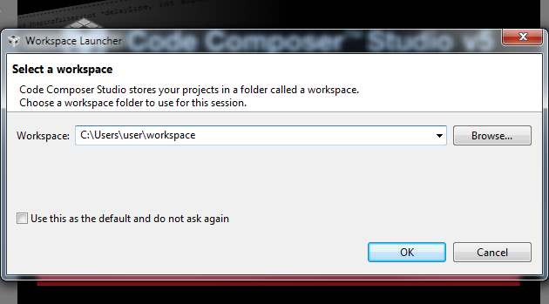
Workspace
Launching CCS for first time requires you to select a workspace folder
Defaults to your user folder
Notes:
18

Slide 19
Eclipse Concept: Workspaces
Main working folder for CCS
Contains information to manage all the projects defined to it
The default location of any new projects created
User preferences, custom perspectives, cached data for plug-ins, etc all stored in the workspace
Multiple workspaces can be maintained
Only one can be active within each CCS instance
The same workspace cannot be shared by multiple running instances of CCS
It is not recommended to share workspaces amongst users
Notes:
19

Slide 20
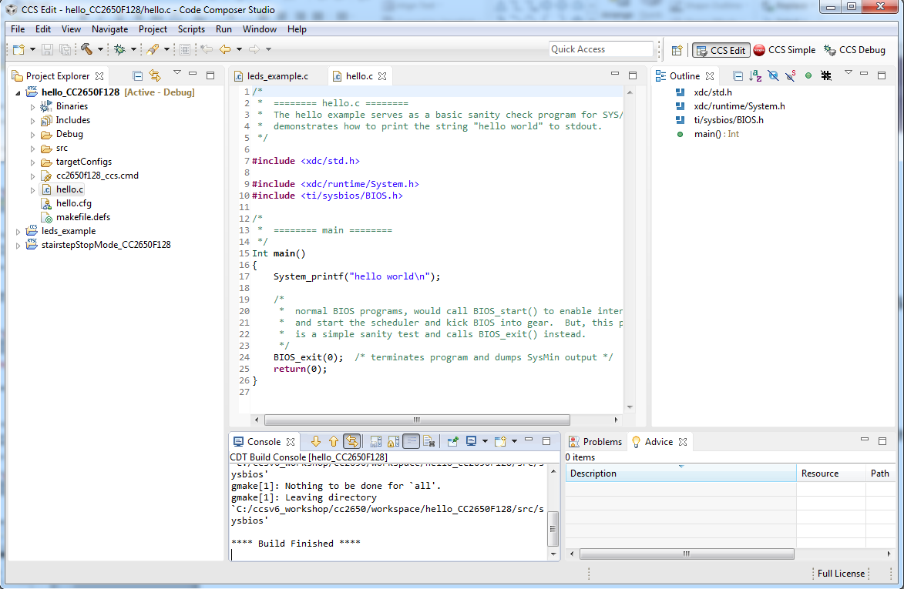
Eclipse Concept: Workbench
Workbench refers to the main CCS GUI window
The Workbench contains all the various views and resources used for development and debug

Slide 21
Eclipse Concept: Projects
Projects map to directories in the file system
Files can be added or linked to the project
Adding file to project
Copies the file into your project folder
Linking file to project
Makes a reference to the file in your project
File stays in its original location
Projects are either open or closed
Closed Projects:
Still defined to the workspace, but it cannot be modified by the Workbench
Closed projects require less memory and are not scanned during routine activity
Projects that are not part of the workspace must be imported into the active workspace before they can be opened
CCSv4/5/6 projects can be imported into the workspace
Notes:
21

Slide 22
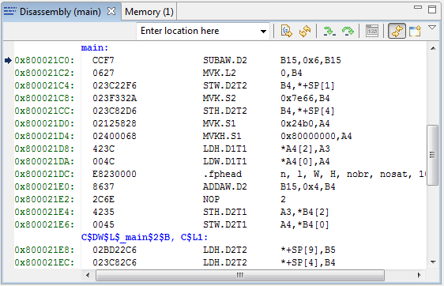
Eclipse Concept: Views
Views are windows within the main Workbench window that provide visual representation of some specific information
Most views can be accessed in the menu View
Can be identified by the organization in tabs
Active tab (in focus)
Inactive tab
(out of focus)

Slide 23
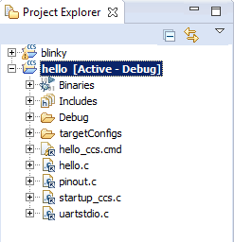
View: Project Explorer
Displays all projects defined in the active workspace
The view is mostly a representation of the file system of the project folder
Linked files are marked with a special link graphic in the icon
Use filters to hide various file types to reduce clutter in the view

Slide 24
Eclipse Concept: Focus
Focus refers to the highlighted portion of the workbench
Can be an editor, a view, a project, etc.
This concept is important since several operations inside Eclipse are tied to the element in focus
Project build errors, console, menu and toolbar options, etc.
hello project is in Focus since it has been selected. So pressing the Debug button will build the project and start the debugger for the hello project. Note how the project in focus is also highlighted in bold and with the word Active next to it for easy identification

Slide 25
View: Console
Multiple contexts
Can display build messages or debug messages (including CIO) depending on which console is selected
Automatically switches contexts when a new message occurs
Can use the Pin option to prevent this
You can open multiple console windows
CIO output in one and build messages in the other
Notes:
25

Slide 26
Target Configuration Files - Basics
Target Configuration files are xml files that define the connection and device (have a file extension *.ccxml)
The Target Configurations view is used to manage and work with target configuration files
Target Configuration Editor is used to create/modify target configuration files
Basic tab is intended to be used by majority of end users
Advanced tab is intended to be used for adjusting default properties, initialization scripts or creating target configurations for new boards/devices

Slide 27
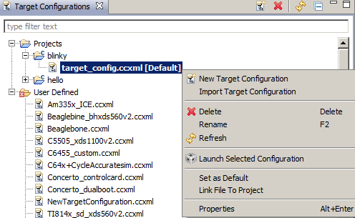
View: Target Configurations
Target configurations are easily deleted, copied and opened for inspection (XML files)
Launch a debug session quick: right-click on target configuration and select Launch Selected Configuration
Debug will use target configuration that is identified with [Default] tag in Target Configurations View
Right click on a file and select Set as Default to make it the default
Debug Active Project will also use the [Default] if there is no target configuration file in the project

Slide 28
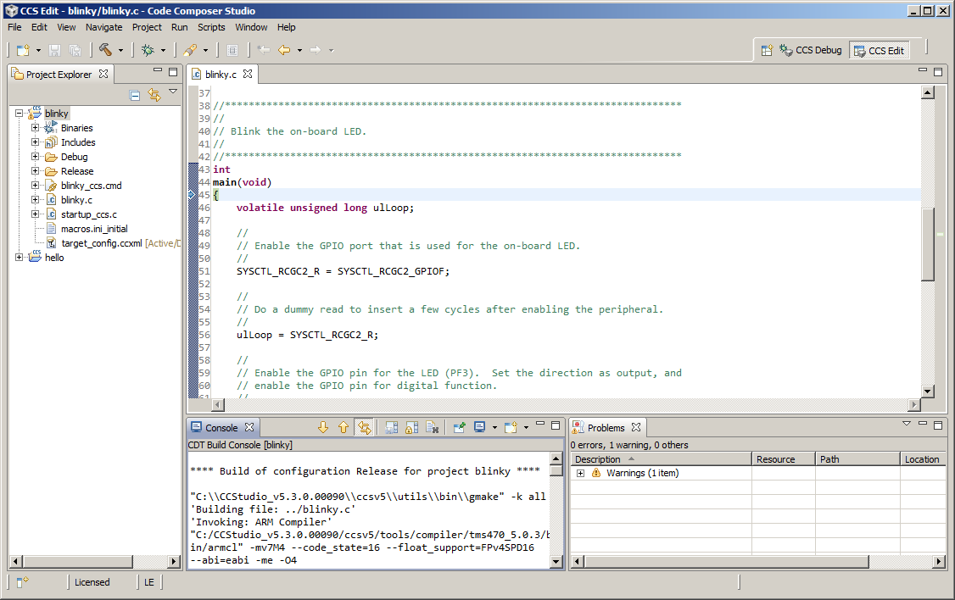
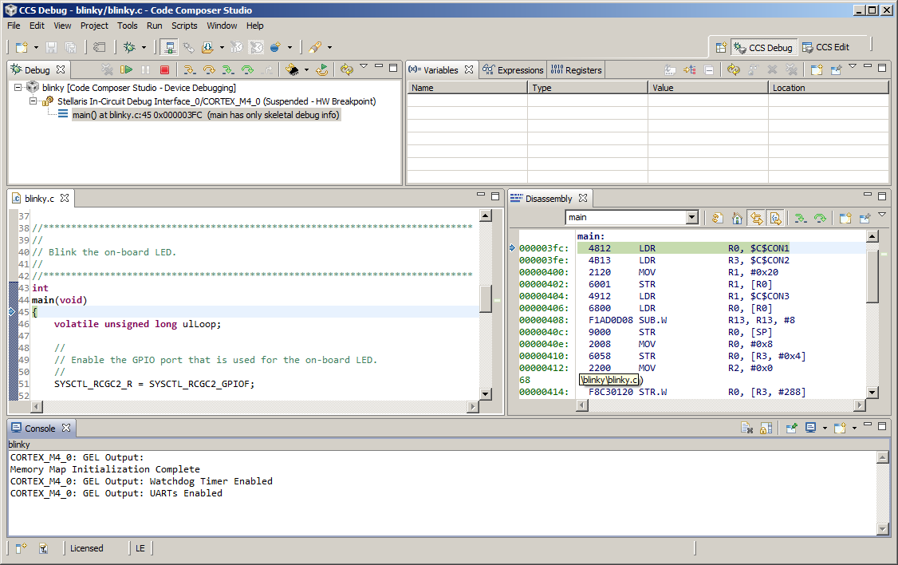
Eclipse Concept: Perspectives
Defines the initial set and layout of views in the Workbench window
Each perspective provides a set of functionality aimed at accomplishing a specific type of task (CCS Edit for project development, CCS Debug for debugging, etc)
CCS will automatically switch to the CCS Debug perspective when the debugger is started
Can create custom perspectives

Slide 29
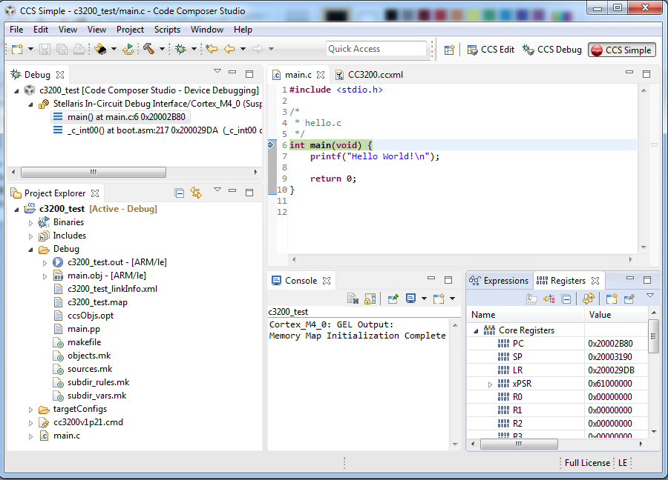
Perspective: CCS Simple
Single perspective that combines just the most common features of the CCS Edit and CCS Debug perspectives
Simplifies the environment for new users
Avoid perspective switching when starting a debug session
Open the CCS Simple perspective from the Getting Started page

Slide 30
View: Debug
Main debug interface (must be open to control the target)
Debug view displays:
Target configuration or project
Call stack
Notes:
30

Slide 31
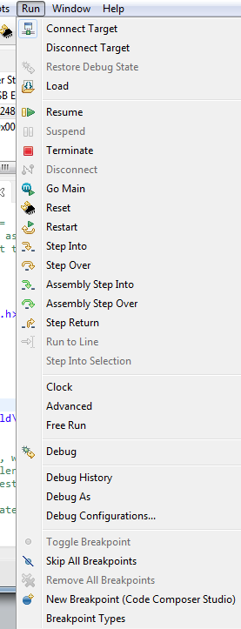
Debug Control
Commands to control target execution is available under the Run menu
CCS must be connected to the target before the target can be controlled
Many of the most commonly used commands are available on the main tool bar
Notes:
31

Slide 32
View: Breakpoints
View all available breakpoints
Can group breakpoints by CPU (multicore device)
Specify various actions when the breakpoint is triggered
Refresh All Windows or update a specific view
Control Profiling (set profile halt/resume points)
File I/O (Probe Points in CCS 3.3)
Run a GEL expression
Set a Watchpoint
Control CPU trace (on selected ARM & DSP devices)
Use the built-in HW counter events (Cortex devices)
Notes:
32

Slide 33
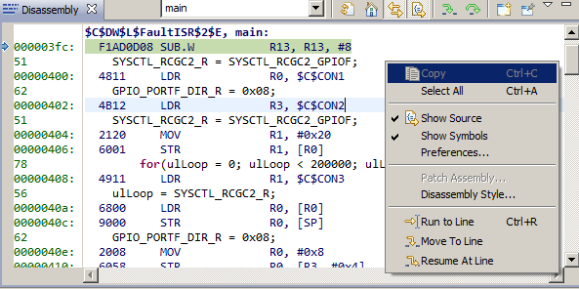
View: Disassembly
View disassembled code, optionally interleaved with C source
Toggling the Show Source button toggles interleaved C source with the disassembly
Type symbol names (such as main) in the address field to view code at that address
Notes:
33

Slide 34
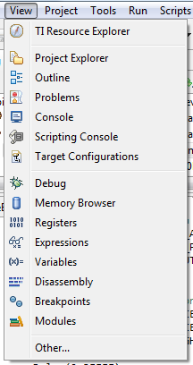
More Debugging
Many other debugging specific views are available from the View menu
Memory Browser: View the contents of memory
Registers: View register values
Disassembly: View disassembled code
Breakpoints: View breakpoints
Modules: Browse loaded debug symbol information
Notes:
34

Slide 35
Compiler Versions
CCS supports building with many different versions of TI compilers
Within a project you can specify the version of compiler to use for the build
Compiler version used with the project is stored in the project files
Before you can specify a compiler version for CCS to use, it should be “discovered” by CCS
Can check which versions of compiler tools are discovered by CCS by going to menu Window -> Preferences -> Code Composer Studio -> Build -> Compilers, and check the versions listed under Discovered tools
Can install multiple versions of compiler tools and have CCS detect it

Slide 36
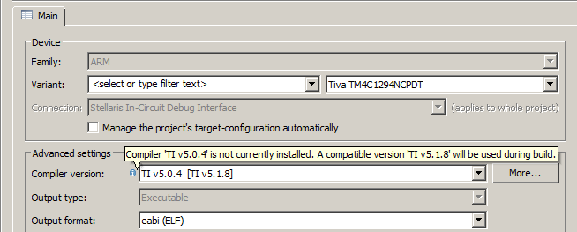
Compiler Versions
To check the version of compiler used for the project build, go to Properties -> General -> Main tab, and view the Compiler version field
Multiple versions will be listed in the same field if the project was originally created using a version that is not available to the current CCS installation (first version) and CCS will try to use the closest equivalent available

Slide 37
Compiler Versions
To install different version of compiler tools:
Go through CCS Update Manager (menu Help -> Check for Updates, or Help -> Install new Software) - CCS will automatically recognize the compiler tools and show it in the drop-down menu under Compiler version
Install using a separate stand-alone installer (not available for ARM and MSP430) - CCS can be made to detect it by:
Adding the compiler installation path to Tool Discovery Path
Browsing directly to compiler installation path from the Project Properties

Slide 38
Lab 1: blinkY example 30 minutes
Open CCS and select the default workspace
You can close the TI Resource Explorer View (it will not be used)
Refer to Lab handouts for instructions
Notes:
38

Slide 39
Blinky Example: Summary
In this lab we completed the following:
Imported and built a simple program to blink the on-board LED
Started a debug session and flashed the program to the Launchpad
Ran the program to blink LED
Used data watchpoints to halt CPU during each LED toggle
Measured clock cycles
Studied Project Build Properties
Updated version of compiler tools
Changed compiler version and compiler options in the project and rebuilt/re-ran the code
Notes:
39

Slide 40
HELLO Example: PORTABLE PROJECT
Notes:
40

Slide 41
Hello Example (Portable Project): Exercise Summary
Key Objectives
Create a new portable project based on the TivaWare Hello example
Create workspace level variables for the project
Link files to the project using variables
Configure build properties using variables
Validate project by building, loading and running the program
Tools and Concepts Covered
Portable Projects
Linked resources
Linked resource path variables
Build variables
Notes:
41

Slide 42
Sharing Projects
Notes:
42

Slide 43
Sharing Projects
Sharing “Simple” projects (all source/header files are contained in the project folder)
Sharing “Linked file” projects and all source (project uses linked files)
Sharing “Linked file” projects only (no source)
Only the project folder is shared (person receiving project already has all source)
Effort involves making the project “portable”
Eliminate absolute paths in the project
This is the most common use case
Notes:
43

Slide 44
Sharing Projects – Simple Projects
USE CASE: Wish to share (give) a project folder and all needed source files to build the project. All source files are inside the project folder.
Easy to share projects with no linked files:
The entire project folder can be distributed to another “as-is”
The user who receives the project can import it into their workspace going to menu Project → Import Existing CCE/CCS Project and selecting the copied folder
Works well for simple projects that only reference files inside the project folder
Notes:
44

Slide 45
Sharing Projects – “Linked file” Projects
Most use cases involve sharing JUST the projects instead of bundling all the source files
Wish to share a project folder only
People will have their own local copies of the source files
Wish to check the project folder/files into source control
Need to make the project portable to make sure the project is easily shared
Ideal portable projects should be usable without modifying any of the project files
This is ideal for projects maintained in source control
Notes:
45

Slide 46
Sharing Projects – “Linked file” Projects
Portable projects should avoid absolute paths
Creating portable projects involves use of two kinds of variables:
Linked Resource Path variable
Build variable
Both variables can be set to point to a directory
Source files/resources can then be linked relative to the Linked Resource Path Variable
Build Variables can be used when setting the project’s compiler and linker options (such as include paths to header files, paths to libraries etc)
Notes:
46

Slide 47
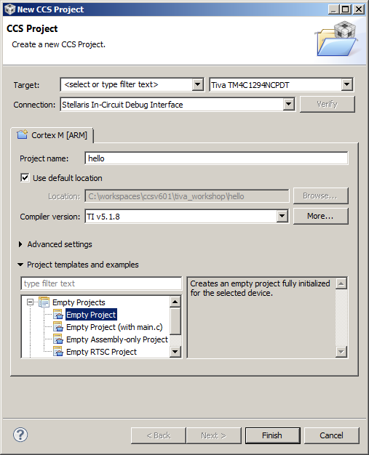
Create a New Project
A shared project is created the same way as a regular project
Launch the New CCS Project Wizard
Go to menu File → New → CCS Project
Fill in the fields as shown in the right
Click Finish when done
Generated project will appear in the Project Explorer view
Delete the files tm4c1294ncpdt.cmd and tm4c1294ncpdt_startup_ccs.c from the project
Notes:
47

Slide 48
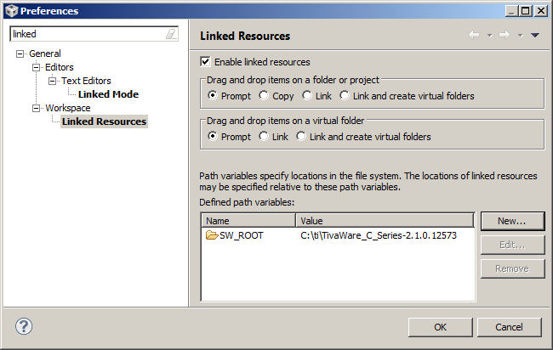
Create a Linked Resource Path Variable
Here we will create the Linked Resource Path Variable which will be used when linking source files (resources) to the project
Open the workspace preferences
Menu Window → Preferences
Go to the Linked Resources preferences
Type ‘Linked’ in the filter field to make it easier to find
Use the New button to create a ‘Linked Resource Variable’ (SW_ROOT) that points to the root location of the TivaWare directory C:\ti\TivaWare_C_Series-2.1.0.12573
Notes:
48

Slide 49
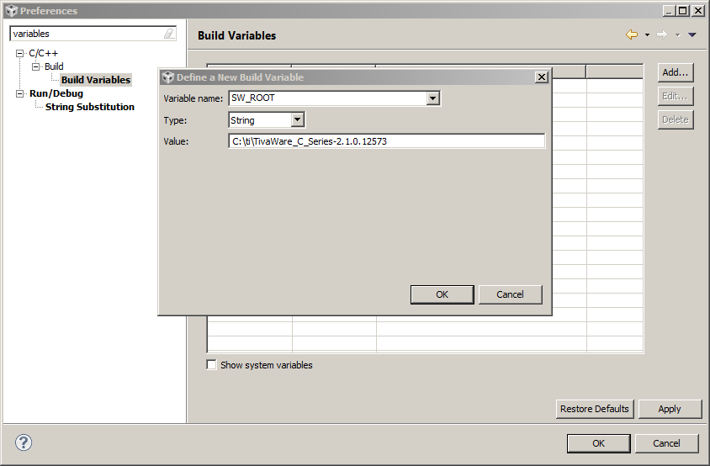
Create a Build Variable
Here we will create the Build Variable which will be used when setting the project’s compiler and linker options
Build Variables allow you to use variables in the project properties
Linked Resource variables are only used for linked files
Go to the Build Variables preferences
Type ‘Variables’ in the filter field to make it easier to find
Use the Add button to create a ‘Build Variable’ (SW_ROOT) that points to the root location of the TivaWare directory C:\ti\TivaWare_C_Series-2.1.0.12573
Click OK
Notes:
49

Slide 50
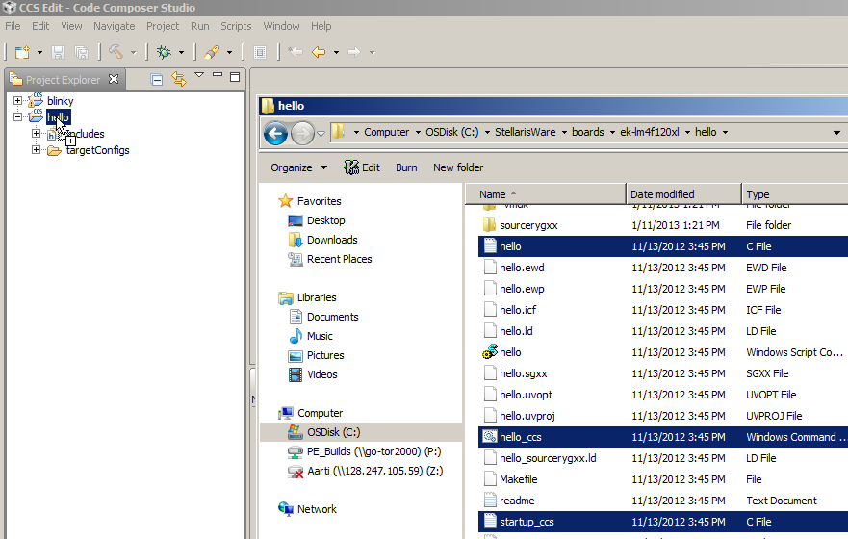
Link Source Files to Project
Source Files/Resources can be linked relative to a Linked Resource Path Variable
As an example, here we will link source files relative to the Linked Resource Path Variable previously created
Open Windows Explorer and browse to: C:\ti\TivaWare_C_Series-2.1.0.12573\examples\boards\ek-tm4c1294xl\hello
Select source files and drag and drop them into the “hello” project in the CCS Project Explorer view
Notes:
50

Slide 51
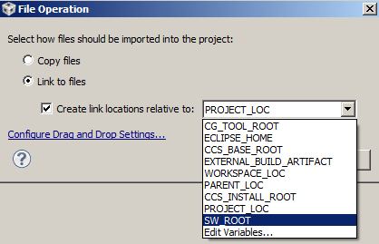
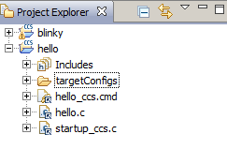
Link Source Files to Project
A dialog will appear asking if you wish to Copy or Link the files:
Select Link to files
Select Create link locations relative to:
Use the new Linked Resource variable we created (SW_ROOT)
Hit OK
Files will now appear in the Project Explorer with the ‘link’ icon
Notes:
51

Slide 52
Link Files to Project
Right-click on the source file “hello.c” and check the Properties
Notice how the Location parameter references the Linked Resource Variable
Notes:
52

Slide 53
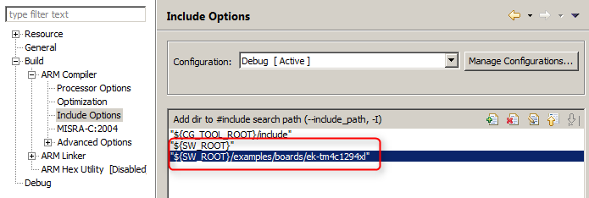
Modifying Project Properties
Paths to include files and libraries can be set relative to Build Variables
As a example, here we will add include file search path using the Build Variable
Right-click on the project and select Properties
In the compiler Include Options, add the following entry to the list of include search paths: ${SW_ROOT}/examples/boards/ek-tm4c1294xl ${SW_ROOT}
Click OK
${<BUILD VARIABLE>} is the syntax to use a Build Variable in the project properties. Here we are setting an include path to the root of TivaWare installation
NOTE: Linked Resource Path Variables are only used when linking source files to a project. They cannot be used for build options. Build Variables should be used when modifying build options
Notes:
53

Slide 54
Project vs Workspace Level Variables
Linked Resource Path Variables and Build Variables can be set at the project level or workspace level
This current lab set these variables at the workspace level
What is the benefit of setting these variables at the workspace level instead of the project level?
All projects can reuse the same variable (set it once)
Do not need to modify the project!
This is important for projects checked into source control and to avoid constant checkouts so the project can be written to!
Notes:
54

Slide 55
Questions?

Slide 56
Lab 2: HELLO example (PORTABLE PROJECT) 30 minutes
Refer to Lab Handouts for instructions
Notes:
56

Slide 57
Hello Example (Portable Project): Summary
In this lab we completed the following:
Created a new portable project
Created workspace level variables for the project – Linked Resource path variable and Build variable
Linked source files to the project using Linked Resource path variable
Configured include paths for compiler using Build variable
Validated project by building, loading and running the program
Notes:
57

