Slide 1

Code Composer
Studio
TM
Fundamentals Workshop with the MSP430
Lab Material

Slide 2
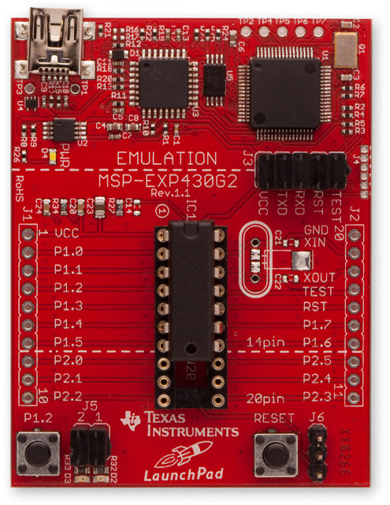
LaunchPad: Hardware Setup
Connect mini-USB cable
from PC to board
Agenda …

Slide 3




LAB conventions
Lab steps are numbered for easier reference
  …
  …
Explanations, notes, warnings are written in blue
  Warnings are shown with
  Information is marked with
  Tips and answers are marked with
  Questions are marked with
Notes:
3

Slide 4
LAB 1: BLINK LED
Notes:
4

Slide 5
Blink LED Example: Exercise Summary
Key Objectives
  Create and build a simple program to blink LED1
  Start a debug session and load/flash the program on the Launchpad
  Run the program to blink LED1
Tools and Concepts Covered
  Workspaces
  Welcome screen / Resource Explorer
  Project concepts
  Basics of working with views
  Debug launch
  Debug control
  Profile Clock
  Local History
  Build Properties
  Changing compiler versions
Notes:
5

Slide 6
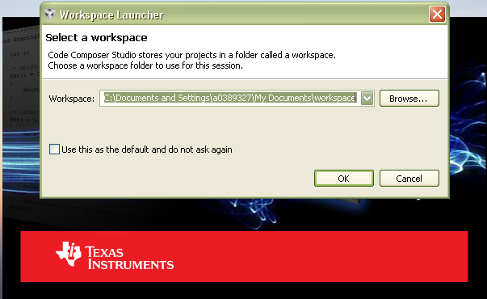
Workspace
Launch CCS and select a workspace folder
  Defaults to your user folder
Notes:
6

Slide 7
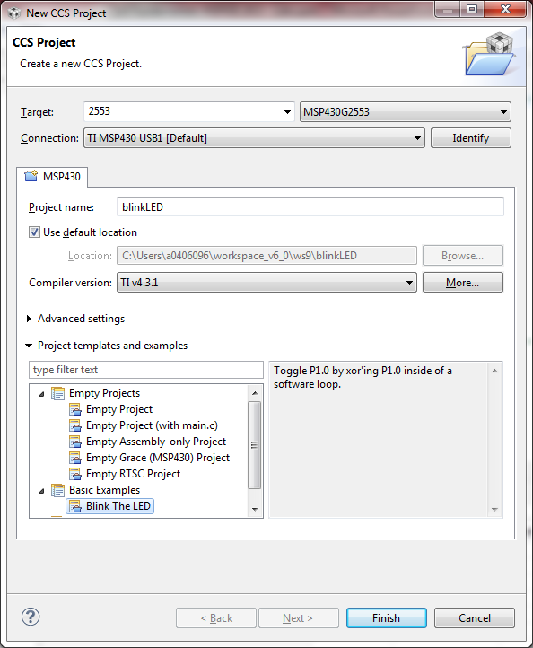
Create the Project
Create a new project in the CCS Workspace by going to menu Project → New CCS Project
Fill in the boxes as shown in the image. Select the Blink LED template and double check the exact device variant with that in the launchpad socket
Click Finish
You may close the “Getting Started” window if still open.

Slide 8
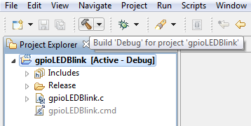
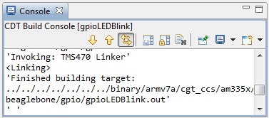
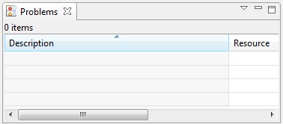
Build ‘BlinkLED’ Project
In the Project Explorer view, select the BlinkLED project (it should appear [Active – Debug]) to make it active
Click on the Build icon in the toolbar. The project will start the building process.
When using a newly installed CCS, the tool will take extra time to build the Runtime Support Library (RTS) at this time. This is normal and will only happen once.
The Console view will appear at the bottom with build messages (information, warnings, errors) as the project builds
The Problems view will also appear at the bottom to highlight any possible build errors.
When building the RTS, some warning messages will appear in the problems view and can be ignored.
If the build is successful, the Problems view will contain no errors (warnings may still be seen)

Slide 9
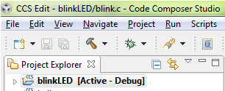
Debug ‘BlinkLED’ Project
Click on the “green bug” button – make sure the project is selected!
When pressing the debug button, several actions are done automatically
  Prompt to save source files
  Build the project (incrementally)
  Start the debugger (CCS will switch to the CCS Debug perspective)
  Connect CCS to the target
  Load the program on the target
  Run to main()

Slide 10
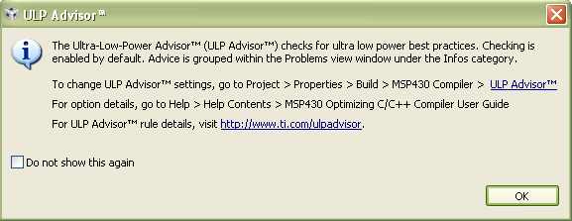
ULP Advisor Message
A message highlighting the ULP Advisor may appear on project debug
This message can be ignored for now as ULP will be covered later in this workshop
Use the “Do not show this again” checkbox if you do not wish to see this message again

Slide 11
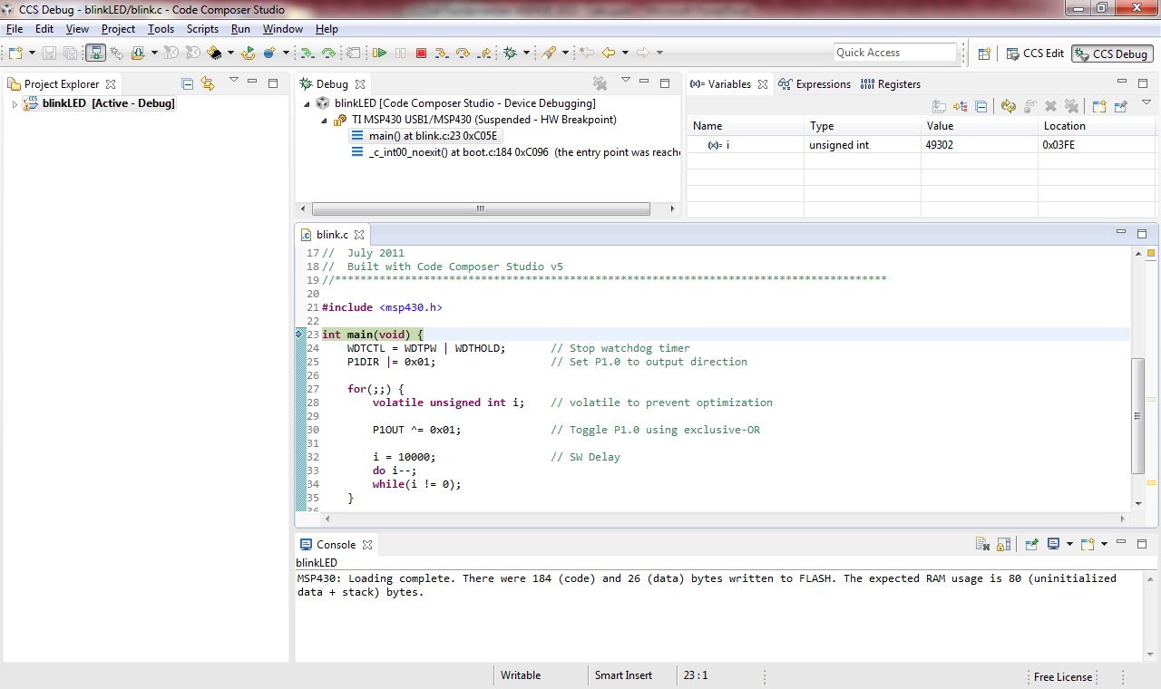
Build, Load/Flash the Program
Switched to ‘CCS Debug’ perspective
Program counter at ‘main’
Code size information displayed in console view
Notes:
11

Slide 12
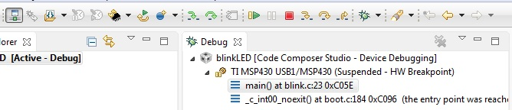
View: Debug
The Debug view displays:
  Target configuration or project
  Call stack
Buttons to ‘run, halt, terminate (debug session), source and asm stepping, reset CPU, restart program
Notes:
12

Slide 13
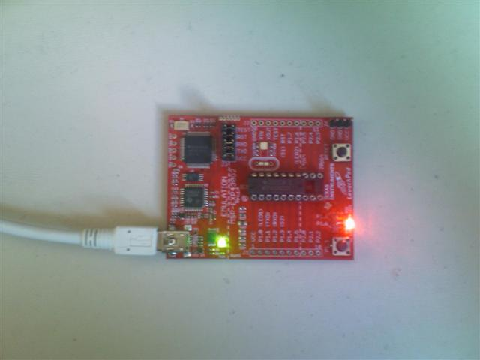
  Blink LED1
Press the Run button to run the program
  LED1 on the Launchpad should now be blinking
Notes:
13

Slide 14

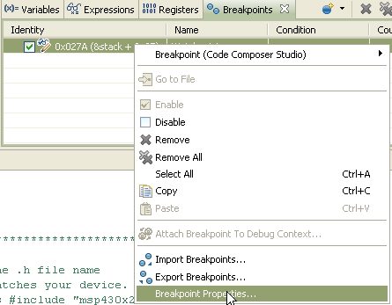
Debugging: Using Watchpoints
A Watchpoint is a type of breakpoint that monitors activity on a memory address
  In this step we will set a watchpoint to halt the CPU anytime the LED will toggle
Press the halt/suspend button to halt the running program
  The code should stop somewhere in the for loop
Open the Breakpoints view
  View → Breakpoints
Create a new Watchpoint
  Location: set it to “i”
Right-click on the watchpoint and select
  “Breakpoint Properties”
Notes:
14

Slide 15
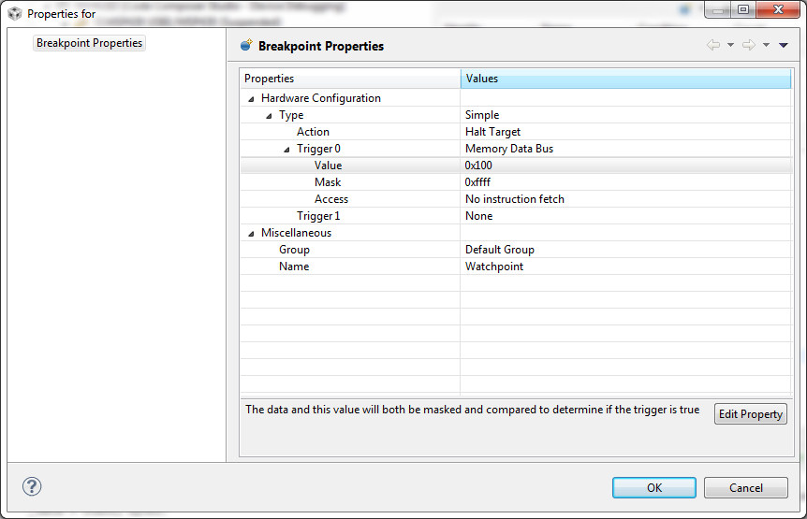
Debugging: Using Watchpoints
Set the Properties as shown below:
Trigger: Memory Data Bus
Value: 0x100 (256)
Basically halt the target when variable ‘i’ is set to value ‘256’
Click OK
Notes:
15

Slide 16
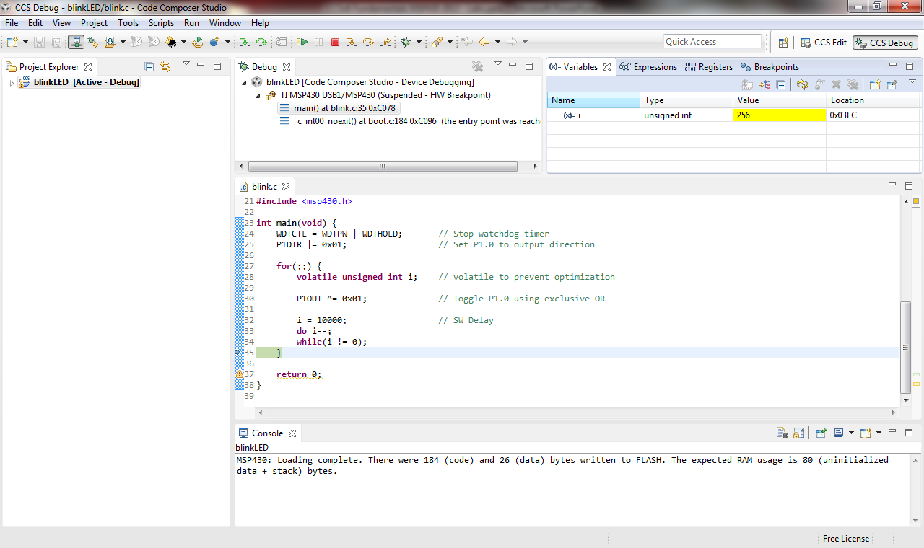

Debugging: Using Watchpoints
Run the target again. Execution will automatically halt when i is 256
  You may need to bring the variables tab into focus
Notes:
16

Slide 17
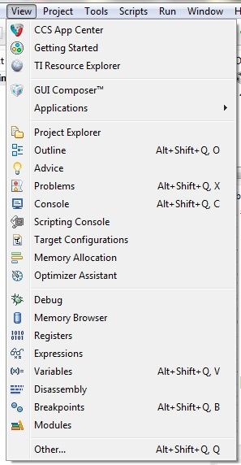
More Debugging
Investigate other debugging views (Open via View menu)
  Memory Browser
  Registers
  Disassembly (see next slide)
Set breakpoints
  Double click on a source line to set/clear
  See list of breakpoints with the Breakpoints view
Use the buttons in the Debug view to:
  Restart the program
  Source stepping
  Assembly stepping
Notes:
17

Slide 18
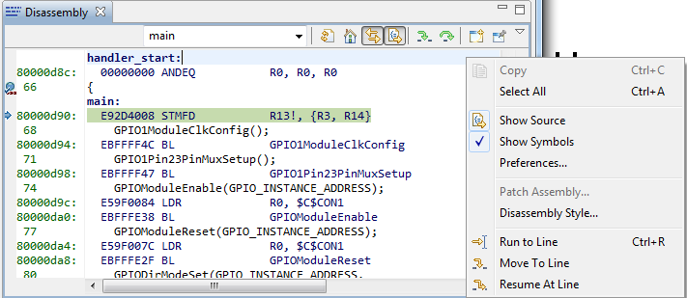
View: Disassembly
Go to the main() symbol in the Disassembly view by typing “main” in the address field and hit <ENTER>
You can see the current location of the PC (small blue arrow) and any breakpoints (small blue circles)
Toggle the Show Source button. Note the toggling of interleaved source with the disassembly
Notes:
18

Slide 19

Remove the Watchpoint
Go to the Breakpoints view
  Select Remove all Breatpoints
  Select “Yes” when prompted
Restart execution
  Go to the Debug View
  Click on the Restart button
  The program counter should be back at main

Slide 20

Debugging: Using Profile Clock
The profile clock
  Available on most devices and can be used to count cycles
  On some targets it can be used to count other events like cache hits/misses, bus stalls, etc.
Enable the Clock
  Menu Run → Clock → Enable
  The clock will now be displayed on the status bar
Add a breakpoint on line 35 “}” of the for loop by double clicking
Click the Run button
  Clock should now show 24 cycles
Tip: Double-clicking on the clock icon will reset the count to ‘0’

Slide 21
Remove the Watchpoint
Go to the Breakpoints view
  Select Remove all Breatpoints
  Select “Yes” when prompted
Restart execution
  Go to the Debug View
  Click on the Restart button
  The program counter should be back at main

Slide 22
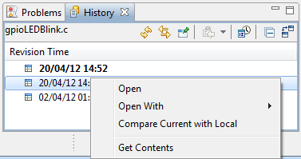
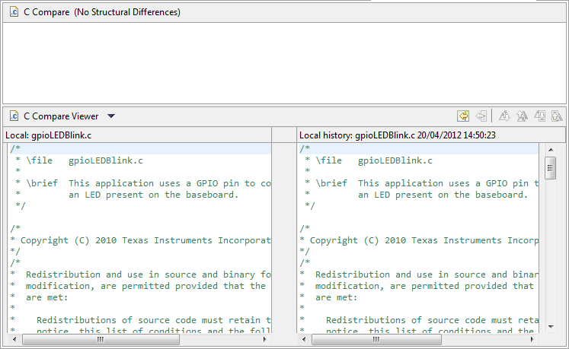
View: Local History
CCS keeps a local history of source changes
Switch to the CCS Edit perspective
Right-click on a file in the editor and select Team → Show Local History
You can compare your current source file against any previous version or replace it with any previous version
Double-click on a revision to open it in the editor
Right-click on a revision to compare that revision to the current version
CCS also keeps project history
Recover files deleted from the project
Right-click on the project and select Recover from Local History in the context menu
Notes:
22

Slide 23
Terminate the Debug Session
Go to the Debug View
Click on the terminate button
This will kill the debugger and return you to the Edit perspective

Slide 24
LAB 2 : Temperature Sense Demo

Slide 25
Temperature Sense Demo: Briefing
Key Objectives
  Create and build the Temperature Sense Demo
  Start a debug session and load/flash the program on the LaunchPad
  Run the program to start Temperature Sense Demo
Tools and Concepts Covered
  Adding source files
  “Focus” concept
  Loading Symbols
  Changing Build Options
  Changing Compiler Version
Notes:
25

Slide 26
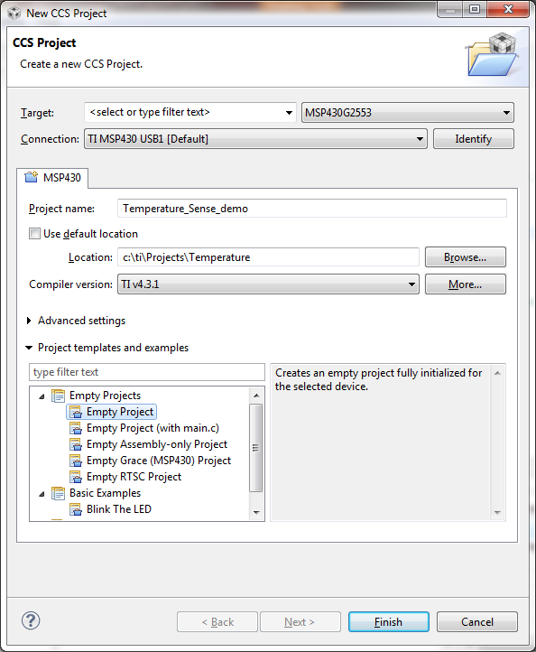
Create the Project
Create a new project in the CCS Workspace by going to menu Project → New CCS Project
Fill in the boxes as shown in the image. This time the project will be created outside the workspace
  Uncheck the box to use default location
  Specify C:\ti\Projects\Temperature
Click Finish

Slide 27
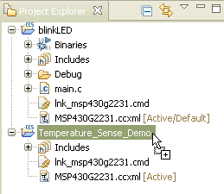
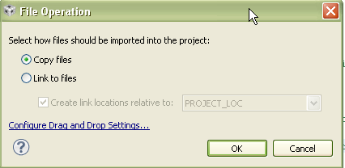
Add Temperature Sensor Source Code
Open Windows explorer and browse to
  C:\TI\LaunchPad\temperature_sensor
Drag and drop ‘Temperature_Sense_Demo_G2xxx.txt’ to the ‘Temperature_Sense_Demo’ project. Use the file that matches the MSP430 device being used (G2231 or G2553) Make sure the file is dragged to the ‘Temperature_Sense_Demo’ project
In the dialog popup, select the option to
‘Copy Files’ and hit ‘OK’

Slide 28
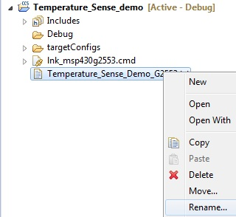
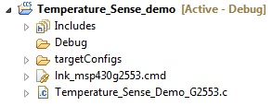
Add Temperature Sensor Source Code
Right-click on the ‘Temperature_Sense_Demo_G2xxx.txt’ file in the Project Explorer and select the option to ‘Rename..’ the file
  -Rename the file so that the ‘.txt’ extension is renamed to ‘.c’
Project is ready to build
Notes:
28

Slide 29

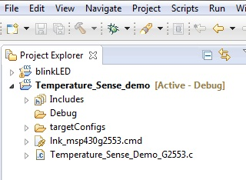
Eclipse Concept: Focus
Focus refers to the highlighted portion of the workbench
  Can be an editor, a view, a project, etc.
This concept is important since several operations inside Eclipse are tied to the element in focus
  Project build errors, console, menu and toolbar options, etc.
‘Temperature_Sense_Demo’ project is in ‘Focus’ since it has been selected. So pressing the ‘Debug’ button will build the project and start the debugger for the ‘Temperatrue_Sense_Demo’ project

Slide 30

Build and Load/Flash the Program
Make sure the ‘Temperature_Sense_Demo’ project is in ‘Focus’. Then use the ‘Debug’ button
Notes:
30

Slide 31
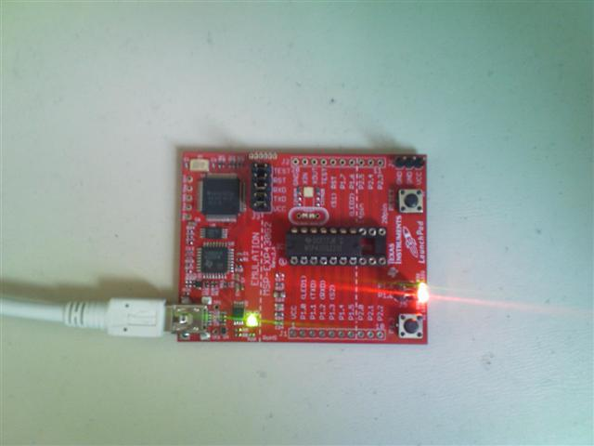
Temperature Sense Demo
Press the ‘run’ button to run the program
  LED1 (red) and LED2 (green) on the LaunchPad should now alternate blinking
Notes:
31

Slide 32
Temperature Sense Demo: Debugging
Press the halt\suspend button to halt the running program
  The code should stop in the PreApplicationMode() function.
Step-into the code once and it will enter the timer ISR for toggling the LEDs (ta1_isr)
Step-over a few more times and notice that the red and green LEDs alternate on and off
When you are done, terminate the debug session
Notes:
32

Slide 33
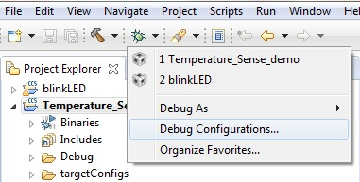
Loading Symbols for Flashed Program
If the program is already flashed in CCS and just wish to debug the existing code flashed on the target, you can configure CCS to debug the project by loading symbols only
Select the drop-down menu next
to the ‘bug’ button and select
‘Debug Configurations..’
  Eclipse Concept: Debug
  Configurations - Cached information
  created when a debug session is first
  launched for a project or target
  configuration. Information cached
  includes which target configuration to
  use, debug settings…

Slide 34
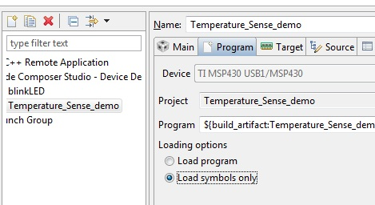
Loading Symbols for Flashed Program
Select ‘Temperature_Sense_Demo’ in the left panel and the ‘Program’ tab in the right panel
Under ‘Loading options’, select ‘Load symbols only’
Then select ‘Apply’ and then ‘Debug’

Slide 35
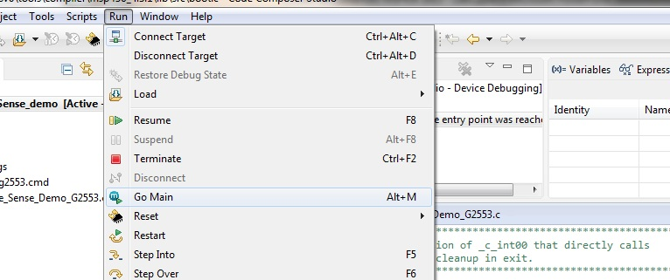
Loading Symbols for Flashed Program
The debugger will start up, connect to the target, and load only the symbols for the program for the debugger (no code is loaded/flashed on the target)
The program counter will be set to the entry point of the code and not at ‘main’
  - ‘Run->Go Main’ will run the target to ‘main’

Slide 36
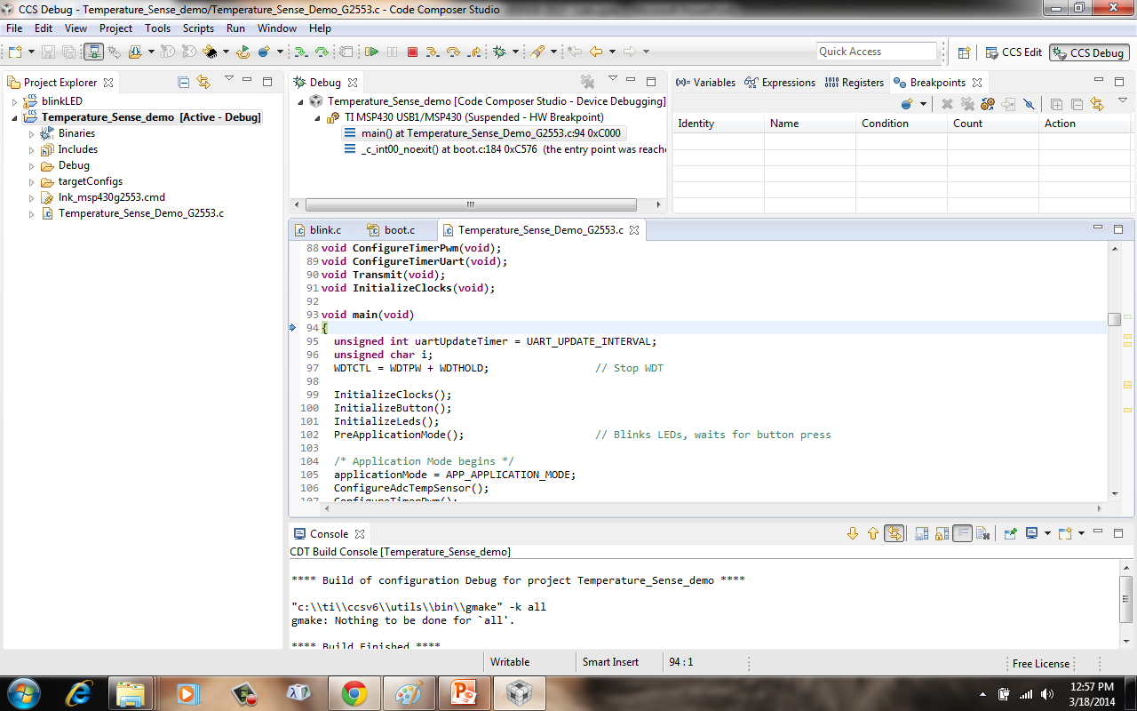
Loading Symbols for Flashed Program
Callstack displayed
Source code is found automatically

Slide 37
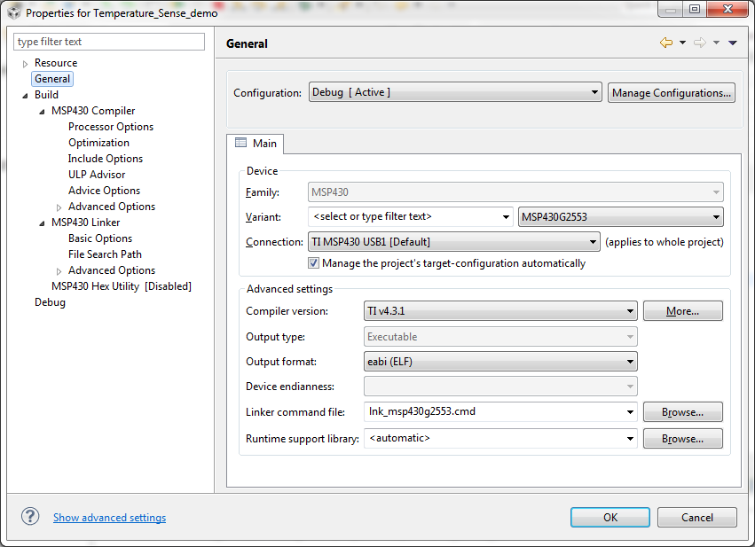
Changing Project Properties
Make sure you are in the CCS Edit perspective
Right click on the Temperature_Sense_demo project and select Properties
Device and high level settings
Compiler Options
Linker Options

Slide 38
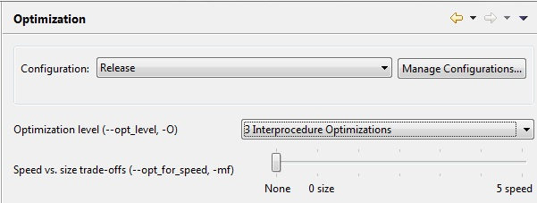
Changing Build Options
Build options are set per build configuration
Change your Configuration to Release
Change the optimization settings
  Go to the Build → MSP430 Compiler → Optimization
  Change the optimization level to 3
  Change the speed vs size to 0
Click OK

Slide 39

Changing Build Options
Change the active configuration to Release
  Right click on the Project
  Select Build Configurations → Set Active → Release
Build the project by clicking the build button
  In the console view you will see that the Release configuration has been built
You can also change the configuration and build it by clicking on the arrow beside the build button and selecting the configuration you want to build
  Select Release and it will build this configuration
  The active configuration is indicated by the Checkmark

Slide 40
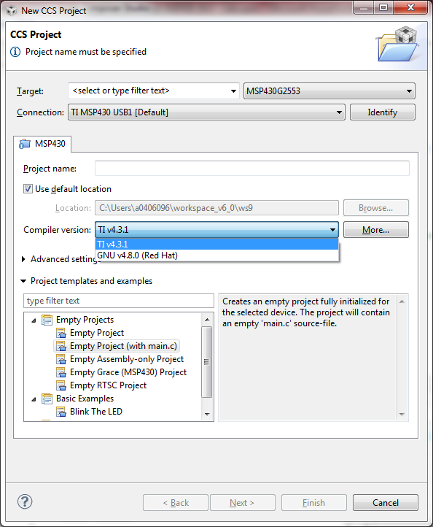
Compiler Versions
Launch ‘New CCS Project’ Wizard --- In ‘CCS Edit’ perspective, Project -> ‘New CCS Project’
Fill in the fields as shown on the right
Expand the ‘Advanced Settings’ and check the ‘Compiler version:’ dropdown menu
  Note there is only one option (v4.3.x)
  Select ‘More…’ button next to the ‘Compiler version:’ field
Notes:
40

Slide 41
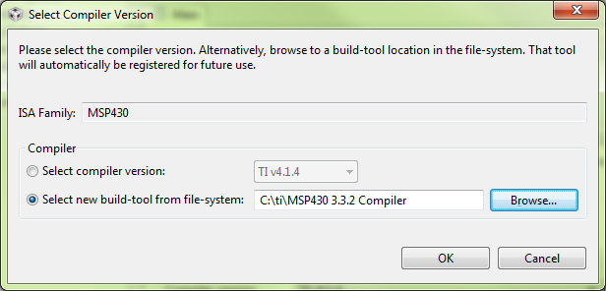
Changing the Compiler Version
Click on General
Click on the More… button beside the Compiler version TI v4.1.x
Check the option Select new build-tool from file-system
Browse to the location of the new compiler tools and click OK
  C:\TI\MSP430 3.3.2 Compiler
CCS will determine what compiler is located there and select it for your active configuration.

Slide 42
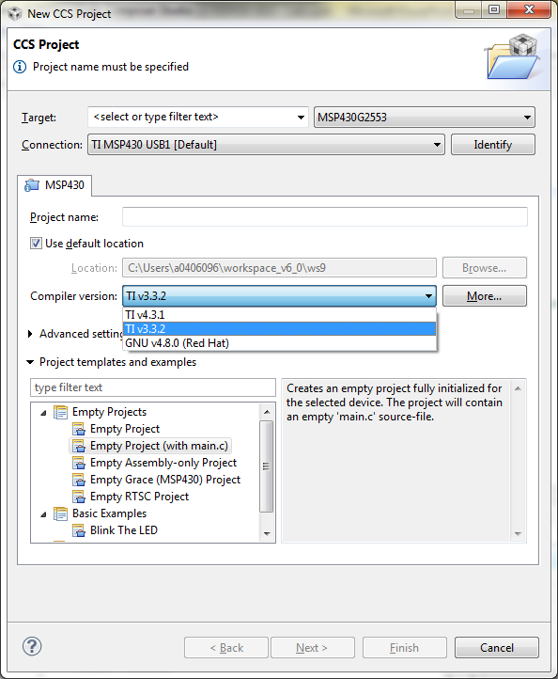
Compiler Versions
The ‘Compiler version:’ field will be updated to use version 3.3.2 of the TI MSP430 compiler
Note how both v3.3.2 and v4.1.x (default version that ships with CCSv5.4) now appear in the dropdown list
The location of v3.3.2 is now known to CCS and will be available as an option for all projects using the same workspace
Note that compiler versions can be changed for existing projects via
  Right click on your project and select ‘Properties’
  Click on ‘General’
Notes:
42

Slide 43
Blink LED Example: Exercise Summary
At this point you experimented the following concepts:
  Workspaces
  Welcome screen / Resource Explorer
  Project concepts
  Basics of working with views
  Debug launch
  Debug control
  Profile Clock
  Local History
  Build Properties
  Changing compiler versions
  Debug symbols
  Profile
Notes:
43

Slide 44
Lab 3 : Sharing Projects
Notes:
44

Slide 45
Portable Projects: Briefing
Key Objectives
  Create a project that uses a linked source file
  Make the project portable
Tools and Concepts Covered
  Linked Resources
  Linked Resource Path Variables
  Build Variables
Notes:
45

Slide 46
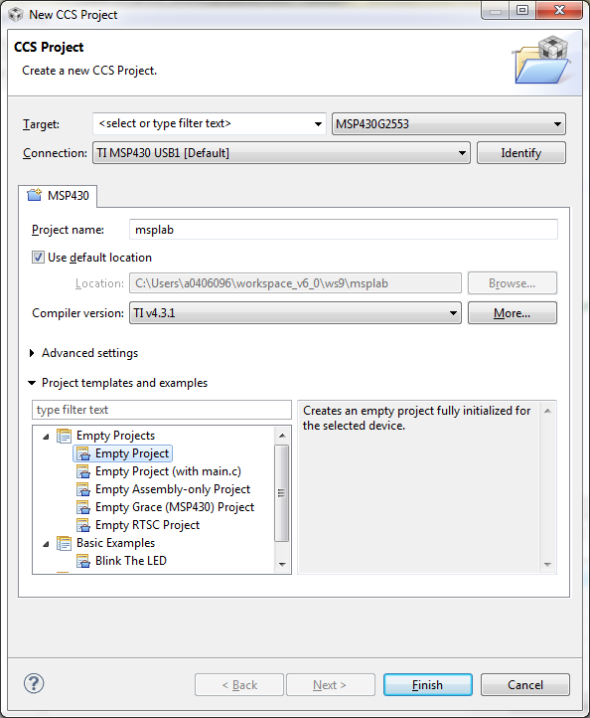
Create a New Project
Launch ‘New CCS Project’ Wizard
  Select ‘New Project’ from the Welcome page
Fill in the fields as shown in the right
  Use compiler version 4.3.x (not 3.2)
Select ‘Finish’ when done
Generated project will appear in the Project Explorer view
Notes:
46

Slide 47
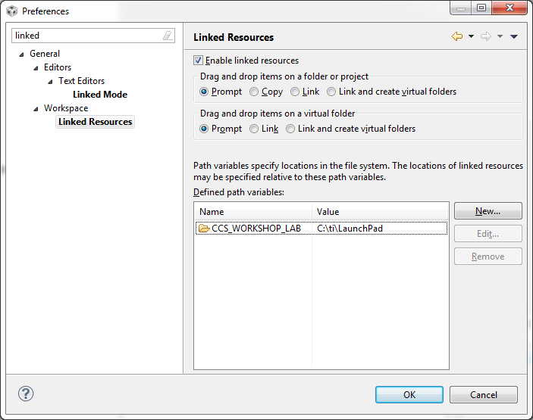
Create a Linked Resource Path Variable
Open the workspace preferences
  Window -> Preferences
Go to the ‘Linked Resources’ preferences
  Type ‘Linked’ in the filter field to make it easier to find
Use the ‘New’ button to create a ‘Linked Resource Variable’ that points to the root location of the workshop LaunchPad labs
Hit ‘OK’ when finished
Notes:
47

Slide 48
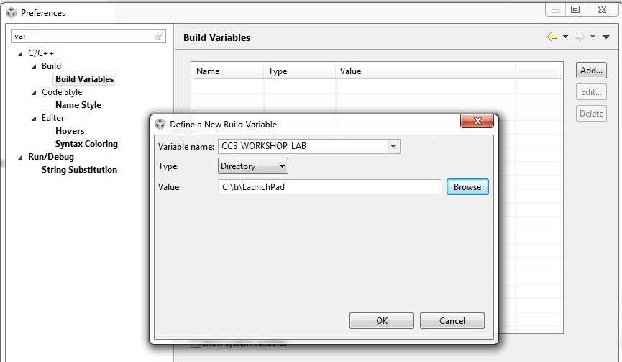
Create a Build Variable
Go to the ‘Build Variables’ preferences
  Type ‘Variables’ in the filter field to make it easier to find
Build Variables allow you to use variables in the project properties
  Linked Resource variables are only used for linked files
Use the ‘Add’ button to create a ‘Build Variable’ that points to the root location of the workshop LaunchPad labs
  Set the ‘Type:’ to ‘Directory’ to browse to a directory
Hit ‘OK’ when done
Notes:
48

Slide 49
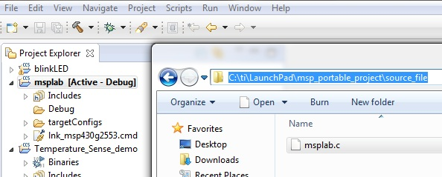
Link Source Files to Project
Open Windows Explorer and browse to C:\TI\LaunchPad\msp_portable_project\source_file
  Drag and drop the ‘msplab.c’ file in to the ‘msplab’ project
Notes:
49

Slide 50
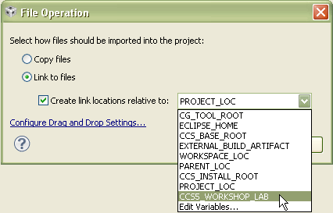
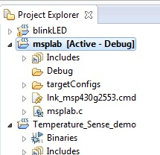
Link Source Files to Project
A dialog will appear asking if you wish to Copy or Link the files:
  Select ‘Link to files’
  Select ‘Create link locations relative to:’
    Use the new Linked Resource variable we created (CCS5_WORKSHOP_LAB)
  Hit ‘OK’
Files will now appear in the Project Explorer with the ‘link’ icon
Notes:
50

Slide 51
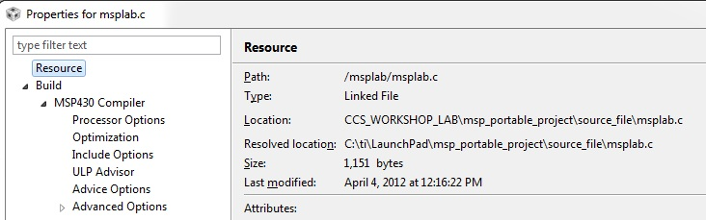
Link Files to Project
Right-click on ‘msplab.c’ file and check the ‘Properties’
  See how the ‘Location’ parameter references the Linked Resource Variable
Notes:
51

Slide 52
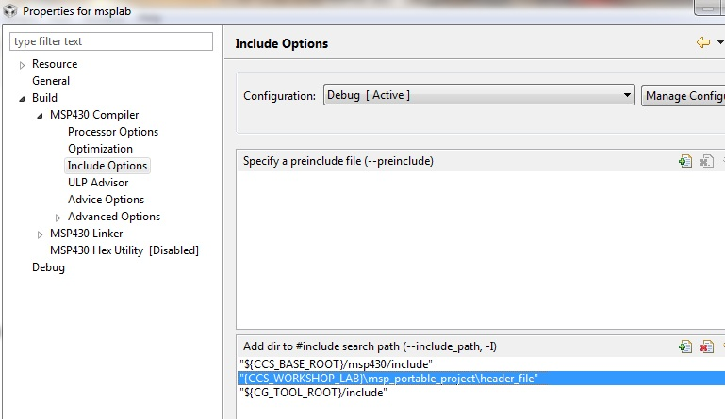
Modifying Project Properties
Right-click on the project and select ‘Properties’
In the compiler ‘Include Options’, add the following entries to the list of include search paths:
  ${CCS5_WORKSHOP_LAB}\msp_portable_project\header_file
‘${<BUILD VARIABLE>}’ is the syntax to use a Build Variable in the project properties
WARNING: Linked Resource Path Variables are only used when linking source files to a project. They can not be used for build options. Use Build Variables when modifying build options
Notes:
52

Slide 53
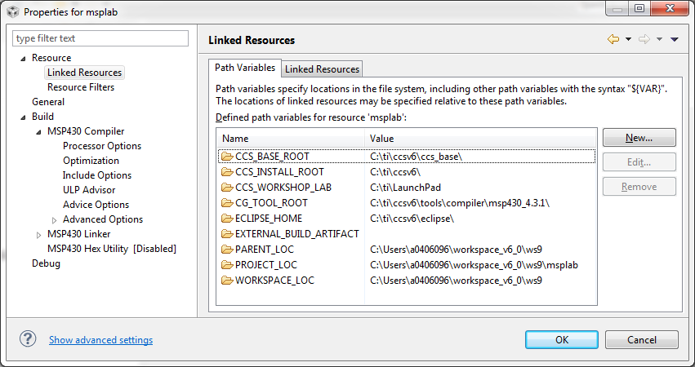
Project Properties
Go to ‘Resource -> Linked Resources’ to see all the Linked Resource Path Variables that is available to the project
  This will show all variables created at the project level and workspace level
See the workspace level Linked Resource Path Variable that was created appears in the list
Variables may be edited here but changes will only be recorded at the project level (stored in the project files)
Notes:
53

Slide 54
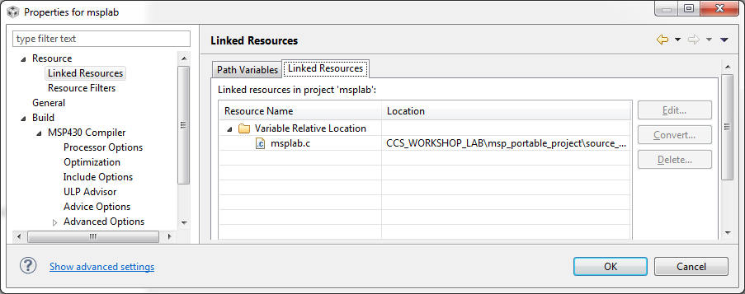
Project Properties
The ‘Linked Resources’ tab will show all the files that have been linked to the project
  It will sort them by files linked with a variable and files linked with an absolute path
Links can be modified here with the ‘Edit…’ button
Links can be converted to use an absolute path with the ‘Convert…’ button
Notes:
54

Slide 55
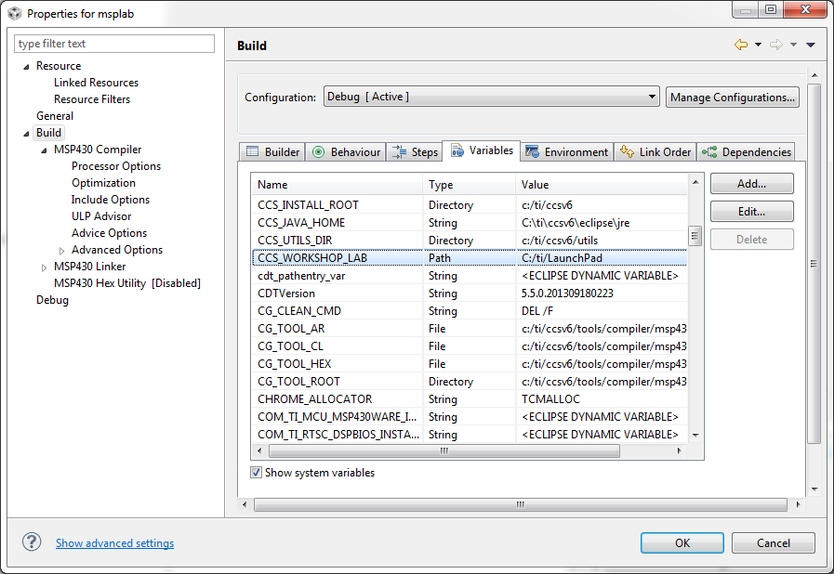
Project Properties
Go to ‘Build’ to see all the Build Variables that is available to the project
  Only project level variables will be listed by default
  Enable the “Show system variables” checkbox to see variables set at the workspace and system level
See how the workspace level Build Variable that was created appears in the list
Notes:
55

Slide 56
LAB 4: Ultra Low Power Advisor
Notes:
56

Slide 57
Import and Build ULP Demo Project
Import ULP Demo project into the workspace
  Import -> Existing CCS Eclipse Project
  Project is located in:
    C:\ti\LaunchPad\ulp_demo
Explore the one source file ‘ulp_demo.c’
Build it

Slide 58
ULP Diagnostics
ULP Diagnostics appear in problems view
Maximize ‘Problems’ view
Click on link to open advice window for that diagnostic
Experiment with the links
Can position Advice window anywhere

Slide 59
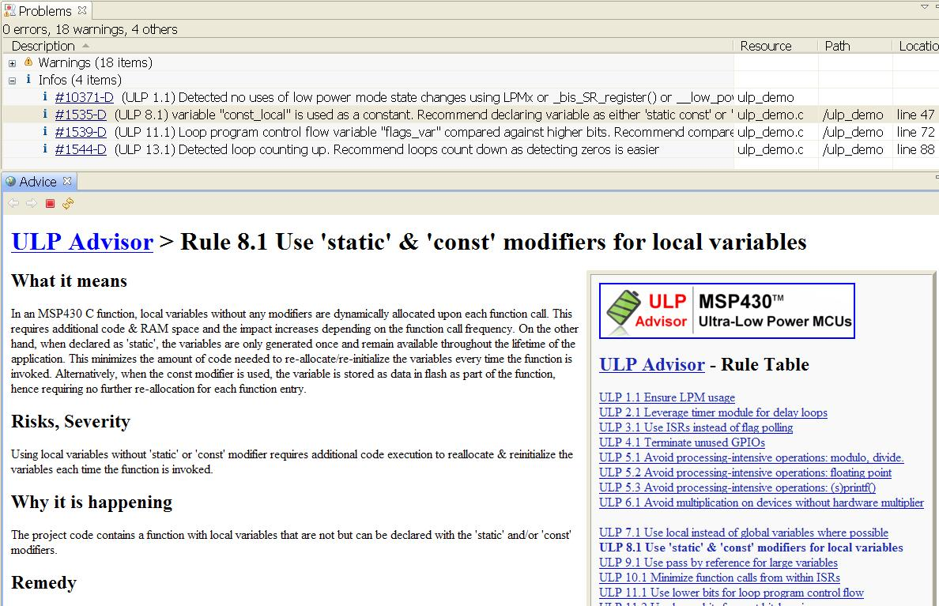
Click here!

Slide 60
Fix Rule 8.1
For function ulp_demo_rule_8_1
Static and const variables are preferred over plain local variables
  Add static const before const_local
Make change directly
Or cheat …
  Change #define BREAK_RULE_8_1 to 0
Build
Diagnostic about rule 8.1 no longer in problems view

Slide 61
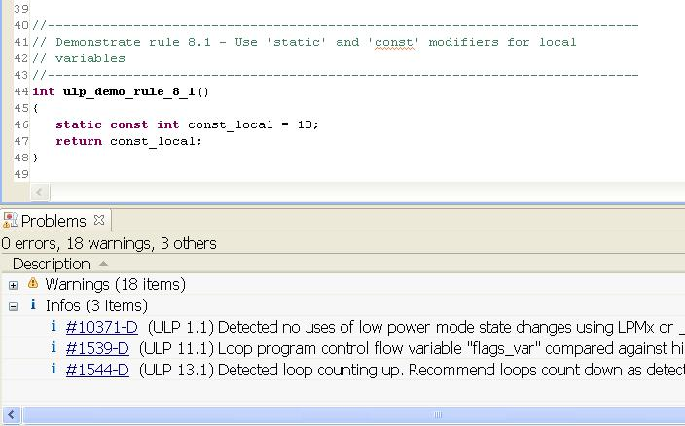
Rule 8.1 – After Fix

Slide 62
Fix Rule 11.1
For function ulp_demo_rule_11_1
Change #define F1 … F4 to 1, 2, 4, 8
  MSP430 can use those constant values cheaply
Make change directly
Or cheat …
  Change #define BREAK_RULE_11_1 to 0
Build
Diagnostic about rule 11.1 no longer in problems view

Slide 63
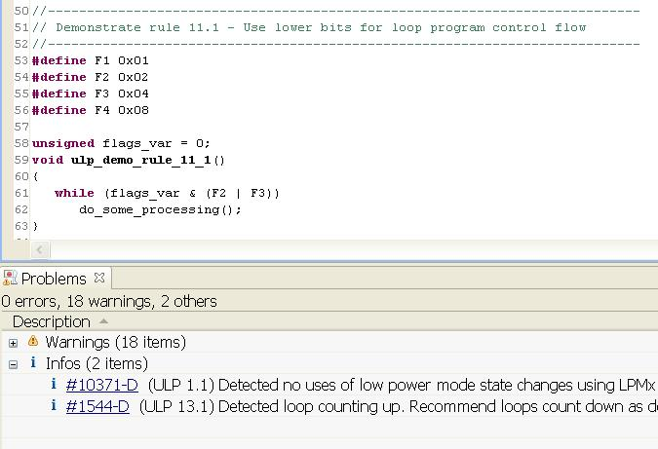
Rule 11.1 – After Fix

Slide 64
Fix Rule 13.1
For function ulp_demo_rule_13_1
Change to loop that counts from N-1 to 0
  Comparisons against 0 are cheaper
Make change directly
Or cheat …
  Change #define BREAK_RULE_13_1 to 0
Build
Diagnostic about rule 13.1 no longer in problems view

Slide 65
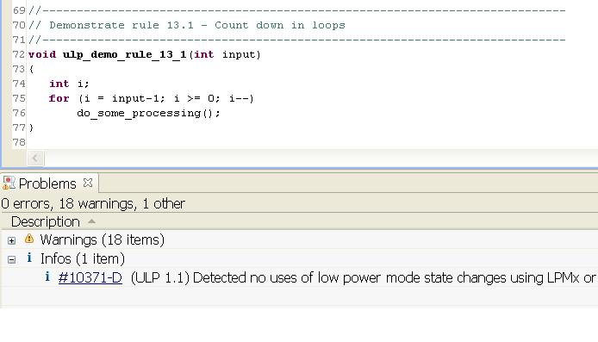
Rule 13.1 – After Fix
Rule 1.1 problem remains
Click the link to see related advice

Slide 66
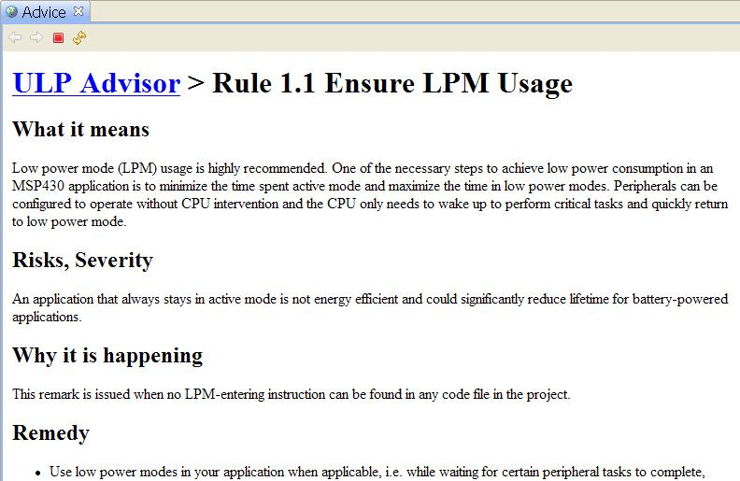
Importance of Rule 1.1

Slide 67
Importance of Rule 1.1
Remain in low power mode (LPM) as long as possible
Cannot run any code while in LPM
Come out of LPM with an interrupt
Primary technique for conserving power
More details beyond scope of this demo

Slide 68
Lab 5 : GRACE
Notes:
68

Slide 69

Create a New (Grace) Project
Start the Project Wizard
  Select ‘New Project’ on the Welcome page
Fill in the fields as shown on the right
  Select the ‘Blink LED from the CPU’ template under ‘Grace Examples’
Select ‘Finish’ when done
Notes:
69

Slide 70

Grace – Configuration File

Slide 71
Grace – Building/Running the Example
Build and load the Grace example using the ‘Debug’ button
  HINT: Make sure the new grace example project is in focus
Run the example
LED1 should be blinking
  Note the blink rate
Terminate the debug session and return to the ‘CCS Edit’ perspective

Slide 72
Grace – Modifying the Example
Let’s change the blink rate. How?
  Modify the source code… or..
  Tweak register values… or..
  Use Grace to change the clock value!
In the ‘led.cfg’ file, select the ‘Device Overview’ button to see the peripheral modules available for configuration

Slide 73

Grace – Modifying the Configuration

Slide 74

Grace – Device Overview
Interactive block diagram of the peripheral modules available for configuration
Select the ‘Basic Clock System+’ (BCS+) peripheral to configure it
  NOTE: The name of the peripheral can vary depending on the device
    G2553: ‘Oscillators Basic Clock System+’

Slide 75

Grace – BCS+ Overview
Overview - This view describes the peripheral and shows you the most important use cases for it
Select the ‘Basic User’ mode to configure the clock frequency

Slide 76

Grace – BCS+ Basic User Mode
This view includes most of the configuration settings that most users will need
Change the frequency of the ‘High Speed Clock Source’ from 1 MHz to 200 kHz
Save the led.cfg file

Slide 77

Grace – BCS+ Power User Mode
Power User Mode. This view includes all the configuration settings of the peripheral

Slide 78

Grace – BCS+ Register Controls
Register Controls. This view depicts the peripheral's control registers and individual bit settings.

Slide 79
Grace
Rebuild and reload the Grace example using the ‘Debug’ button
  HINT: Make sure the new Grace example project is in focus
Run the example
LED1 should be blinking
  Note that new blink rate is 5x slower

