Slide 1
TI-RTOS Analysis for Tiva
Embedded Development Tools

Slide 2
What is TI-RTOS?
One-stop solution for developing applications on TI microcontrollers
Combines real-time kernel with additional middleware components such as TCP/IP and USB stacks, FAT file system, and device drivers
Includes several examples that can be used as starting point
Contains the following components:
SYS/BIOS, IPC, MSP430Ware, MWare, NDK, TivaWare, UIA, XDCTools
More details and download available at
http://www.ti.com/tool/ti-rtos

Slide 3
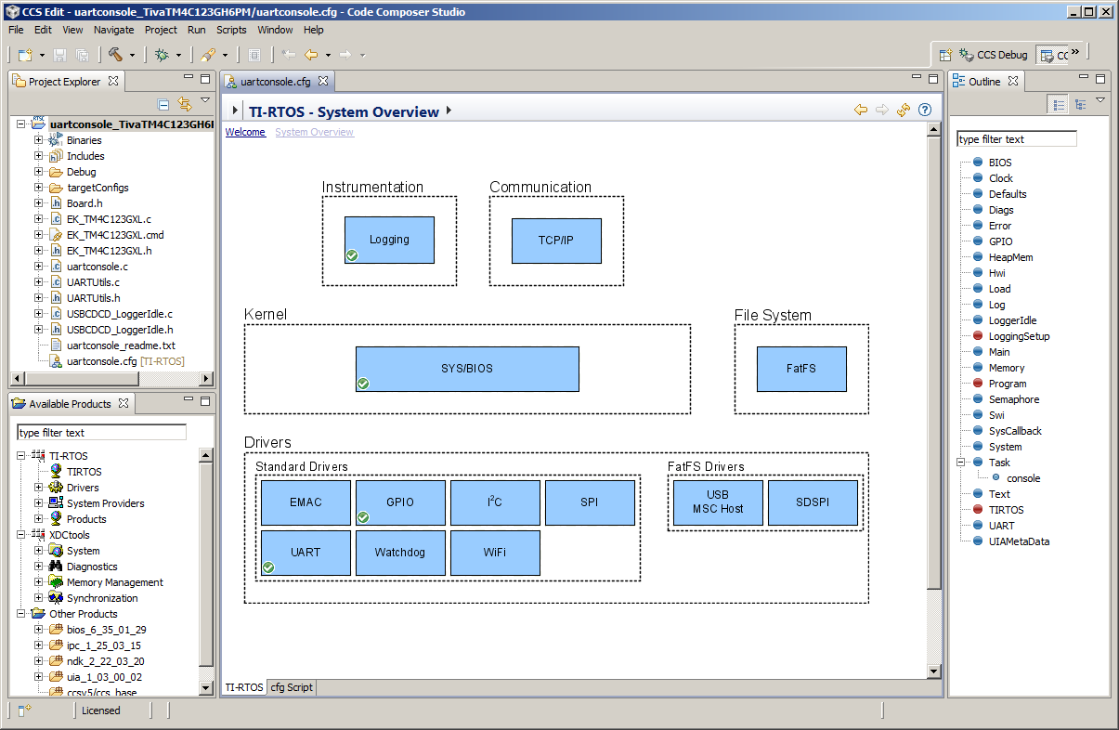
Configure TI-RTOS using XGCONF
TI-RTOS and its components can be viewed and configured using the XGCONF graphical configuration editor included with CCS
Double-clicking on configuration (.cfg) file in Project Explorer opens it in XGCONF graphical editor by default
XGCONF is made up of several views that are used together
Property view
Outline view
Available Products view
One or more views can be used for configuring TI-RTOS, SYS/BIOS and other components

Slide 4
Instrumentation with TI-RTOS
TI-RTOS uses Unified Instrumentation Architecture (UIA) target content to instrument the application
Instrumented data can be viewed with System Analyzer (SA) host side tooling to create execution graphs, load graphs and more
Data can be transported to host PC via different transports such as Ethernet, JTAG, USB/UART
System Analyzer tool suite works together with UIA to provide visibility into real-time performance and behavior
For more details refer to the System Analyzer Users Guide
http://www.ti.com/lit/pdf/spruh43

Slide 5
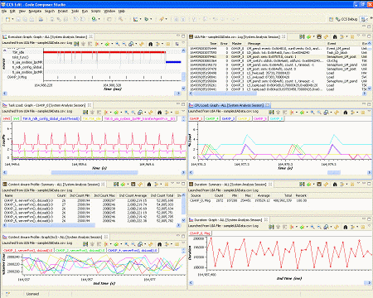
System Analyzer
System Analyzer provides many different analysis features
Analysis views can be opened as graphs, detailed logs and summary logs

Slide 6
System Analyzer Analysis Features
Execution Graph
Shows execution of threads running on the target
CPU Load
Shows SYS/BIOS load data collected for all cores in the system
Task Load
Shows the CPU load data measured within a SYS/BIOS Task thread
Concurrency
Shows when each core is active and how many are active at once
Task Profiler
Shows percent of time that each task spent in each execution state
Printf Logs
Shows messages output by program through Log_printf() calls
The above features use data that is automatically logged by SYS/BIOS

Slide 7
System Analyzer Analysis Features
Count Analysis
Tracks data values on the target
Context Aware Profile
Calculates duration with awareness of interruptions by other threads and functions
Duration
Calculates time between two points of execution
The above features require modifications to application code to perform additional logging

Slide 8
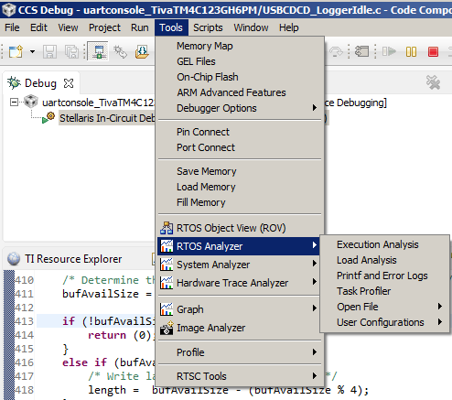
RTOS Analyzer
RTOS Analyzer is part of System Analyzer suite of tools
Invoked from CCS menu Tools->RTOS Analyzer
RTOS Analyzer menu includes analysis features that use data that is automatically logged by SYS/BIOS, (ie) do not require modification to application code

Slide 9
RTOS Object View (ROV)
Provides state information about the modules used by the application
Stop mode debugging tool
Invoked from CCS menu Tools->RTOS Object View (ROV)

Slide 10
LAB Requirements
Software:
Code Composer Studio v6.0.0.00190 Download from http://processors.wiki.ti.com/index.php/Download_CCS and install into C:\ti
TI-RTOS for TivaC v2.00.00.22 or later Install from CCS App Center (CCS menu View->CCS App Center)
PuTTY terminal program (optional) http://the.earth.li/~sgtatham/putty/latest/x86/putty.exe
Hardware
Tiva C Series LaunchPad (TM4C123GXL) or Connected Launchpad (TM4C1294XL)
Lab Materials
Extract rtosanalyzer.zip into C:\CCSWorkshop\rtosanalyzer
NOTE: The steps in this lab are written for TM4C123GXL Launchpad but the same steps can be followed with TM4C1294XL Launchpad. Just be sure to use the appropriate example from TI Resource Explorer for the board

Slide 11
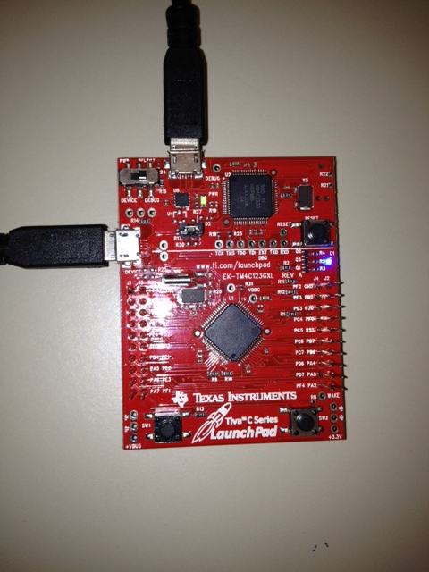
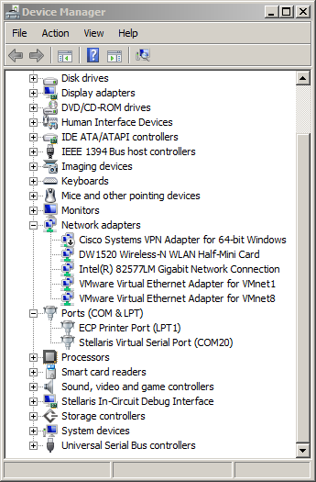
Hardware Setup
Connect the LaunchPad to the PC using 2 micro USB cables
After connecting the USB cables, the drivers should be automatically installed and the Device Manager should look similar to this

Slide 12
LAB Conventions
Before starting, it is important to review some lab conventions that will ease your work…
Lab steps are in black and numbered for easier reference
…
…
Explanations, notes, warnings are written in blue
Warnings are shown with
Information is marked with
Tips and answers are marked with
Questions are marked with
Notes:
12

Slide 13
LAB 1: ROV and RTOS ANALYZER basics
30 MINUTES
Open CCS and select a workspace (the default is fine)
Notes:
13

Slide 14
LAB 1: Exercise Summary
Objectives
Get familiar with using ROV (RTOS Object View) to inspect state of the scheduler, threads and objects in the system
Learn how to add SYS/BIOS objects (tasks, semaphores etc) to the BIOS configuration
Get familiar with using RTOS Analyzer to view RTA data (execution graph, task/CPU load etc)
Tools and Concepts Covered
Resource Explorer
RTOS Object Viewer (ROV)
RTOS Analyzer
Notes:
14

Slide 15
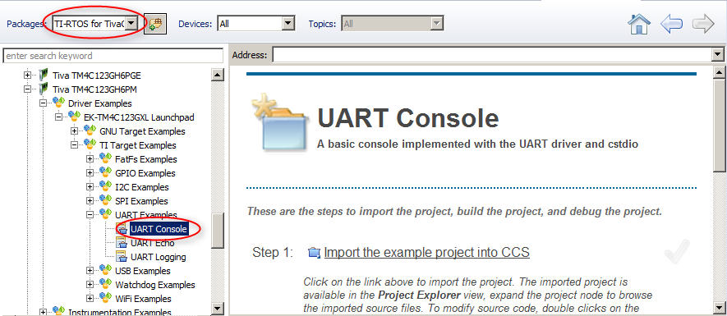
Import an Example with Resource Explorer
Go to CCS menu View -> Resource Explorer (Examples)
Select TI-RTOS for TivaC in the Packages filter box
Expand Tiva C Series->Tiva TM4C123GH6PM->Driver Examples->EK-TM4C123GXL Launchpad->TI Target Examples->UART Examples, and select UART Console

Slide 16
Build and load the example
Click the Step 1 link to “Import the example project into CCS”
Click the Step 2 link to “Build the imported project”
Click the Step 3 link and select “Stellaris In-Circuit Debug Interface”
Click the Step 4 link to “Debug the imported project” The program should be loaded and halted at main()

Slide 17
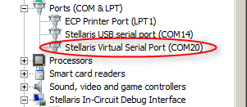
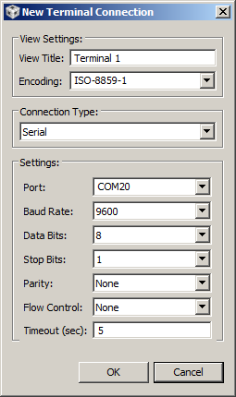
Run a Terminal Program (Terminal plugin)
You can use either the Terminal Plugin in CCS or PuTTY (if installed) to verify program operation. Based on the Terminal program used, run the steps either in this slide OR the next slide
Go to menu View->Other->Terminal->Terminal
Click on Connect and enter the parameters as shown:
Connection type: “Serial”
Baud Rate: 9600
Port: choose the COM port # of “Stellaris/Tiva Virtual Serial Port” in Device Manager
Click the Resume button in CCS Debug view
The Terminal view should print out:

Slide 18
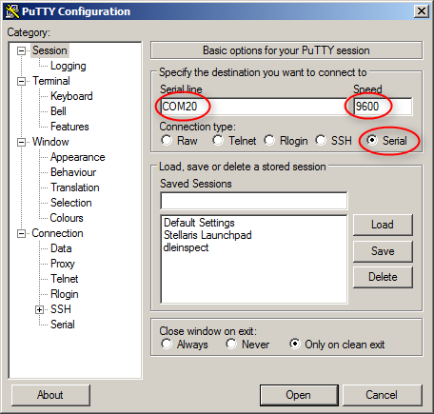
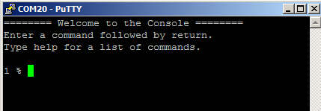
Run a Terminal Program (PuTTY)
Start PuTTY by running putty.exe
Select the Connection type as “Serial”
Set the Speed to 9600
COM port number needs to match the “Stellaris/Tiva Virtual Serial Port” in Windows Device Manager
Click the Resume button in CCS Debug view
The PuTTY screen should print out:

Slide 19
Open the RTOS Object View (ROV)
Click the Suspend button to halt the program
CCS may show a warning: “Can’t find a source file…”. This is because code is halted in code with no debug information thus CCS is unable to locate the source file.
Go to menu Tools->RTOS Object View (ROV) to open ROV
In RTOS Object View, expand uartconsole_TivaTM4C123GHp6PM.out it not already expanded

Slide 20
Using ROV
Click on “Task” to see details of tasks in the system
For each task answer the following:
What are their priorities and current state/mode?
What is the size of stack and stack peak? (Hint: check in Detailed tab)
Click on “HeapMem” to see details about the system heap
Answer the following questions: (Hint: need to go to Detailed tab for some info)
What is the total size of heap?
How much is free?
What is the starting address of the heap?
Click on the Terminate button in the Debug View
More information on ROV is available at: http://rtsc.eclipse.org/docs-tip/RTSC_Object_Viewer

Slide 21
Using ROV - Answers
Console:
Priority: 1, State: Blocked, Stack size: 1536, Stack peak: 1216
Idle:
Priority: 0, State: Running, Stack size: 2048, Stack peak: 324
System heap:
Total size: 0x800, Free: 0x6b0, Starting address: 0x200032CC
Numbers may be slightly different if it is running on a different board and/or different version of tools

Slide 22
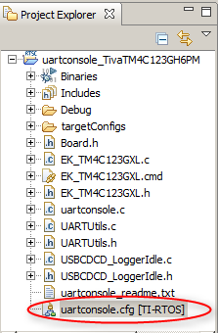
Launch XGCONF
In the Project Explorer view, expand the project uartconsole_TivaTM4C123GH6PM and double-click on uartconsole.cfg to open it in the XGCONF graphical editor
As it is possible to have more than one configuration file in your project the name of the product that a file is associated with is listed beside the filename [TI-RTOS]
This will open 3 views:
The Editor view in the middle
The Outline view on the right
The Available Products view at the bottom left

Slide 23
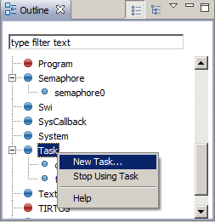
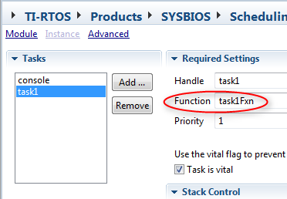
Add a task
In the Outline view, select Task
Right-click on Task and select ‘New Task…’
A new task named ‘task1’ will appear with a red X beside it. The red X is due to not having defined a function name yet
In the Outline view, click on task1
This will open the editor at the Task – Instance Settings
Select task1 in the Tasks list
Set the function name to task1Fxn
Click the Save button to save the .cfg file

Slide 24
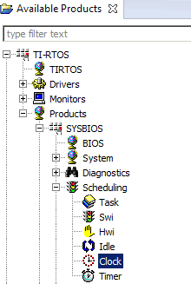
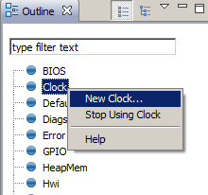
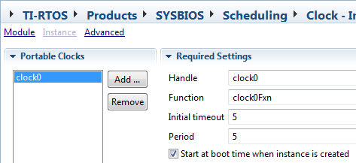
Add a Clock
In the Available Products View, expand TI-RTOS-> Products->SYSBIOS->Scheduling
Right-click on Clock and select ‘Use Clock’
In the Outline view, select Clock
Right-click on Clock and select ‘New Clock…’
A new clock instance named ‘clock0’ will appear
In the Outline view, click on clock0
Adjust its settings:
Function: clock0Fxn
Initial timeout: 5
Period: 5
Check “Start at boot time when instance is created”
Click the Save button to save the .cfg file

Slide 25
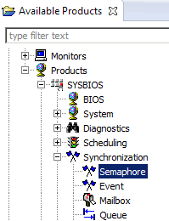
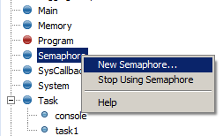
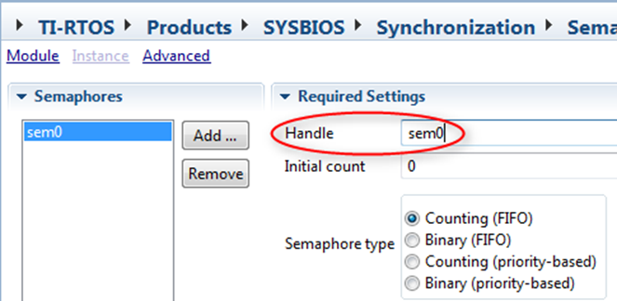
Add a Semaphore
In the Available Products View, expand TI-RTOS-> Products->SYSBIOS->Synchronization
Right-click on Semaphore and select ‘Use Semaphore’
In the Outline view, select Semaphore
Right-click on Semaphore and select ‘New Semaphore…’
A new clock instance named ‘semaphore0’ will appear
In the Outline view, click on semaphore0
Change the handle to “sem0”
Click the Save button to save the .cfg file

Slide 26
Add source file (app.c) to project
In the Project Explorer view, right-click on project uartconsole_TivaTM4C123GH6PM and select “Add Files…”
Browse to the directory C:\CCSWorkshop\rtosanalyzer, select ‘app.c’ and click Open
When prompted whether to Copy files or Link to files, select Copy files and click OK
The contents of app.c is provided here for reference, so you could also create a new source file named app.c, copy its contents into it and save it
#include <xdc/std.h>
#include <ti/sysbios/BIOS.h>
#include <ti/sysbios/knl/Semaphore.h>
extern Semaphore_Handle sem0;
Void task1Fxn(UArg a0, UArg a1)
{
for (;;) {
Semaphore_pend(sem0,BIOS_WAIT_FOREVER);
}
}
Void clock0Fxn(Void)
{
Semaphore_post(sem0);
}

Slide 27
Build and Run
Select the uartconsole_TivaTM4C123GH6PM project in the Project Explorer view
Click the debug button to build the project, load the code and run to main()
Click the Resume button to run the program
Let it run for 5 seconds, then click the Suspend button to halt
Go to the RTOS Object view
If needed it can be opened from the View menu
Expand uartconsole_TivaTM4C123GHp6PM.out (if it is not already expanded)

Slide 28
Using ROV
Click on Task in ROV
Answer the following questions:
How many tasks are there?
What are their priorities and current state?
Click on HeapMem in ROV and determine how much heap has been used
Click on Clock in ROV
Select the Module tab and look at the clock ticks
Run the program for 10 seconds. Check Clock ticks again
Verify that “10 seconds = 10,000 ticks” since 1ms tick rate
Click on Terminate button in the Debug view

Slide 29
Using ROV - Answers
Tasks:
There are 3 tasks: Idle, task1, console
console: priority 1, blocked
task1: priority 1, blocked
Idle: priority 0, running
Heap:
Free: 0x698
Used: 0x800 – 0x698 = 0x168
Clock:
Clock ticks should increase by 10,000 when you run for 10 sec since there is a 1 ms tick rate

Slide 30
Add Another Task
In the Project Explorer view, double-click on uartconsole.cfg
In the Outline view right-click on Task and select ‘New Task…’
Adjust its settings:
Function: task2Fxn
Priority: 3
Open settings of previously created task1 and change priority to 2
Click the Save button to save the .cfg file

Slide 31
Update app.c
In Project Explorer view, double-click on app.c to open it
Add the following code above task1Fxn
Save app.c
#include <ti/sysbios/knl/Task.h>
void task2Fxn(UArg a0, UArg a1)
{
for (;;) {
Task_sleep(10);
}
}

Slide 32
Using ROV
Click the Debug button to build, load the code and run to main()
Click the Resume button to run
Let it run for a few seconds, then click the Suspend button to halt
Go to the RTOS Object View (ROV) view
Click on Task
Answer the following questions:
How many tasks are there in the system now?
What are their priorities and current states?

Slide 33
Using ROV - Answers
Tasks:
There are 4 tasks
console: priority 1, blocked
task1: priority 2, blocked
task2: priority 3, blocked
Idle: priority 0, running

Slide 34
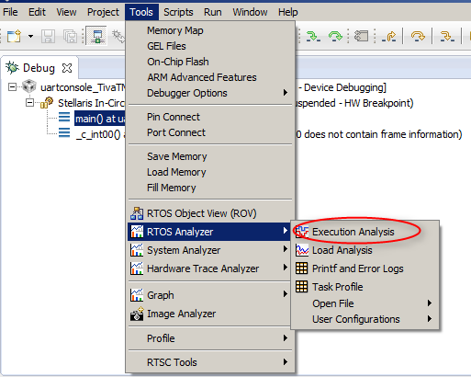
Launch RTOS Analyzer
Click the Resume button to run
Go to Tools->RTOS Analyzer->Execution Analysis

Slide 35
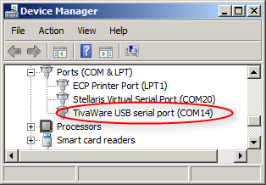
Analysis Configuration
RTOS Analyzer will detect from the application configuration that USB is being used for the data transport
In the Analysis Configuration dialog, for Port Name, enter the COM port that matches the TivaWare or Stellaris USB serial port
Go to Device Manager to find the COM port number. Note that this will be different than the virtual COM port used earlier for PuTTy
If you do not see a “USB serial port” listed in Device Manager, then the drivers are not installed. You can manually install the driver - it is located in the \windows_drivers folder in tirtos_xxx\products\TivaWare_xxx

Slide 36
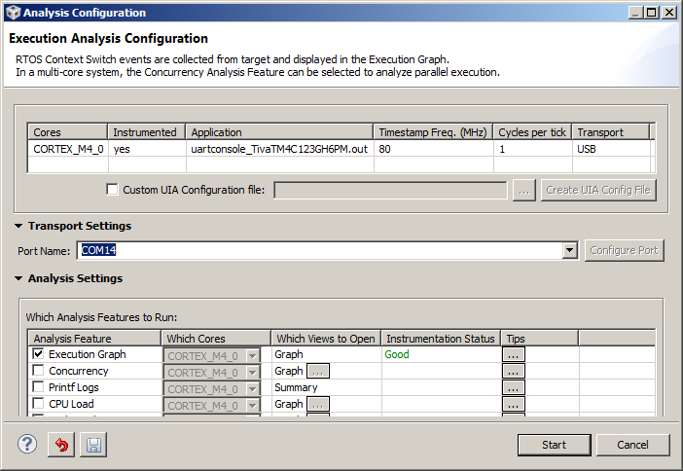
Analysis Configuration
In the Analysis Configuration dialog, the Analysis Feature “Execution Graph” should already be checked (Additional analysis features can be optionally selected here) If you are using TI-RTOS older than 2.00.00.xx/UIA older than 2.0, then Instrumentation Status may say “Cannot Determine”. This is just an informational message and should not be a problem
Click Start

Slide 37
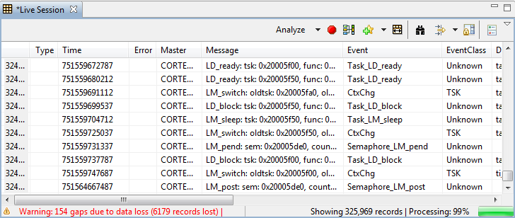
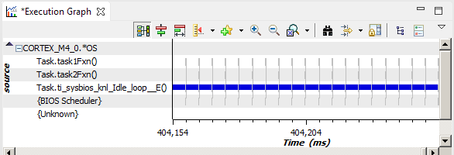
Using RTOS Analyzer
The Live Session and Execution Graph views will open
Expand the OS node in the Execution graph

Slide 38
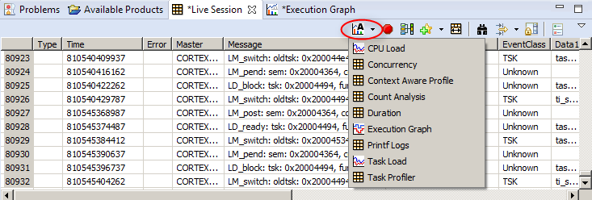
Additional Views
If desired, additional RTOS Analyzer views can be opened from to “Analyze” drop down menu within the Live Session view

Slide 39
Zooming in the Execution Graph
Click the Suspend button to halt the program and data collection
Use the zoom buttons on the Execution Graph toolbar to zoom in and out
Now try using the region zoom feature:
Hold the Alt key and the left mouse button
As you drag the cursor it shows you the zoom region
Let go of the mouse button and it will zoom into that region
Zoom region

Slide 40
Using Measurement Markers
Zoom in so that you can see task1Fxn
Right click and select “Insert Measurement Mark”. Drag it to the start of the first task1Fxn and click the left mouse button
Insert a bookmark so that you do not lose your spot. Right-click and select “Insert a BookMark”
Zoom out so that you can see multiple instances of task1Fxn
On the toolbar select BKM1 to center the graph on your first bookmark
Go to the next instance of task1Fxn. Zoom in
Insert a Measurement Mark at the start of task1Fxn
The period of task1 is now shown at the top of the execution graph X2 – X1 = ~ 5,000us

Slide 41
Clean Up
Right-click inside the view and select “Remove All Measurement Marks”
On the Execution Graph menu, under the bookmarks drop-down, select “Manage The Bookmarks”
In the dialog box select MKM1 and click the Delete button and then the Close button
Click on Terminate button in the Debug View to exit debug session

Slide 42
Modify app.c to add delay to task2Fxn()
In the Project Explorer view, double-click on app.c to open it
Add the delay() function and a call to it from task2Fx as shown in green
Save app.c
Click the Debug button to build, load and run to main()
Click the Resume button to run
void delay()
{
volatile int i;
for (i=0; i < 10000; i++) {}
}
void task2Fxn(UArg a0, UArg a1)
{
for (;;) {
Task_sleep(10);
delay();
}
}

Slide 43
Using RTOS Analyzer
Go to Tools->RTOS Analyzer->Execution Analysis
For Port Name, enter the COM port number that matches the TivaWare USB serial port
Click Start
After few seconds of data collection, click the Suspend button to halt the program
In the Execution Graph view, expand the OS node

Slide 44
Execution Graph
Use Zoom In and insert measurement markers at the start and end of task2Fxn
The time spent in task2Fxn() should be ~1536 us
Zoom Out until several instances of task1 and task2 are visible Why is task2 nicely periodic but task1 is not?
Click the Terminate button in the Debug view to end the debug session

Slide 45
LAB 2: Add analysis support to a BIOS app
15 MINUTES
Open CCS and select a workspace (the default is fine)
Notes:
45

Slide 46
LAB 2: Exercise Summary
Objectives
Learn how to configure a SYS/BIOS application to enable data collection from pre-instrumented SYS/BIOS threads
Use RTOS Analyzer to view RTA data (execution graph, task/CPU load)
Tools and Concepts Covered
UIA Logging
JTAG transport
Notes:
46

Slide 47
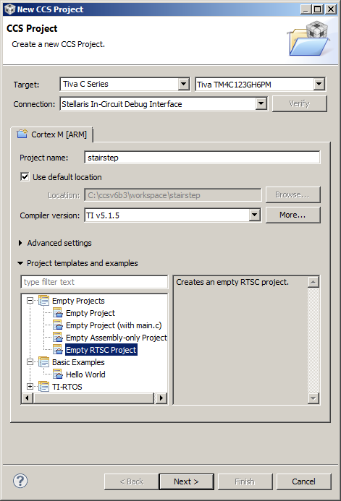
Create a TI-RTOS Kernel Application
Go to CCS menu Project->New CCS Project
Select these options:
Target: Tiva TM4C123GH6PM
Connection: Stellaris In-Circuit Debug Interface
Project name: stairstep
Template: Empty RTSC Project
Click Next

Slide 48
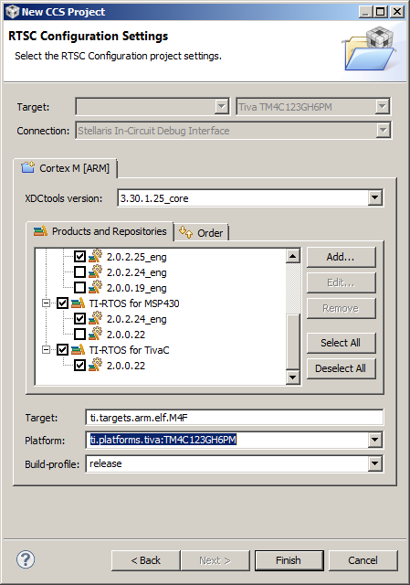
Create a TI-RTOS Kernel Application
Set the Platform as: ti.platforms.tiva:TM4C123GH6PM
Click Finish

Slide 49
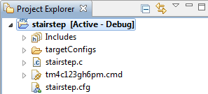
Add Source Files
In the Project Explorer view, right-click on stairstep project and select “Add Files…”
Browse to C:\CCSWorkshop\rtosanalyzer and select stairstep.c, stairstep.cfg and tm4c123gh6pm.cmd
Click Open
When prompted whether to Copy files or Link to files, select Copy files and click OK

Slide 50
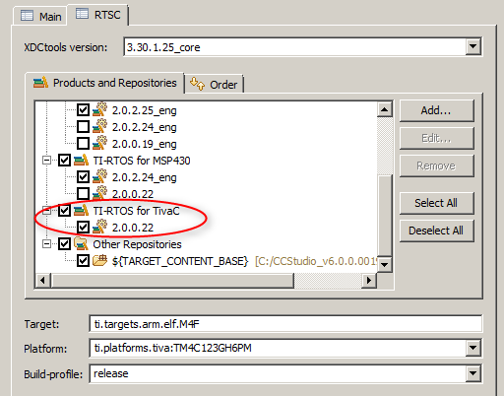
Enable TI-RTOS
Right-click on the project and select “Properties”
Select “General” in the left pane and click on the “RTSC” tab in the right pane
Ensure that TI-RTOS for TivaC is enabled
Click OK

Slide 51
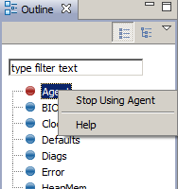
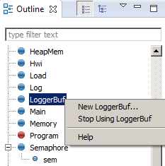
Disable Older Logging Methods
In the Project Explorer view, double-click on stairstep.cfg
In the Outline view, right-click on Agent and select “Stop Using Agent”
It should disappear from the Outline view
In the Outline view, right-click on LoggerBuf and select “Stop Using LoggerBuf”
It should disappear from the Outline view
The previous 2 steps disable older forms of BIOS logging that may have already existed in the application. We can now enable logging via UIA

Slide 52
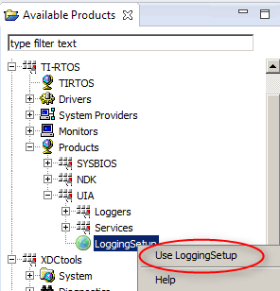
Add RTA Logging support
In Available Products view, go to TI-RTOS->Products->UIA-> LoggingSetup, right-click and select “Use LoggingSetup”
Save the .cfg file

Slide 53
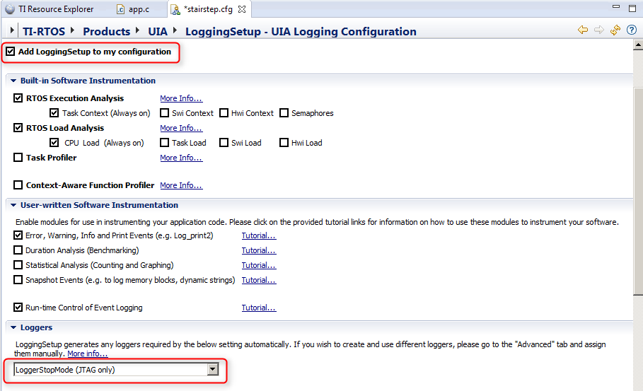
Add RTA Logging support
Observe that LoggingSetup module has been added to the configuration and transport type is set to LoggerStopMode (JTAG)

Slide 54
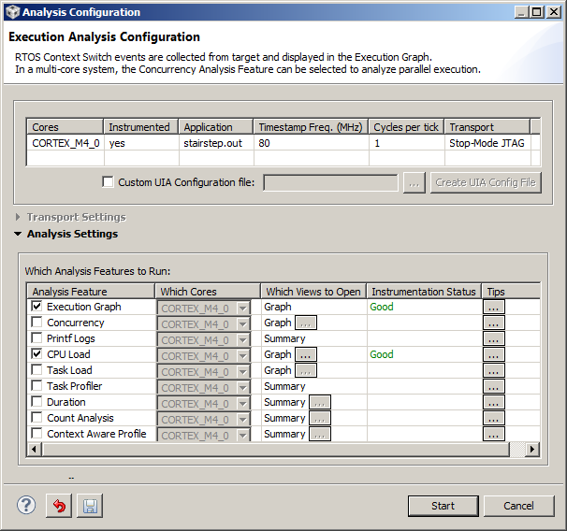
Using RTOS Analyzer
Click on stairstep in the Project Explorer
Click the Debug button to build, load and run to main()
Click the Resume button to run
Go to Tools->RTOS Analyzer-> Execution Analysis
Enable CPU Load in addition to Execution Graph
Click Start

Slide 55
Using RTOS Analyzer
A few seconds after all the RTOS Analyzer views have opened, click the Suspend button to halt the program and view graphs/data
Click the Resume button to run. After ~5-10 seconds click the Suspend button again
Run and Halt (after few seconds) several times and observe the graphs/data update during each halt

Slide 56
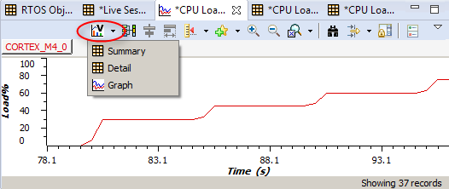
Using RTOS Analyzer
Go to CPU Load:Graph view The graph should look like a stairstep The Load Analysis views can be opened as Graphs, Summary logs or Detailed logs
The Summary view numerically shows the min, max and average load values
When finished with analysis, click on the Terminate button

Slide 57
Exercise Summary
After completing the labs you should be familiar with:
Using ROV (RTOS Object View) to inspect state of the scheduler, threads and objects in the system.
Adding objects (tasks, semaphores etc) to the configuration using XGCONF.
Using RTOS Analyzer to view RTA data (execution graph, task/CPU load).
Adding support to an existing SYS/BIOS application for logging RTA data.
Additional References:
TI-RTOS Users Guide: http://www.ti.com/lit/spruhd4
System Analyzer Users Guide: http://www.ti.com/lit/spruh43
SYSBIOS Wiki: http://processors.wiki.ti.com/index.php?title=Category:SYSBIOS

