Slide 1
TI-RTOS Analysis for CC3200
Embedded Development Tools

Slide 2
What is TI-RTOS?
One-stop solution for developing applications on TI processors and microcontrollers
Combines real-time kernel with additional middleware components such as TCP/IP and USB stacks, FAT file system, and device drivers
Includes several examples that can be used as starting point
Contains the following components:
SYS/BIOS, UIA, MSP430Ware, MWare, NDK, TivaWare, etc
More details and download available at
http://www.ti.com/tool/ti-rtos
Notes:
TI-RTOS for CC3200 includes SYSBIOS, UIA and CC3200 SDK

Slide 3
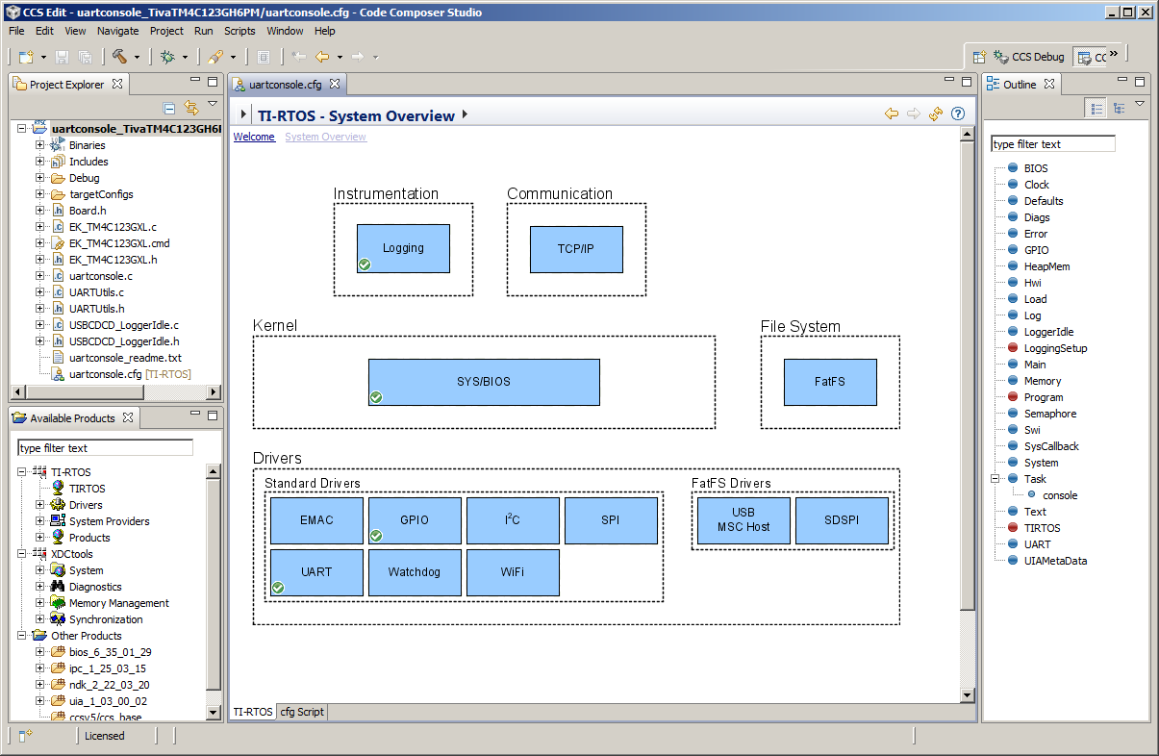
Configure TI-RTOS using XGCONF
TI-RTOS and its components can be viewed and configured using the XGCONF graphical configuration editor included with CCS
Double-clicking on configuration (.cfg) file in Project Explorer opens it in XGCONF graphical editor by default
XGCONF is made up of several views that are used together
Property view
Outline view
Available Products view
One or more views can be used for configuring TI-RTOS and other components

Slide 4
Instrumentation with TI-RTOS
TI-RTOS uses Unified Instrumentation Architecture (UIA) target content to instrument the application
Instrumented data can be viewed with System Analyzer (SA) host side tooling to create execution graphs, load graphs and more
Data can be transported to host PC via different transports such as Ethernet, JTAG, USB/UART
System Analyzer tool suite works together with UIA to provide visibility into real-time performance and behavior
For more details refer to the System Analyzer Users Guide
http://www.ti.com/lit/pdf/spruh43

Slide 5
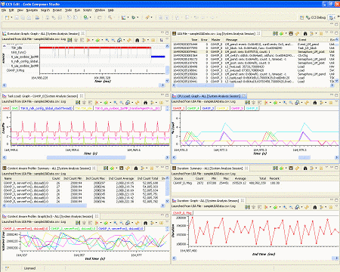
System Analyzer
System Analyzer provides many different analysis features
Analysis views can be opened as graphs, detailed logs and summary logs

Slide 6
System Analyzer Analysis Features
Execution Graph
Shows execution of threads running on the target
CPU Load
Shows SYS/BIOS load data collected for all cores in the system
Task Load
Shows the CPU load data measured within a SYS/BIOS Task thread
Concurrency
Shows when each core is active and how many are active at once
Task Profiler
Shows percent of time that each task spent in each execution state
Printf Logs
Shows messages output by program through Log_printf() calls
The above features use data that is automatically logged by SYS/BIOS

Slide 7
System Analyzer Analysis Features
Count Analysis
Tracks data values on the target
Context Aware Profile
Calculates duration with awareness of interruptions by other threads and functions
Duration
Calculates time between two points of execution
The above features require modifications to application code to perform additional logging

Slide 8
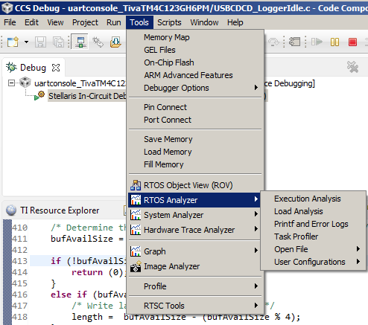
RTOS Analyzer
RTOS Analyzer is part of System Analyzer suite of tools
Invoked from CCS menu Tools->RTOS Analyzer
RTOS Analyzer menu includes analysis features that use data that is automatically logged by SYS/BIOS, (ie) do not require modification to application code

Slide 9
RTOS Object View (ROV)
Provides state information about the modules used by the application
Stop mode debugging tool
Invoked from CCS menu Tools->RTOS Object View (ROV)

Slide 10
LAB Requirements
Software:
Code Composer Studio v6.0.0.00190 (Download from http://processors.wiki.ti.com/index.php/Download_CCS and install into C:\ti)
TI-RTOS for SimpleLink Wireless MCUs (Install from CCS App Center from within CCS)
Hardware:
CC3200 Launchpad

Slide 11
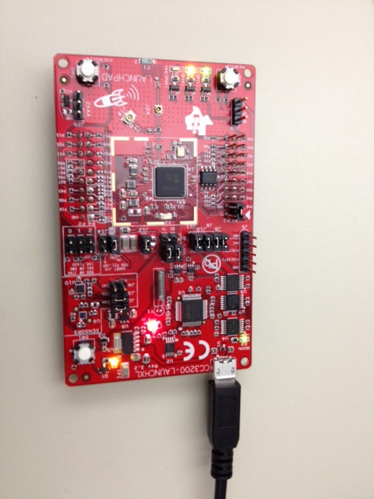
Hardware Setup
Connect the Development kit to the PC using the USB cable

Slide 12
LAB Conventions
Before starting, it is important to review some lab conventions that will ease your work…
Lab steps are in black and numbered for easier reference
…
…
Explanations, notes, warnings are written in blue
Warnings are shown with
Information is marked with
Tips and answers are marked with
Questions are marked with
Notes:
12

Slide 13
LAB 1: ROV and RTOS ANALYZER basics
20 MINUTES
Open CCS and select a workspace (the default is fine)
Notes:
13

Slide 14
LAB 1: Exercise Summary
Objectives
Get familiar with using ROV (RTOS Object View) to inspect state of the scheduler, threads and objects in the system
Get familiar with using RTOS Analyzer to view RTA data (execution graph, task/CPU load etc)
Tools and Concepts Covered
RTOS Object Viewer (ROV)
RTOS Analyzer
Summary
This lab uses an example included with TI-RTOS that already has logging enabled to capture RTA data. The data is transported to host using JTAG Stop Mode so graphs and data view will be updated only when target is halted.
Notes:
14

Slide 15
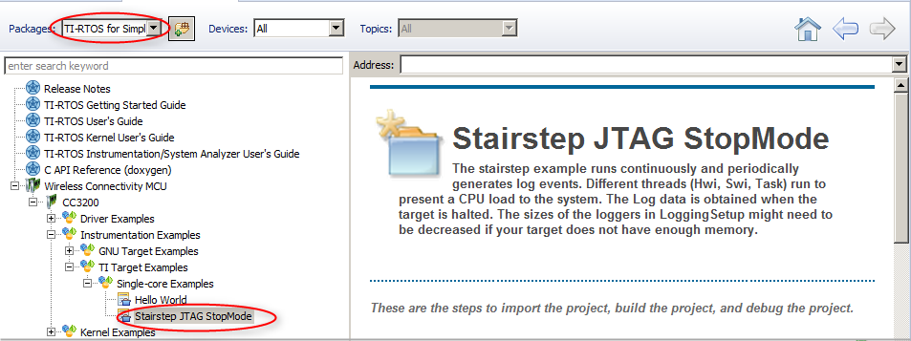
Import an Example with Resource Explorer
Go to CCS menu View -> Resource Explorer (Examples)
Select TI-RTOS for SimpleLink Wireless MCUs in the Packages filter box
Expand Wireless Connectivity MCU->CC3200->Instrumentation Examples->TI Target Examples->Single-core Examples, and select Stairstep JTAG StopMode

Slide 16
Import, Build and load the example
Click Step 1 link in the right pane to “Import the example project into CCS”
The project will appear in the Project Explorer view if the import is successful and a green checkmark will appear next to the link in the right pane
Click Step 2 link in the right pane to “Build the imported project” The Console view will appear along the bottom with build messages as the project builds. If the build is successful, a green check mark will appear in the link in the right pane
Click Step 3 link in the right pane to set up “Debugger Configuration”. Select Stellaris In-Circuit Debug Interface
Click Step 4 link in the right pane to “Debug the imported project”

Slide 17
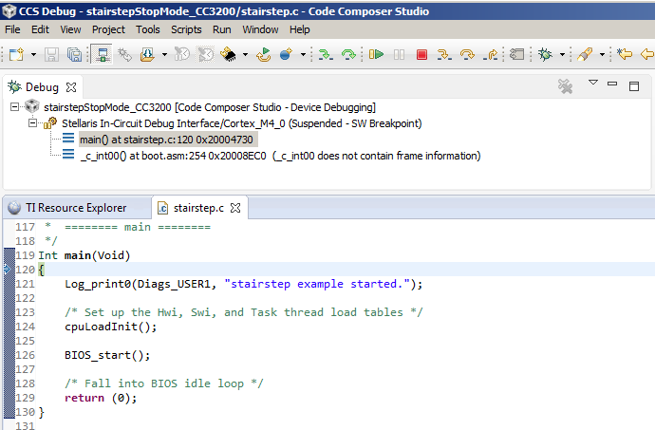
Debug session
The program should be loaded and halted at main()

Slide 18
Open the RTOS Object View (ROV)
ROV can be used to inspect state of the scheduler, threads and objects in the system
Go to menu Tools->RTOS Object View (ROV) to open ROV
In RTOS Object View, expand stairstepStopMode_CC3200.out

Slide 19
Use ROV
Click on “Task” to see details of tasks in the system
Answer the following for each task:
What are the priorities and current states/mode?
What is the size of stack and stack peak? (Hint: some info is in Detailed tab)
Click the Resume button to run the program
Let it run for 5 seconds, then click the Suspend button to halt Answer the following for each task again:
What are the current states/mode?
What is the stack peak?

Slide 20
Use ROV
Click on “HeapMem” to see details about the system heap
Answer the following: (Hint: need to go to Detailed tab for some info)
What is the total size of heap, and free size?
What is the starting address of the heap?
Click on the Terminate button in the Debug View More information on ROV is available at: http://rtsc.eclipse.org/docs-tip/RTSC_Object_Viewer

Slide 21
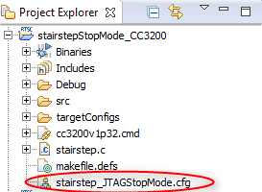
Launch XGCONF
In the Project Explorer view, expand the stairstepStopMode_CC3200 project and double-click on stairstep_JTAGStopMode.cfg to open it in the XGCONF graphical editor
This will open 3 views:
The Editor view in the middle
The Outline view on the right
The Available Products view at the bottom left

Slide 22
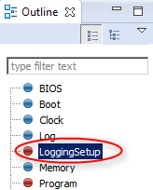
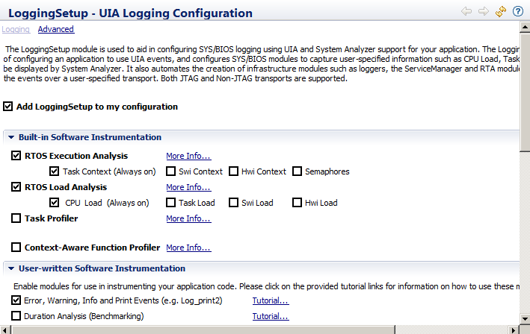
RTA Logging
In the Outline view, click on LoggingSetup Note that LoggingSetup is enabled in the configuration. The LoggingSetup module is used to configure SYS/BIOS logging of info such as CPU/Task Load and Execution so it can be displayed by System Analyzer

Slide 23
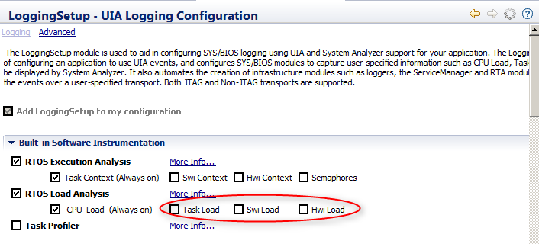
RTA Logging
In the Editor view, under Built-in Software Instrumentation, uncheck Task Load, Swi Load and Hwi Load
Due to smaller RAM in these devices, we are limiting the load logging to CPU Load to avoid much data loss
Save the .cfg file

Slide 24
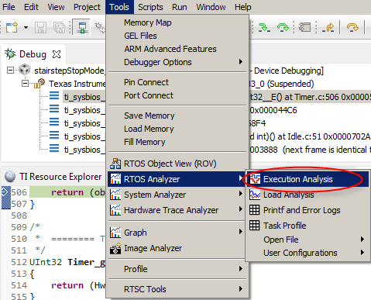
Launch RTOS Analyzer
Click the Debug button to build, load the code and run to main()
Go to menu Tools->RTOS Analyzer->Execution Analysis

Slide 25
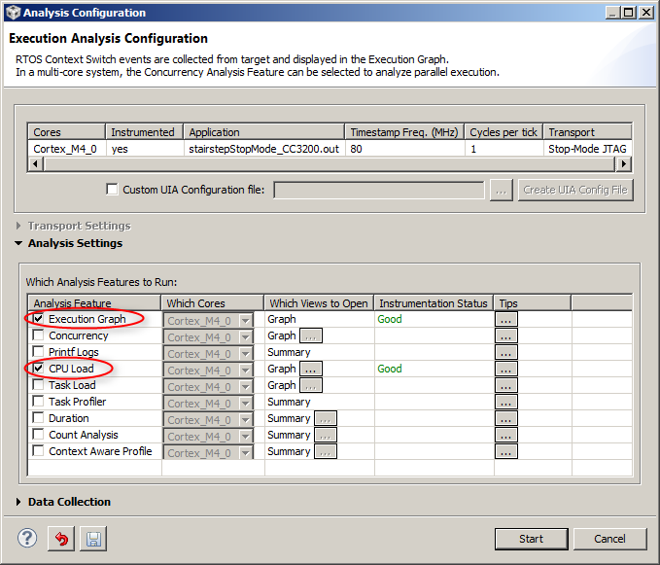
Analysis Configuration
In the Analysis Configuration dialog, the Analysis Feature “Execution Graph” should already be enabled (Additional analysis features can be optionally selected here)
Enable “CPU Load”
Click Start The Live Session, Execution Graph and CPU Load Graph views will open

Slide 26
Run the code
Click the Resume button to run
Let it run for ~5-10 seconds, then click the Suspend button to halt
Repeat this Run/Suspend process 3-4 times

Slide 27
Execution Graph
Go to the Execution Graph view and expand the OS node in the Execution graph

Slide 28
Use Zoom in the Execution Graph
Use the zoom buttons on the Execution Graph toolbar to zoom in/out
Zoom out a few times until you see many instances of taskLoad
Then zoom into one instance of taskLoad using either:
Zoom in and moving the time axis so you can see the task OR
Using the region zoom feature:
Hold the Alt key and the left mouse button
As you drag the cursor it shows you the zoom region
Let go of the mouse button and it will zoom into that region

Slide 29
Use Measurement Marks to measure Time
Right click and select “Insert Measurement Mark”. Drag it to the start of taskLoad and click the left mouse button
Right click and select “Insert Measurement Mark”. Drag it to the end of the same taskLoad and click the left mouse button
The time spent in task1Fxn is shown at the top of the view: X2 – X1 = 7us
To remove the measurement marks, right-click inside the view and select “Remove All Measurement Marks”
Measurement marks

Slide 30
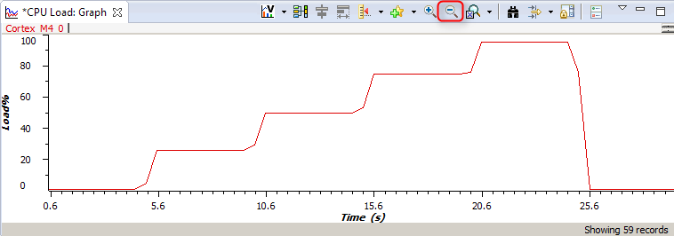
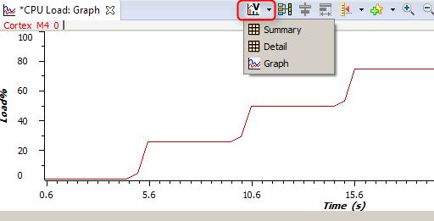
Use RTOS Analyzer
Go to CPU Load:Graph view
Zoom out a few times (The Load graph should look like a stairstep The Load Analysis views can be opened as Graphs, Summary logs or Detailed logs The Summary views numerically show the min, max and average load values
When finished with analysis, click the Terminate button

Slide 31
Exercise Summary
After completing the lab you should be familiar with:
Using ROV (RTOS Object View) to inspect state of the scheduler, threads and objects in the system.
Using RTOS Analyzer to view RTA data (execution graph, task/CPU load).
Additional References:
TI-RTOS Users Guide: http://www.ti.com/lit/spruhd4
System Analyzer Users Guide: http://www.ti.com/lit/spruh43
SYSBIOS Wiki: http://processors.wiki.ti.com/index.php?title=Category:SYSBIOS

Slide 32
LAB 2: Add ANALYSIS SUPPORT TO TI-RTOS APPLICATION
30 MINUTES
Open CCS and select a workspace (the default is fine)
Notes:
32

Slide 33
LAB 2: Exercise Summary
Objectives
Configure a TI-RTOS application to enable data logging from pre-instrumented SYS/BIOS threads, and transport data to host using JTAG
Modify the app to transport the data to the host through UART instead of JTAG
Tools and Concepts Covered
Enabling data logging in RTSC configuration file
Configuring UIA Logger based on event upload method
Setting UIA Logger to upload data over UART during SYS/BIOS Idle task
Summary
This lab takes a TI-RTOS example that does not have logging enabled and shows how to modify it to enable data logging and also how to configure the UIA Logger based on the type of transport desired
Notes:
33

Slide 34
LAB 2a: Add ANALYSIS SUPPORT TO TI-RTOS APP AND upload events via jtag (stop mode)
Notes:
34

Slide 35
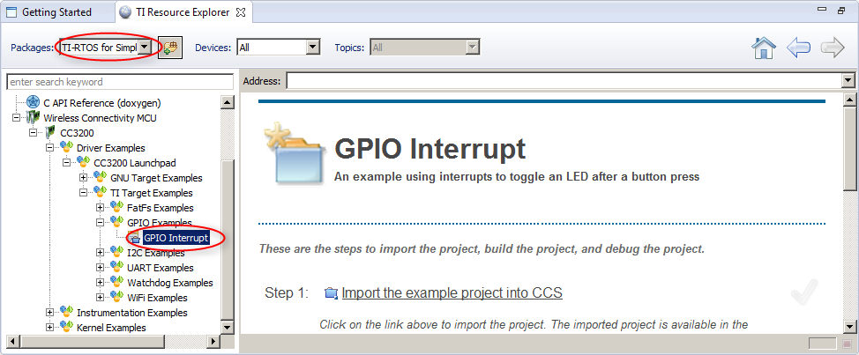
Import an Example with Resource Explorer
Go to CCS menu View -> Resource Explorer (Examples)
Select TI-RTOS for SimpleLink Wireless MCUs in the Packages filter box
Expand Wireless Connectivity MCU->CC3200->Driver Examples->CC3200 Launchpad->TI Target Examples->GPIO Examples, and select GPIO Interrupt

Slide 36
Import an Example with Resource Explorer
Click Step 1 link in the right pane to “Import the example project into CCS”
The project will appear in the Project Explorer view if the import is successful and a green checkmark will appear next to the link in the right pane
Click Step 3 link in the right pane to set up “Debugger Configuration”. Select Stellaris In-Circuit Debug Interface

Slide 37
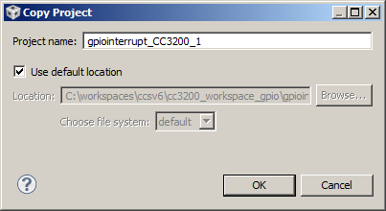
Make a copy of the project
These steps make a copy of the project so we can make changes to the copied version rather than the original
In Project Explorer view, right-click on project gpiointerrupt_CC3200 and select Copy
In Project Explorer view, click anywhere else and select Paste
Give the copied project a name (gpiointerrupts_CC3200_1)
Click OK

Slide 38
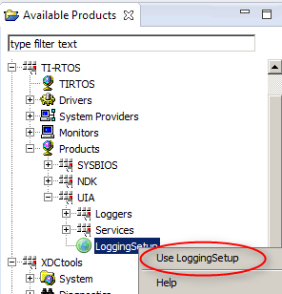
Add RTA Logging Support
These steps add LoggingSetup Module to the configuration
In the Project Explorer view, expand project gpiointerrupt_CC3200_1 and double-click on gpiointerrupt.cfg
In Available Products view, go to TI-RTOS->Products->UIA-> LoggingSetup, right-click and select “Use LoggingSetup”

Slide 39
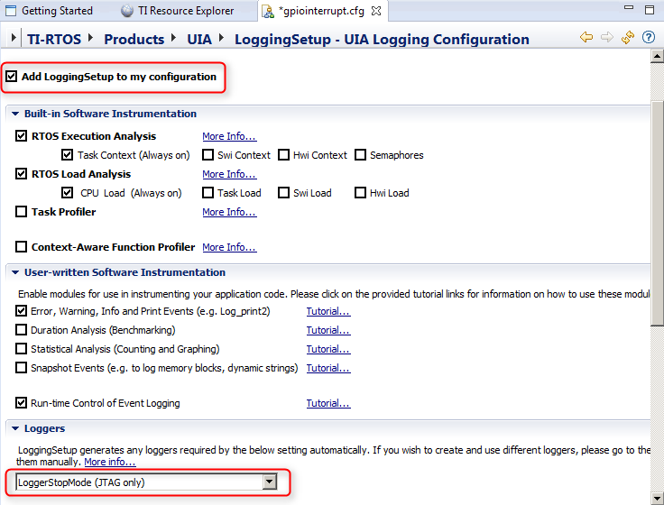
Add RTA Logging support
Observe that LoggingSetup module has been added to the configuration and Logger defaults to LoggerStopMode (JTAG only)

Slide 40
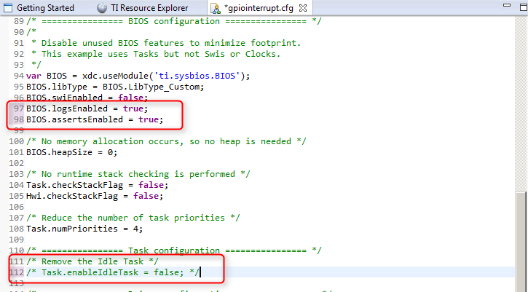
Add RTA Logging Support
In the Editor view, go to “cfg Script” tab to edit the .cfg file in text editor
Enable BIOS Logs and Asserts by modifying the below lines BIOS.logsEnabled = true; BIOS.assertsEnabled = true;
Comment out the line that removes the Idle Task /* Task.enableIdleTask = false; */
Click the Save button to save the .cfg file

Slide 41
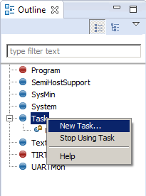
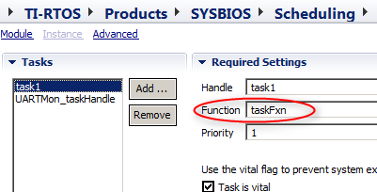
Add a Task
In the Editor view, go to TI-RTOS tab
In the Outline view, select Task
Right-click on Task and select ‘New Task…’
A new task named ‘task1’ will appear with a red X beside it. The red X is due to not having defined a function name yet
In the Outline view, click on task1
This will open the editor at the Task – Instance Settings
Set the function name to taskFxn
Click the Save button to save the .cfg file

Slide 42
Update gpiointerrupt.c
In Project Explorer view, double-click on gpiointerrupt.c to open it
Add the following code for taskFxn above main()
Include the header files Diags.h and Log.h under other XDCtools Header file includes
Save gpiointerrupt.c
Void taskFxn(UArg arg0, UArg arg1)
{
unsigned int sleepDur = 100;
unsigned int id = (unsigned int)arg0;
unsigned int count = 0;
while (1) {
Task_sleep(sleepDur);
Log_print2(Diags_USER1, "Task %d awake, count = %d", id, count);
count++;
}
}
#include <xdc/runtime/Diags.h>
#include <xdc/runtime/Log.h>

Slide 43
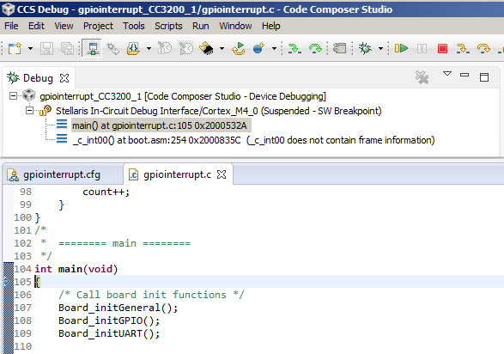
Build and load code
In Project Explorer view, select the gpiointerrupt_CC3200_1 project
Click the Debug button to build, load the code and run to main() The program will load and be halted at main()

Slide 44
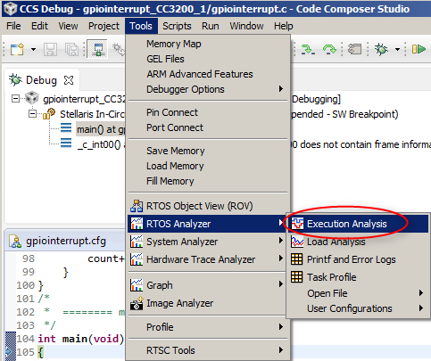
Launch RTOS Analyzer
Go to menu Tools->RTOS Analyzer->Execution Analysis

Slide 45
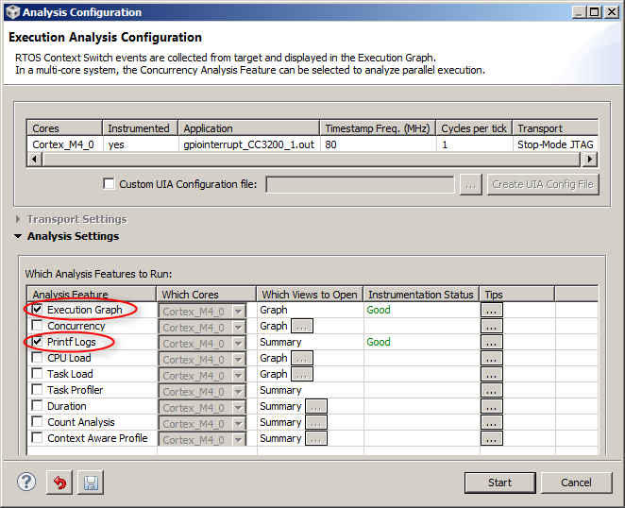
Analysis Configuration
In the Analysis Configuration dialog, the Analysis Feature “Execution Graph” should already be checked (Additional analysis features can be optionally selected here)
Enable “Printf Logs”
Click Start The Live Session, Execution Graph and Printf Logs views will open

Slide 46
Run the code
Click the Resume button to run
Let it run for ~5-10 seconds, then click the Suspend button to halt
Repeat this Run/Suspend process 2-3 times Observe that the analysis views will get updated whenever the target is halted

Slide 47
Execution Graph
Go to the Execution Graph view and expand the OS node in the Execution graph
Click the zoom out button a few times to view Execution Graph

Slide 48
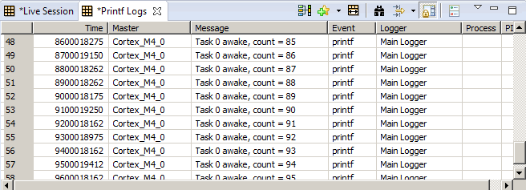
Printf Logs
Go to Printf Logs view The Printf Log events will be displayed here
When finished with analysis, click the Terminate button

Slide 49
LAB 2b: modify app to upload events via UART
Notes:
49

Slide 50
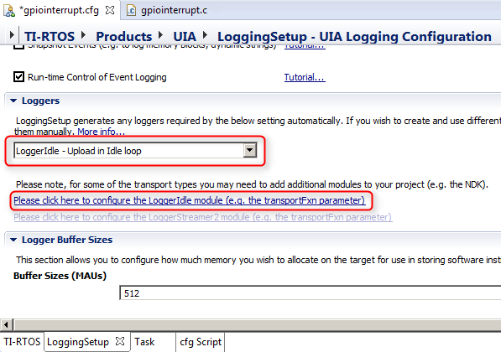
Change Loggers
These steps change Loggers from LoggerStopMode to LoggerIdle, which stores log events in a buffer, and during idle time, sends a section of the buffer to a user configured transport function
In the Project Explorer view, highlight project gpiointerrupt_CC3200_1 and double-click on gpiointerrupt.cfg
In Outline view, click on LoggingSetup
Change Loggers to “LoggerIdle”
Click on the link to configure the LoggerIdle module

Slide 51
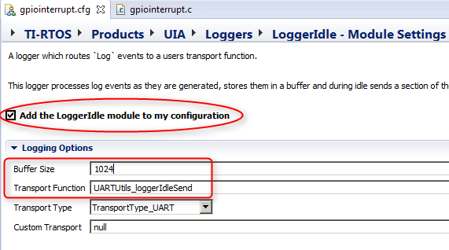
Enable LoggerIdle
These steps add the LoggerIdle module to the configuration and set the transport function to UARTUtils_loggerIdleSend, which formats the Log data and sends it out to the UART
Check the box to “Add the LoggerIdle module to my configuration”
Set Buffer Size to “1024”
Set Transport Function to “UARTUtils_loggerIdleSend”
Save the .cfg file

Slide 52
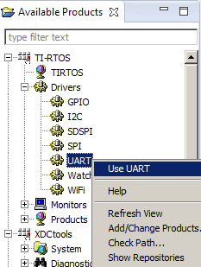
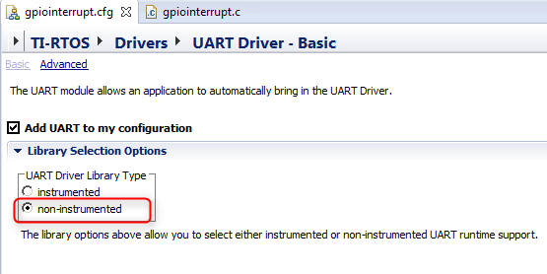
Add UART Module
These steps add the UART module to the configuration. This module allows the application to automatically bring in the UART driver.
In Available Products view, go to TI-RTOS->Drivers->UART, right-click and select “Use UART”
In the Editor view, select the non-instrumented library
Save the .cfg file

Slide 53
Add UART source files to project
These steps add the source files required for UART related functions
In Windows Explorer, browse to the directory C:\ti\tirtos_simplelink_2_00_02_36\packages\examples You may need to adjust the path based on your CCS installation
Select the files UARTUtils.c and UARTUtils.h and choose “Copy”
In CCS Project Explorer view, select the project gpiointerrupt_CC3200_1 and choose “Paste”

Slide 54
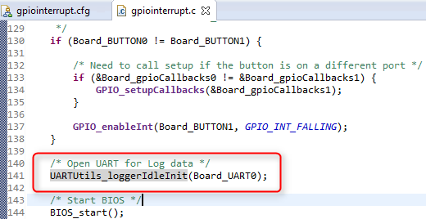
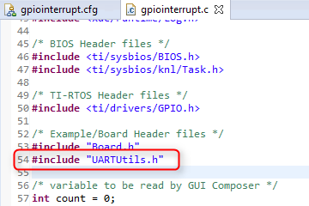
Update gpiointerrupt.c
These steps modify gpiointerrupt.c to add a call to open UART
In Project Explorer view, double-click on gpiointerrupt.c to open it
Add a call to UARTUtils_loggerIdleInit just before BIOS_start()
Add #include “UARTUtils.h” under other #includes

Slide 55
Build and load code
In Project Explorer view, select the gpiointerrupt_CC3200_1 project
Click the Debug button to build, load the code and run to main() The program will load and be halted at main()

Slide 56
Launch RTOS Analyzer
Go to menu Tools->RTOS Analyzer->Execution Analysis

Slide 57
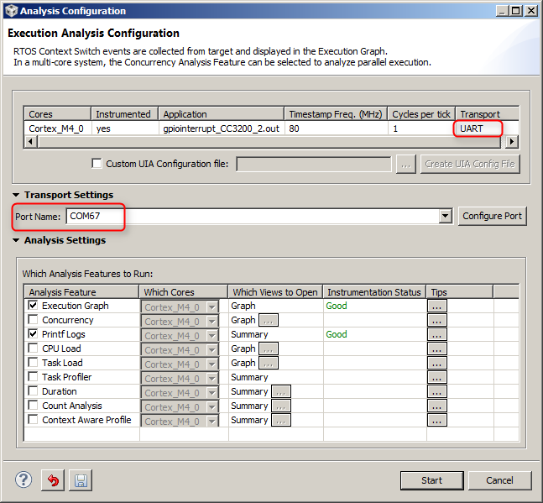
Analysis Configuration
In the Analysis Configuration dialog, the Analysis Feature “Execution Graph” should already be checked (Additional analysis features can be optionally selected here)
Enable “Printf Logs” If lab2a was completed, this should already be enabled Note that Transport is set to UART and the Port Name is auto-detected
Click Start The Live Session, Execution Graph and Printf Logs views will open

Slide 58
Run the code
Click the Resume button to run
Let it run for few seconds Observe that the analysis views get updated while the code is running, since data is being uploaded over UART during BIOS Idle task
Click the Suspend button to halt

Slide 59
Execution Graph
Go to the Execution Graph view and expand the OS node in the Execution graph
Click the zoom out button a few times to view Execution Graph

Slide 60
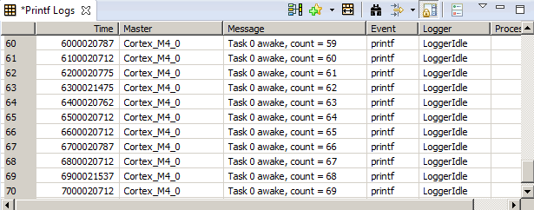
Printf Logs
Go to Printf Logs view The Printf Log events will be displayed here
When finished with analysis, click the Terminate button

Slide 61
Exercise Summary
After completing the lab you should be familiar with:
Configuring TI-RTOS application for data collection from pre-instrumented SYS/BIOS threads
Configuring UIA Logger based on event upload method
Additional References:
TI-RTOS Users Guide: http://www.ti.com/lit/spruhd4
System Analyzer Users Guide: http://www.ti.com/lit/spruh43
SYSBIOS Wiki: http://processors.wiki.ti.com/index.php?title=Category:SYSBIOS

