Slide 1
Portable Projects
Embedded Development Tools

Slide 2
Portable Projects: Briefing
Key Objectives
Create a project that uses linked files
Make the project portable
Tools and Concepts Covered
Sharing Projects
Linked Resources
Linked Resource Path Variables
Build Variables
Files needed for version control
Notes:
2

Slide 3
Portable Projects: Lab Requirements
The following tools/software are used for the hands-on lab section:
CCSv6.1 with all C2000 components installed
controlSUITE (assumed to be installed in the default ‘C:\ti\controlSUITE’ directory)
F28027 Launchpad (optional – only if you wish to test the application on a real target)
Notes:
3

Slide 4
Sharing Projects
Sharing “Simple” projects (all source/header files are contained in the project folder)
Sharing “Linked file” projects only (no source)
Only the project folder is shared (person receiving project already has all source)
Effort involves making the project “portable”
Eliminate absolute paths in the project
This is the most common use case
Notes:
4

Slide 5
Sharing Projects – Simple Projects
USE CASE: Wish to share (give) a project folder and all needed source files to build the project. All source files are inside the project folder.
Easy to share projects with no linked files:
The entire project folder can be distributed to another “as-is”
The user who receives the project can import it into their workspace using ‘Project -> Import CCS Projects’ and selecting the copied folder
Works well for simple projects that only reference files inside the project folder
Notes:
5

Slide 6
Sharing Projects – “Linked file” Projects
USE CASE(S):
Wish to share (give) a project folder only. The person receiving the project file already has a copy of the source files
Wish to check the project folder/files into source control
Most use cases involve sharing JUST the projects instead of bundling all the source files
People will have their own local copies or access to the source files (shared location, available via source control, etc)
Need to make the project portable to make sure the project is easily shared
Avoid using absolute paths
Ideal portable projects should be usable without modifying any of the project files
This is ideal for projects maintained in source control
Notes:
6

Slide 7
Sharing Projects – “Linked file” Projects
Creating portable projects involves use of two kinds of variables:
Linked Resource Path variable
Build variable
Both variables can be set to point to a directory
Source files/resources can be linked relative to the Linked Resource Path Variables
Build Variables can be used when setting the project’s compiler and linker options (such as include paths to header files, paths to libraries etc)
Creating Variables:
In CCS 6.1.0 and greater, variables can be defined in a single location and used as both Path variable and Build variable
In CCS versions prior to 6.1.0, Path variable and Build variable had to be defined in two different locations
Notes:
7

Slide 8
Creating a Portable Project - Example Walkthrough

Slide 9
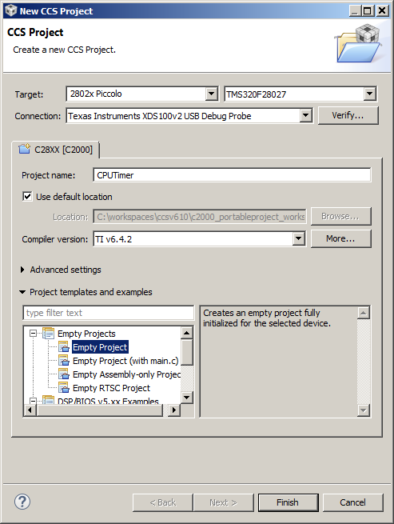
Create a New Project
Open CCS and Launch ‘New CCS Project’ Wizard
Go to menu File → New → CCS Project
Fill in the fields as shown in the right
Target: TMS320F28027
Connection: Texas Instruments XDS100v2 USB Debug Probe
Project name: CPUTimer
In Project templates and examples, select Empty Project
Select Finish when done Generated project will appear in the Project Explorer view
Expand the project and delete 28027_RAM_lnk.cmd from the project
Notes:
9

Slide 10
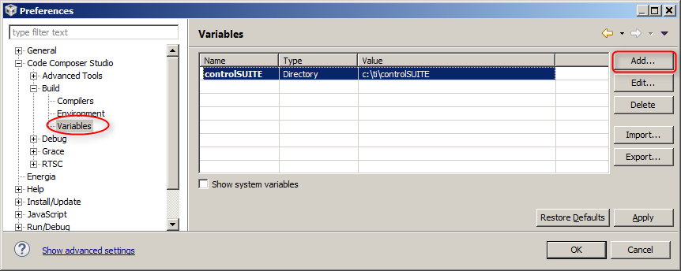
Create a Variable
Here we will create a Variable which can then be used when linking source files (resources) to the project as well as when specifying build options
Open the workspace preferences from menu Window → Preferences
Go to the Variables preference by expanding Code Composer Studio->Build
Use the Add button to create a Variable: Variable name: controlSUITE Type: Directory Value: C:\ti\controlSUITE (root location of the controlSUITE directory)
Click OK
Notes:
10

Slide 11
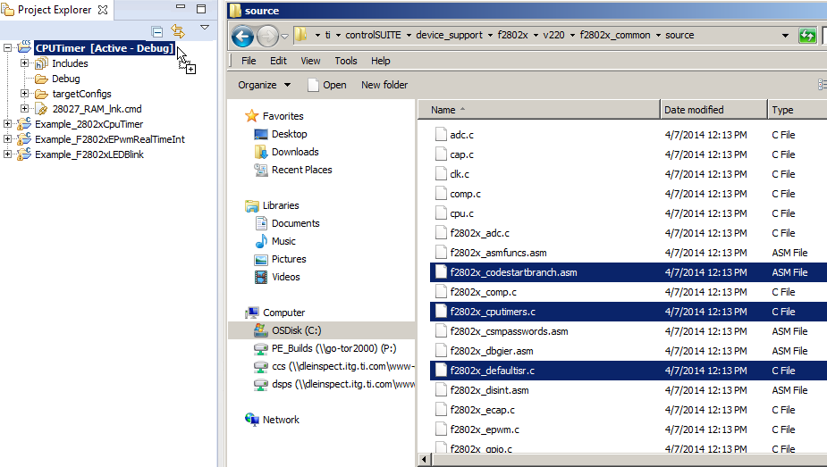
Link Source Files to Project
Here we will link source files relative to the Variable just created
Open Windows Explorer and browse to:
C:\ti\controlSUITE\device_support\f2802x\v222\f2802x_common\source
Select the following files and drag and drop them into the “CPUTimer” project in the CCS Project Explorer view
f2802x_codestartbranch.asm
f2802x_cputimers.c
f2802x_defaultisr.c
f2802x_piectrl.c
f2802x_pievect.c
f2802x_sysctrl.c
f2802x_usdelay.asm
Notes:
11

Slide 12
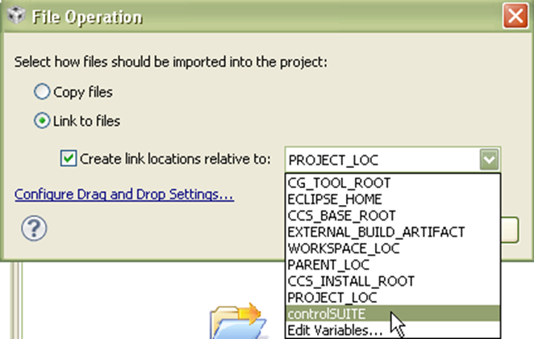
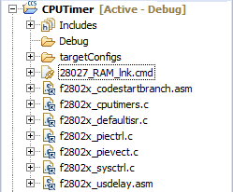
Link Source Files to Project
A dialog will appear asking if you wish to Copy or Link the files:
Select Link to files
Select Create link locations relative to: controlSUITE
Use the new variable we created (controlSUITE)
Click OK
Files will now appear in the Project Explorer with the ‘link’ icon
Notes:
12

Slide 13
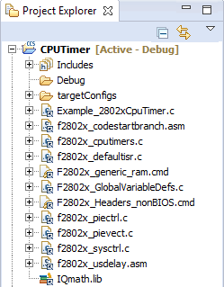
Link Source Files to Project
Follow the same procedure to link other source files
Drag and drop each of the following files one by one into the “CPUTimer” project in the Project Explorer view
C:\ti\controlSUITE\device_support\f2802x\v222\f2802x_examples_structs\cpu_timer\Example_2802xCpuTimer.c
C:\ti\controlSUITE\device_support\f2802x\v222\f2802x_headers\source\F2802x_GlobalVariableDefs.c
C:\ti\controlSUITE\device_support\f2802x\v222\f2802x_headers\cmd\F2802x_Headers_nonBIOS.cmd
C:\ti\controlSUITE\device_support\f2802x\v222\f2802x_common\cmd\F2802x_generic_ram.cmd
C:\ti\controlSUITE\libs\math\IQmath\v160\lib\IQmath.lib
In each case, in the dialog that appears, select Link to files
Select Create link locations relative to: controlSUITE
Use the new variable we created (controlSUITE)
Click OK
Notes:
13

Slide 14
Link Files to Project
Right-click on source file “Example_2806xCpuTimer.c” and go to Properties.
Click on Resource in the left pane Notice how the Location parameter references the Variable
Click Cancel
Notes:
14

Slide 15
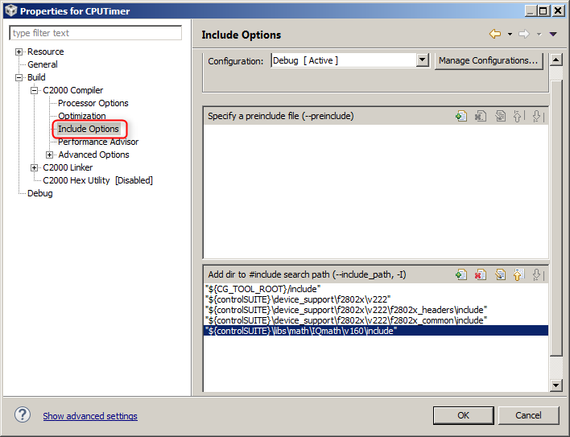
Modifying Project Properties
Here we will add include file search paths using the Variable
Right-click on the project and select Properties
In the Compiler Include Options, click on the + sign next to --include_path option to add the following entries:
${controlSUITE}\device_support\f2802x\v222
${controlSUITE}\device_support\f2802x\v222\f2802x_headers\include
${controlSUITE}\device_support\f2802x\v222\f2802x_common\include
${controlSUITE}\libs\math\IQmath\v160\include
‘${<BUILD VARIABLE>}’ is the syntax to use a Build Variable in the project properties.
The variable we previously created can be used to specify search paths relative to it
Notes:
15

Slide 16
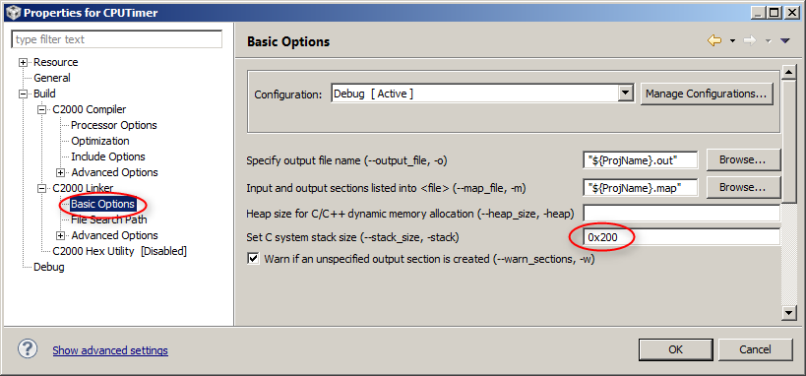
Modifying Project Properties
In the Linker Basic Options, change the stack size to 0x200 This step is done simply to facilitate all the code and data to fit within the available memory
Notes:
16

Slide 17
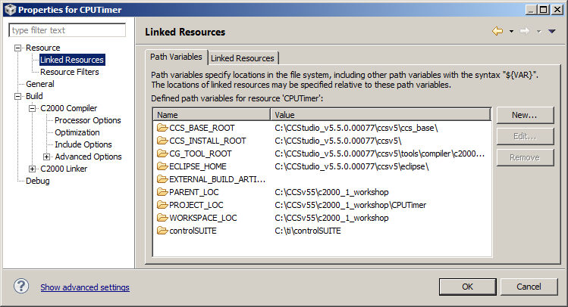
Project Properties
Go to Resource → Linked Resources to see all the Path Variables that are available to the project
This will show all variables created at the project level and workspace level
Check that the workspace level variable that was created earlier (controlSUITE) appears in the list Variables may be edited here but changes will only be recorded at the project level (stored in the project files)
Notes:
17

Slide 18
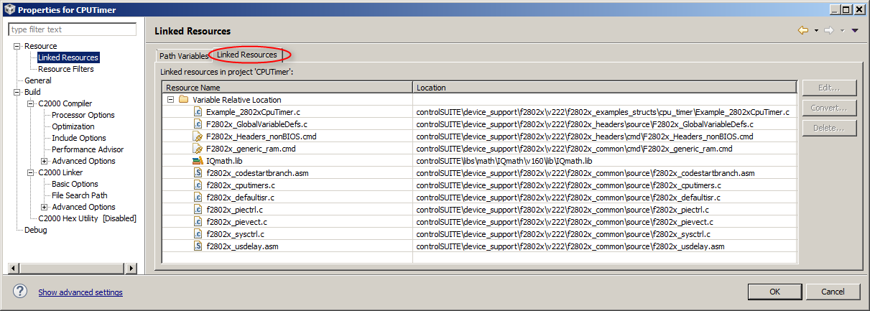
Project Properties
The Linked Resources tab will show all the files that have been linked to the project
It will sort them by files linked with a variable and files linked with an absolute path
Links can be modified here with the Edit… button
Links can be converted to use an absolute path with the Convert… button
Notes:
18

Slide 19
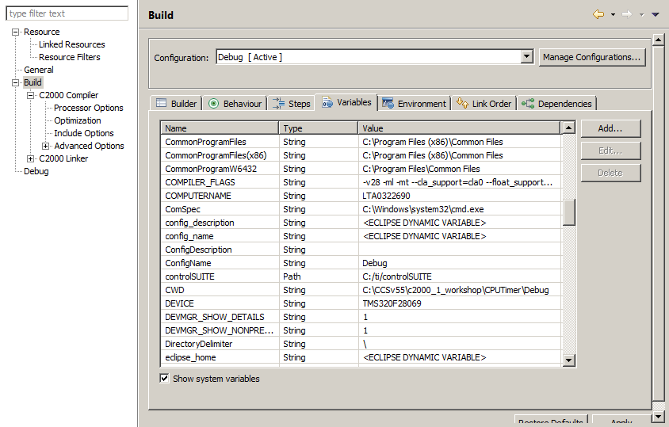
Project Properties
Go to Build → Variables tab to see all the Build Variables that are available to the project
Only project level variables will be listed by default
Enable the Show system variables checkbox to see variables set at the workspace and system level
Check that the workspace level variable that was created earlier (controlSUITE) appears in the list
Click OK
Notes:
19

Slide 20
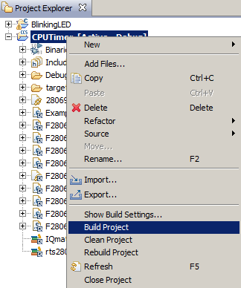
Build the Program
Make sure the ‘CPUTimer’ project is in focus in the Project Explorer view
Right-click on the project and select Build Project The project should build without errors
Optionally run the program on the F28027 Launchpad to verify that it works
Notes:
20

Slide 21
CPU Timer Example (Portable Project): Summary
In this lab we completed the following:
Created a new portable project
Created workspace level variable for the project
Linked source files to the project using the variable
Configured include paths for compiler using the variable
Validated that project builds without errors
Notes:
21

Slide 22
Project vs Workspace Level Variables
Variables can be set at the project level or workspace level
At project level, setting a build variable (from Project Properties->CCS Build->Variables tab) to a value which is a directory path will automatically create a project level linked resource path variable of the same name and value (check under Project Properties->Resource->Linked Resources)
This lab sets the variable at the workspace level
What is the benefit of setting these variables at the workspace level instead of the project level?
All projects can reuse the same variable (set it once)
Do not need to modify the project!
This is important for projects checked into source control and to avoid constant checkouts so the project can be written to!
Notes:
22

Slide 23
Defining Variables in a File
It is possible to share the variables needed by the project by defining the needed variables to an *.ini file that a user can import
The file can get automatically read on an import of a project if:
The *.ini file is called ‘vars.ini’
The file is at the project root location
Otherwise the file can be manually imported via ‘File -> Import -> Code Composer Studio -> Build Variables’
During import, can specify whether to set the variable at workspace level or at project level
The variable will be set BOTH as a ‘Linked Resource Path Variable’ and a ‘Build Variable’ (despite the name of the import dialog being called just ‘Build Variables’)
Notes:
23

Slide 24
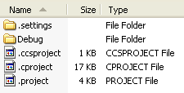
Version Control – Check in Which Files?
Several files/folders are generated by CCS inside the project folder
.cproject and .project are Eclipse project files and should be checked in
.ccsproject is a CCS specific project file that should be checked in
.settings folder is a standard Eclipse folder that contains settings that apply to the project. This folder should be checked in
.launches directory is generated when you start a debug session. It is not related to the build of your project and is not necessary to check in
The contents of the project configuration folder (Debug/Release) do not need to be checked in
Notes:
24

