Slide 1
Portable Projects
Notes:
1

Slide 2
Portable Projects: Briefing
Key Objectives
Create a project that uses a linked files
Make the project portable
Tools and Concepts Covered
Sharing Projects
Linked Resources
Linked Resource Path Variables
Build Variables
Files needed for version control
Notes:
2

Slide 3
Portable Projects: Lab Requirements
The following tools/software are used for the hands-on lab section:
CCSv5.1 or greater with all C2000 components installed
controlSUITE
This presentation assumes it is installed in the default ‘C:\ti\controlSUITE’ directory
All C2806x support needs to installed
F28069 controlSTICK (optional – only if you wish to test the application on a real target)
Notes:
3

Slide 4
Sharing Projects
Sharing “Simple” projects (all source/header files are contained in the project folder)
Sharing “Linked file” projects and all source (project uses linked files)
Sharing “Linked file” projects only (no source)
Only the project folder is shared (person receiving project already has all source)
Effort involves making the project “portable”
Eliminate absolute paths in the project
This is the most common use case
Notes:
4

Slide 5
Sharing Projects – Simple Projects
USE CASE: Wish to share (give) a project folder and all needed source files to build the project. All source files are inside the project folder.
Easy to share projects with no linked files:
The entire project folder can be distributed to another “as-is”
The user who receives the project can import it into their workspace using ‘Project -> Import Existing CCE/CCS Project’ and selecting the copied folder
Works well for simple projects that only reference files inside the project folder
Notes:
5

Slide 6
Sharing Projects – Linked File Projects
USE CASE: Wish to share (give) a project folder and all needed source files to build the project. Some (or all) of the source files are linked to the project
Use the CCS Export Project to create an archive (zip) file that contains the project folder and all project linked source files
Exporting your project: These instructions cover how to archive your project on the source computer
File -> Export
Expand "General" and select "Archive File". Click "Next"
The dialog that appears allows you to select which projects you wish to export to the archive. When you select a project it will show you on the right hand side all of the items it is going to export. Check the box beside the project to indicate that you want to archive it.
Specify a name for your archive and select either zip or tar, then click "Finish"
You now have a zip file on your computer containing the project. Not only did it copy in the files that are physically located in your project directory but it also copied in your linked/referenced resources
Notes:
6

Slide 7
Sharing Projects – Importing an Archive Project
Importing the project on another machine: These instructions cover how to import the project from the archive. What happens is that it will import the project into your workspace
Project -> Import Existing CCS/CCE Eclipse Project
Change the radio button selection at the top to "Select archive file"
Browse to and select your archive file
It will list all of the projects found in the archive. The are all selected by default. Select the ones you want and click "Finish"
The project is now in your workspace
For linked/referenced resources, it will copy those files from the archive and then place them at the same path where they were located on the original computer
NOTE: This feature is broken in CCSv5 due to a bug in the Eclipse version that CCSv5 is based on
Notes:
7

Slide 8
Sharing Projects – “Linked file” Projects
USE CASE(S):
Wish to share (give) a project folder only. The person receiving the project file already has a copy of the source files
Wish to check the project folder/files into source control
Most use cases involve sharing JUST the projects instead of bundling all the source files
People will have their own local copies or access to the source files (shared location, available via source control, etc)
Need to make the project portable to make sure the project is easily shared
Portable projects must avoid any absolute paths
Ideal portable projects should be usable without modifying any of the project files
This is ideal for projects maintained in source control
Notes:
8

Slide 9
Creating a Portable Project - Example Walkthrough

Slide 10
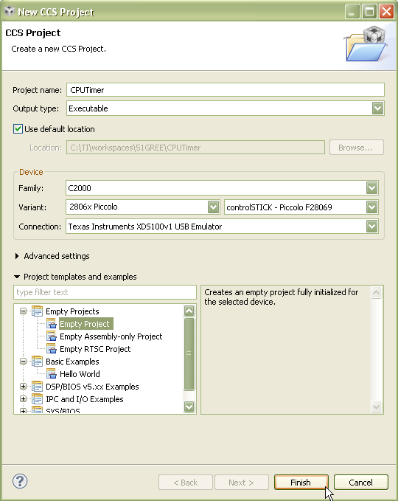
CPU Timer: Create a New Project
Launch ‘New CCS Project’ Wizard
Select ‘New Project’ from the Welcome page
Fill in the fields as shown in the right
Select ‘Finish’ when done
Generated project will appear in the Project Explorer view
Remove the generated ‘main.c’ file from the project
Notes:
10

Slide 11
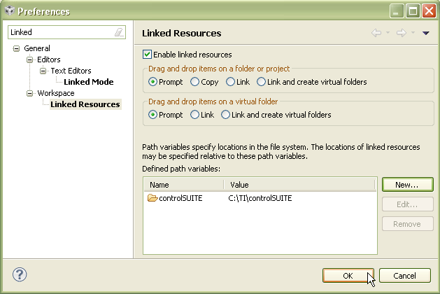
CPU Timer: Create a Linked Resource Path Variable
Open the workspace preferences
Window -> Preferences
Go to the ‘Linked Resources’ preferences
Type ‘Linked’ in the filter field to make it easier to find
Use the ‘New’ button to create a ‘Linked Resource Variable’ that points to the root location of the controlSUITE directory
Hit ‘OK’ when finished
Notes:
11

Slide 12
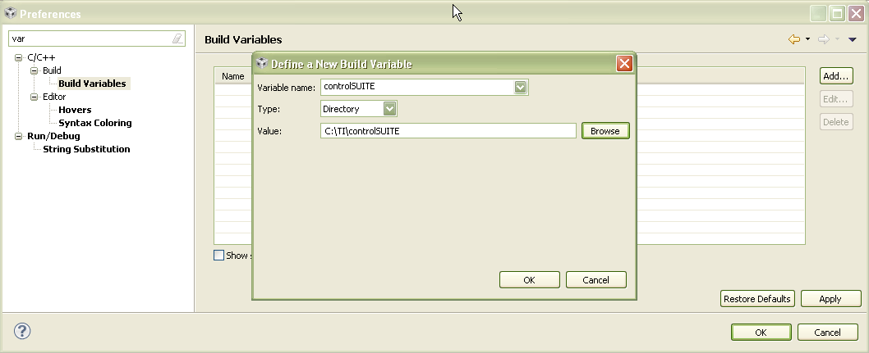
CPU Timer: Create a Build Variable
Go to the ‘Build Variables’ preferences
Type ‘Variables’ in the filter field to make it easier to find
Build Variables allow you to use variables in the project properties
Linked Resource variables are only used for linked files
Use the ‘Add’ button to create a ‘Build Variable’ that points to the root location of the controlSUITE directory
Hit ‘OK’ when done
Notes:
12

Slide 13
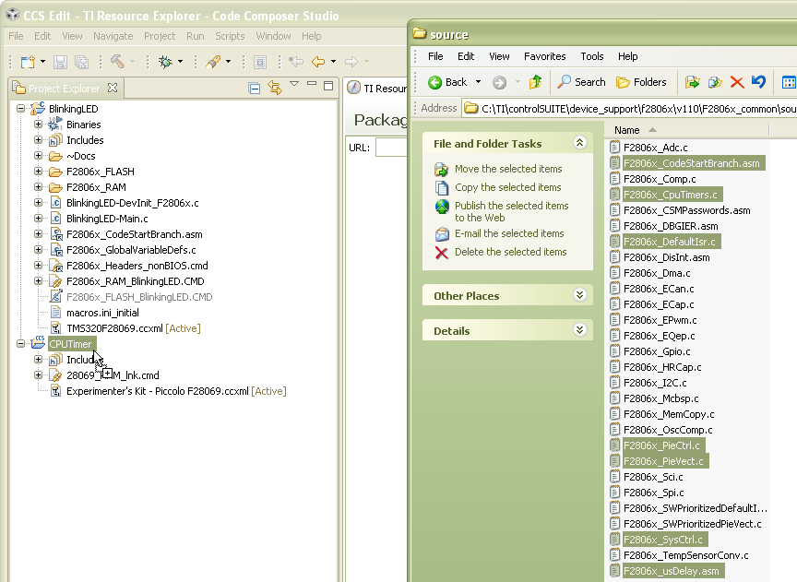
CPU Timer: Link Source Files to Project
Open Windows Explorer and browse to:
C:\TI\controlSUITE\device_support\f2806x\v110\F2806x_common\source
Drag and drop the following source files into the new project in the CCS Project Explorer view
F2806x_CodeStartBranch.asm
F2806x_CpuTimers.c
F2806x_DefaultIsr.c
F2806x_PieCtrl.c
F2806x_PieVect.c
F2806x_SysCtrl.c
F2806x_usDelay.asm
Notes:
13

Slide 14
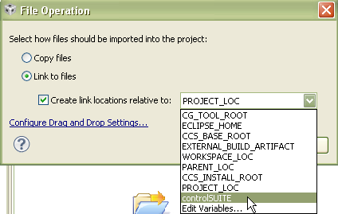
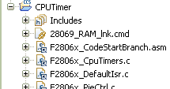
CPU Timer: Link Source Files to Project
A dialog will appear asking if you wish to Copy or Link the files:
Select ‘Link to files’
Select ‘Create link locations relative to:’
Use the new Linked Resource variable we created (controlSUITE)
Hit ‘OK’
Files will now appear in the Project Explorer with the ‘link’ icon
Notes:
14

Slide 15
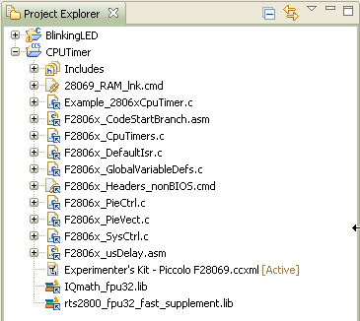
CPU Timer: Link Files to Project
Link the rest of the needed files the same way:
C:\TI\controlSUITE\device_support\f2806x\v110\F2806x_examples\cpu_timer\Example_2806xCpuTimer.c
C:\TI\controlSUITE\device_support\f2806x\v110\F2806x_headers\source\F2806x_GlobalVariableDefs.c
C:\TI\controlSUITE\device_support\f2806x\v110\F2806x_headers\cmd\F2806x_Headers_nonBIOS.cmd
C:\TI\controlSUITE\libs\math\IQmath\v15c\lib\rts2800_fpu32_fast_supplement.lib
C:\TI\controlSUITE\libs\math\FPUfastRTS\V100\lib\IQmath_fpu32.lib
Notes:
15

Slide 16
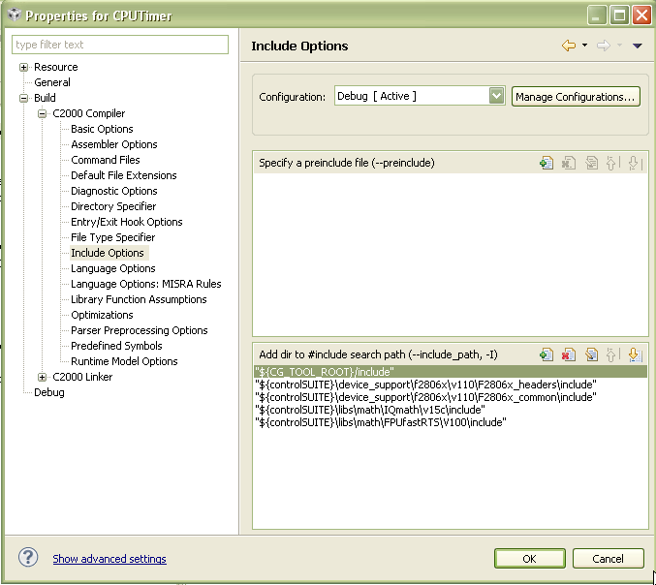
CPU Timer: Modifying Project Properties
Right-click on the project and select ‘Properties’
In the compiler ‘Include Options’, add the following entries to the list of include search paths:
${controlSUITE}\device_support\f2806x\v110\F2806x_headers\include
${controlSUITE}\device_support\f2806x\v110\F2806x_common\include
${controlSUITE}\libs\math\IQmath\v15c\include
${controlSUITE}\libs\math\FPUfastRTS\V100\include
‘${<BUILD VARIABLE>}’ is the syntax to use a Build Variable in the project properties
WARNING: Linked Resource Path Variables are only used when linking source files to a project. They can not be used for build options. Use Build Variables when modifying build options
Notes:
16

Slide 17
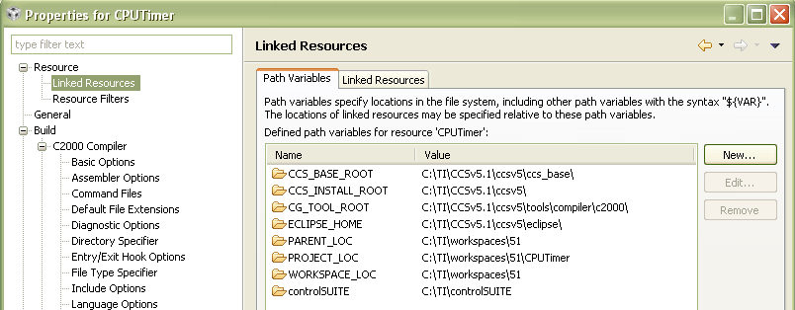
CPU Timer: Project Properties
Go to ‘Resource -> Linked Resources’ to see all the Linked Resource Path Variables that is available to the project
This will show all variables created at the project level and workspace level
See the workspace level Linked Resource Path Variable that was created appears in the list
Variables may be edited here but changes will only be recorded at the project level (stored in the project files)
Notes:
17

Slide 18
CPU Timer: Project Properties
The ‘Linked Resources’ tab will show all the files that have been linked to the project
It will sort them by files linked with a variable and files linked with an absolute path
Links can be modified here with the ‘Edit…’ button
Links can be converted to use an absolute path with the ‘Convert…’ button
Notes:
18

Slide 19
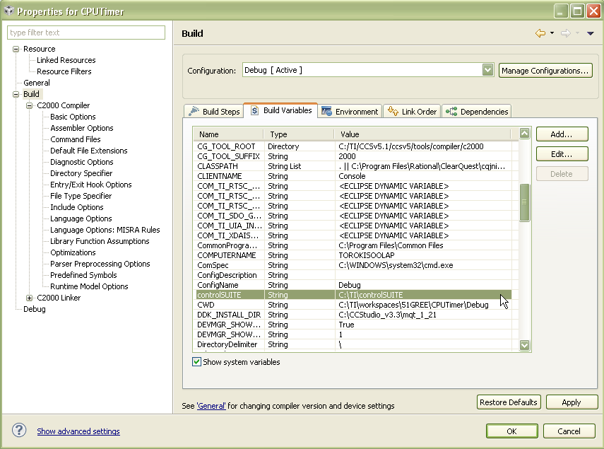
CPU Timer: Project Properties
Go to ‘CCS Build’ to see all the Build Variables that is available to the project
Only project level variables will be listed by default
Enable the “Show system variables” checkbox to see variables set at the workspace and system level
See how the workspace level Build Variable that was created appears in the list
Notes:
19

Slide 20
Project vs Workspace Level Variables
The last few slides shows that ‘Linked Resource Path Variables’ and ‘Build Variables’ can be set at the project level
This current lab set these variables at the workspace leve
What is the benefit of setting these variables at the workspace level instead of the project level?
All projects can reuse the same variable (set it once)
Do not need to modify the project!
This is important for projects checked into source control and to avoid constant checkouts so the project can be written to!
Notes:
20

Slide 21
Defining Variables in a File
It is possible to share the variables needed by the project by defining the needed variables to an *.ini file that a user can import
The file can get automatically read on an import of a project if:
The *.ini file is called ‘vars.ini’
The file is at the root location
Otherwise the file can be manually imported via ‘File -> Import… -> Build Variables’
The variable is set BOTH as a ‘Linked Resource Path Variable’ and a ‘Build Variable’ (despite the name of the import dialog being called just ‘Build Variables’)
The variables are set at the workspace level
Notes:
21

