Slide 1
Multi-core Debug Basics
Embedded Development Tools

Slide 2
Multi-Core Debug Overview
A single debug session may have multiple debuggable cores
A single device that has multiple cores like Keystone, Concerto, etc
A single board that has multiple devices (single or multi core) on the same JTAG scan chain
Multiple boards, each with their own emulation connection, connected to the same single debug instance
A combination the above
CCS has the ability to provide debug visibility and control over all debuggable cores from a single debug session called a multi-core debug session
The following material show how to work with a multi-core debug session on an 8-core Keystone device (C6678) though the same techniques can apply to any multi-core target
This extreme example (as most devices do not have as many cores) is used to demonstrate the ability of CCS to handle many cores in a single debug session

Slide 3
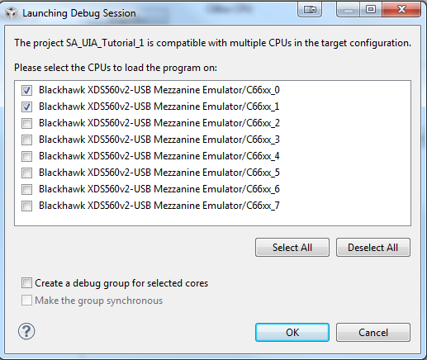
Starting a Debug Session
Project-less Debug Session
Launch the debugger for a target configuration from the Target Configuration view
Manually connect / load program to desired CPU
Project Debug Session
Build the project in context and then launch a debug session for the project, connect, and load the application to desired CPUs
CCS will detect which CPUs match the project type and then prompt the user asking which CPUs to debug the project on (connect, load program)
The prompt will only appear the first time a Debug Configuration is launched

Slide 4
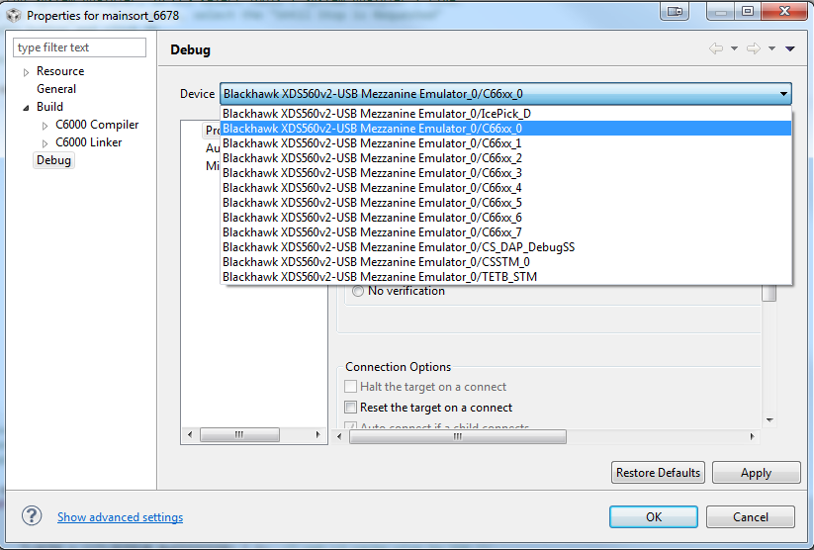
Project Debug Properties
Specify different Debug properties (Debugger Options) on a per CPU basis
Right-click on the project in the Project Explorer and select Properties to access the project Debug properties
Project-less debug sessions can use the Debug Configurations to access these same options

Slide 5
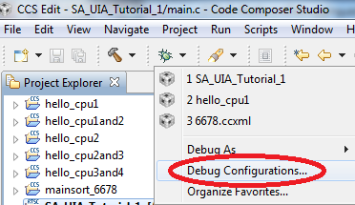
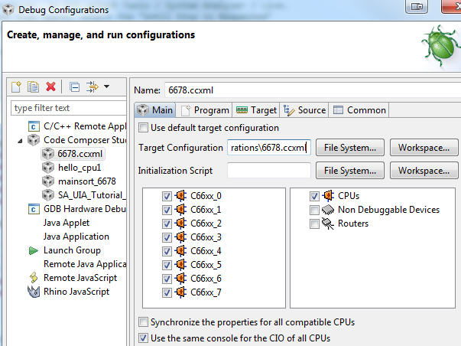
Debug Configurations
Modify the Debug Configuration to:
Use the Initialization Script field to specify a single JavaScript for target initialization for all CPUs (Main tab)
GEL startup scripts can only be specified on a per CPU basis in the target configuration file
Specify CPUs to show/hide in the Debug view (Main tab)
Specify if all CPUs share the same console for C I/O (Main tab)
C I/O will be interleaved in the same console (preceded with the CPU name)
Uncheck the option to create a separate C I/O console for each CPU

Slide 6
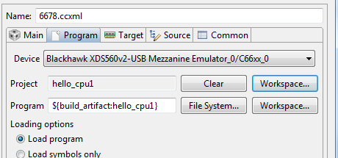
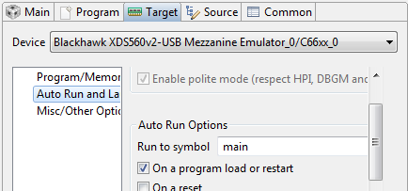
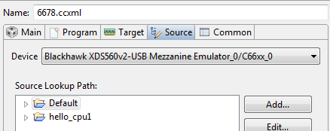
Debug Configurations
Specify which CPU loads which programs (Program)
Specify different Debug options per CPU (Target)
Specify different source debug lookup paths per CPU (Source)

Slide 7
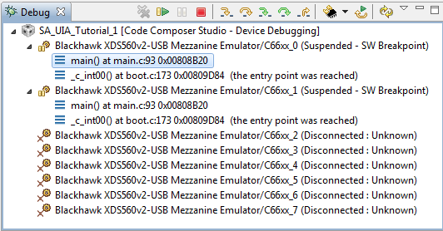
Debug View
Debug visibility to all ‘debuggable’ CPUs can be gained through the Debug view
Selecting the stack frame for a particular CPU in the Debug view will give you debug visibility for that particular CPU (set the ‘debug context’ for that CPU)
Most views in the CCS Debug perspective show data for the debug context
All debugger commands (run, step, reset, etc) apply to the debug context
Debugger options (Tools -> Debugger Options) apply to the debug context

Slide 8
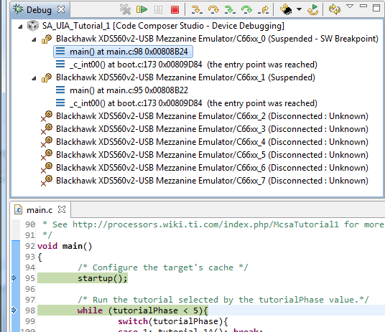
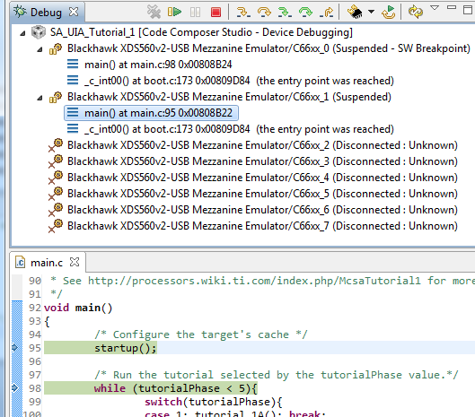
Debug Context - Editor
The CCS editor will show the PC location for all CPUs for any shared source files
Selecting a debug context will highlight the PC source line for that context in light blue

Slide 9
Pinning a View to a CPU
You can pin debug session views to the debug context of the currently selected CPU:
Done using the Pin to Debug Context icon in the view
The name of the connection and CPU of the debug context will in the view to identify which context the view is “pinned” to
Change the debug context to another CPU but still have that view still reflect the context of the CPU it is "pinned" to
Open multiple views of the same kind with each “pinned” to different CPU for quick side-by-side comparison

Slide 10
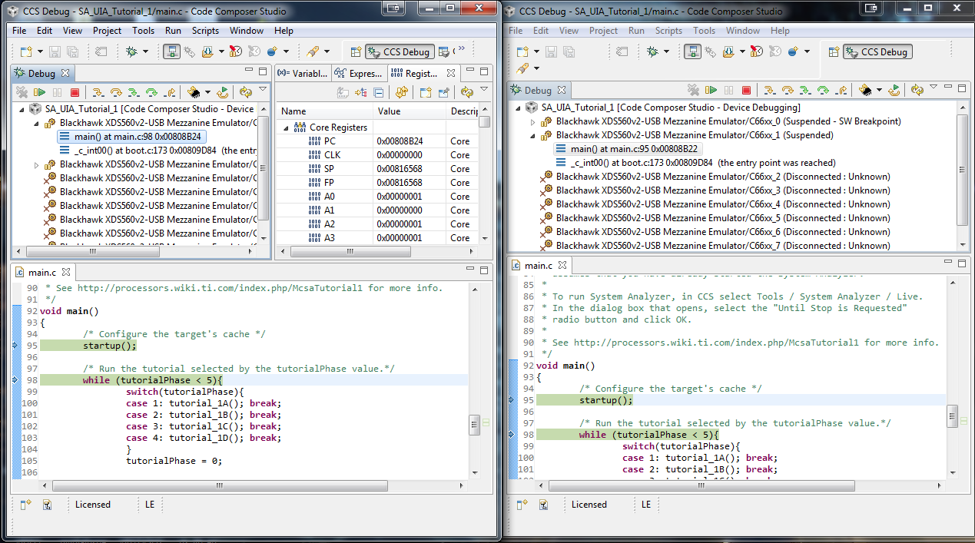
Use Multiple Workbench Windows
TIP: Open a separate Workbench Windows for a CPU
Window -> New Window
All workbench windows reference the same debug server
Window 1 with CPU 1 in context
Window 2 with CPU 2 in context

Slide 11
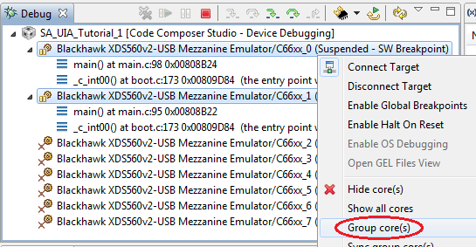
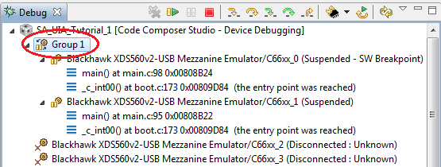
Grouping CPUs
Combine CPUs into groups to broadcast debug commands to multiple CPUs at once
Synchronous target stepping of multiple CPUs can be done through a group
Multi-select the CPUs of interest in the Debug view, right-click and select Group core(s) in the context menu
A Group node will be created
Select the Group node in the Debug view to send commands to the group

Slide 12
Grouping CPUs
Group node:
Control all CPUs in the group by selecting the group node (set debug context to the group)
Can still control individual CPUs in the group by selecting the specific CPU in the group to get that CPU’s debug context
Various views may be blank when the group is in context since multiple CPUs will be in context (unless the view is pinned)
Group settings are saved in the Debug Configuration and subsequent launches of the Debug Configuration will remember the group settings

Slide 13
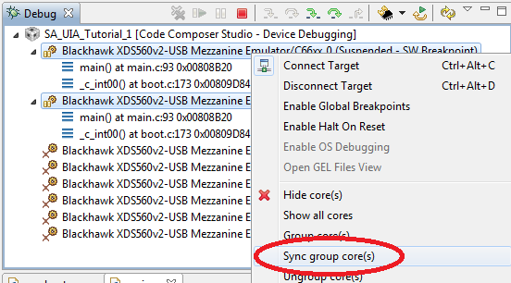
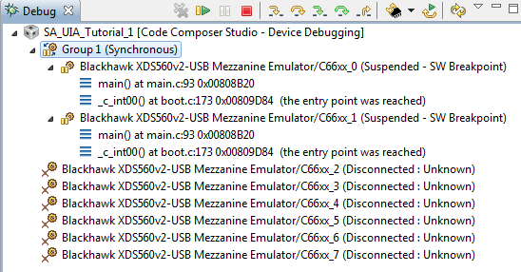
Synchronous (“Sync”) Groups
Similar to a standard group except that CCS will always treat the cores of a sync group as one single debug entity
CCS will run, halt, step and reset all the cores as a group, automatically apply loaded debug symbol across all of them, and set/clear any breakpoints across all of them
Multi-select the CPUs of interest in the Debug view, right-click and select Synch group core(s) in the context menu
A Sync Group will be created

Slide 14
Synchronous (“Sync”) Groups
Differs from a standard group in that even the debug context is a single CPU in the sync group, any actions will apply to all CPUs in the group
Does not have to have the Group node in context
Cannot have an action to apply to only one (or some of the) CPU(s) in the groups
Setting a breakpoint for one CPU in a sync group will set the same breakpoint for all the other CPUs in the group
Any CPU that reaches a breakpoint will trigger a halt for all CPUs in the sync group (similar to cross-triggering for global breakpoints)
Hardware resources are required to create a sync group, hence the option may not be available if the:
CPUs do not have the capability,
Necessary resources are already in use (by another sync group or cross triggering)
CPUs are in a state where the resources cannot be reprogrammed (running)

Slide 15
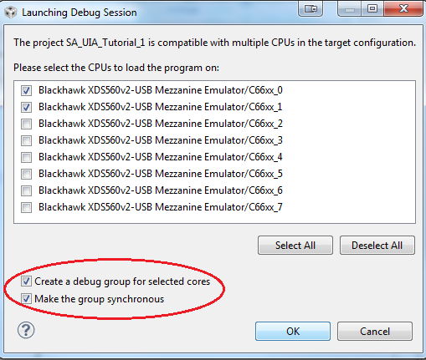
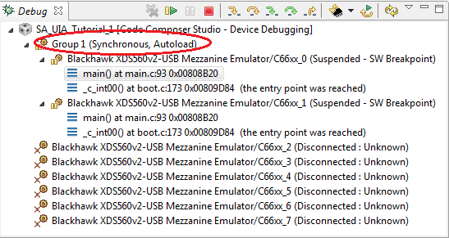
Auto-Grouping CPUs
CCS can also be configured to automatically group CPUs when first prompted to specify which CPUs to load the program on
Can also specify to make the group a sync group

Slide 16
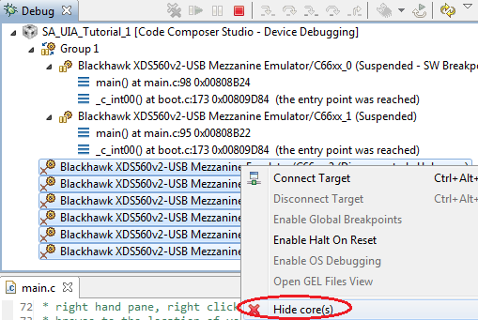
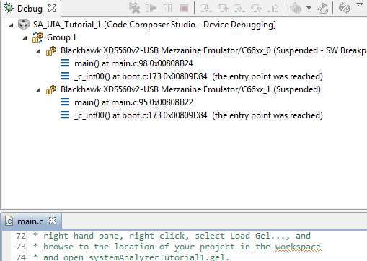
Hiding CPUs
Hide CPUs that will not be used from the Debug view
Multi-select the CPUs to hide, right-click and select Hide core(s) in the context menu
Selected CPUs will disappear from the Debug view
To Unhide all CPUs, right-click on a debug context and select Show all cores in context menu
Configure CCS to automatically hide CPUs in the Debug Configurations options

Slide 17
Breakpoints View
The Breakpoint view will display all breakpoints set for all CPUs by default
Use the Show Breakpoints Supported by Selected Target button to show only breakpoints for the currently selected CPU

Slide 18
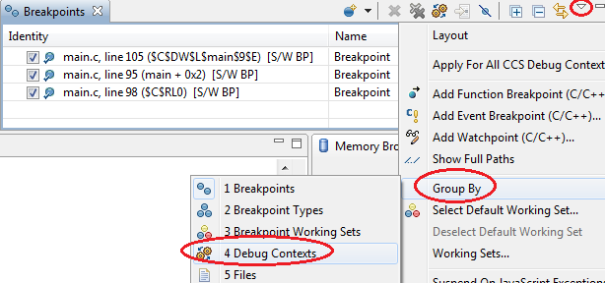
Breakpoints View
The Breakpoints view can also display all breakpoints set for all cores and group them by CPU
This can be enabled by selecting Group By -> Debug Contexts in the options for the Breakpoints view:
This will group breakpoints under their respective cores to easily identify which CPU a breakpoint if set for

Slide 19
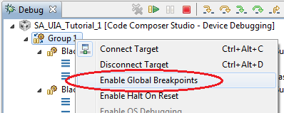
Global Breakpoints
Each debug context can be configured for Global Breakpoints
This feature will essentially make breakpoints global across all debug contexts that have it enabled
Example: If the debug contexts for CPU 1 and 3 have global breakpoints enabled, and CPU 1 hits a breakpoint, CPU 3 will also be halted (if it was running), and vice versa.
Right click on a debug context in the Debug view and select Enable Global Breakpoints in the context menu
If the debug context is a group, this will enable global breakpoints for all CPUs in the group

Slide 20
Global Breakpoints
Below shows an example of where the first CPU in the group hits a breakpoint set on main.c, line 98 for just that CPU (as shown with the Suspended - SW Breakpoint message) and triggers the second CPU in the group to be halted (Suspended - Cross-triggering)
NOTE: All CPUs in a sync group will automatically have breakpoints cross-trigger to all the CPUs in the sync group due to the nature of sync groups

Slide 21
Global Breakpoints – Known Issues
Global breakpoints are supported only for CPUs that are on the same JTAG scan path (not across multiple emulators)
C66x based devices: The DRM needs to be configured to output the proper signals to enable global breakpoints across different devices on the same JTAG scan path (ex: 2 separate C6670 devices on the same JTAG scan path)
Full instructions are on the wiki: http://processors.wiki.ti.com/index.php/Multi-Core_Debug_with_CCSv5#Known_Issues

