Slide 1

Code Composer
Studio
TM
MSP430 Energy Trace Lab Material

Slide 2
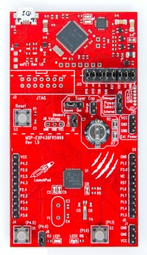
LaunchPad: Hardware Setup
Connect mini-USB cable
from PC to board
Agenda …

Slide 3
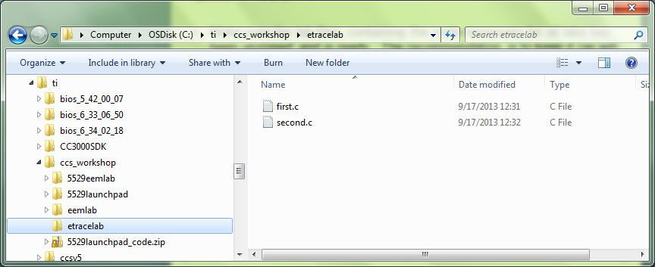
Lab Files
Make sure the lab files, containing the code necessary for all labs has been unzipped and is ready. The recommendation is to keep it (as will be assumed in the following steps) in c:/ti/ccs_workshop/etracelab
This could create a directory structure as shown below

Slide 4




LAB conventions
Lab steps are numbered for easier reference
  …
  …
Explanations, notes, warnings are written in blue
  Warnings are shown with
  Information is marked with
  Tips and answers are marked with
  Questions are marked with
Notes:
4

Slide 5
Lab 1: Energy trace Basics
30 minutes
Open CCS and select the default workspace
You can close the TI Resource Explorer View (it will not be used)
Notes:
5

Slide 6
Lab 1: Exercise Summary
Key Objectives
  What is energy trace
  Using energy trace in ccs
Tools and Concepts Covered
  Energy Trace
Notes:
6

Slide 7
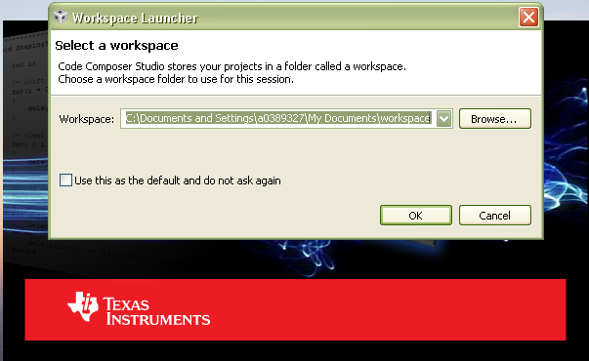
Workspace
Launch CCS and select a workspace folder
  Defaults to your user folder
Notes:
7

Slide 8
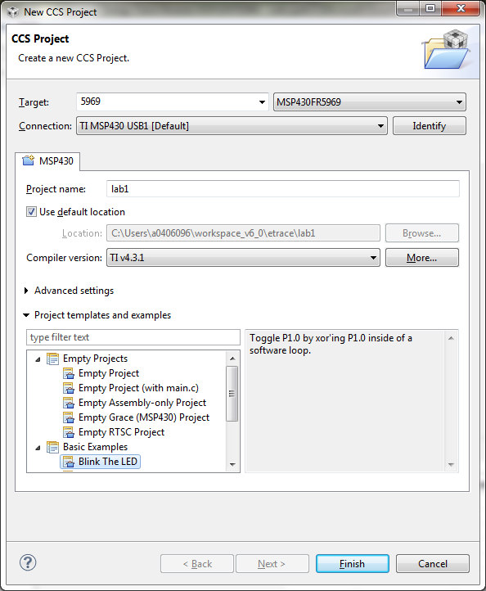
Create the Project
Create a new project in the CCS Workspace by going to menu Project → New CCS Project
Fill in the boxes as shown in the image. Select the “Blink the LED” example
Click Finish

Slide 9
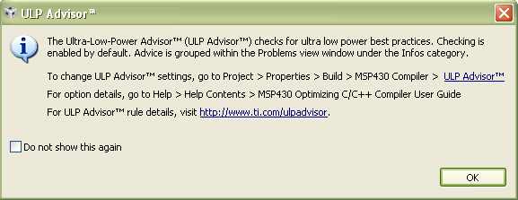
ULP Advisor Message
A message highlighting the ULP Advisor may appear on project creation
This message can be ignored
Use the “Do not show this again” checkbox if you do not wish to see this message again

Slide 10
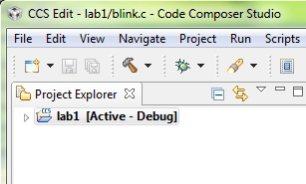
Debug ‘lab1’ Project
Click on the “green bug” button – make sure the project is selected!

Slide 11
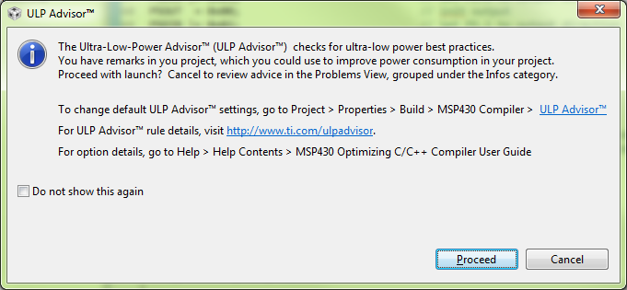
Debug ‘lab1’ Project
Should the ULP message appear (which can be disabled with the ”do not show again” tickbox) simple select “proceed”

Slide 12
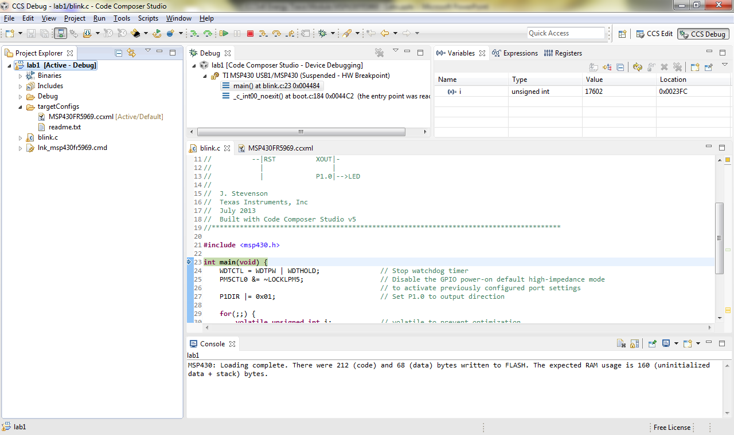
Build, Load/Flash the Program
Notes:
12

Slide 13
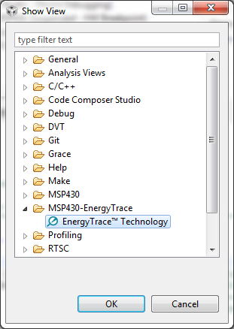
Open Energy Trace
Not all MSP devices support the full energy trace feature set
Open the Energy Trace view
  View → Other->MSP430-EnergyTrace
Select “Energy Trace”
Select “ok”
Notes:
13

Slide 14
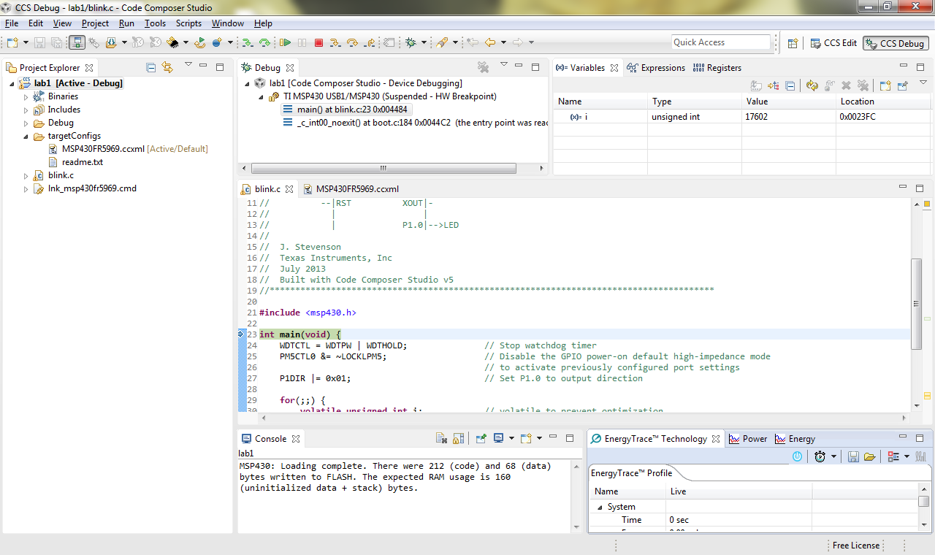
Energy Trace now available
Notes:
14

Slide 15
Configure Energy Trace
The buttons on the console in order from left to right are:
  Enable/Disable Energy Trace
  Set capture Time
  Save EnergyTrace Data
  Load Energy Trace Data
  Advanced Options
  Toggle between Energy Only Mode and Full Mode (showing state data)
Notes:
15

Slide 16
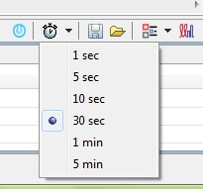
Configure Energy Trace
Select the “Set Capture Time Button”
  Set the capture time to 30s for this example/lab
Notes:
16

Slide 17
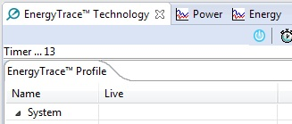
Run the code
Press Run to start the code and energy trace (which is by default in energy only mode)
You will see energy trace start up doing a live count and capture
Notes:
17

Slide 18
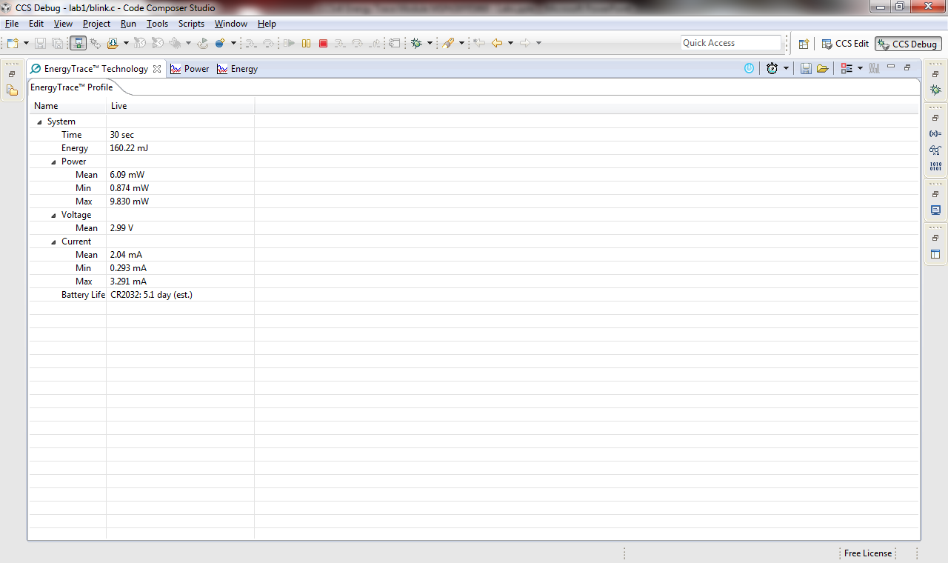
Run the code
When 30 Seconds have elapsed, double click on energy trace to get full view
Notes:
18

Slide 19
Examine the Data and Views
Examine the data and view available! Main View
Notes:
19

Slide 20
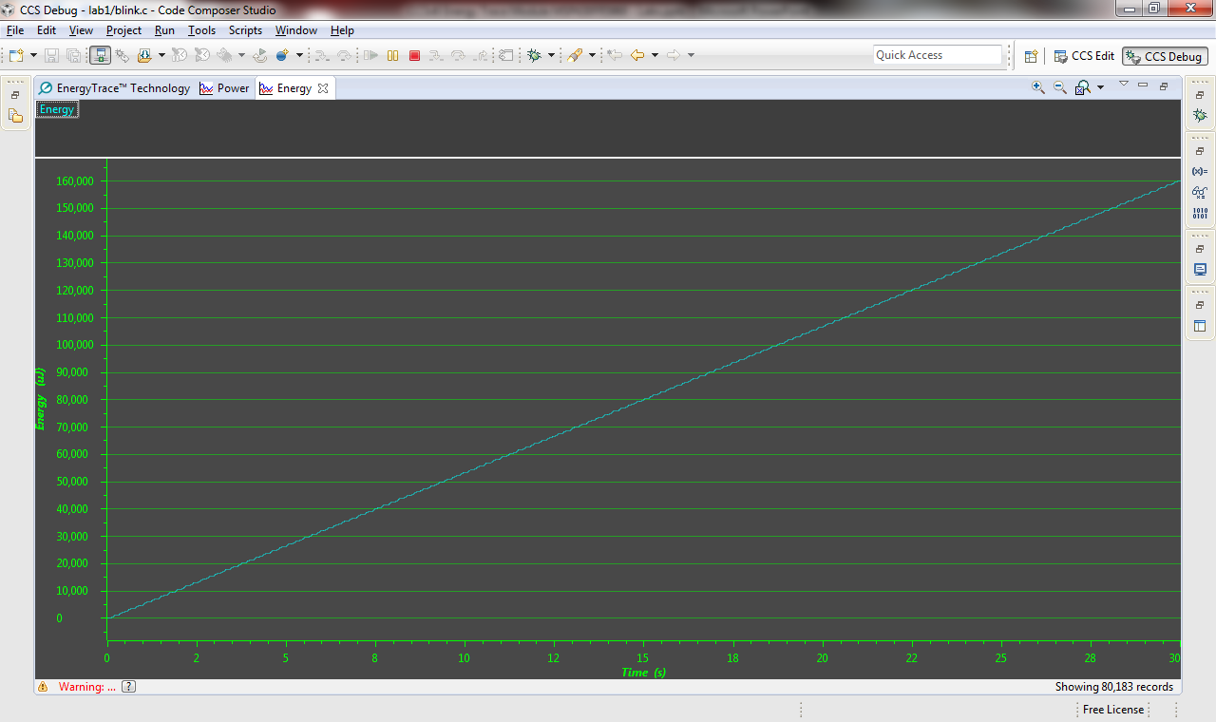
Examine the Data and Views
Energy View
Notes:
20

Slide 21
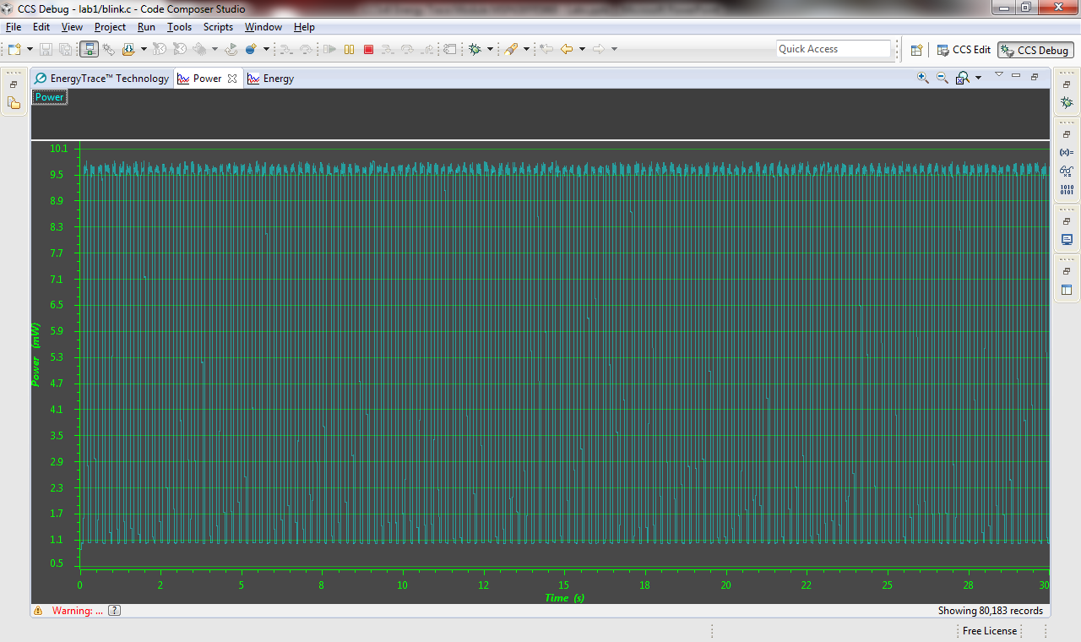
Examine the Data and Views
Power View
Notes:
21

Slide 22
Terminate the Debug Session
Minimize EnergyTrace and click on the terminate button to end this session
This will kill the debugger and return you to the Edit perspective
We will now move on to part 2 where we will look at the full feature (state capture) mode
We will use the same project!

Slide 23
Debug ‘lab1’ Project
Click on the “green bug” button once again– make sure the project is selected! Our terminating the session should have brought you back here!

Slide 24
ULP Advisor Message
A message highlighting the ULP Advisor may appear on project creation
This message can be ignored
Use the “Do not show this again” checkbox if you do not wish to see this message again

Slide 25
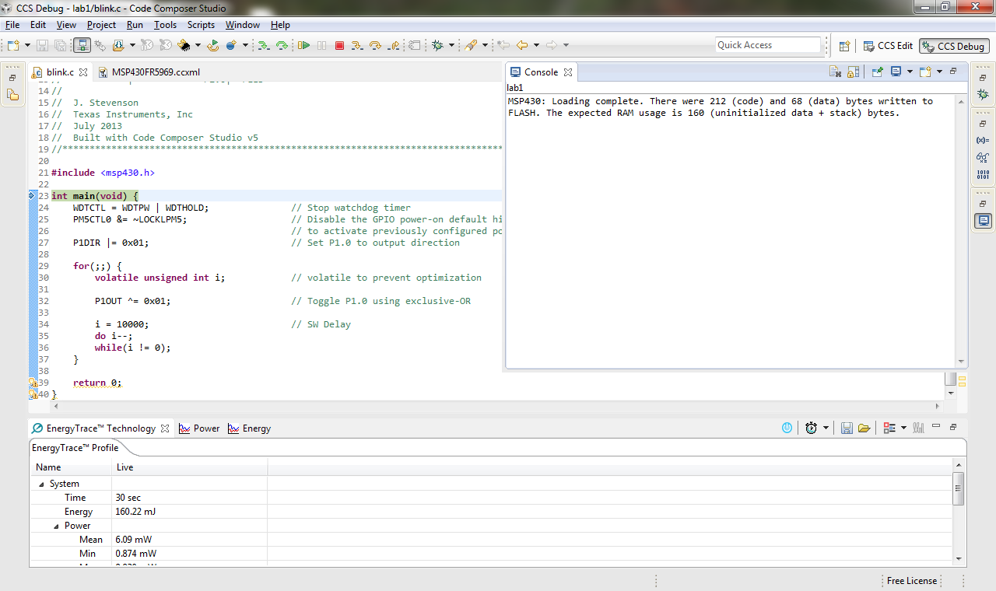
Debugging a second Time
Note energy trace is still available
Notes:
25

Slide 26
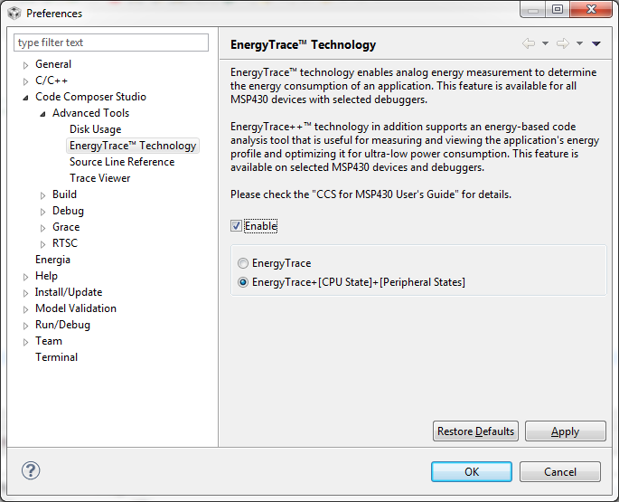
Configure Energy Trace
Select the “Advanced Button” and set preferences as shown
Notes:
26

Slide 27
Run the code
Press Run to start the code and energy trace (which is by default in energy only mode)
You will see energy trace start up doing a live count and capture as previously
Notes:
27

Slide 28
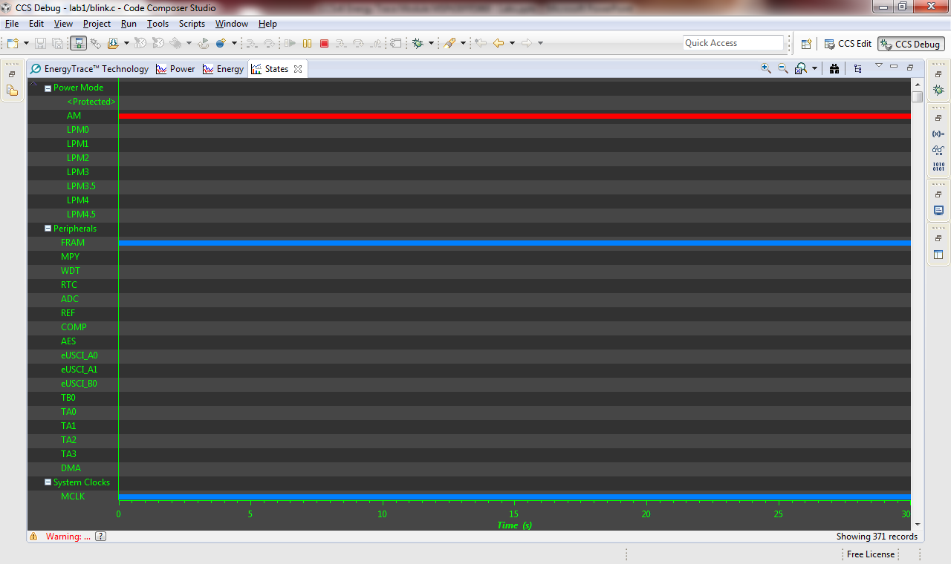
Examine the State View
Maximize and examine the data and view available! State View
Notes:
28

Slide 29
Notes
Explore the energy trace + views and data!

Slide 30
Terminate the Debug Session
Minimize EnergyTrace and click on the terminate button to end this session
This will kill the debugger and return you to the Edit perspective
We are finished lab1!

Slide 31
Lab 2: Energy trace – comparing data
30 minutes
Open CCS and select the default workspace
You can close the TI Resource Explorer View (it will not be used)
Notes:
31

Slide 32
Lab 2: Exercise Summary
Key Objectives
  More advanced energy trace look
  Capturing and comparing data to asses the affect of code changes
Tools and Concepts Covered
  Advanced energy trace
Notes:
32

Slide 33
Workspace
Launch CCS and select a workspace folder
  Defaults to your user folder
Notes:
33

Slide 34
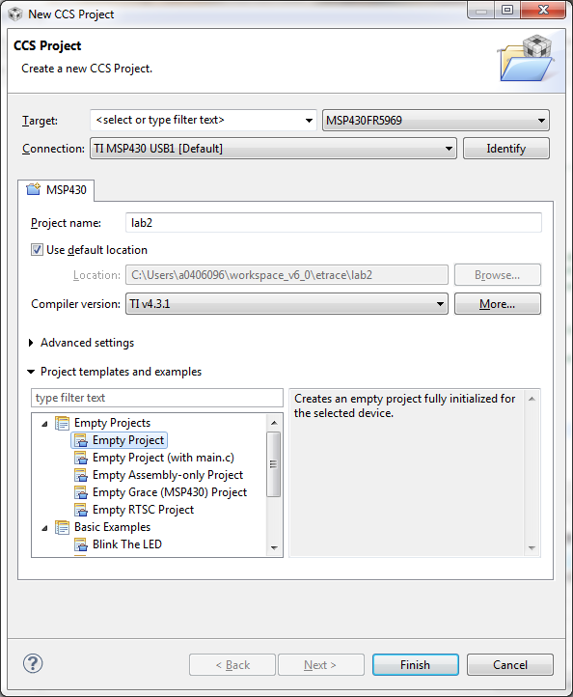
Create the Project
Create a new project in the CCS Workspace by going to menu Project → New CCS Project
Fill in the boxes as shown in the image. Select the “Empty Project” template
Click Finish

Slide 35
ULP Advisor Message
A message highlighting the ULP Advisor may appear on project creation
This message can be ignored
Use the “Do not show this again” checkbox if you do not wish to see this message again

Slide 36
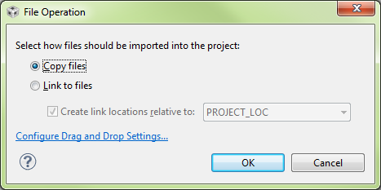
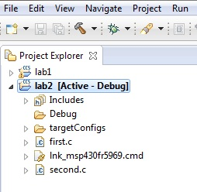
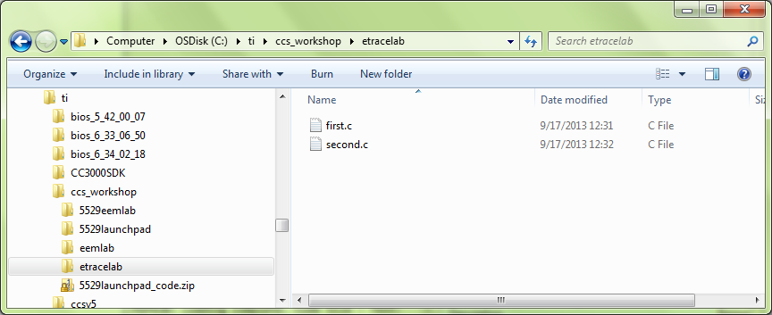
Add code for lab2
Drag and drop “first.c” and “second.c” into the empty project just created
Leave the default “copy files” selected as shown and ensure the c files are now in the project
You should now have the file as part of your project.

Slide 37
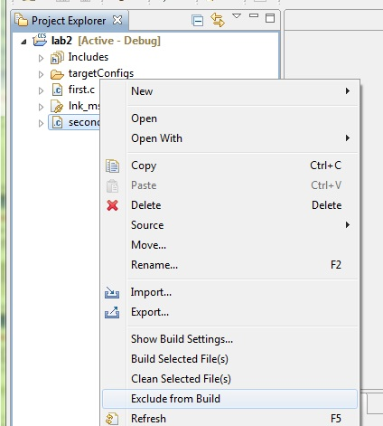
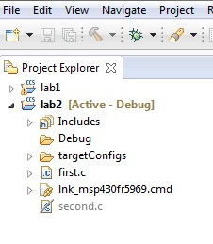
Setup Project
Exclude “second.c” from the build, we will use this later
Right click on “second.c” and select “Exclude from build”
You should now have the file excluded

Slide 38
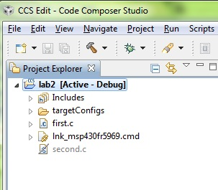
Debug ‘lab2’ Project
Click on the “green bug” button once again– make sure the project is selected! Our terminating the session should have brought you back here!
Enter Debug mode as before

Slide 39
ULP Advisor Message
A message highlighting the ULP Advisor may appear on project creation
This message can be ignored
Use the “Do not show this again” checkbox if you do not wish to see this message again

Slide 40
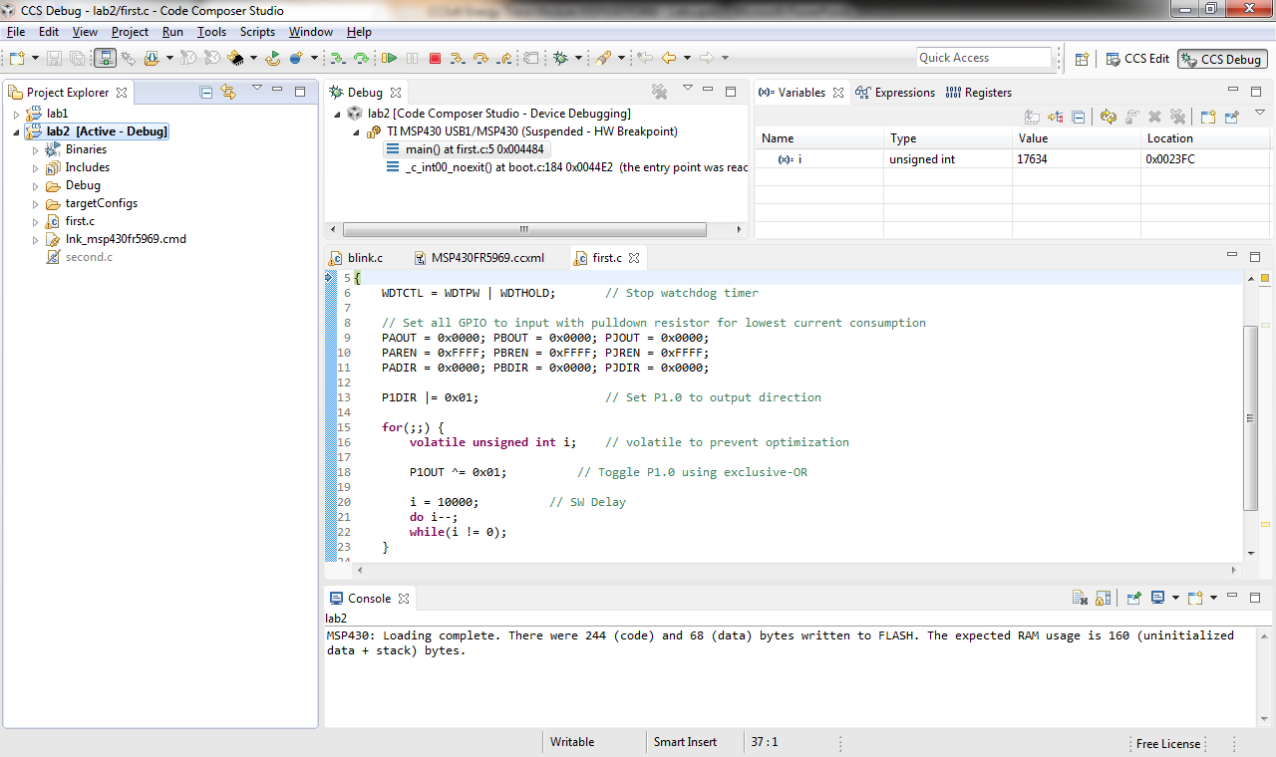
Debug Lab2
Notes:
40

Slide 41
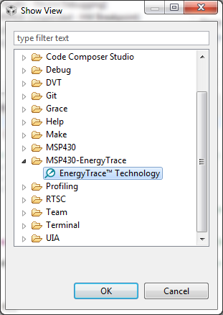
Open Energy Trace
Not all MSP devices support the full energy trace feature set
Once in Debug mode, open the Energy Trace view
  View → Other->MSP430-EnergyTrace
Select “Energy Trace”
Select “ok”
Notes:
41

Slide 42
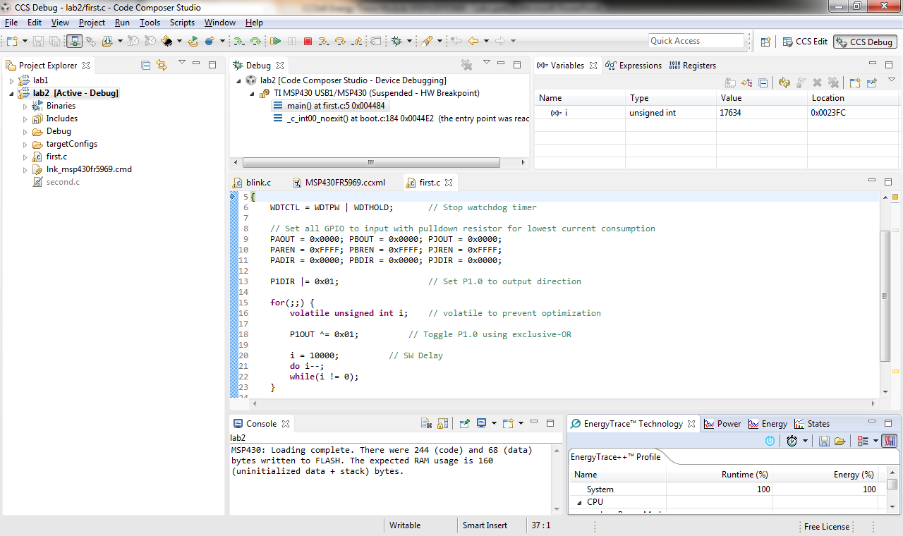
Energy Trace now available
Notes:
42

Slide 43
Configure Energy Trace
Select the “Set Capture Time Button”
  Set the capture time to 30s for this example/lab
Notes:
43

Slide 44
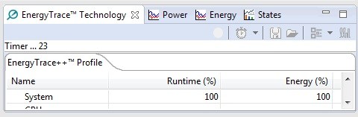
Run the code
Press Run to start the code and energy trace (which is by default in energy only mode)
You will see energy trace start up doing a live count and capture
Notes:
44

Slide 45

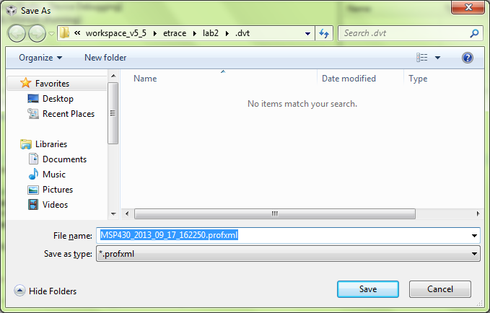
Save Energy Trace Data
Once the 30s capture is done, select “save current energy profile”
You will be asked to name and locate your file, leaving the default is fine, so select “save”, but remember where it is!
Notes:
45

Slide 46
Terminate the Debug Session
Minimize EnergyTrace and click on the terminate button to end this session
This will kill the debugger and return you to the Edit perspective
We will now use the other more energy efficient piece of code we pasted and compare! This version does not use delays and does use low power modes.

Slide 47
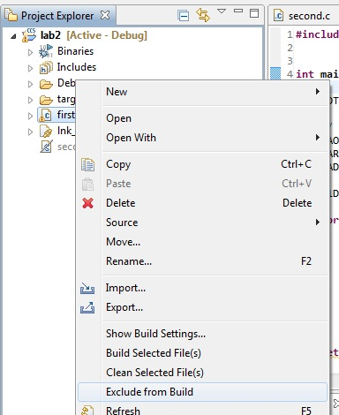
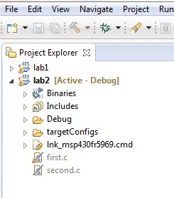
Setup Project
Exclude “first.c” from the build, we already have the data
Right click on “first.c” and select “Exclude from build”
You should now have the file excluded

Slide 48
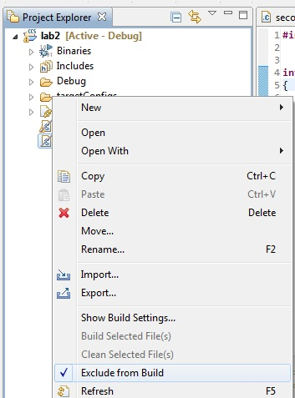
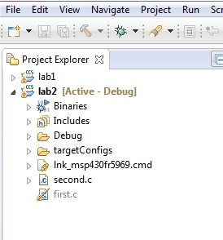
Setup Project
Include “second.c” from the build, we will use this later
Right click on “second.c” and select “Exclude from build” again to reinclude the file.
You should now have the file included and ready to capture this data

Slide 49
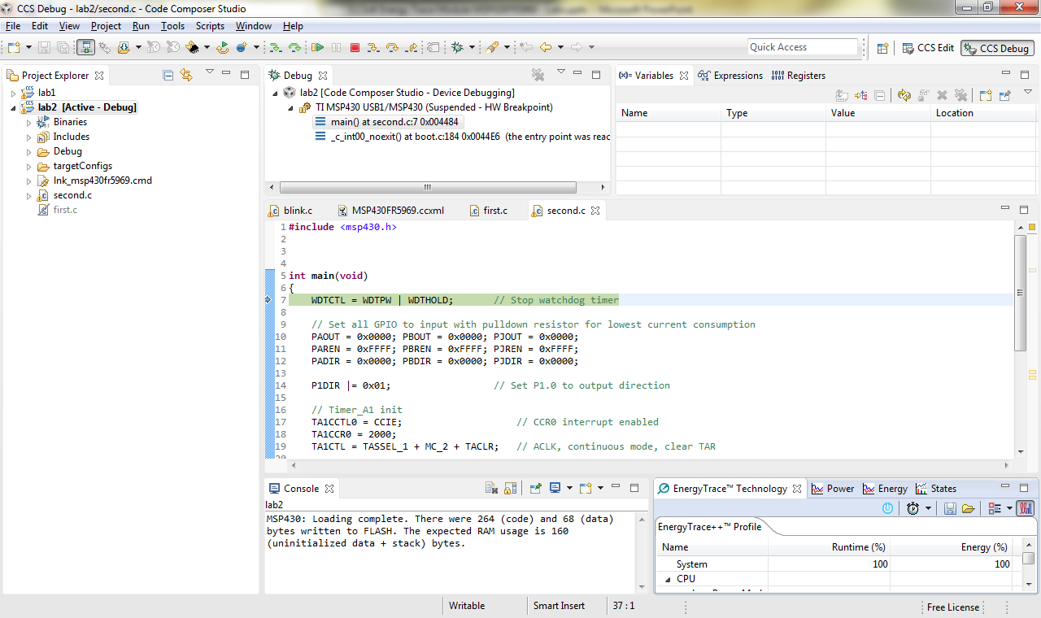
Debug Lab2
Notes:
49

Slide 50
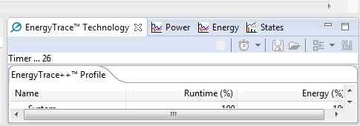
Run the code
Press Run to start the code and energy trace (which is by default in energy only mode)
You will see energy trace start up doing a live count and capture
Note energy trace is still set to 30s
Notes:
50

Slide 51
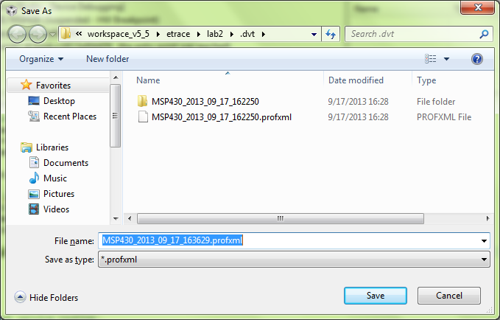
Save Energy Trace Data
Once the session reaches the 30s, select “save current energy profile”
You will be asked to name and locate your file, leaving the default is fine, so select “save” but remember where!
Notes:
51

Slide 52
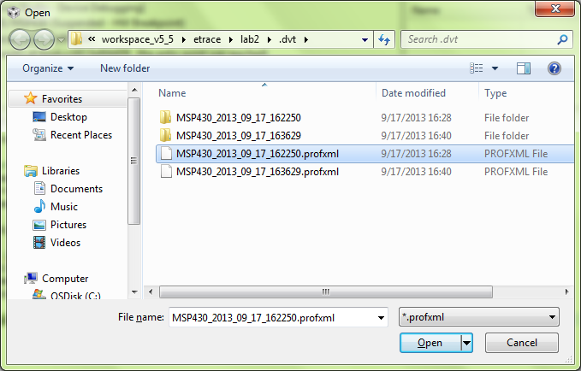
Load Energy Trace Data
Open the previous data from the non efficient version which we just saved by selecting “load reference energy profile”
You will be asked to select and locate your file, so select the file we just created with “first.c”
Notes:
52

Slide 53
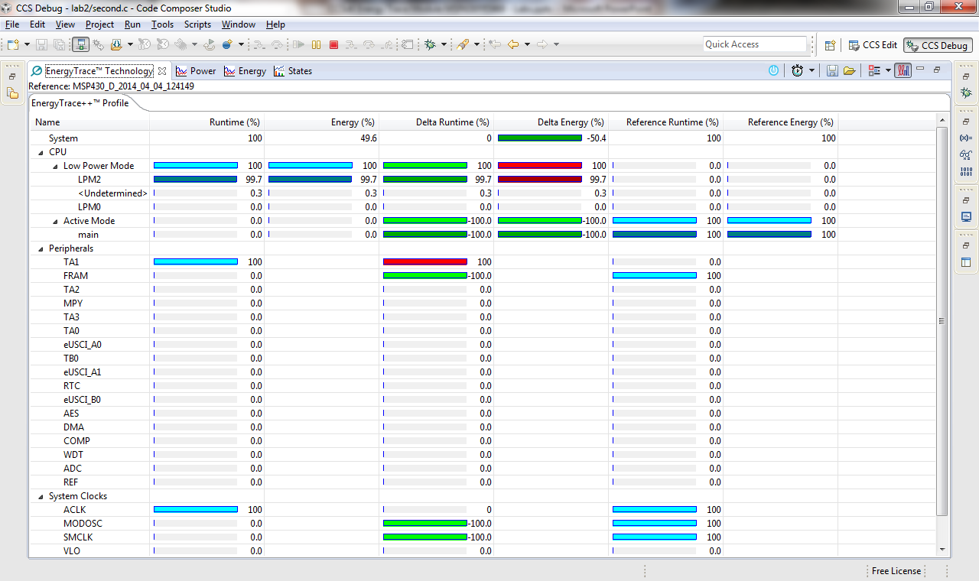
Examine the Data and Views
Double click to expand energy trace to full view and see the views/comparison
Notes:
53

Slide 54
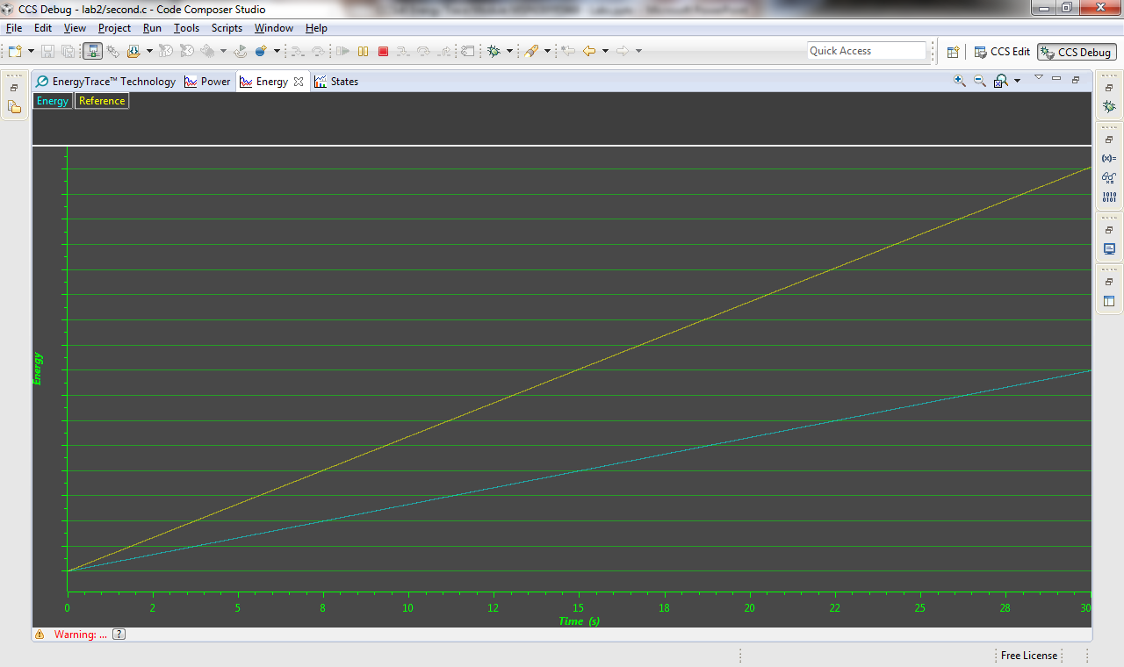
Examine the Data and Views
See how much more efficient the second.c code is
Notes:
54

Slide 55
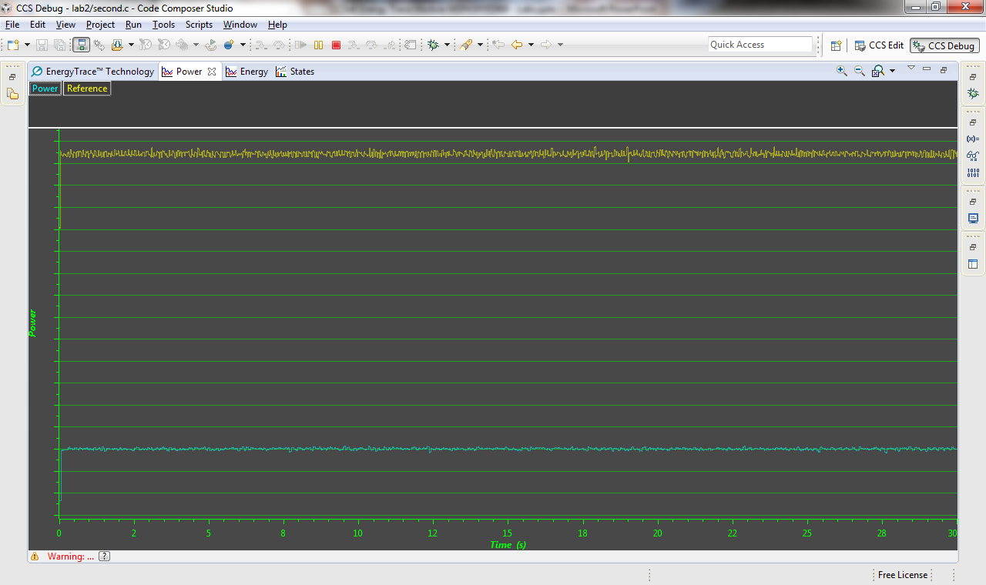
Examine the Data and Views
See how much more efficient the second.c code is
Notes:
55

Slide 56
Terminate the Debug Session
Minimize EnergyTrace and click on the terminate button to end this session
This will kill the debugger and return you to the Edit perspective
We are finished lab2!

