Slide 1
Code Coverage
Notes:
1

Slide 2
Code Coverage
The amount of code within a program that is exercised
Important for discovering code within a program that is not being exercised by test cases
Code coverage tools measure how thoroughly tests exercise programs

Slide 3
Code Coverage Tools with CCS
There are two main techniques to obtain code coverage data
Simulator Code Coverage Tool: Simulation based code coverage collection
Compiler Path Profiler Tool: Compiler instrumented profiling that can be used for code coverage collection

Slide 4
Simulation Code Coverage Tool
Generates code coverage data for application
Instrumentation and collection handled by the simulator non-intrusively
View function and line coverage data
Enable editor highlighting of line coverage data

Slide 5
Simulation Code Coverage Tool: Limitations
Only supported on C6000 simulators
No support on hardware targets (tool is a simulator feature)

Slide 6
Compiler Code Coverage Tool
Generate code coverage data for application
Data is collected using the compiler Path Profiling capability
Path profiler will add additional instrumentation code to the application
View function and line coverage data
Enable editor highlighting of line coverage data (TBD)

Slide 7
Path Profiling
Build and link to create instrumented executable
Execute multiple times with different input data
RTS function writes pprofout.pdat via C I/O
Profile data decoder
Saves overhead on target
Build and link to create optimized executable
cl6x --gen_profile_info
app.out
Execute
pprofout.pdat
pdd6x
test.prf
cl6x --use_profile_info=f.prf

Slide 8
Path Profiling – Generate Code Coverage
Build and link to create instrumented executable
RTS function writes pprofout.pdat via C I/O
Profile data decoder
Saves overhead on target
Generates code coverage data
cl6x --gen_profile_info
app.out
Execute
pprofout.pdat
pdd6x
test.prf
cl6x -use_profile_info=test.prf --onlycodecov

Slide 9
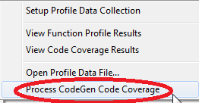
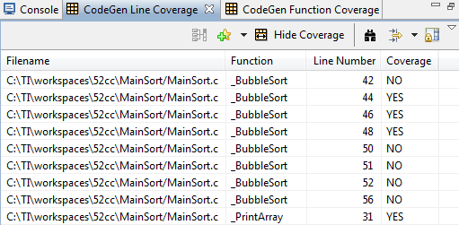
Path Profiling – Generate Code Coverage
Build and link to create instrumented executable
RTS function writes pprofout.pdat via C I/O
Profile data decoder
Saves overhead on target
Generates code coverage data
cl6x --gen_profile_info
app.out
Execute
pprofout.pdat
pdd6x
test.prf
Handled by CCS CodeGen Code Coverage processer
cl6x -use_profile_info=test.prf --onlycodecov

Slide 10
Path Profiling Details
Code is instrumented to count number of times each section is entered
Not all sections are instrumented
Post processing computes counts for sections not instrumented
Run-time-support function writes the collected information into a profile data file called a PDAT file
This file is written to the host using C I/O
The write occurs when the run-time-support exit() function is called
Can execute on any HW or simulation platform
Collected data can be used for generating code coverage reports
Only supported on C6000 TI compilers version 6.1 and greater
Learn more about Path Profiling in the C6000 Compiler User’s Guide
http://www.ti.com/lit/ug/spru187u/spru187u.pdf (Section 3.8)

Slide 11
Profiling Overhead
Compile Time Overhead
Additional compiler passes pprof6x.exe and pdd6x.exe
Activated under --[gen|use]_profile_info
Runs between parser and optimizer
Handles adding profile code, or using profile info
Slows build time
Memory Footprint Overhead
Additional instructions for collecting profile information
.ppdata section contains memory for the profile information
Runtime Overhead
Not all blocks have counters added

Slide 12
Profiling Limitations
PDAT file is written to the host when the run-time-support exit() function is called
Application must terminate to reach the exit() function
Run-time-support library must be used
Following applications will need additional tweaking to support writing of path profiling data
Non-terminating
No main()
Custom boot/initialization routine
No run-time initialization model selected in the linker options
JTAG connection required for C I/O call to write the PDAT file to the host (CCS uses JTAG to communicate to the target)
Check the C6000 Compiler User’s Guide for more details on how to workaround these limitations:
http://www.ti.com/lit/ug/spru187u/spru187u.pdf (Section 3.8)

Slide 13
Reduce Profile Overhead
Path profile block counts also unaffected by compiler options
Thus, reduce profile overhead by choosing options that reduce code size
For instrumented build consider:
-ms3: Smallest code size
-mu: Disable software pipelining
-o: Continue using optimization
-oi0: Disable automatic inlining
Avoid making the code so slow it takes too long to run the tests
Especially if using a simulator

Slide 14
LABS
Notes:
14

Slide 15
LAB conventions
Before starting, it is important to review some lab conventions that will ease your work…
Lab steps are in black and numbered for easier reference
…
…
Explanations, notes, warnings are written in blue
Warnings are shown with
Information is marked with
Tips and answers are marked with
Questions are marked with
Notes:
15

Slide 16
Simulation Code Coverage: Exercise Summary
Key Objectives
Import/Build/Load MainSort.c example
Enable CCS Code Coverage tool
Run the program and view Code Coverage data
Tools and Concepts Covered
Importing an existing CCS Eclipse project
CCS Code Coverage tool
Notes:
16

Slide 17
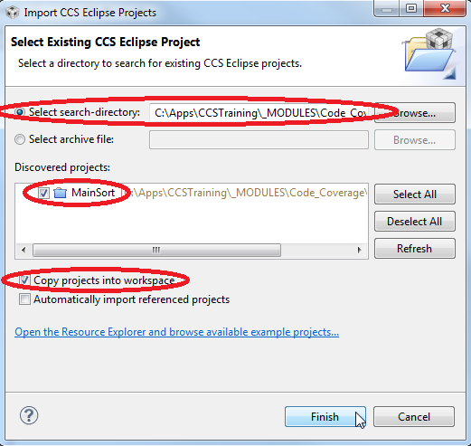
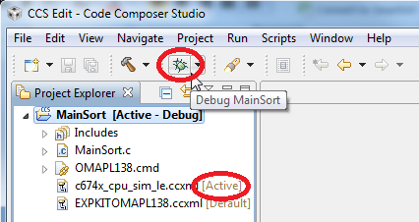
Import/Build/Load ‘MainSort’ Project
Import the MainSort project into CCS (Project -> Import Existing CCS Eclipse Project)
Enable the option to Copy projects into workspace
In the Project Explorer view, select the MainSort project (it should appear [Active – Debug]) to make it active
Check to make sure that the c674x_cpu_sim_le.ccxml file is [Active]. If it is not [Active], right-click on the file and select Set as Active Target Configuration in the context menu
Click on the Debug icon in the toolbar. This will build the project, start the debugger, load the program and run to main

Slide 18
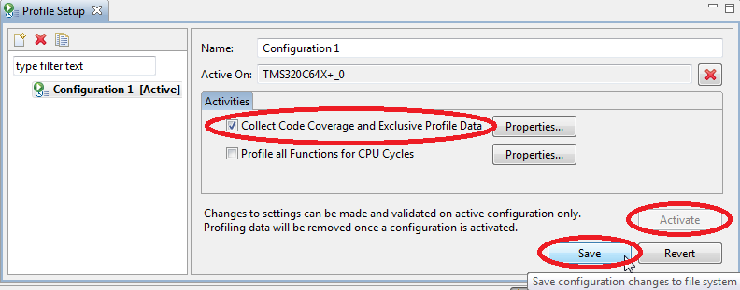
Enable Code Coverage Collection
Open the Profile Setup view (Tools-> Profile -> Setup Profile Data Collection)
In the Profile Setup view:
Press the Activate button to enable profiling/coverage collection
Enable the Collect Code Coverage and Exclusive Profile Data option
Press the Save button
Code Coverage collection has been enabled

Slide 19
Collect Coverage Data and View Results
Press the Resume button to run the program
The program should terminate on its own
View the collected coverage data in the Coverage views (Tools-> Profile -> Setup Profile Data Collection)
Two views will be opened:
Function Coverage view: Displays function coverage data
Line Coverage view: Displays line coverage data
In the Line Coverage view, select the Highlight coverage info in editor button. This will highlight line coverage data in the editor – green for lines that were executed and red for lines not executed

Slide 20
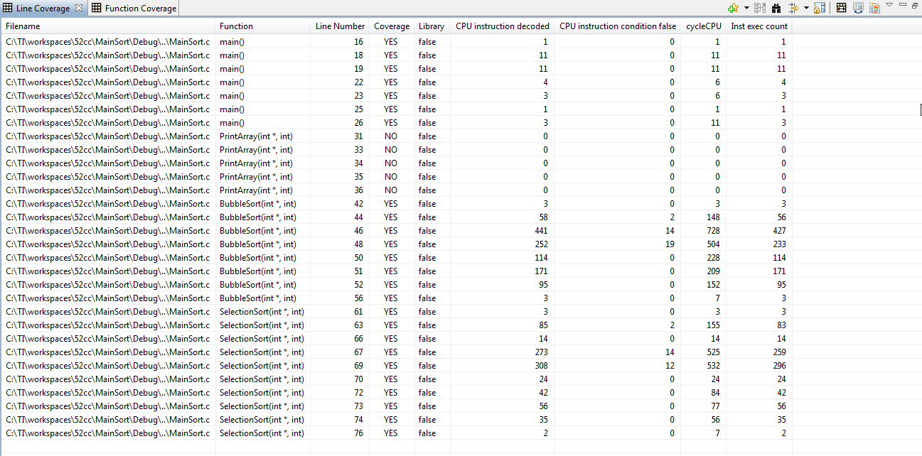
View Function and Line Coverage Results

Slide 21
CGT Path Profiling Tool: Exercise Summary
Key Objectives
Enable compiler path profiling collection
Run the program and view compiler Code Coverage data
Tools and Concepts Covered
Compiler path profiling option
View path profiling based code coverage data in CCS
Notes:
21

Slide 22
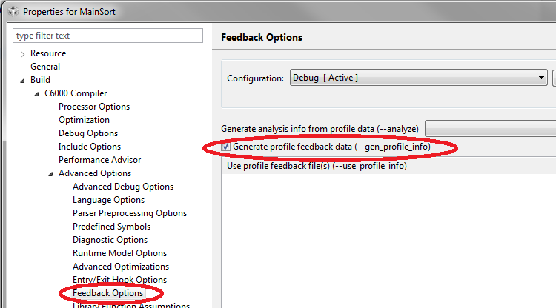
Enable Compiler Path Profiling Collection
In the Project Explorer view, right-click on the MainSort project and select Properties in the context menu to open the MainSort project properties dialog
Navigate to the Feedback Options (Build -> C6000 Compiler -> Advanced Options -> Feedback Options) and enable the option for Generate profile feedback data
Hit OK to apply the changes

Slide 23
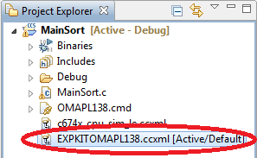
OPTIONAL: Change Active Target Configuration
The below steps are for if you have an OMAP L138 Experimenter Kit and would like to run the Compiler Code Coverage lab on it. If you do not have this hardware, you can continue to run on the simulator and skip the steps in this slide
In the Project Explorer view, select the MainSort project (it should appear [Active – Debug]) to make it active
Right-click on the EXPKITOMAPL138.ccxml file in the Project Explorer view and select Set as Active Target Configuration in the context menu

Slide 24
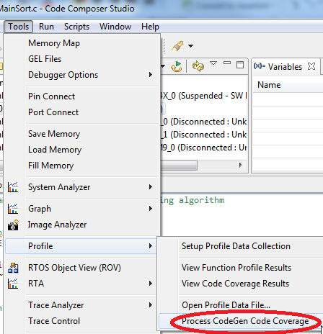
Collect Path Profile Data and View Code Coverage Results
Click on the Debug icon in the toolbar to rebuild, load and run to main
Navigate to Tools -> Profile and enable the option for Generate profile feedback data
Press the Resume button to run the program
The program should terminate on its own
View the collected coverage data in the Coverage views (Tools-> Profile -> Process CodeGen Code Coverage)
Two views will be opened:
CodeGen Function Coverage view: Displays function coverage data
CodeGen Line Coverage view: Displays line coverage data
Hit OK to apply the changes

Slide 25
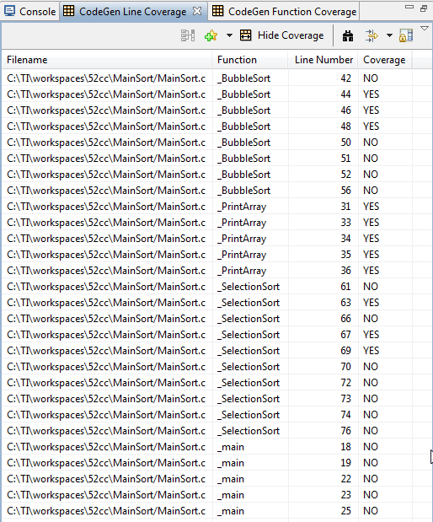
CodeGen Line Code Coverage Results

