Slide 1
CCSv6 Tips & Tricks
Embedded Development Tools

Slide 2
Tips and Tricks
General
  Workspaces
  Getting Started views
  ‘Simple’ Perspective
  Windows and Views (basics)
  Installing Eclipse Plug-ins
Projects
  Working Sets
  Editor Tips
  Indexer
  Useful CCS Edit Views
Debugging
  Debug Configurations
  Debugging Without a Project
  Useful Debug Views

Slide 3
General
Notes:
3

Slide 4

Eclipse Concept: Workspaces
Main working folder for CCS
Contains information to manage all the projects defined to it
  The default location of any new projects created
User preferences, custom perspectives, cached data for plug-ins, etc are all stored in the workspace
Multiple workspaces can be maintained
  Only one can be active within each CCS instance
  The same workspace cannot be shared by multiple running instances of CCS
  It is not recommended to share workspaces amongst users
Notes:
4

Slide 5
Use Multiple Workspaces
Multiple Users: Keep separate workspaces for each user on a shared machine
  Custom preferences, layouts, etc will be maintained on a per user basis
  Each user can be working on specific project(s) that would only be applicable to a their workspace
Project Organization: Break up all your CCS projects into separate workspaces for better maintenance
  A workspace for each software release
  A workspace for each module/feature of a release
Performance: The larger the contents of the workspace (number of open projects), the greater the impact on performance of CCS
Notes:
5

Slide 6



(Occasionally) Clean Your Workspace
The workspace folder can get corrupted over time
Good idea to periodically clean your workspace for best CCS (Eclipse) performance and stability
To clean workspace, either:
  Delete the .metadata folder in workspace folder
  Use a new workspace folder
Before cleaning, save current workspace settings so they can be imported into the new workspace
  Save settings: File->Export...->General->Preferences->To preference file
  Import Settings: File->Import...->General->Preferences->From preference file
Any projects will have to be re-imported after cleaning the workspace
Notes:
6

Slide 7
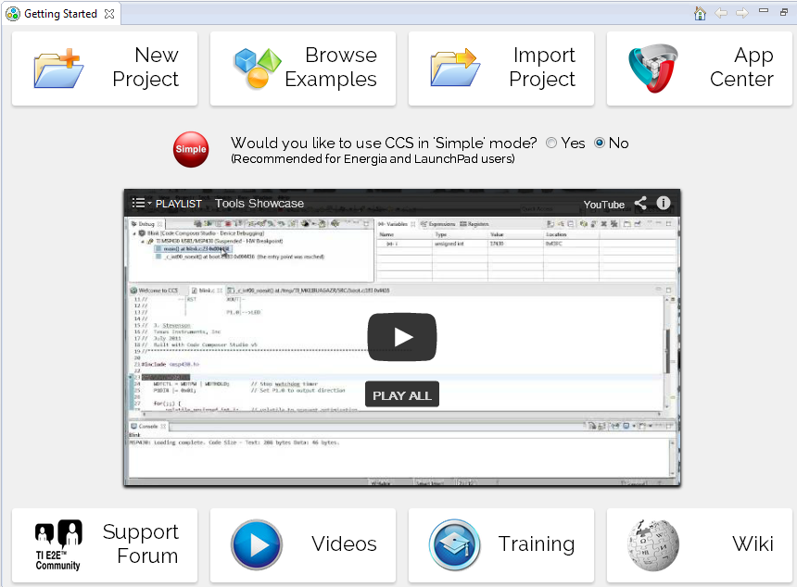
View: Getting Started
Access a variety of resources from the Getting Started page:
  Code examples
  Support forums
  Training material
  CCS Videos
  Additional TI content
  (App Center)
  Create/Import projects
Available from the View
menu

Slide 8
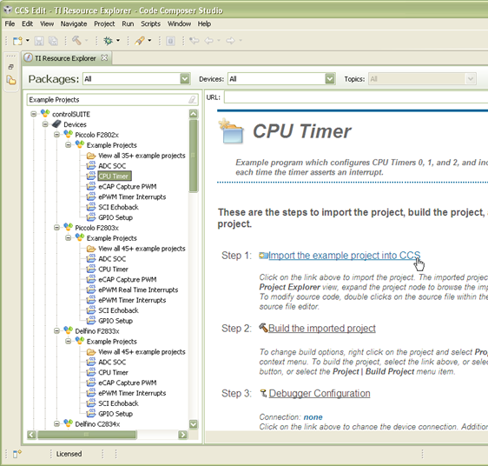
View: TI Resource Explorer
Easily access a broad selection of software packages including:
  controlSUITE
  MSP430ware
  TivaWare
  TI-RTOS
Guides you step by step through using examples
Browse resources:
  Documentation
  Videos

Slide 9
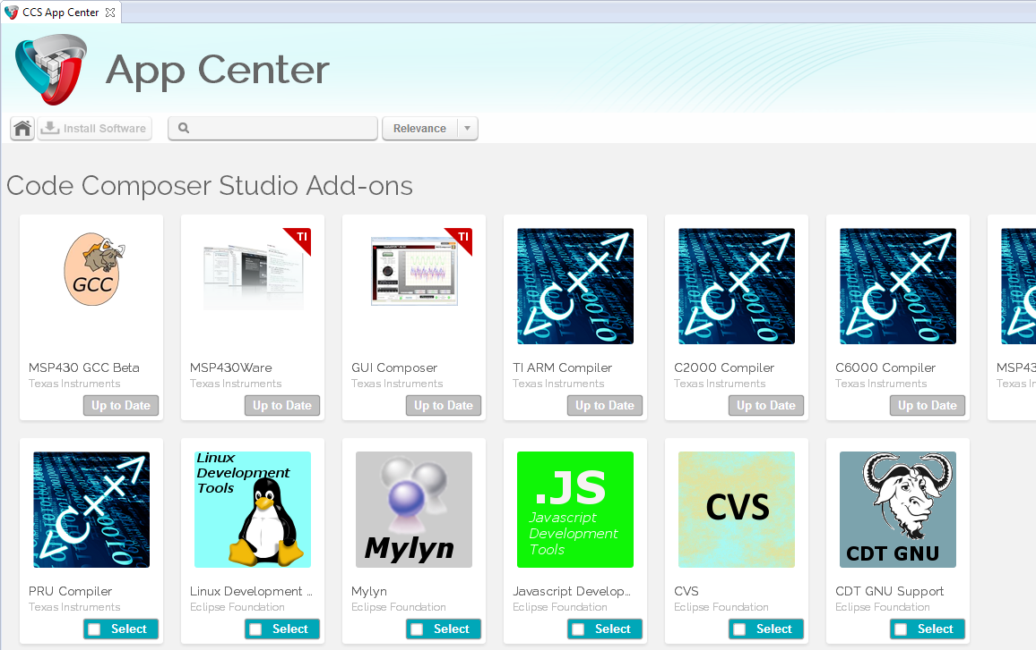
View: App Center
Access a variety of TI content from the CCS App Center page
  Browse/install additional content (plug-ins, compilers, code examples)
  Check for additional updates to installed content
  Available from the View menu

Slide 10
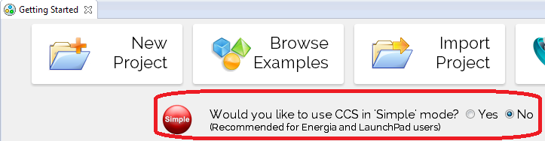
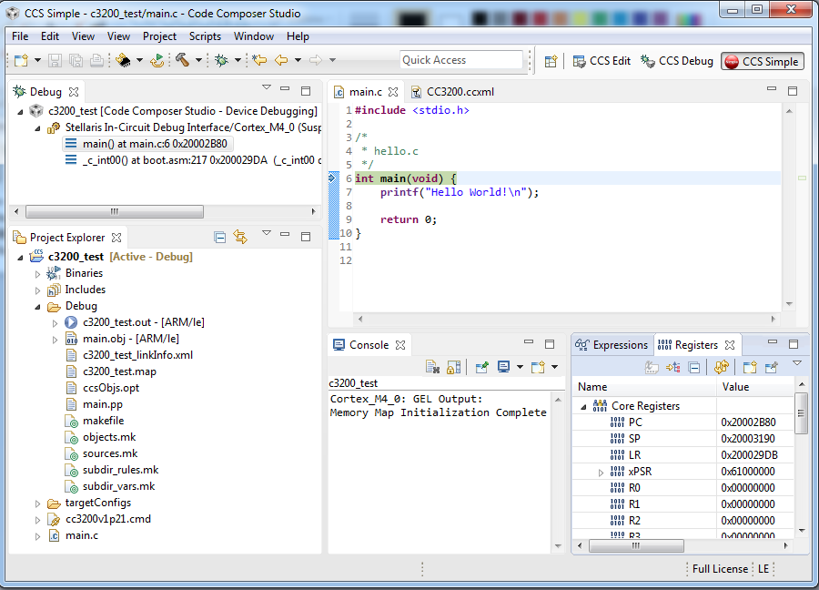
Perspective: Simple
Single perspective that combines just the most common features of the CCS Edit and CCS Debug perspectives
  Simplifies the environment
  for new users
  Avoid perspective switching when starting a debug session
Open the Simple perspective from the Getting Started page

Slide 11
Windows and views
Notes:
11

Slide 12
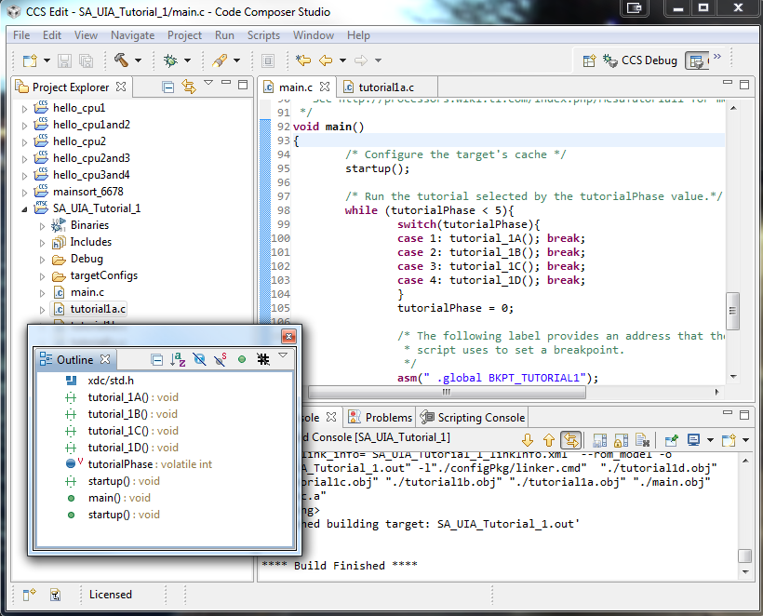
Window Types
Editor:
Only editor windows are part of this group
Tab Group:
Several windows
grouped together
Fast view: Hidden until you click on the button to restore them. Click on another window to hide.
Detached:
Floating window not tied to Workbench
Notes:
12

Slide 13
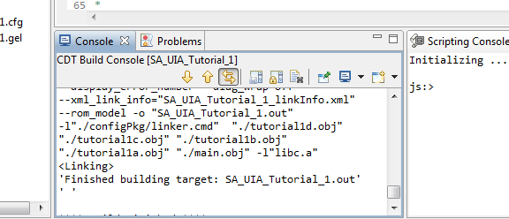
Windowing Tips
Current window
Double-clicking on the title bar of a window will maximize the window
  Double-clicking again will restore it to its previous size
Fast-view windows are great for windows you use infrequently but need a lot of space when you do use them
The window that has focus is indicated by a blue border and heading
Notes:
13

Slide 14
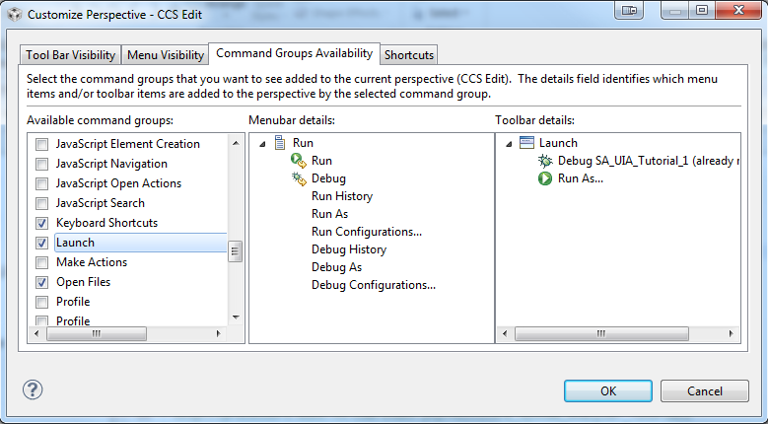
Customizing Perspectives
You can customize the menu items and toolbars in your perspective
  Right click on the toolbar and select Customize Perspective
Notes:
14

Slide 15
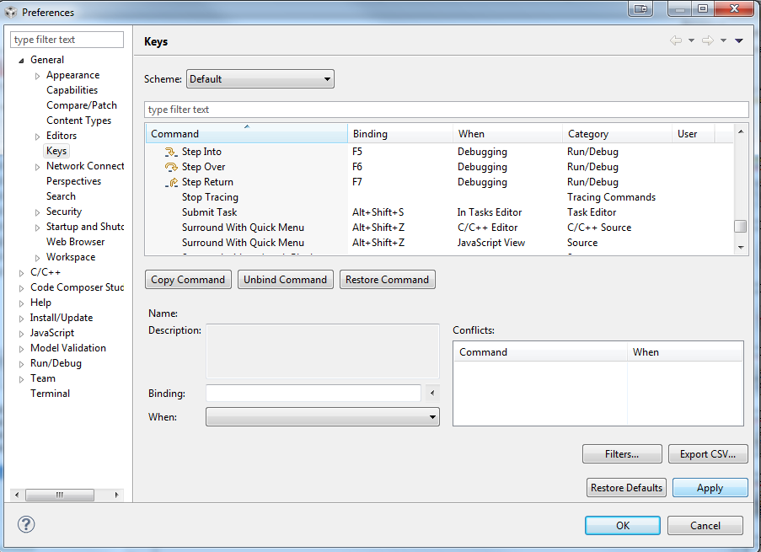
Using the Keyboard…
All key bindings can be viewed and modified: Window -> Preferences -> General -> Keys
Key bindings are part of the general preferences that can be exported
to a preferences file and
imported

Slide 16
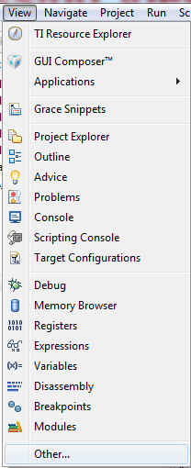
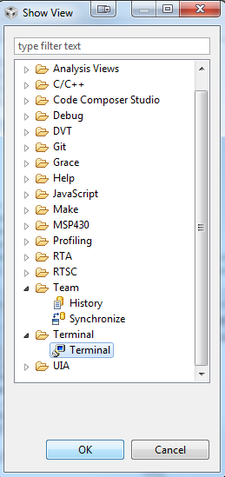
Accessing Views
To open a new view go to the View menu
  List the most commonly used views with CCS
To access views that are
not listed select Other…
Many useful “hidden” views…
Notes:
16

Slide 17
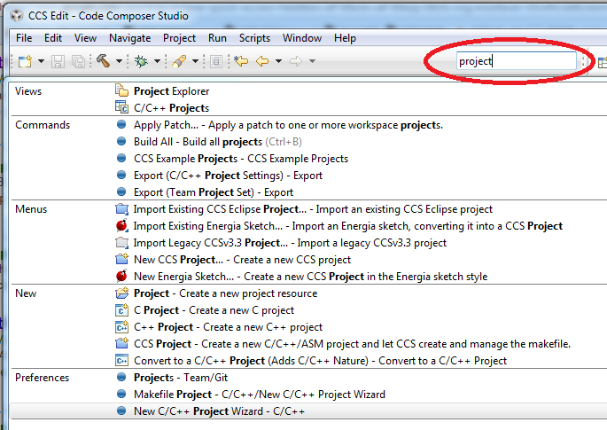
Quick Access Field
Global search field that will search all of CCS
Search for:
  Views
  Commands
  Menu items
  Preferences

Slide 18
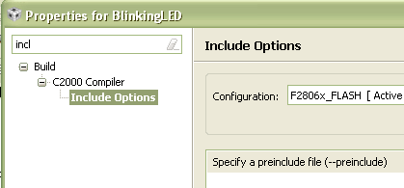
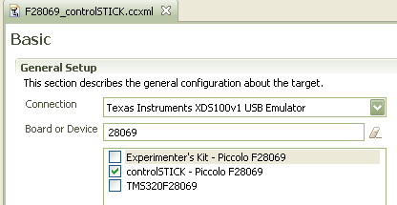
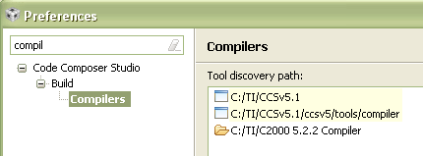
Filter Field
Use it to find options/properties faster in the scope of a specific dialog/view
  Narrows list of options down depending on characters entered in the field
Available in many dialogs
  Project Properties
  Window Properties
  Workspace Properties..
  Target Configuration view

Slide 19
Eclipse Plug-ins
Notes:
19

Slide 20
Eclipse Plug-ins - Basics
CCSv6 is based on Eclipse and is able to leverage many of the huge selection of 3rd party Eclipse plug-ins available
  http://marketplace.eclipse.org/
CCSv6.0 is based off Eclipse 4.3 and CDT 8.2
  Look for plug-ins that support this version for best compatibility
CCS App Center focuses on TI specific content and only shows a tiny fraction of available Eclipse plug-ins

Slide 21
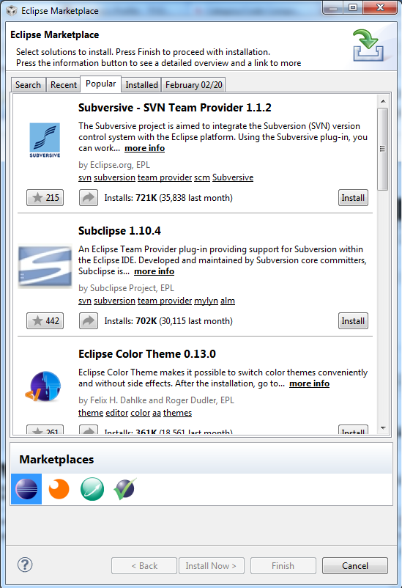
Eclipse Plug-ins - Marketplace
Find additional Eclipse plug-ins from within
CCS with the Eclipse Marketplace plug-in
  Help -> Eclipse Marketplace…
  Browse through a list of featured or
  popular plug-ins
  Search for plug-ins with a keyword
  search
  Easy install of any plug-in found in the
  marketplace

Slide 22
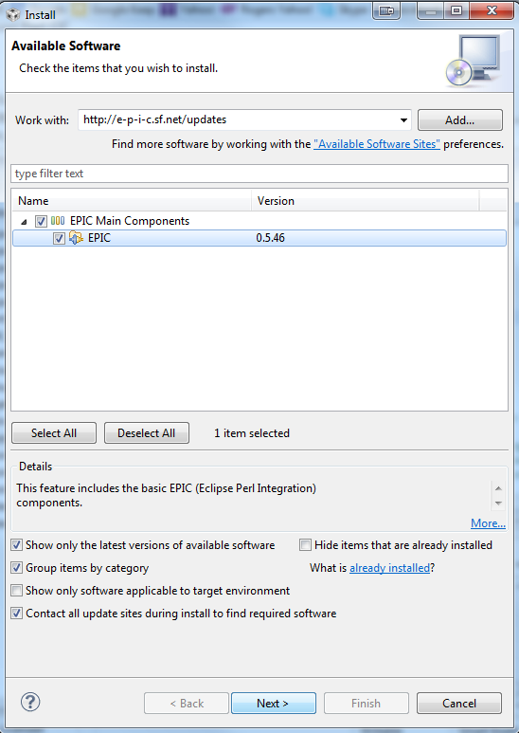
Eclipse Plug-ins - Installation
Use the Eclipse Update Manager to
install plug-ins if the plug-in update site
is already known
  Help -> Install New Software for new
  updates to install (specify remote site
  (URL) or local site (directory) )
Drop-in plugins manually
  Many plug-ins can be simply downloaded
  as an archive and copied into the
  .\ccsv6\eclipse\dropins folder

Slide 23
Projects
Notes:
23

Slide 24
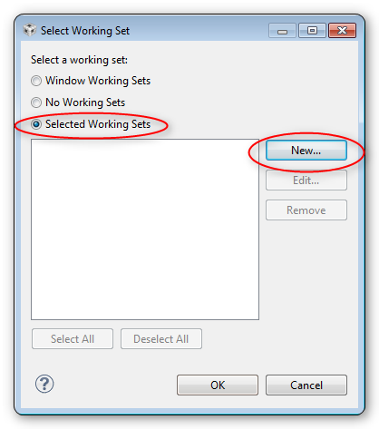
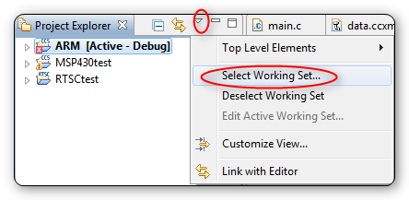
Working Sets (1)
Use working sets to group projects inside the Project Explorer
  Useful for multi-core environments to clearly differentiate projects by which core they are for
Change the select to selected working sets. Then click the New… button
Notes:
24

Slide 25
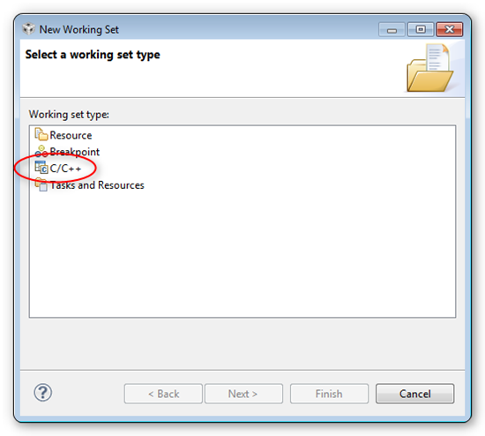
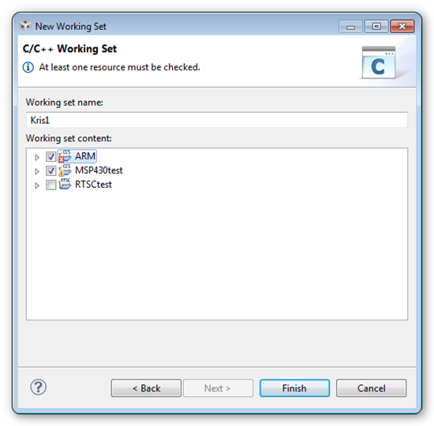
Working Sets (2)
Give your working set a name and select the projects that you want to be part of it. Click Finish
Select C/C++ as the type of working set and click Next
Notes:
25

Slide 26
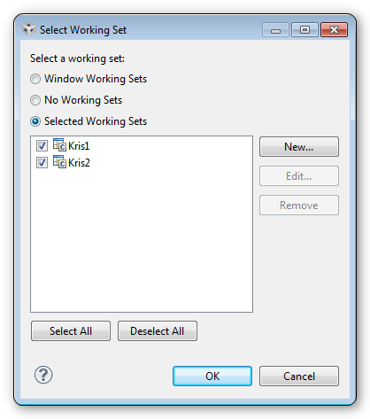
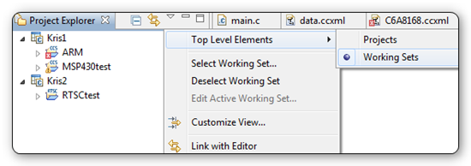
Working Sets (3)
Then go through the process again for the next working set. Once you have the both created make sure they are checked and the click OK
Now you need to change the project explorer to organize by the working set
Notes:
26

Slide 27
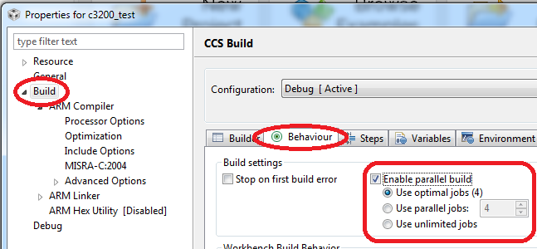
Parallel Builds
Have a multi-core PC? Take advantage of all those cores to speed up your CCS project builds with parallel builds!
In the project properties, under the Behavior tab under Build, turn on the Enable parallel build option
Notes:
27

Slide 28
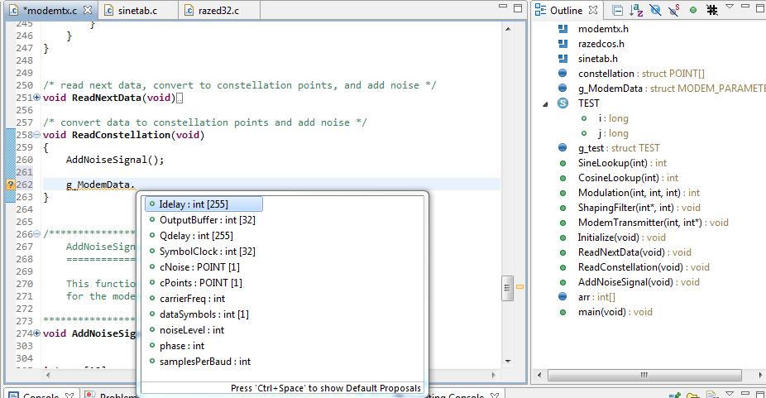
Source Code Editor
CCS comes with an excellent, feature rich editor
Outline view displays lists structural elements for the selected source file
Editor tabs
Collapse and expand functions
Code Completion (CTRL+SPACE for suggestions)
Notes:
28

Slide 29
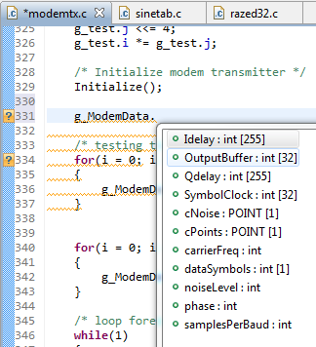

Advanced Editor Features
Code Completion
  Complete word
  Auto-member information
  Auto-parameter information
Navigation
  Back/Forward buttons
  Back to last edit button
  Go to definition
  Go to declaration
Code Folding
  Collapse functions
Notes:
29

Slide 30
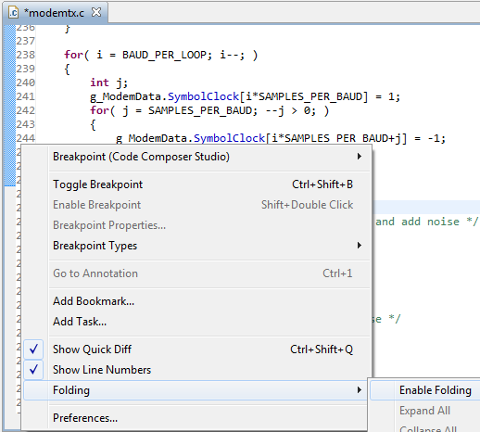
Advanced Editor Features
Right-click in the editor margin to:
  Toggle line numbers in the editor margin
  Enable/Disable code Folding
  Enable/Disable Quick Diff
  Open editor Preferences… to
  access more options to
  configure:
    Content Assist (Code
    Completion)
    Folding
    Syntax Coloring
    Hovers (Cursor "hover over"
    behavior)
    Typing behavior
    etc
Notes:
30

Slide 31
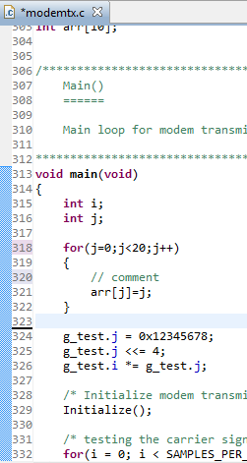
Edit Markers
If you have the line number column on, it also indicates changes in your source file since your last save
Modified lines
Inserted lines
Deleted lines
Notes:
31

Slide 32
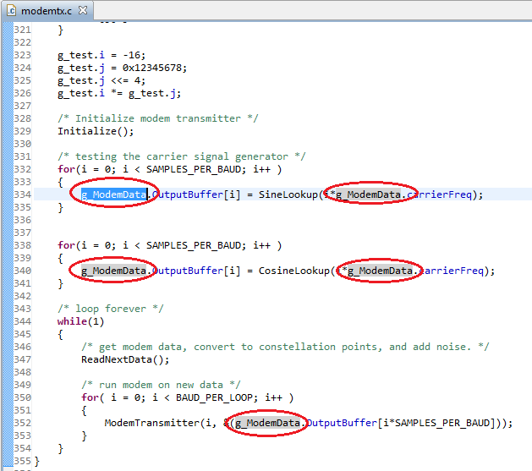
Variable Highlighting
Highlighting a variable in the editor will highlight all instances of the variable in the editor
Notes:
32

Slide 33
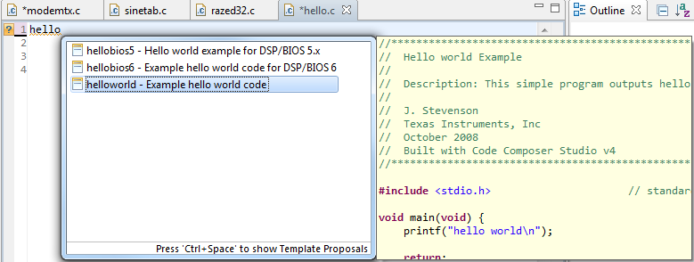
Source Templates
CCS provides code templates
  Ex: Hello World
    Type in h in the editor and use Content Assist by pressing CTRL+SPACE keys (can also right-click in the editor and select Content Assist from the context menu)
  Create custom templates for commonly used source code blocks or customize existing templates
    Window->Preferences…->C++->Editor->Templates
Notes:
33

Slide 34
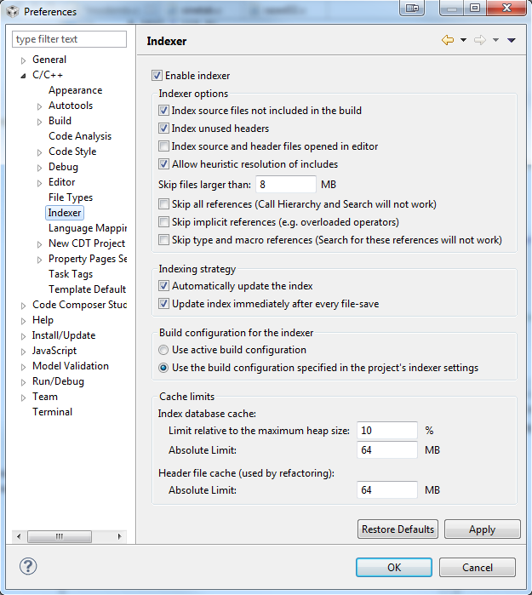
Indexer
The advanced editor features rely
on a database of the source and
header files of the project that
provides the basis for C/C++
search, navigation features and
parts of content assist
(code completion)
The C/C++ Indexer creates this
database by parsing all of the
source and header files of the
projects open in the workspace
Configure the Indexer:
  Window -> Preferences -> C/C++
  -> Indexer
Notes:
34

Slide 35

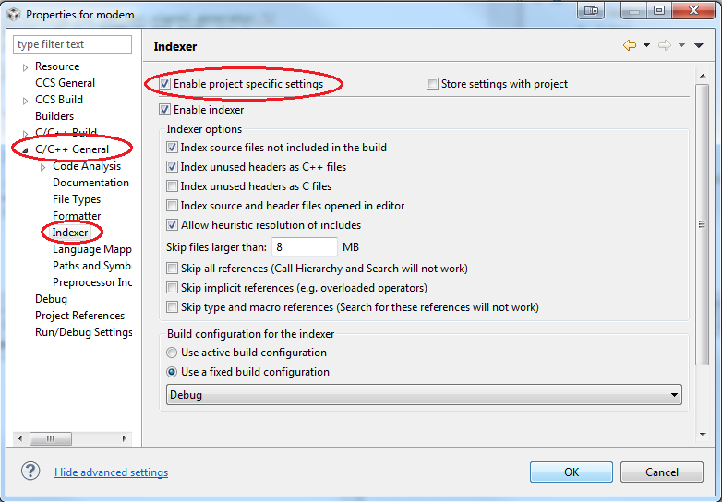
Indexer
The Indexer can also be configured on a per project basis in the project properties
  Must click on the Show Advanced Settings link in the lower left corner of the project properties dialog to expose the options for the Indexer
  C/C++ General -> Indexer
Notes:
35

Slide 36

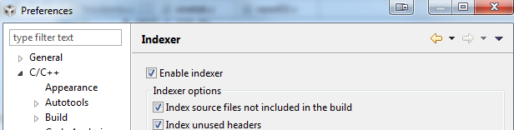
Performance Tip: Turn off the Indexer
Don’t use the CCS editor or don’t need the advanced editor features?
Turn off the Indexer!
  The indexer constantly scans all open projects to support some advanced editor features
  The indexer can use a decent amount of system resources, causing CCS to appear sluggish
    This is most evident with large projects or many open projects in the workspace (or both)
  The default CCS setting is to have the indexer enabled
Notes:
36

Slide 37
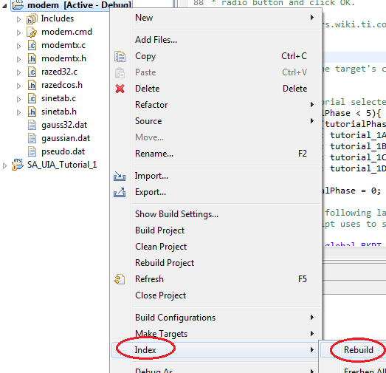
Troubleshooting Tip: Rebuild the Index
Advanced editor feature not working right?
  Code completion not working or bringing up the wrong suggestions?
  Open declaration not finding the
  declaration?
  Outline/Hierarchy views showing
  incorrect information?
Indexed database/cache may
have gotten corrupted or is out
of date!
Rebuild it!
  Right-click on a project and select
  Index -> Rebuild to rebuild the
  indexed database for that project
Notes:
37

Slide 38
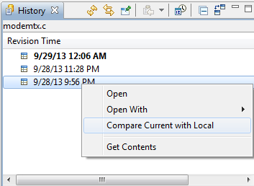
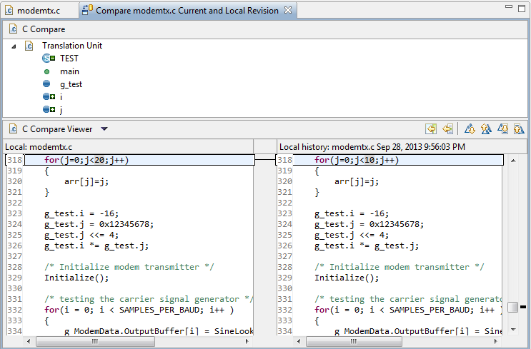
View: History
CCS keeps a local history of source changes
  Switch to the CCS Edit perspective
  Right-click on a file in the editor an select
  Team -> Show Local History
    Opens History view
Use the History view to
compare the current
source file against any
previous version or replace
it with any previous version
  Double-click on a revision
  to open it in the editor
  Right-click on a revision to
  compare that revision to
  the current version
CCS also keeps project history
  Recover files deleted from the project
  Right-click on the project and select “Recover from Local History” in the context menu
History view
File Comparer
Notes:
38

Slide 39
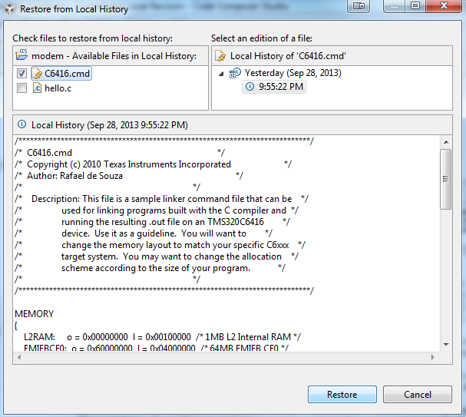
Local History - Project
CCS keeps a local history of files for the project
  Recover files deleted from the project
  Right-click on the project and select Recover from Local History in the context menu
Notes:
39

Slide 40
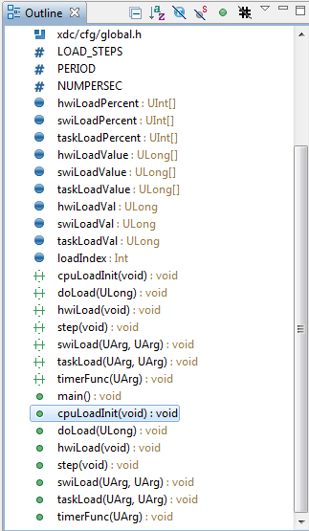
View: Outline
Displays an outline of a structured file that is
currently open in the editor area, and lists
structural elements
View -> Outline

Slide 41
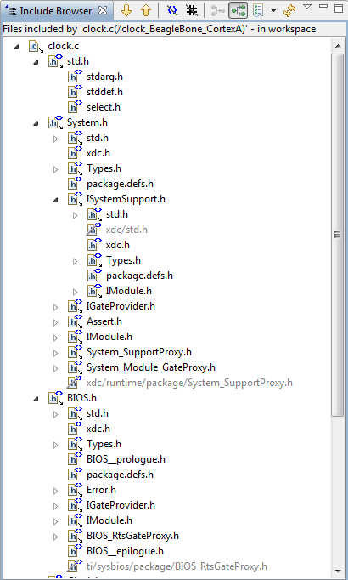
View: Include Browser
Which header files is this source file
including? Who is including this header file?
Directly? Indirectly?
Show hierarchy of included header files for
a source file
View -> Other… -> C/C++ -> Include
Browser

Slide 42
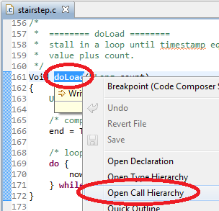
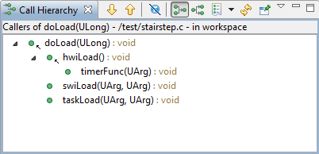
View: Call Hierarchy
Displays callers and callees for a selected function
Right-click on a function and then select Open Call Hierarchy in the context menu
Notes:
42

Slide 43
Debugging
Notes:
43

Slide 44
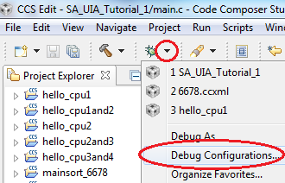
Debug Configurations
Debug information created when a debug session is first launched for a project or target configuration
  Information stored includes which target configuration to use, debug settings…
Both project and project-less debug sessions launch debug sessions using a debug configuration
  A debug session can be started by explicitly launching a debug configuration
To configure: Use drop-down menu
next to the Debug As button and
select Debug Configurations…

Slide 45
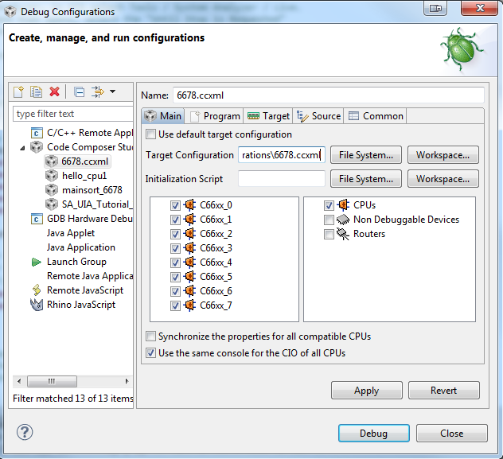
Debug Configurations
Interface to manage existing configuration or to create new ones
Existing debug configurations are configurable

Slide 46
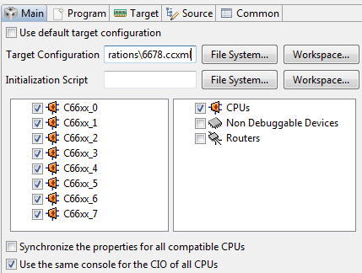
Debug Configurations – Main Options
Use the Main tab to:
  Which target configuration to use
  Use the Initialization Script field to specify a DSS JavaScript for target initialization
  Specify which devices on the JTAG scan chain will be visible by in the Debug view by default
  Specify if all CPUs share the same console for C I/O (for multi-core debug)
    C I/O will be interleaved in the
    same console (preceded with the
    CPU name)
    Uncheck the option to create a
    separate C I/O console for each
    CPU

Slide 47
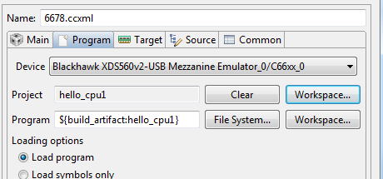
Debug Configurations – Program Options
Use the Program tab to:
  Specify which CPU to load the executable on (for multi-core devices)
    Can specify different programs for each CPU
  Specify to load the program (default) or just symbols only (to debug code in flash, etc)

Slide 48
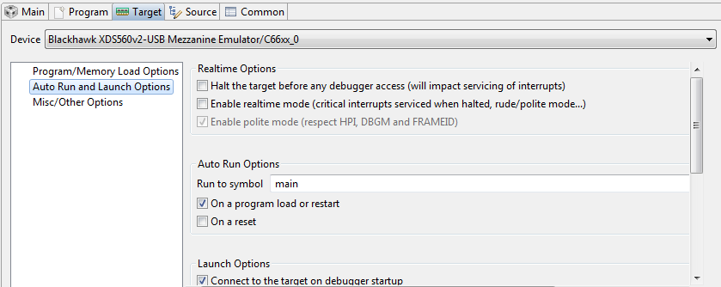
Debug Configurations – Target Options
The Target tab can be used to set a variety of debug options like auto-run to main, auto-connect to a HW target, real-time options, program verification on load, etc…
Flash Programmer options are available for applicable devices

Slide 49
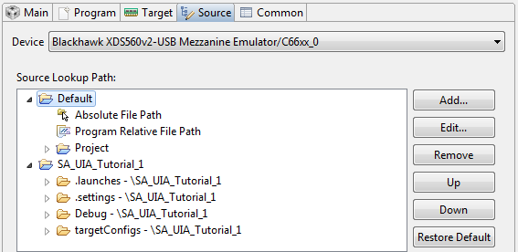
Debug Configurations – Source Options
The Source tab allows you to add additional source lookup search paths
  Specify paths on a per CPU granularity (for multi-core devices)
  All paths to any source files in your project are automatically added by default

Slide 50
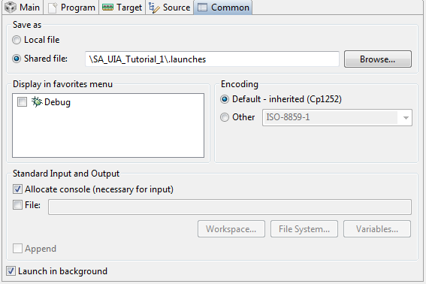
Debug Configurations – Common Options
The Common tab contains a collection of miscellaneous options
  Can specify the debugger to send all CIO to a file instead of the console
  Specify character encoding

Slide 51
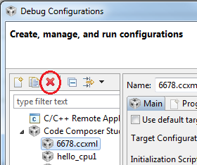
Troubleshooting Tip: Debug Configuration
Having some strange debugger issues?
  Having problems launching a debug session?
  Can’t connect to the target anymore?
  Is the debug session unstable?
Debug Configuration may have gotten corrupted!
Delete it and have CCS generate a new one
  Select the Debug Configuration to delete in the Debug Configurations dialog and press the delete button
Notes:
51

Slide 52
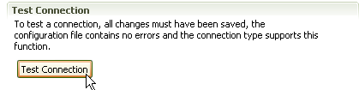

Troubleshooting Tip: Test Connectivity
Having target connection issues?
Validate your physical JTAG connection
to the device from the driver
Use the Test Connection button in the
Advanced tab of the target configuration
  Will test both the target configuration file
  and the JTAG connectivity between CCS
  and the target by running some diagnostics
  If all test pass, then the physical connection
  between the device and the driver is fine
  and the issue is with the debugger
  If there are failures, send the results to TI
  support
Not all emulators support this feature
  http://processors.wiki.ti.com/index.php/Debugging_JTAG_Connectivity_Problems

Slide 53
Debugging Without a Project
For project-less debug sessions, CCS will look for source files using relative path information stored in the debug symbols
  CCS will find the source files if the executable and source files are in the exact same location as when the executable was originally built
If the location of the executable file or source (or both) has changed, CCS may not be able to find the source files
CCS can be instructed where to find the source files one of two ways:
  Tell CCS where the first file is and let CCS find the rest of the files using relative path information in the symbols (recommended method)
  Set Source Lookup Paths for CCS to scan when looking for source files:
    Set for current debug session
    Set for Debug Configuration - apply for every debug session launched by the debug configuration (under the Source options}
    Set at global (workspace) level – apply for any debug session started with this workspace
Notes:
53

Slide 54

Method #1 (Recommended)
If a source file cannot be found during debug, it will be indicated in the editor
Use Locate the Source File… button to browse to the location of the source file
  The debugger can then find other source files in the same location or use relative path information to find files relative to
  the current file
  Location is remembered for future
  loads of the same program
This method has the best
performance for finding source
files
Notes:
54

Slide 55


Method #2 – Debug Context (CCSv6.0.x)
Source lookup paths can also
be explicitly specified for each
debug context
Right-click in the Debug view
and select Edit Source
Lookup… in the context menu
To add a file system path,
select File System Directory
to browse to and add paths
For multi-core debugging, each
debug context has its own set of
source lookup paths
NOTE: This option is only available
for CCSv6.0.x
Notes:
55

Slide 56

Method #3 – Debug Configuration
The Source tab in the debug configuration allows you to add additional source lookup search paths
  All paths to any source files in your project are automatically added by default
  Debug Configurations may also be accessed during an active debug session by right-clicking in the debug view and select "Edit <Debug Configuration>“ in the context menu

Slide 57

Method #4 – Global (Workspace)
Source lookup paths can also be set globally to apply for all debug contexts (in a multi-core environment) and debug sessions
  Windows -> Preferences -> C/C++ -> Debug -> Source Lookup Path
Notes:
57

Slide 58

More Debugging: Source Lookup Paths
Once the path is known to the debugger
(using any method), the source file will be
opened in the debugger
Method #1 is recommended due to
having the best performance
The other methods will do recursive
searches inside the specified directories
when searching for files. If the directories
have many subfolders and many files
inside, the search may be slow and thus
lead to slow performance when looking
for the source files
Notes:
58

Slide 59

View: Modules
Provides information for all loaded symbol files
View -> Modules

Slide 60

View: Terminal
Terminal emulator that can connect to a remote target via a serial port or over TCP/IP using the TELNET or SSH protocol.
View -> Other… -> Terminal -> Terminal

Slide 61


View: Remote Systems
Remote Systems Explorer (RSE) is an Eclipse
plug-in that provides:
  Drag-and-drop access to the remote file system
  Remote shell execution
  Remote terminal
  Remote process monitor
Access Remote Systems view via View -> Other… -> Remote Systems -> Remote Systems
RSE must be enabled in the workspace preferences (Window -> Preferences )

